Slide 1
CHIA Data User Workgroup
Donald Kirkwood, Manager of Data Release and Procurement
Anne Medinus, Senior Research Account Specialist
Sylvia Hobbs, Associate Director of Data Strategy and User Support
October 22, 2024

Slide 2
Agenda
Announcements:
  All FY2023 Case Mix Releases Now Available
  Case Mix Documentation and Release Notes
  MA APCD Releases CY2021 and CY2022
  ZIP Code Data in MA APCD Application
Website Updates
  Check the Status of Releases
  Data Applications Received and Commenting
Data User Support Questions
  Race and Ethnicity variables
  Government versus non-government applications
  Contents of the HIDD, EDD and the OOD
  Groupers in the MA APCD?
  Member and Subscriber Relationship Codes
  Psychiatric Care Settings in MA APCD
  Procedure Code Modifiers for Emergency Care
Q&A

Slide 3
Announcements

Slide 4
All Case Mix FY2023 Releases Now Available
ALL RELEASES AVAILABLE FOR THE FOLLOWING FILE:
  Hospital Inpatient Discharge Data FY2023 (HIDD)
  Outpatient Emergency Department Visit Data FY2023 (EDD)
  Outpatient Observation Stay Data FY2023(OSD)
  Applicants with approved projects using previous years data that require newly available year 2023 case mix data should submit to CHIA a completed Exhibit B (Certificate of Continued Need and Compliance) of the Data Use Agreement. After submitting a completed Exhibit B you will receive an invoice (if applicable) for the requested data. Upon payment of the invoice the order for the data will be placed.

Slide 5
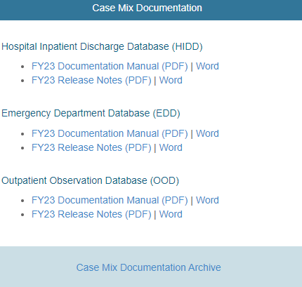

Case Mix Release Documentation
Review Documentation and Release Notes
Data users are advised to review CHIA’s comprehensive case mix documentation manuals and release notes which provide information on data quality issues connected with certain data elements and includes background on the database’s development and the DRG Groupers. The release notes also contains hospital-reported discrepancies received in response to the data verification process. Also, twenty-four years of historical documentation are available online on the documentation archive website
https://www.chiamass.gov/case-mix-data/
https://www.chiamass.gov/case-mix-data-documentation-archive/
The documentation archive contains outpatient emergency department, outpatient observation stay, and hospital inpatient discharges documents dating back to fiscal year 2000.
Link to Archive

Slide 6

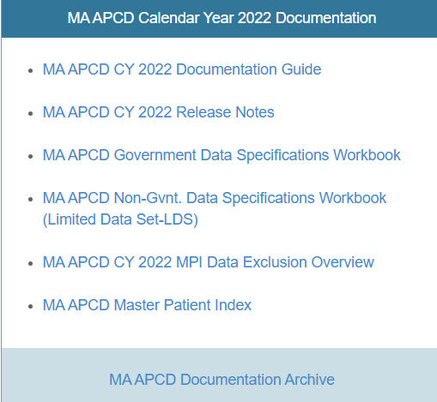
MA APCD CY2021 and CY2022 Releases
CY2021 and CY2022 Available for Request
  CY 2021 Data which includes medical, pharmacy, and dental claims incurred between January 1, 2017, and December 31, 2021, and it includes six (6) months of run-out (paid claims through June 30, 2022) and the new CY 2022 Data which includes claims incurred from January 1, 2018, through December 31, 2022, and includes six (6) months of run-out (paid claims through June 30, 2023) are available for request. In addition to claims data, the releases contain relevant reference files including member eligibility, providers, products, and benefit plans. This data encompasses public and private payers as well as fully-insured and self-insured plans. Keep in mind that due to the Supreme Court decision, Gobeille v. Liberty Mutual, the self-insured plans are severely reduced starting in 2016. The releases also includes MassHealth Medicaid data.
  https://www.chiamass.gov/ma-apcd/
  Applicants with approved projects that require updated MA APCD data (CY 2021 Data or CY2022) should submit to CHIA a completed Exhibit B (Certificate of Continued Need and Compliance) of the Data Use Agreement. After submitting a completed Exhibit B, you will receive an invoice (if applicable) for the requested data. Upon payment of the invoice the order for the data will be placed.
  The new CY 2022 MA APCD Documentation Guide and Release Notes are available on CHIA’s website for your review before using the data. The CY2021 MA APCD Documentation are available online in the documentation archive.

Slide 7
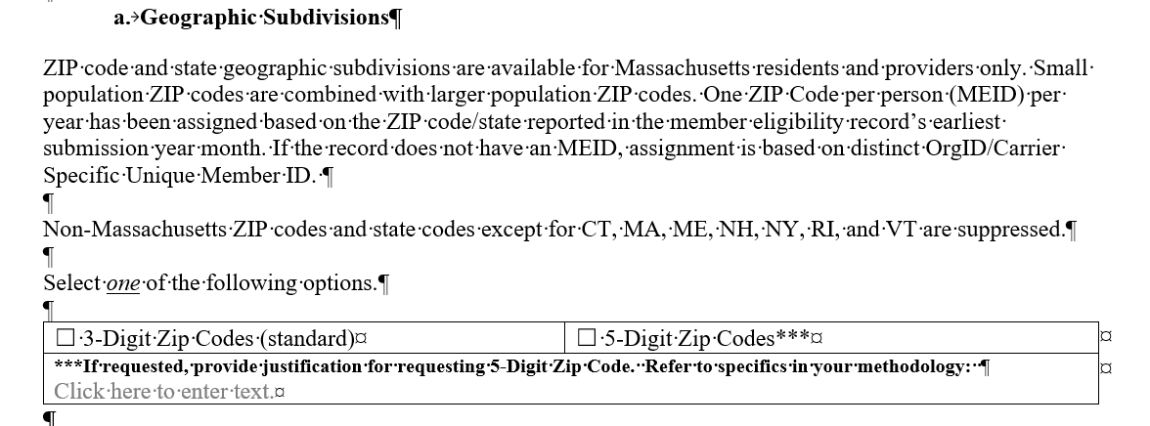
ZIP Code Data in the MA APCD Application
The December 2023 revision to MA APCD application specifies that the member ZIP code geographic data is now only released at the level of one ZIP code per person per year based on the member’s ZIP code reported in the member’s earliest submission year month.
See application excerpt below.

Slide 8
Website Updates

Slide 9
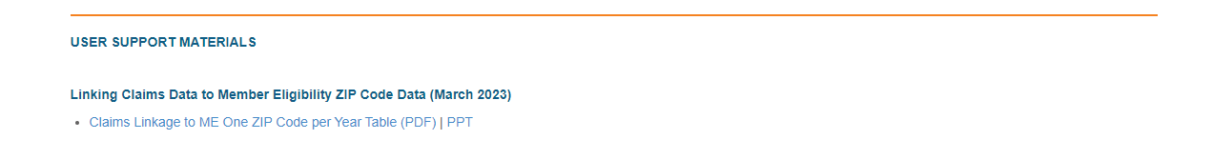
Instructions for Linking One ZIP Table to Claims
Researchers and data users are advised that ZIP code-level information is stored in a distinct table, which is included on the Massachusetts All-Payer Claims Database (MA APCD) hard drive provided upon distribution. Access to the ‘Member Eligibility One ZIP’ table is available as an additional purchase (buy-up) for data applicants specifically requesting member-level ZIP code data. This specialized dataset comprises six key variables: ‘orgid’ (organization identifier), ‘chiacarrierspecificuniqueid’ (carrier-specific unique member identifier), ‘calendaryear’ (year of eligibility), ‘submissionyearmonth’ (the month and year of data submission), ‘zipcode’ (member’s ZIP code), and ‘state’ (member’s state of residence). These variables are available upon request for approved users.
Instructions for linking the data are available on the CHIA website at: https://www.chiamass.gov/chia-data-user-workgroup-information/

Slide 10
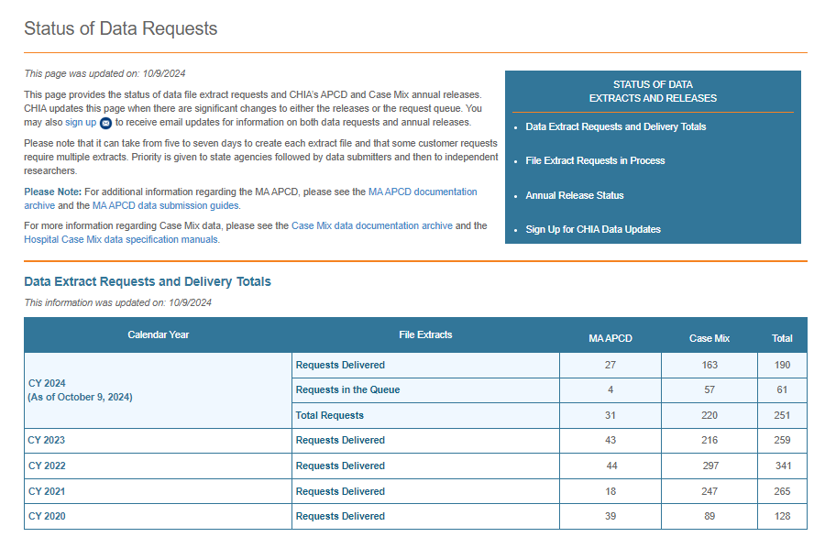
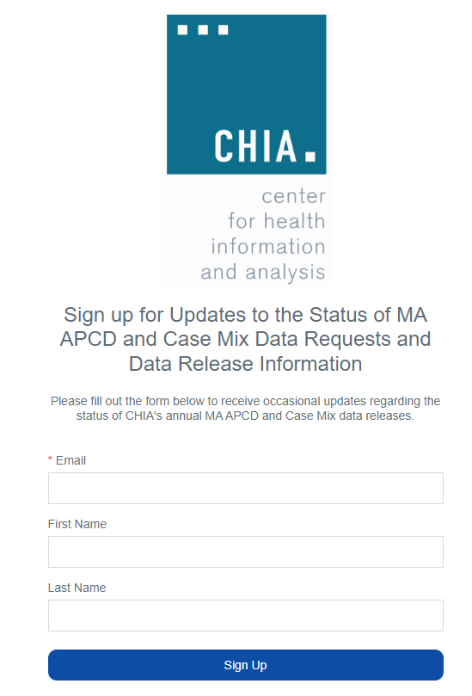
Check the Status of Release Website (Updated 10/9/2024)
  You can visit the CHIA website http://www.chiamass.gov/status-of-data-requests/ to check the status of data extracts and releases, and sign-up to receive updates of MA APCD and case mix data requests and data release information.

Slide 11
Data User Support Questions

Slide 12
Question:
I recently realized that the race variable is not in the latest APCD releases. Not having the race/ethnicity variable severely constrains our ability to attain the main objective of our research project. I am writing to strenuously request that you reconsider releasing the race variable for my project request.
Answer:
There are no Race and Ethnicity variables in the APCD. CHIA does not collect Race and Ethnicity data as part of the APCD. We encourage every data applicant whose study requires the use of those variables to apply for the Case Mix data, which has highly populated race and ethnicity fields. If you must use the APCD and still need the demographics by race, and are a non-governmental data applicant, you must buy-up the 5-digit ZIP Code to link to the American Community Survey of the Census data which provides the demographic information. Please note that you will only have one ZIP Code per person per year.
For more information on the data elements available to Non-Government Data applicants, click on the following link and select “APCD Non-Government Data Specification Workbook (Excel)”:
https://www.chiamass.gov/application-documents/

Slide 13
Answer:
There is a difference between government and non-government applications. Not all data elements available to government applicants are available to non-government applicants. That is the reason you believe there are missing data elements. If some of the government only elements are required for your study and you believe you are entitled to receive them, please provide us the proof of your legal authority to receive such data.
To identify provider location, you should request that data element on the spreadsheet, and also request decrypted National Provider Identifier (NPI) to link to the CMS National Plan and Provider Enumeration System (NPPES) data.
For more information on the data elements available to Non-Government Data applicants, please click on the following link and select “APCD Non-Government Data Specification Workbook (Excel)”:
https://www.chiamass.gov/application-documents/
Question:
We initially submitted a government request but were approved for a non-government request following a discussion with a CHIA staff. We are missing many variables, some of which are *critical* to any attempt to meet our aims. Most notably, we cannot identify where patients are getting hospitalized and receiving their care without provider addresses. This is a major aim of the study, and, at a minimum, we need more details about the providers.

Slide 14
Answer:
Section 8 of Chapter 12C of the Massachusetts General Laws grants the Center for Health Information and Analysis (CHIA) the authority to collect data from all Massachusetts (MA) acute care hospitals. As a result, CHIA issued Regulation 957 CMR 8:00 which governs the submission of the Case Mix and charge data by all MA acute care hospitals.
You are correct in requesting data from all three Case Mix databases for your study. However, unlike the Hospital Inpatient database, which contains all discharge-level inpatient diagnosis data, and the Outpatient Emergency database, which contains all visit-level emergency department visits, the Outpatient Observation database consists of discharge-level Outpatient Observation stay data only. For instance, it does not have outpatient visits to primary care providers. For more information on the MA Case Mix databases, please click on the following link:
https://www.chiamass.gov/assets/Uploads/casemix/Case-Mix-Whitepaper.pdf
Question:
I am studying the prevalence of Cannabinoid hyperemesis syndrome, using diagnosis code for each year 2012 to 2021. I requested ED visits, Outpatient visits, and Inpatient admissions. Do these represent ALL ED visits, outpatients’ visits and inpatient admissions across the hospitals that participated in CHIA?

Slide 15
Answer:
Please note that there are no groupers in the MA APCD. There are groupers in the MA Case Mix data. If your study requires the use of DRGs, you need to apply for the Case Mix data.
Question:
We are using the APCD file and the data we received does not appear to have a DRG variable associated with it. We have a “drglevel” variable, but do not have the associated “MC071” DRG variable. Is there a way to determine DRGs in the APCD data?

Slide 16

Question: I am applying for the MA APCD to study the correlation between parental and neonatal health status. Which specific fields facilitate linkage of newborn medical claims to parent claims?
Relationship Data
Answer: In the MA APCD, associating a parent with a newborn typically requires the use of specific fields that link the claims and eligibility data between family members. Combining some of the fields listed below facilitate linking claims and eligibility records of a parent and newborn.
Individual Relationship Code: Patient to Subscriber Relationship Code field is in both the medical claims table and member eligibility table. This code can be used to explicitly state the relationship of the newborn to the parent.
Subscriber ID: Newborns are typically covered under their parent's insurance plan, in these instances, the subscriber ID of parent and newborn should match. Using this match in combination with the Individual Relationship Code should accurately confirm relationship.
Insurance Plan and Product Codes: These codes can show that the parent and newborn are covered under the same insurance plan, which can further help in confirming the relationship.
Cover Level Code: These codes (see below) that defines the dependent coverage, which can further help in confirming the relationship.
    CHD Children Only DEP Dependents Only
    ECH Employee and Children ELF Employee and Life Partner
    EMP Employee Only ESP Employee and Spouse
    FAM Family IND Individual
    SPC Spouse and Children SPO Spouse Only
    UNK Unknown

Slide 17
Question: I plan to study differences in emergency procedures for patients in urban, suburban, and rural areas, focusing on timeliness of care. Does the MA APCD contain HCPCS/CPT code modifiers to indicate emergency care services administered in pre-hospital or in-hospital emergency department settings?
Procedure Code Modifiers
Answer: Yes, the MA APCD contains four procedure code modifier fields (MC056, MC057, MC058, and MC059). The medical claims filing specifications instruct carriers to populate these fields when the modifier clarifies/improves the accuracy of the procedure code. Specific modifiers that facilitate a detailed analysis of emergency care utilization, including patterns of emergency interventions across geographies found in the MA APCD are listed below:
ET: Emergency Services. This modifier is specifically used to designate care as an emergency service, making it highly useful for distinguishing emergency episodes of care across geographic or population-based studies.
25: Significant, separately identifiable evaluation and management service by the same physician on the same day of the procedure or other service. This modifier can be used to identify instances where emergency care includes additional services beyond the primary intervention.
76: Repeat Procedure by the Same Physician. This modifier indicates the repetition of an emergency procedure, which could be critical in analyzing the frequency of emergency interventions.
59: Distinct procedural service. This modifier is applied to indicate that emergency care included a distinct or separate service from other interventions provided on the same day.
77: Repeat Procedure by Another Physician. It can be employed to capture situations where emergency care required subsequent intervention by a different provider, often relevant in multi-stage or time-sensitive emergency treatments.
G0: Telehealth services for diagnosis, evaluation, or treatment of symptoms of an acute stroke. This can be critical in analyzing telemedicine-based emergency care, especially in rural or underserved areas where physical emergency services may not be immediately accessible.

Slide 18

Question: I am interested in applying for the MA APCD to analyze the continuity of care for behavioral health patients across diverse healthcare settings. Does the MA APCD contain specific facility taxonomy information that would facilitate evaluating variations in patient volume across different types of behavioral health care settings?
Psychiatric Care Settings
Answer: Yes, the MA APCD includes over thirty types of behavioral health care settings. Some of the top care settings by taxonomy are as follows:
  Clinic/Center, Adolescent and Children Mental Health (Code: 261QM0855X)
  Crisis Intervention (Code: 261QM0900X)
  Clinic/Center, Substance Use Disorder (Code: 261QR0405X)
  Rehabilitation Hospital, Substance Use Disorder (Code: 276400000X)
  Psychiatric Unit, within another care setting (Code: 273R00000X)
  Partial Hospitalization, Mental Health (Code: 2835P2200X)
  Adult Residential Facility (Code: 310400000X)
  Long Term Care Hospital (Code: 282E00000X)
It is important to note that some facilities providing psychiatric care have multiple taxonomies not limited to behavioral health. Therefore, the taxonomy codes listed in the medical claims as primary specialty that are not categorically behavioral health related could also be a source of high-volume care. Multiple specialties can be found by linking to the provider table.
continued

Slide 19
Answer (continued): In addition to facilities designating their primary specialty by taxonomy as
behavioral health in the MA APCD, the acute care case mix data also contains a significant
volume of behavioral health care.
Psychiatric Care Settings
                In the case mix hospital inpatient discharge (HID) care setting (see Figure 1), there has been a steady decline over the six-year fiscal years in patients with a principal diagnosis in the behavioral health code range. From a high of 58,588 episodes in 2018, decreasing progressively, with a marked drop by 2022. The 2023 volume (44,651) represents a substantial reduction.
                In the case mix emergency department (ED) care setting. There was likewise been a sharp and consistent reduction in volume. Beginning at 165,794 episodes in 2018, and a significant decline to 112,400 by 2023. This suggests a noteworthy shift away from emergency department care for behavioral health issues, possibly due to either improved preventative care, alternative outpatient care settings which can be found in the MA APCD.
                Most notably, in the case mix outpatient observation stay (OSD)care setting, behavioral health demonstrates a notable increase in episodes, particularly in 2023, where the volume (19,469) nearly doubles the count from 2018. This could reflect an expansion of or increasing reliance on alternative care models or outpatient services for managing behavioral health conditions.

Slide 20

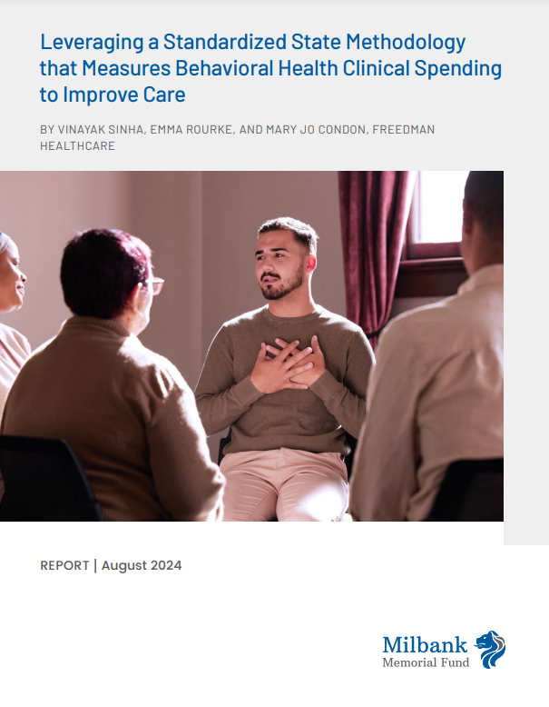
New Report Alert
The August 2024 report, “Leveraging a Standardized State Methodology that Measures Behavioral Health Clinical Spending to Improve Care” available at
https://www.milbank.org/wp-content/uploads/2024/08/MMF-BH-Spend-Measurement-Policy.pdf discusses how a standardized methodology for behavioral health spending measurement offers policymakers and stakeholders a baseline for understanding the landscape of behavioral health in their state. The report includes an overview of how Massachusetts, Maine, and Rhode Island measure behavioral health spending across the clinical care continuum defining spending using a combination of diagnosis codes, procedure codes, and provider taxonomy codes. The co-authors initial report published in April 2024 https://www.milbank.org/wp-content/uploads/2024/04/BH_SPENDING61824.pdf , included an accompanying code set https://www.milbank.org/wp-content/uploads/2024/03/Appendix-A-Code-Set-Final.xlsx , and technical specifications https://www.milbank.org/wp-content/uploads/2024/08/BH-Measurement-Technical-Specifications.pdf to allow states to tailor behavioral health spending measurement based on their priorities and analyze spending data to improve behavioral health care delivery and outcomes.

Slide 21
When is the next Data User Group meeting?
  The next User Group will meet Tuesday, November 26, 2024.
  http://www.chiamass.gov/ma-apcd-and-case-mix-user-workgroup-information/

Slide 22
Questions?
Questions related to MA APCD email:
apcd.data@chiamass.gov
Questions related to Case Mix email:
casemix.data@chiamass.gov
REMINDER
CHIA still receives a high volume of email from data users who do not include their IRBNet ID. If you are in the process of or have already submitted a data application to CHIA through IRBNet https://www.irbnet.org/release/home.html, due to the volume of email CHIA receives, please remember to always include your IRBNET ID# in the subject line of your email. Doing so facilitates tracking your application and expediting responses to any questions.

