Slide 1

Massachusetts All-Payer Claims Database:
Technical Assistance Group (TAG)
April 14, 2015

Slide 2
Agenda
Housekeeping
Submission Guides – Version 4 Timeline
2015 Annual Premiums Data Request
Enrollment Trends
Total Medical Expenses (TME)
Wrap Up

Slide 3
Housekeeping – Risk Adjustment
Risk Adjustment Lockdown
Data Due 4/30/2015
All RACP fields and premiums
Data Extracts
Risk Adjustment Member Month Tracker
Supplemental Diagnosis Submission Guide

Slide 4
Housekeeping – DOI Reports
Membership Reports
Review Logic
Reply to Liaisons
Reruns based on logic updates
Utilization Reports
Meetings June 3rd – June 19th
Pre-meetings the week prior

Slide 5
Version 4 Intake Timeline
Version 4 File Submissions DELAYED
New Production TimeLine
Supplemental Diagnosis (SD) – Production Starts 7/1/2015
ME, MC, PC, DC, PV, PR, BP – Production Starts 8/1/2015
Testing TimeLine – June/July 2015
Priority – SD, MC, PV, ME followed by all others

Slide 6
Version 5 Intake and Beyond
MA APCD Intake Process | Timeline
Data Partners Propose Version 5 Updates | November 2015
Proposals Shared/Discussed with Carriers | December 2015
Draft Submission Guides published | January 2016
Guides Reviewed at Technical Advisory Group | January 2016
Carrier Comment Period | January 2016
Administrative Bulletin and Guides Adopted | February 2016
Development/Testing | March/June 2016
Carrier Testing | July 2016
MA APCD Intake Version 5 Production | August 2016
* CHIA plans to maintain this timeframe on an annual basis

Slide 7
2015 annual premiums data request
Kevin Meives| Senior Health Policy Analyst
April 14, 2015

Slide 8
Annual Premiums Data Request
Payer Questions
    Review of First TAG
    Behavioral Health, Dental, and Vision Benefits
    Counting Membership
    Average Employer Size
Additional Questions
Timeline

Slide 9
Review of First TAG
Question: Can payers use the same data submitted last year for 2012 and 2013 in this year’s Request?
Answer: No. Please generate fresh data for 2012 and 2013, re-running queries to account for retro-activity, complete run-out, and specification consistency.
Question: CHIA is requesting premiums and claims data be split by fully-insured and self-insured. Should we go back to 2012 and 2013 and split out that data?
Answer: Yes. We ask that payers split out claims data by fully- and self-insured for all three years, not just for 2014.

Slide 10
Behavioral Health, Dental, & Vision Expenses
Question: Should Allowed and Incurred claims include behavioral health, dental, and vision expenses?
Answer:
Scenario 1: Behavioral health, dental, or vision benefits are part of the comprehensive medical policy (either as the base policy or attached as a rider).
Yes, they should be included in the reported premium and claims amounts.
Scenario 2: The behavioral health, dental or vision are sold entirely separately as standalone policies.
No, these would fall under the category of “other non-primary, non-medical business,” and be excluded from the request.
If behavioral health is carved out of medical, that should be reflected in the Percent of Benefits Not Carved Out.

Slide 11
Counting Membership
Question: When counting membership/member months, should we count members active on 12/31 of the reporting year or members active any time during the reporting year?
Answer: Please report the total member months of coverage during the year, for members that were active any time during the year.
Notes:
.

Slide 12
Counting Membership - Example
Member Effective Date: April 1, 2014
Coverage Terminated Date: July 31, 2014
What You Would Report:
Membership: 4 member months
Premiums and Claims: The premium that was earned and the claims that were incurred for that member for the 4 months of coverage.
There should be consistency between the member months, premiums, and claims reported.

Slide 13
Average Employer Size
Question: For average employer size, should we count all covered employees regardless of their state of residence or only covered employees who reside in MA?
Answer: All of the reporting should be based on the contract situs, not member residence. For the average employer size count, this would include all covered employees, both residents and non-residents.

Slide 14
Additional Questions
Are there any other questions at this time?

Slide 15
Timeline
Annual Premiums Data Request: 2015 Timeline
Date(s) | Milestone
May 6, 2015 | Payer data due to Oliver Wyman
May - June 2015 | CHIA and Oliver Wyman payer data verification
July 2015 | Oliver Wyman follow-up for “3 R” amounts
July - August 2015 | “Annual Report” analysis
September 2015 (early) | “Annual Report” publication

Slide 16
Contact Information & Request Materials
General Questions:
Kevin Meives
Senior Health Policy Analyst
CHIA Health System Performance Analytic Team
Kevin.Meives@state.ma.us
Technical Questions:
Dianna Welch
Principal
Oliver Wyman Actuarial Consulting, Inc.
(414) 277-4657
Dianna.Welch@oliverwyman.com

Slide 17
Enrollment Trends
APCD Enrollment Reporting
Ashley Storms| Health System Policy Analyst
April 14, 2015

Slide 18
CHIA Enrollment Trends Reporting
Enrollment Trends Overview
About the Report
Timeline
Data Verification: Payer Data Breakouts
Questions and Answers
Contact Information

Slide 19
CHIA Enrollment Trends Overview
Enrollment Trends monitors health insurance coverage in the Commonwealth of Massachusetts within the top 16 commercial payers, MassHealth and Medicare (as data allow).
Population: unique, Massachusetts residents with primary, medical coverage
Transition from direct payer reporting (“ACA Enrollment Trends”) to APCD Member Eligibility data
    Identifying the Enrollment Trends population:
      Member State – ME016 = MA
      Medical Coverage – ME018 = 1
      Primary Insurance Indicator – ME028 = 1
    Understanding enrollment by category:
      Insurance Type Code Product – ME003
      Coverage Type – ME029
      Market Category Code – ME030

Slide 20
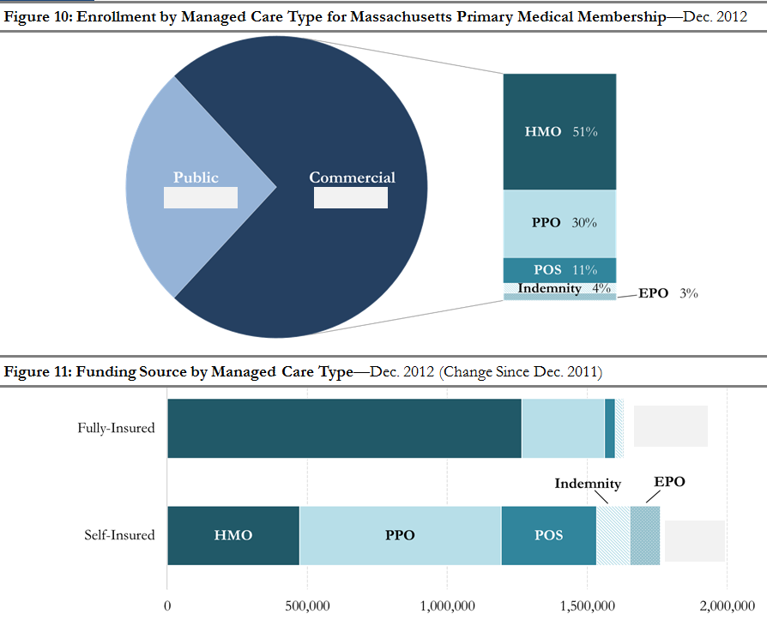
About the Report
Report with DataBook and Technical Notes
Profiles of MA commercial enrollment by:
  Funding source
  Managed care type
  Market category
Enrollment trends in public programs, including MassHealth, Commonwealth Care, and the Medical Security Program
Reports enrollment as of the last day of each quarter
For July Report, data from Dec. 2013 – March 2015, covering the full ACA adoption period in Massachusetts
Released bi-annually starting in July 2015

Slide 21
Enrollment Trends Production Timeline
Date(s) | Milestone
April and May 2015 | Verify enrollment breakouts with individual payers via bi-weekly APCD calls
May 8, 2015 | Supplemental Reports* due to CHIA liaison
June 2015 | Final APCD summary data sent for payer review
July 2015 | "Enrollment Trends" Report publication
*If requested

Slide 22
Data Verification: Payer Data Breakouts

Slide 23
Data Verification: Payer Data Breakouts

Slide 24
Data Verification: Payer Data Breakouts

Slide 25
Data Verification: Payer Data Breakouts

Slide 26
Additional Questions
Are there any other questions at this time?

Slide 27
Contact Information
General Questions:
Ashley Storms
Health System Policy Analyst
CHIA Health System Performance Analytic Team
Ashley.Storms@state.ma.us
Technical Questions:
Cathy Ho
Senior Health Informatics Analyst
CHIA Health System Performance Analytic Team
Cathy.Ho@state.ma.us

Slide 28
TME, APM, and RP Timelines
Total Medical Expenses
Date(s) | Milestone
May 1, 2015 | CY 2013 Final TME
May 1, 2015 | CY 2014 Preliminary TME (with IBNRs applied)
Alternative Payment Methods
Date(s) | Milestone
May 15, 2015 | CY 2014 Legacy APM
May 15, 2015 | CY 2014 APM Addendum
Relative Price
Date(s) | Milestone
June 1, 2015 | CY 2014 Hospital Relative Price
June 1, 2015 | CY 2013 Physician Group Relative Price
June 1, 2015 | CY 2014 Other Provider Relative Price

Slide 29
Next Meetings
May 12, 2015 @ 2:00 pm
June 9, 2015 @ 2:00 pm

