Slide 1
Massachusetts All-Payer Claims Database: Technical Assistance Group (TAG)
July 14, 2015

Slide 2
Agenda
Compliance
Intake Version 4
Premiums Data Request
Enrollment Trends Preview
Risk Adjustment Topics
Wrap Up

Slide 3
Compliance
MA APCD Analytic files for 2014
Run out thru June 2015
Full compliance needed by July 31, 2015
Connector RA Simulation
Simulation Period April 2014 – March 2015
Run out thru June 2015
Full compliance needed by July 31, 2015

Slide 4
Compliance
MA APCD Intake Version 4
Production starts August 2015
Version 3 will no longer be valid
All Version 3 formatted files through June 2015 must be in and passed by July 31, 2015
No June 2015 files should be in Version 4 format

Slide 5
Intake Version 4
Timeline
Variances
Testing

Slide 6
Version 4 Intake Timeline
Production TimeLine
Supplemental Diagnosis (SD) – Production Starts 7/2015
ME, MC, PC, DC, PV, PR, BP – Production Starts 8/2015
Testing TimeLine – July/August 2015
July Production files due by 8/31/2015 in Version 4 format

Slide 7
Intake Version 4 Variance
Template/Spreadsheet
Submission

Slide 8
Intake Version 4 Testing
CHIA Readiness
Submission Periods
File Size
Format Testing
Edit Testing
Threshold Testing

Slide 9
Intake Version 4 Testing
CHIA has been accepting test files since first week of July
Test files must be for submission periods 201505 or 201312
201312 allows you to test a Version 3 time period in Version 4 format
201312 allows you to test those fields with December only requirements
File Size – start small

Slide 10
Intake Version 4 Format Testing
File Types that have not had full edit testing by CHIA are:
Dental Claims
Edits in Place
Updates Weekly

Slide 11
Intake Version 4 Edit Testing
Most File Types have had full edit testing by CHIA.
These are:
Medical/Pharmacy Claims
Supplemental Diagnosis
Provider
Product
Member Eligibility
Benefit Plan
Edits will be updated periodically as carrier testing progresses.

Slide 12
Intake Version 4 Threshold Testing
Threshold Testing Not Expected until late July
Format/Edit Testing First
Contact liaison when Ready

Slide 13
2015 annual premiums data request
July Addendum
Kevin Meives| Senior Health Policy Analyst
July 14, 2015

Slide 14
Annual Premiums Data Request July Addendum
“3R” (Risk Adjustment, Risk Corridor, Reinsurance) Amounts
PMPM Verifications
Report “Context” Questions
If you’ve already received the Addendum, please refer to the file that you received Monday, July 13th, and not the earlier version sent Friday, July 10th.

Slide 15
3R Amounts
CHIA requests that you resubmit your Annual Premiums Data with the following three changes to tab ‘D1. Fully-Insured’ (2014 Individual and Small Group market sectors only):
3R Amounts
Amounts for risk adjustment and transitional reinsurance should not reflect the fees for those programs
Updated premiums net of MLR rebates
Earned Premium amounts should not reflect risk adjustment amounts

Slide 16
PMPM Verification
The ‘PMPM Verification’ tab of the July Addendum contains several key PMPM figures based on the latest payer-submitted data
Please review the PMPMs and then in row 32’s drop-down menus, indicate whether the data is correct or has issues
If there any issues, please elaborate in the space provided
CHIA will assume accuracy if no response is given, though a formal confirmation is appreciated
Please give special attention to the treatment of scaled premiums and claims using "Percent Benefits Not Carved Out."

Slide 17
Context Questions
The final tab of the workbook contains contextual questions on the Annual Data Request and the Massachusetts commercial health insurance market
Responses to these questions will be used to inform CHIA’s statewide results
Questions are not necessarily reflective of final results, nor of CHIA's official position
Responses will not be identified by payer in any reporting
Responses are optional, though requested by the same date as the 3R and PMPM Verification submissions.

Slide 18
Timeline and Questions
CHIA requests that all data submissions and responses be delivered to Dianna Welch of Oliver Wyman Actuarial Consulting - at dianna.welch@oliverwyman.com - by Tuesday, July 28th at 5pm
Please direct any questions to Dianna Welch at dianna.welch@oliverwyman.com or at (414) 277-4657
Please submit both your last Premiums Submission (now including 3R data) and the July Addendum workbook (with any responses or comments) by this time.

Slide 19
Enrollment Trends
July 2015 edition
Ashley Storms| Health Policy Analyst
July 14, 2015

Slide 20
Background
What are we releasing?
Two-page brief
Enhanced DataBook
Technical Notes
Infographic
How did we get here?
Transition to APCD eligibility data and Supplemental Reports
Payer data verification in May and June (two rounds)
Conversations and data troubleshooting with payers
External review by stakeholders

Slide 21
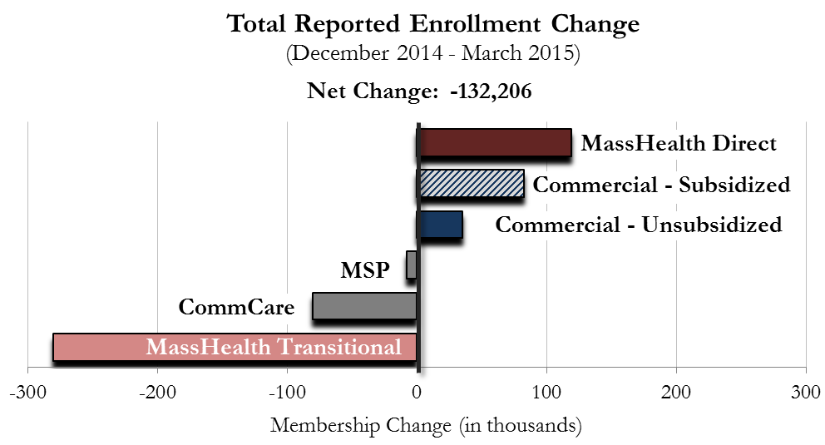
Overall Trends
Total non-Medicare market membership remained steady (+1%) between March 2014 and March 2015, although it declined slightly (-2%) during Open Enrollment after temporarily peaking in December 2014.

Slide 22
Commercial Trends
Preferred Provider Organization (PPO) membership grew slightly to 38% of the commercial market over the year ending March 2015, continuing a longer-term shift to plans with more flexible provider networks.
Massachusetts Commercial Membership (March 2015)

Slide 23
Risk Adjustment
Member Month Tracker Report Signoff
Supplemental Diagnosis
Small Group Designation

Slide 24
Member Month Tracker Report
After reviewing this Tracker with your team for completeness, please sign this page and return to CHIA within 30 days of receiving the report.
If a discrepancy arises, you will be asked to identify and resolve issues to be fixed and work with CHIA on a timeframe for correction and possibly file resubmission.
If you neither confirm that the data in the Tracker is accurate nor report any data discrepancy, the Connector and CHIA will assume that the Tracker report is accurate and that no discrepancies have been identified.
Signature below must be from an officer of the company, preferably in the financial and actuarial area.
Signed:
Print Name:
Carrier:
Submission Year-Month:

Slide 25
Small Group Designation
Market Category Code (ME 030)
Identify the 51-100 groups properly in the APCD.
RACP Indicator (ME126 and BP File)
Flag groups 51-100 as RACP=3 until they convert to the Massachusetts merged market and enroll under an ACA plans.
RACP Related data fields and files
Populate all other fields according to the APCD requirements and ensure accurate data submission.
SUBMISSION STARTS WITH SEPTEMBER 2015 DATA
DUE OCTOBER 2015

Slide 26
Next Meetings
August 11, 2015 @ 2:00 pm
September 8, 2015 @ 2:00 pm

Slide 27
Questions?

