Slide 1

Massachusetts All-Payer Claims Database:
Technical Assistance Group (TAG)
January 12, 2016

Slide 2
Agenda
Housekeeping
Annual Premium, Enrollment Trends and Medical Expenditure Trends Updates
APCD Version 5.0 Submission Guides
Wrap Up

Slide 3
Housekeeping
Pharmacy Claims Versioning
Supplemental Diagnosis File for Risk Adjustment
Upcoming File Submission Deadlines

Slide 4
Supplemental Diagnosis File
Inform your liaison if you plan on submitting this file type for Risk Adjustment final settlement
Consider submitting a December 2015 file to work out any issues before final settlement

Slide 5
Upcoming File Submission Deadlines
Files (through December 2015) for the next Risk Adjustment simulation must be in and passed intake edits by 1/31/2016.
Files (through March 2016) for the next CHIA data release must be in and passed intake edits by 4/30/2016. This also coincides with the Risk Adjustment final settlement.
V5 submission guides go into effect in August for July 2016 data and any resubmissions back to October 2013.

Slide 6

CHIA Reporting Updates:
Annual Premiums Data Request, Enrollment Trends, and Medical Expenditure Trends
Kevin Meives | Senior Health System Policy Analyst
Ashley Storms | Senior Health System Policy Analyst
Nathan Bosdet | Senior Health System Policy Analyst
January 12th, 2016

Slide 7
Annual Premiums Data Request

Slide 8
Agenda
Updated Regulation
Data Request Overview
Data Request Content Changes from 2015
Data Request Format & Submission Enhancements
Timeline
Please deliver any initial comments to Kevin Meives at kevin.meives@state.ma.us by January 15th.
Payers will also have the opportunity to comment on the draft submission materials themselves.

Slide 9
Updated Regulation
Reporting requirements remain largely unchanged
Proposed regulation : 957 CMR 10.00: Health Care Payers Premiums and Claims Data Reporting Requirements
  Available at http://www.chiamass.gov/regulations/
  Subjects payers with at least 25,000 commercial members in Massachusetts, per Enrollment Trends, to reporting requirements
Comments:
  Written comments may be submitted to CHIA-Regulations@state.ma.us
  Public hearing January 27th, 10:00am, 501 Boylston St.
  More information available at http://www.chiamass.gov/regulations/#publiccomments

Slide 10
Data Request Overview
Purpose
  To assess cost and coverage trends in the Massachusetts commercial market, based on contract-membership
Data
  Aggregated member months, premiums, and claims data
  Breakouts by Funding Type, Market Sector, Product Type (HMO, PPO), and Benefit Design Type (HDHPs, Tiered Networks, Limited Networks)
  Covers previous three years (2013, 2014, 2015)

Slide 11
Data Request: Content Changes from 2015
Proposed Deletions
  In/out-of-network claims by all categories:
    Funding Type
    Product Type
    Benefit Design Type
    Market Sector
  Average employer size by:
    Product Type
    Benefit Design Type
Proposed Additions
  Benefit Design Type: Limited Network Category
  Market Sector: Group Insurance Commission (GIC) Category

Slide 12
Data Request: Content Changes from 2015
Proposed Deletions
  In/out-of-network claims by all categories:
    Funding Type
    Product Type
    Benefit Design Type
    Market Sector
  Average employer size by:
    Product Type
    Benefit Design Type
Proposed Additions
  Benefit Design Type: Limited Network Category
  Market Sector: Group Insurance Commission (GIC) Category

Slide 13
Data Request: Content Changes from 2015
Proposed Deletions
  In/out-of-network claims by all categories:
    Funding Type
    Product Type
    Benefit Design Type
    Market Sector
  Average employer size by:
    Product Type
    Benefit Design Type
Proposed Additions
  Benefit Design Type: Limited Network Category
  Market Sector: Group Insurance Commission (GIC) Category

Slide 14
Data Request: Content Changes from 2015
Proposed Deletions
  In/out-of-network claims by all categories:
    Funding Type
    Product Type
    Benefit Design Type
    Market Sector
  Average employer size by:
    Product Type
    Benefit Design Type
Proposed Additions
  Benefit Design Type: Limited Network Category
  Market Sector: Group Insurance Commission (GIC) Category

Slide 15
Data Request Format & Submission Enhancements
Data Submission Manual
CHIA will post a data submission manual and Excel reporting workbooks to its website
  Will still notify responsible payers through liaisons
PMPM Verification Cover Sheet
Submission Format Options

Slide 16
Data Request Format & Submission Enhancements
Data Submission Manual
CHIA will post a data submission manual and Excel reporting workbooks to its website
  Will still notify responsible payers through liaisons
PMPM Verification Cover Sheet
Certain key PMPM figures will auto-populate based on entered data
Will simplify payer quality checking process, reducing the need for resubmissions
Submission Format Options

Slide 17
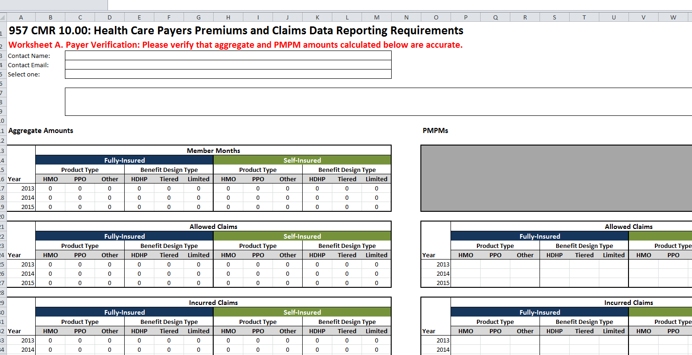
PMPM Verification Cover Sheet
DRAFT

Slide 18
Format & Submission Option Enhancements
Data Submission Manual
CHIA will post a data submission manual and Excel reporting workbooks to its website
  Will still notify responsible payers through liaisons
PMPM Verification Cover Sheet
Certain key PMPM figures will auto-populate based on entered data
Will simplify payer quality checking process, reducing the need for resubmissions
Submission Format Options
Option #1: 2015 Request template (similar)

Slide 19
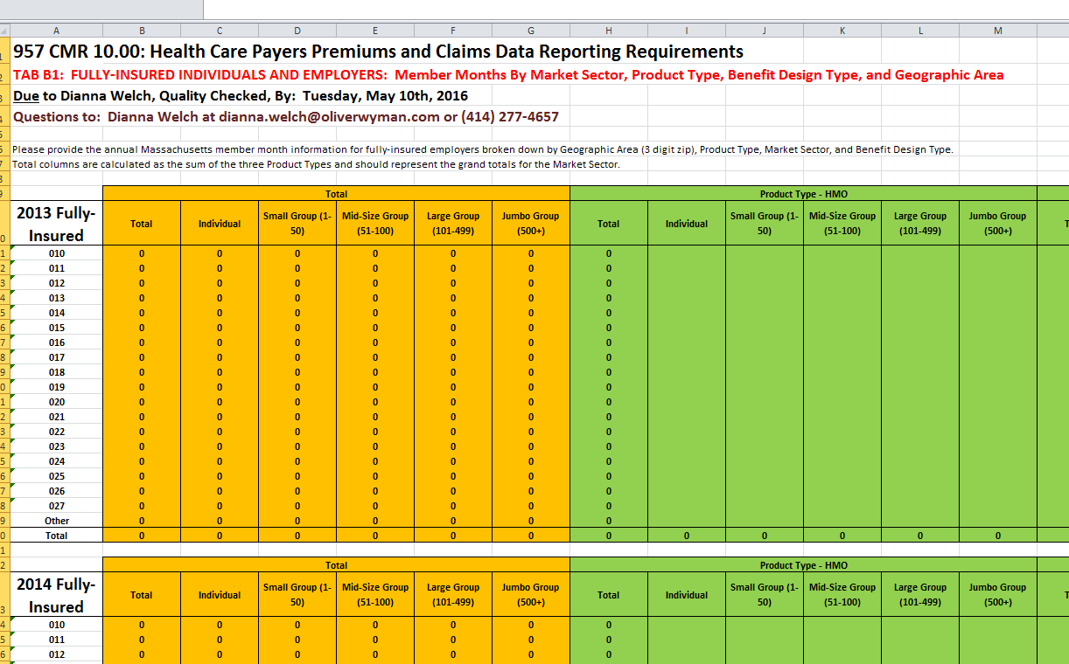
Option #1: Modified 2015 Template
DRAFT

Slide 20
Format & Submission Option Enhancements
Data Submission Manual
CHIA will post a data submission manual and Excel reporting workbooks to its website
  Will still notify responsible payers through liaisons
PMPM Verification Cover Sheet
Certain key PMPM figures will auto-populate based on entered data
Will simplify payer quality checking process, reducing the need for resubmissions
Submission Format Options
Option #1: 2015 Request template (similar)
Option #2 (new): Flat tables for member months, premiums, and claims reporting

Slide 21
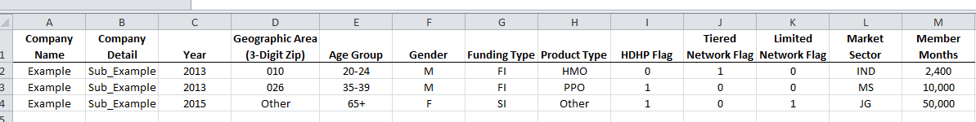
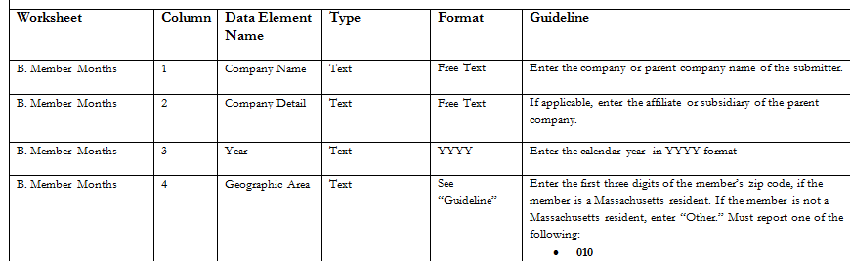
Option #2: Flat Tables
Submission Format:
DRAFT
Submission Guidelines:

Slide 22
Timeline
Jan. 2016 | Feb. 2016 | March 2016 | April 2016 |  | May 2016
Draft Data Submission Manual distributed (late January) | Finalized Data Submission Manual posted (mid February)
 |  | Payer TAG #1 (March 8th) |  | Payer TAG #2 (April 12th)
 |  |  |  |  |  | Submissions Due (May 10th)

Slide 23
Enrollment Trends

Slide 24
Thank You
Payer support is critical to ensuring accurate, timely enrollment data reporting.
Membership verified through Enrollment Trends (Massachusetts residents with primary, medical coverage) will also serve as the foundation for claims-based reporting.

Slide 25
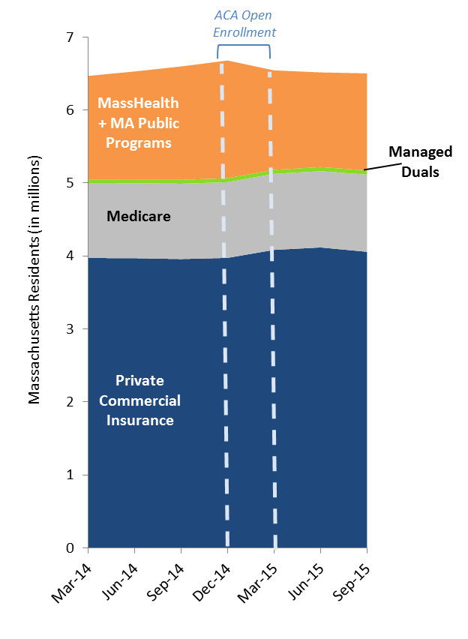
Enrollment Trends Reporting (Preview)
Total Massachusetts Enrollment
(March 2014 – September 2015)
January 2016 Release:
Report
Databook
Technical Notes
Programming Code
DRAFT

Slide 26
Enrollment Trends Timeline
Jan. 2016 | Feb. 2016 | Mar. 2016 | Apr. 2016 | May 2016 | June 2016 | July 2016
Reporting
Work with remaining payers to fix MA APCD ME files; Validate new MA APCD fields for ongoing enrollment reporting
 |  |  | March 2016 MA APCD file submissions
 |  |  |  | Supplemental reporting due (required payers)
 |  |  |  | Payer data verification
 |  |  |  |  |  | Reporting

Slide 27
Medical Expenditure
Trends

Slide 28

Medical Expenditure Trends
Enrollment Trends has produced accurate, reliable, reproducible membership data for each payer using payers’ Member Eligibility (ME) files
Next step is to assign and verify – for accuracy and completeness – those members’ medical claims, as submitted in payers’ Medical Claims (MC) files
Goal
To produce reliable, payer-verified per member per month (PMPM) measures of the cost of health care services for Massachusetts residents by enrollment subpopulations. For example:
    Total monthly expenditures by market sector
    Payer-paid PMPMs for fully-insured HMO enrollees:

Slide 29
Methods
Payers’ Medical Claims (MC) data merged to Member Eligibility (ME) data on Carrier Specific Unique Member ID (ME107) for:
    The Enrollment Trends population
    Claims with dates of services in State Fiscal Year 2014 (July 2013 – June 2014)
    Run out into CY2015
Analysis restricted to “final versioned” medical claims, using logic developed in partnership with payers
Like enrollment, claims data will be able to be aggregated and analyzed by Funding Type, Product Type, and Market Sector for commercial, MassHealth MCO, and Medicare Advantage populations.

Slide 30
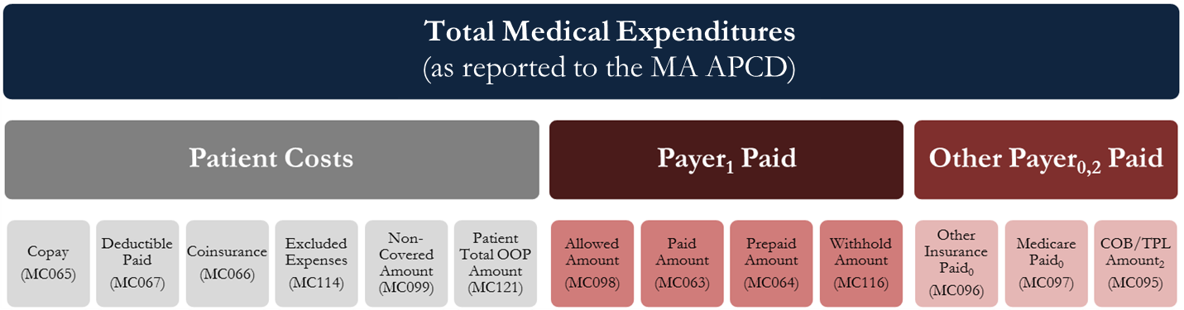
Methods
Working internally and with payers to understand how each payer populates these APCD fields
Understanding how individual financial fields may be building blocks to total medical expenditures (PMPM)
Comparing against quality control totals (e.g. Premiums Data Request, Total Medical Expenses, Milliman, HPC) to ensure completeness

Slide 31
MA APCD Validation: Payer Partnership
Payer Input Needed:
Payer Financial Benchmarks
MA APCD Field Assessment and Data Summary

Slide 32
Payer Financial Benchmarks
Request:
CHIA will send (via your payer liaison) an Excel workbook in which we will ask you to provide certain key per member per month financial values generated from your internal reporting systems.
Purpose:
These “benchmark” PMPMs will help CHIA verify that the PMPM figures sourced from the APCD are accurate and comprehensive.
Timeline:
Sent within the next week; return requested within 3-4 weeks.

Slide 33
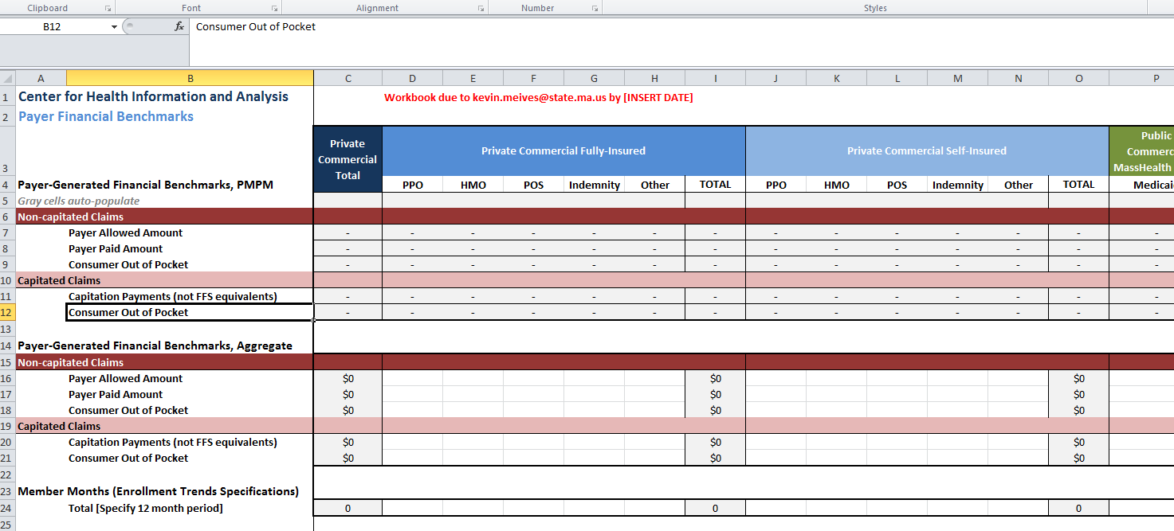
Financial Benchmarks Workbook
DRAFT

Slide 34
MA APCD Field Assessment & Data Summary
Request:
  Indicate which APCD Medical Claims (MC) financial fields your payer populates
  Briefly answer several contextual questions related to how the MC file captures medical expenditures (e.g. in relation to global payments)
  Verify that CHIA’s APCD-generated PMPM amounts are accurate
Purpose:
To ensure that CHIA knows how to use payers’ APCD data to arrive at accurate and comprehensive measures of medical expenditures.
Timeline:
Sent two weeks after Financial Benchmarks request; return requested early to mid-March.

Slide 35
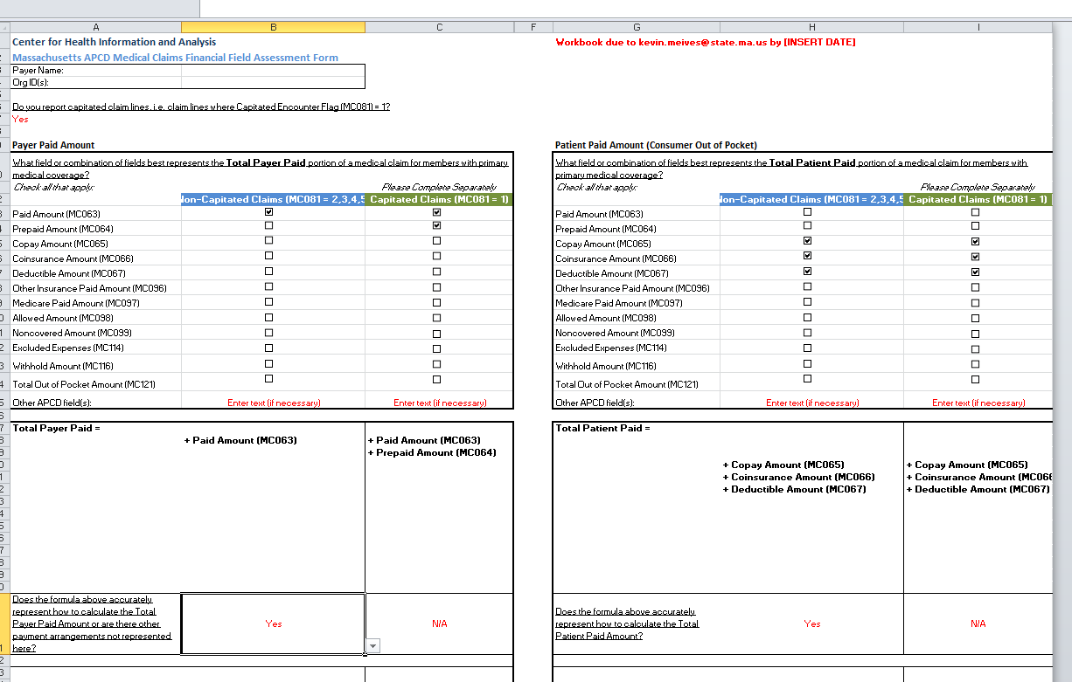
MA APCD Field Assessment
DRAFT

Slide 36
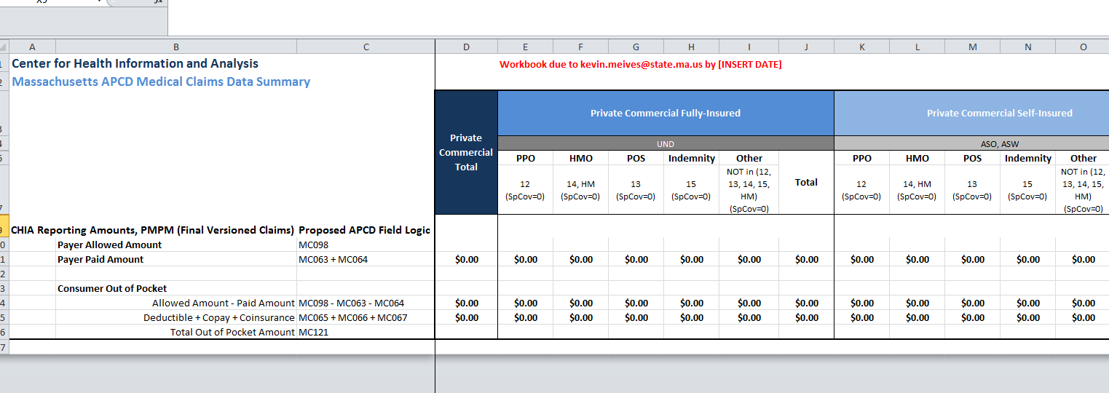
MA APCD Data Summary
DRAFT

Slide 37
Timeline
Jan. 2016 |  |  | Feb. 2016 |  | March 2016 |  | Q2 – Q3 2016 |  |  | Q4 2016
CHIA payer data review
 | Payer Financial Benchmark request
 |  | MA APCD Field Assessment & Data Summary request
 |  |  |  |  |  | CHIA data anomaly resolution and product development
 |  |  |  |  |  |  |  | Product preview |  | Public Reporting

Slide 38
Contact Information
For questions about Annual Premiums:
Contact your CHIA liaison and Kevin Meives at kevin.meives@state.ma.us
For questions about Enrollment Trends:
Contact your CHIA liaison and Ashley Storms at ashley.storms@state.ma.us
For questions about Medical Expenditure Trends:
Contact your CHIA liaison and Nathan Bosdet at nathan.bosdet@state.ma.us

Slide 39
Intake Version 5.0
MA APCD Intake Process | Timeline
Data Partners Propose Version 5 Updates | November 2015
Proposals Shared/Discussed with Carriers | December 2015
Draft Submission Guides published | January 2016
Guides Reviewed at Technical Advisory Group | January 2016
Carrier Comment Period | January 2016
Administrative Bulletin and Guides Adopted | February 2016
Development/Testing | March/June 2016
Carrier Testing | July 2016
MA APCD Intake Version 5 Production | August 2016

Slide 40
Next Meetings
February 9, 2016 @ 2:00 pm
March 8, 2016 @ 2:00 pm

Slide 41
Questions?

