Slide 1

Massachusetts All-Payer Claims Database:
Technical Assistance Group (TAG)
October 11, 2016

Slide 2
Agenda
APCD Compliance Updates
Annual Premiums Data Request, Enrollment Trends and Medical Expenditure Trends Updates
Wrap Up

Slide 3
APCD Version 5.0 Intake
Production data through September 2016 is due by 10/31/16 and needed for:
Risk Adjustment simulation (select carriers)
Data release 5.1 (all carriers)
Resubmissions from Oct 2013 forward need to be in V5 format.
Any remaining V5 Variance workbooks should be returned to your liaison for review/loading prior to production data submission.

Slide 4
APCD Version 5.0 Intake Edits
PV034 – Provider ID Code/PV039 – National Provider ID: Edit now requires that the entity type of the NPI in PV039 agree with the type of provider in PV034.
MC154-MC178: POA Exempt Codes:
Condition Present on Admission Flag Code | Condition Present on Admission Description
Y | Yes
N | No
U | Unknown
W | Clinically undetermined
1 | Not applicable (only valid for CMS.gov official published list of not applicable ICD codes for POA flag.)
Blank field | Not applicable (only valid for CMS.gov official published list of not applicable ICD codes for POA flag.)

Slide 5
DOI Reporting from MA APCD
2016Q2 and CY2015 membership reports sent to select carriers earlier this month.
Parallel submission period until both DOI and your organization agree to move to MA APCD-only membership reporting.
Responses due by 11/21/16.

Slide 6

CHIA Reporting Updates:
Annual Premiums Data Request, Enrollment Trends, and Medical Expenditure Trends
Ashley Storms | Associate Analytic Reporting Manager
October 11, 2016

Slide 7
Annual Premiums Data Request

Slide 8
2016 Annual Premiums Data Request Update
Work on the 2017 Request will begin this fall; more information will be forthcoming.
Oct. 2016 | Nov. 2016 | Dec. 2016 | Jan. 2017 | Feb. 2017 | Mar. 2017
Data specification refinement
 |  |  | Payer outreach
 |  |  |  |  | Data request release
Dates are approximate.

Slide 9
Enrollment Trends

Slide 10
Enrollment Trends Update
The next edition of Enrollment Trends, sourced from September 2016 MA APCD Member Eligibility data, will be released in January 2017.
Where populations cannot be sourced from the MA APCD, payers are asked to provide supplemental enrollment data by November 15th.
Payers will be sent MA APCD-sourced enrollment counts for review in early December.

Slide 11
Enrollment Trends Timeline
Oct. 2016 | Nov. 2016 | Dec. 2016 | Jan. 2017
Data collection, profiling, and analysis
Sept. 2016 Member Eligibility file submission
 | Supplemental reports due (identified payers)
 |  | Payers review APCD enrollment counts
 |  |  | Reporting

Slide 12
Medical Expenditure Trends

Slide 13
Medical Expenditure Trends Update
CHIA’s first Medical Expenditure Trends report will be released in the coming weeks.
Thank you for helping us move towards claims-based reporting from the MA APCD.
MA APCD data collection, profiling, and analysis has begun for the next edition of Medical Expenditure Trends which will be released in Spring 2017.

Slide 14
Medical Expenditure Trends Update
To facilitate continued MA APCD sourcing transitions, CHIA will request Financial Control Totals (aggregate membership and claims data) from payers for the following spending categories:
  Medical Claims
    “Med-Surg” (based on primary diagnosis)
    Substance Use (based on primary diagnosis)
    Behavioral Health (based on primary diagnosis)
  Pharmacy Claims
CHIA will provide a list of HEDIS codes to identify substance abuse and behavioral health claim categories.
The timespan for this request is State Fiscal Year 2015 (July 1, 2014 to June 30, 2015)

Slide 15
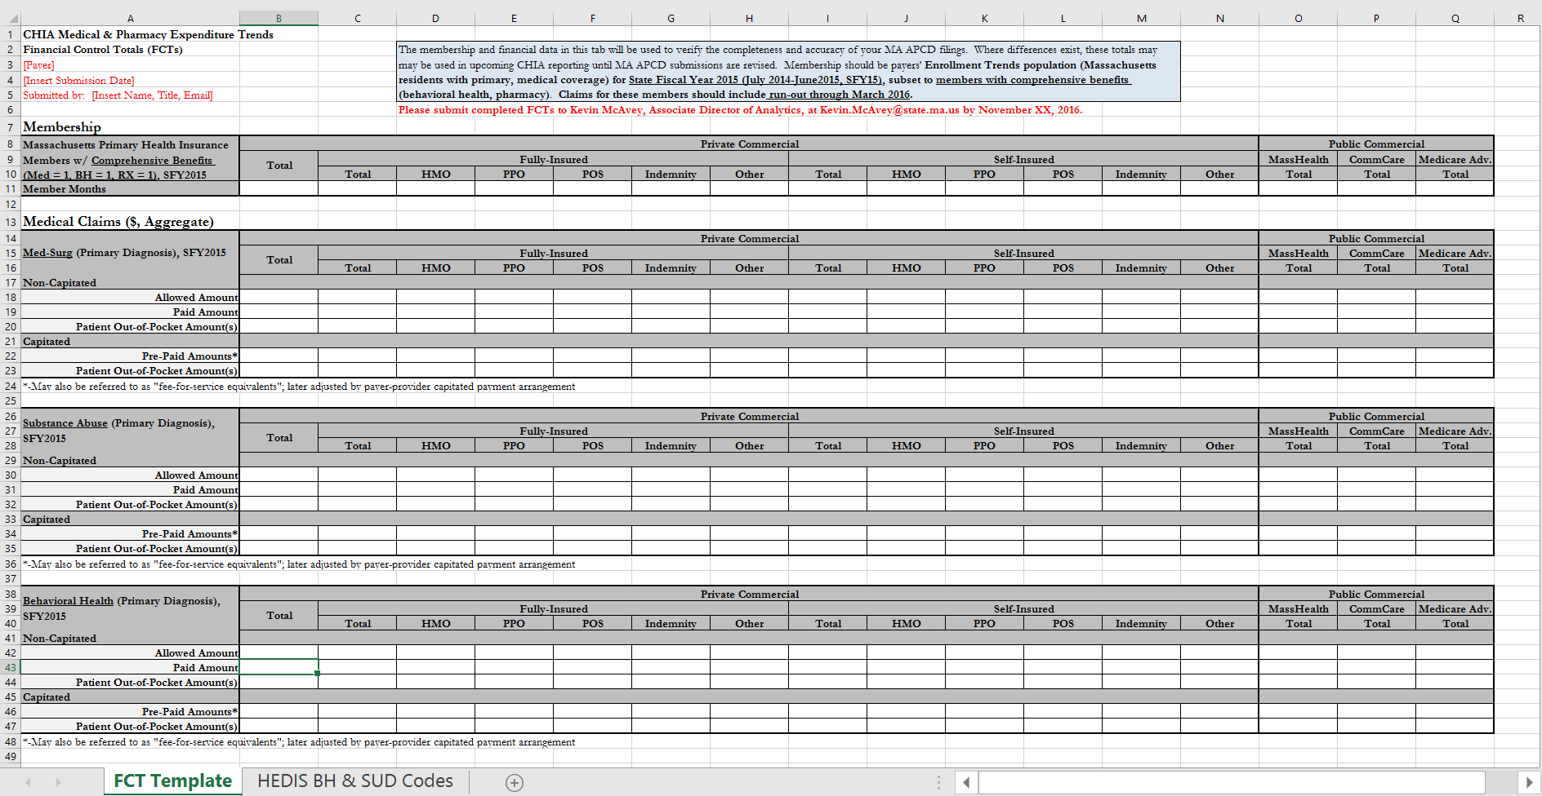
Financial Control Totals Template
DRAFT

Slide 16
Medical Expenditure Trends (2nd Edition) Timeline
Oct. 2016 | Nov. 2016 | Dec. 2016 | Jan. 2017 | Feb. 2017 | Spring 2017
MA APCD medical and pharmacy claims collection, profiling, and analysis
 | Financial Control Totals due
 |  | FCT vs. MA APCD data sourcing decisions finalized
 |  |  |  |  | Reporting

Slide 17
Contact Information
For questions about Annual Premiums, Enrollment Trends,
or Medical Expenditure Trends:
Contact your CHIA liaison and Ashley Storms at ashley.storms@state.ma.us

Slide 18
Next Meetings
November 8, 2016 @ 2:00 pm
December 13, 2016 @ 2:00 pm

Slide 19
Questions?

