Slide 1
Massachusetts All-Payer Claims Database: Technical Assistance Group (TAG)
November 8, 2016

Slide 2
Agenda
APCD Compliance Updates
Annual Premiums Data Request, Enrollment Trends and Medical Expenditure Trends Updates
Wrap Up

Slide 3
APCD Version 5.0 Intake
Production data through September 2016 was due by 10/31/16 and needed for:
Risk Adjustment simulation (select carriers)
Data release 5.1 (all carriers)
Resubmissions from Oct 2013 forward need to be in V5 format.
Version 5 file intake edits are now posted on CHIA’s website.

Slide 4
APCD Version 6.0 Intake
Early stages of planning for APCD Version 6.0 Submission Guide updates.
More details in the upcoming weeks and on the December TAG call.

Slide 5
DOI Reporting from MA APCD
2016Q2 and CY2015 membership reports sent to select carriers in October.
Parallel submission period until both DOI and your organization agree to move to MA APCD-only membership reporting.
Responses due by 11/21/16.

Slide 6
CHIA Reporting Updates:
Annual Premiums Data Request, Enrollment Trends, and Medical Expenditure Trends
Ashley Storms | Associate Analytic Reporting Manager
November 8, 2016

Slide 7
Annual Premiums Data Request

Slide 8
2017 Annual Premiums Data Request Update
Work on the 2017 Request has begun. Payers will receive more information in January 2017.
Oct. 2016 | Nov. 2016 | Dec. 2016 | Jan. 2017 | Feb. 2017 | Mar. 2017
Data specification refinement
 |  |  | Payer outreach
 |  |  |  |  | Data request release
Dates are approximate.

Slide 9
Enrollment Trends

Slide 10
Enrollment Trends Update
The next edition of Enrollment Trends, sourced from September 2016 MA APCD Member Eligibility data, will be released in January 2017.
Where populations cannot be sourced from the MA APCD, payers are asked to provide supplemental enrollment data by November 15th. Payers have already been notified if this applies to them.
CHIA will share MA APCD-sourced enrollment counts for payer review in early December. The review period will be approximately four weeks.

Slide 11
Enrollment Trends Timeline
Oct. 2016 | Nov. 2016 | Dec. 2016 | Jan. 2017
Data collection, profiling, and analysis
Sept. 2016 Member Eligibility file submission
 | Supplemental reports due (identified payers)
 |  | Payers review APCD enrollment counts
 |  |  | Reporting

Slide 12
Medical Expenditure Trends

Slide 13
Medical Expenditure Trends Update
To facilitate continued MA APCD sourcing transitions, CHIA has requested Financial Control Totals (aggregate membership and claims data) from payers for the following spending categories:
Medical Claims
Substance Use Disorder Primary Diagnosis
Mental Health Primary Diagnosis
Med-Surg-Other Primary Diagnosis
Pharmacy Claims
The workbook includes a list of HEDIS codes to identify Substance Use Disorder and Mental Health claims.
The timespan for this request is State Fiscal Year 2015 (July 1, 2014 to June 30, 2015)

Slide 14
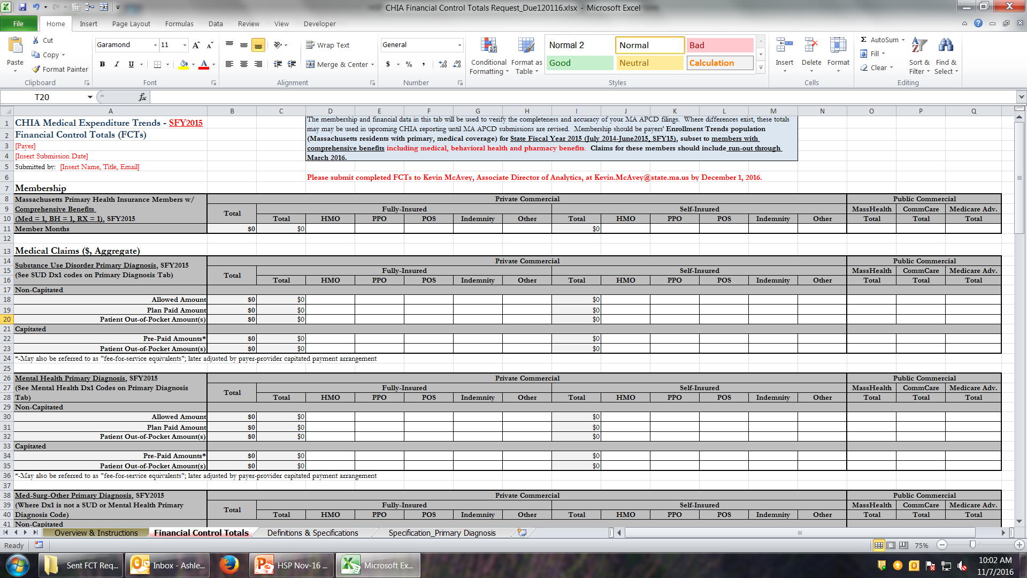
Financial Control Totals Template
(Should be formatted as number, not currency)

Slide 15
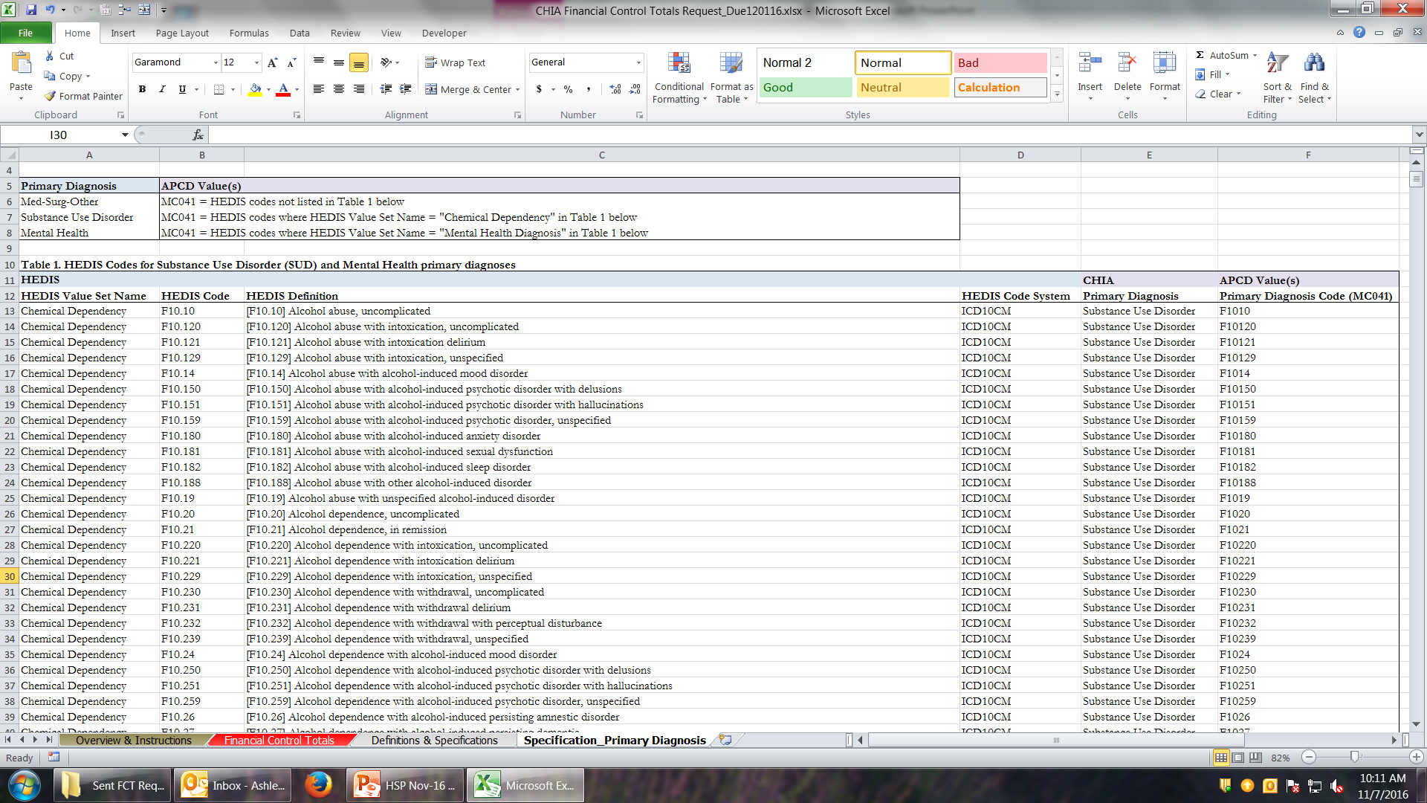
Financial Control Totals Template

Slide 16
Medical Expenditure Trends Update
Please return completed Financial Control Total workbooks to Kevin McAvey by December 1st.

Slide 17
Medical Expenditure Trends (2nd Edition) Timeline
Oct. 2016 | Nov. 2016 | Dec. 2016 | Jan. 2017 | Feb. 2017 | Spring 2017
MA APCD medical and pharmacy claims collection, profiling, and analysis
 |  | Financial Control Totals due
 |  | FCT vs. MA APCD data sourcing decisions finalized
 |  |  |  |  | Reporting

Slide 18
Contact Information
For questions about Annual Premiums, Enrollment Trends,
or Medical Expenditure Trends:
Contact your CHIA liaison and Ashley Storms at ashley.storms@state.ma.us

Slide 19
Next Meetings
December 13, 2016 @ 2:00 pm
January 10, 2017 @ 2:00 pm

Slide 20
Questions?

