Slide 1

Massachusetts All-Payer Claims Database:
Technical Assistance Group (TAG)
December 13, 2016

Slide 2
Agenda
Annual Premiums Data Request, Enrollment Trends and Medical Expenditure Trends Updates
APCD Compliance Updates:
  Version 6.0 Changes
  DOI Reporting
Wrap Up

Slide 3

CHIA Reporting Updates:
Annual Premiums Data Request, Enrollment Trends, and Medical Expenditure Trends
Ashley Storms | Associate Analytic Reporting Manager
December 12, 2016

Slide 4
Annual Premiums Data Request

Slide 5
2017 Annual Premiums Data Request Update
Payers will receive a preview of the 2017 Annual Premiums request next month. More information will be provided on the January 2017 TAG call
Dec. 2016 | Jan. 2017 | Feb. 2017 | Mar. 2017 | Apr. 2017 | May 2017
Data specification refinement
 | Payer outreach
 |  |  | Data request release
 |  |  |  | Payers complete data request

Slide 6
Enrollment Trends

Slide 7
Enrollment Trends Update
CHIA shared MA APCD-sourced enrollment counts for payer review earlier this month. These enrollment counts are based on payers’ September 2016 Member Eligibility submissions and do not reflect any additional supplemental data.
Please contact us with any comments or concerns about this data by December 30th. Feedback received after this date may not be incorporated into the upcoming report.

Slide 8
Enrollment Trends Timeline
Oct. 2016 | Nov. 2016 | Dec. 2016 | Jan. 2017
Data collection, profiling, and analysis
Sept. 2016 Member Eligibility file submission
 | Supplemental reports due (identified payers)
 |  | Payers review APCD enrollment counts
 |  |  | Reporting

Slide 9
Medical Expenditure Trends

Slide 10
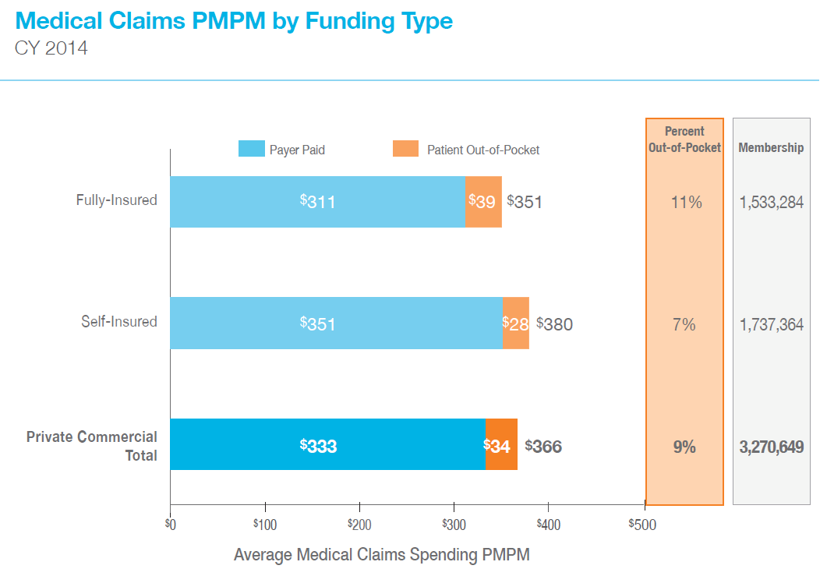
Medical Expenditure Trends Update
CHIA’s first Medical Expenditure Trends report will be released today.
The first edition reports medical claims spending for Massachusetts residents with private commercial insurance in 2014.

Slide 11
Medical Expenditure Trends Update
Thank you to all who submitted Financial Control Totals for the next Medical Expenditure Trends report.
CHIA will be in touch over the next month or two with follow up questions and next steps.
The second edition of Medical Expenditure Trends will be released in Spring 2017.

Slide 12
Medical Expenditure Trends (2nd Edition) Timeline
Oct. 2016 | Nov. 2016 | Dec. 2016 | Jan. 2017 | Feb. 2017 | Spring 2017
MA APCD medical and pharmacy claims collection, profiling, and analysis
 |  | Financial Control Totals due
 |  | FCT vs. MA APCD data sourcing decisions finalized
 |  |  |  |  | Reporting

Slide 13
Contact Information
For questions about Annual Premiums, Enrollment Trends,
or Medical Expenditure Trends:
Contact your CHIA liaison and Ashley Storms at ashley.storms@state.ma.us

Slide 14
APCD Version 6.0 Intake Changes
Liaisons sent out an email with the following:
• Memo on removal of patient information
• Technical information on data submission
• Overview of changes to eligibility submission
• Overview of changes to claim submissions
• Timeline

Slide 15
Intake Version 6.0
MA APCD Intake Process | Intake 6.0 Timeline
Proposals Shared/Discussed with Carriers | December 2016/January 2017
New sftp testing | January 2017
Draft Submission Guides published | December 2016/January 2017
Guides Reviewed at Technical Advisory Group | December 2016/January 2017
Carrier Comment Period | January 2017
New sftp PROD | February 2017
Administrative Bulletin and Guides Adopted | January/February 2017
Development/Testing | February/June 2017
Carrier Testing – new guides and new transmission process | July 2017
Removal of PII from CHIA internal data | July 2017
MA APCD Intake Version 6 Production | August 2017

Slide 16
APCD Version 6.0 Intake Changes
CHIA is proposing changes that will affect:
• What is submitted
• How it is submitted
• How it is protected
• How historical data will be handled
• How data linkage will be maintained
• How continuity across years will be maintained

Slide 17
APCD Version 6.0 Intake Changes
What is submitted: Submission Guide Changes
CLAIM FILE:
Patient fields removed: SSNs, Subscriber/Member name fields, street, city, state address fields.
We will not be reformatting the layout but rather will require these fields to be NULL to limit the extent of changes required.
ELIGIBILITY FILE:
Patient fields removed: street, city, and state address fields
Other Patient fields hashed prior to the upload to CHIA

Slide 18
APCD Version 6.0 Intake Changes
Medical Claim Submission – Patient Information Removal
Element | Element Name | Format/Length | Desc. | Guideline | Remove(Null) or Leave as is | Category
MC004 | Payer Claim Control Number | varchar[35] | Payer Claim Control Identification | Report the Unique identifier within the payer's system that applies to the entire claim. | Leave as is | A0
MC006 | Insured Group or Policy Number | varchar[30] | Group / Policy Number | Report the number that defines the insured group or policy. Do not report the number that uniquely identifies the subscriber or member. | Leave as is | A2
MC007 | Subscriber SSN | char[9] | Subscriber's Social Security Number | Report the Subscriber's SSN here; used to validate Unique Member ID; will not be passed into analytic file. Do not use hyphen. If not available do not report any value here | Remove/Null | B
MC008 | Plan Specific Contract Number | varchar[30] | Contract Number | Report the Plan assigned contract number. Do not include values in this field that will distinguish one member of the family from another. This should be the contract or certificate number for the subscriber and all of the dependents. | Leave as is | A2

Slide 19
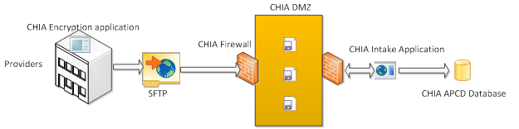
APCD Version 6.0 Intake Changes
How it is submitted: SENDS+/INET Changes
CHIA will be using a new method of sending files which will replace SENDS+/INET. The new method will include a new web portal and be a standard SFTP client for data submitters.
The MA APCD files will be encrypted using AES-256 encryption.

Slide 20
APCD Version 6.0 Intake Changes

Slide 21
APCD Version 6.0 Intake Changes
How it is protected: Hashing Member Eligibility Data
FileSecure - mask member eligibility patient identifying information before transmission
NIST certified SHA-3 hashing algorithm with a CHIA defined 128-bit SALT
unique encryption keys built inside the executable to encrypt the file before transmission
download from the web portal and will reside within the carrier’s local PC or network
Fields to be hashed include SSNs, DOB, member and subscriber names.

Slide 22
APCD Version 6.0 Intake Changes
How historical data will be handled: Removal of Patient Information
All data models and databases will be updated to remove all patient identifying information fields and incorporate new hashed fields.
All back-ups, including tape storage, will be updated to remove all patient identifying information fields.
These changes will be fully tested.

Slide 23
APCD Version 6.0 Intake Changes
How data linkage will be maintained: Creation of an MEID (Member Enterprise ID)
Prior to masking the data onsite, the software will perform two data processing functions - nickname processing and phonetic processing
An MEID will be created via CHIA’s MDM software. The software will utilize a select number of fields in matching members across data. These fields include the carrier unique member and subscriber IDs, the member’s 5 digit postal code, hashed name, hashed DOB and birth month/year.

Slide 24
APCD Version 6.0 Intake Changes
How continuity across years will be maintained: Member eligibility data to be held by carrier
CHIA needs the ability to maintain an accurate de-identified member ID (MEID) over a 5 year period. This allows CHIA, sister agencies and researchers to perform longitudinal analyses. To provide for future security implementations and to allow analytic interoperability across years we require all carriers to hold in escrow each December member eligibility file, prior to CHIA hashing/encryption, for a period of 5 years. As software updates occur CHIA may require resubmission of these files to update security measures and to accurately assign an MEID.

Slide 25
APCD Version 6.0 Intake Changes
Additional changes are minor and include:
Submission Guide wording changes for select data elements to provide clarification.
Updated edits including potential changes on capitated and prepaid fields.
Removal/nulling of additional fields such as Other Ethnicity and Other Language
Possible lookup table update for PV011 (Suffix)

Slide 26
Intake Version 6.0
MA APCD Intake Process | Intake 6.0 Timeline
Proposals Shared/Discussed with Carriers | December 2016/January 2017
New sftp testing | January 2017
Draft Submission Guides published | December 2016/January 2017
Guides Reviewed at Technical Advisory Group | December 2016/January 2017
Carrier Comment Period | January 2017
New sftp PROD | February 2017
Administrative Bulletin and Guides Adopted | January/February 2017
Development/Testing | February/June 2017
Carrier Testing – new guides and new transmission process | July 2017
Removal of patient identifying information from CHIA internal data | July 2017
MA APCD Intake Version 6 Production | August 2017

Slide 27
DOI Reporting from MA APCD
2016Q2 membership report: discussion with select carriers ongoing to address feedback/questions/issues.
2016Q3 membership reports sent to carriers in November and responses are due by 1/6/17.
Parallel submission period until both DOI and carrier agree to move to MA APCD-only membership reporting.

Slide 28
Next Meetings
January 10, 2017 @ 2:00 pm
February 14, 2017 @ 2:00 pm

Slide 29
Questions?

