Slide 1
Massachusetts All-Payer Claims Database: Technical Assistance Group (TAG)
February 9, 2016

Slide 2
Agenda
Housekeeping
Annual Premium, Enrollment Trends and Medical Expenditure Trends Updates
Wrap Up

Slide 3
Housekeeping
APCD V5 Submission Guides
Risk Adjustment
Upcoming File Submission Deadlines
Proposed Changes to TME/APM Reporting

Slide 4
Intake Version 5.0
MA APCD Intake Process | Timeline
Data Partners Propose Version 5 Updates | November 2015
Proposals Shared/Discussed with Carriers | December 2015
Draft Submission Guides published | January 2016
Guides Reviewed at Technical Advisory Group | January 2016
Carrier Comment Period | January 2016
Administrative Bulletin and Guides Adopted | February 2016
Development/Testing | March/June 2016
Carrier Testing | July 2016
MA APCD Intake Version 5 Production | August 2016

Slide 5
PV011 - Suffix
D/N | Dietitian/Nutritionist
DC | Doctor of Chiropractic
DO | Doctor of Osteopathy
DPM | Doctor of Podiatric Medicine
HC | Homecare
HO | Hospital Based PM&R
KT | Kinesiotherapist
LAC | Licensed Acupuncturist
MD | Medical Doctor
MT | Massage Therapist
ND | Naturopathic Physician
OF | Physician Office Based PM&R
OT | Occupational Therapist
PA | Physicians Assistant
PT | Physical Therapist
R | Rolfer
SLP | Speech Language Pathologist
ST | Speech Therapist

Slide 6
Risk Adjustment
Deadline extended to 2/26/2016 for submitting Supplemental Diagnosis file for December 2015
Inform your liaison if you plan on submitting this file type for Risk Adjustment
Connector/Milliman joining upcoming bi-weekly calls to discuss the Q4 2015 Data Quality reports

Slide 7
Upcoming File Submission Deadlines
Files (through March 2016) for the next CHIA data release must be in and passed intake edits by 4/30/2016. This also coincides with the Risk Adjustment final settlement.
V5 submission guides go into effect in August for July 2016 data and any resubmissions back to October 2013.

Slide 8
Proposed Changes to TME/APM Reporting
Please send any comments or questions by Friday, February 12th to:
Caitlin Sullivan, Policy Implementation Manager
caitlin.sullivan2@state.ma.us
All TME/APM/RP and TAG materials can be found here: http://www.chiamass.gov/information-for-data-submitters-payer-data-reporting/

Slide 9
CHIA Reporting Updates:
Annual Premiums Data Request, Enrollment Trends, and Medical Expenditure Trends
Kevin Meives | Senior Health System Policy Analyst
Ashley Storms | Senior Health System Policy Analyst
Nathan Bosdet | Senior Health System Policy Analyst
February 9th, 2016

Slide 10
Annual Premiums Data Request

Slide 11
2016 Annual Premiums Data Request Update
Draft Data Submission Manual
Comments due to Kevin Meives at kevin.meives@state.ma.us by February 12th
Limited Network Definition
Flat File Submission Option
Timeline

Slide 12
Limited Networks Proposed Definition
Cost/Premium Threshold
MA DOI definition uses 14% cost threshold
Proposing using 10% threshold
Fully-Insured Plans
Apply threshold based on premium relativities in manual rating algorithm
A network that is considered limited in Merged Market would also be so in large group
Self-Insured Plans
Apply fully-insured criteria to self-insured networks

Slide 13
Flat File Submission Option
Submission Format:
Submission Guidelines:

Slide 14
Timeline
Feb. 12th 2016 | Feb. 17th 2016 | March 2016 | April 2016 |  | May 2016
Comments on Draft Data Submission Manual Due | Finalized Data Submission Manual posted
 |  | Payer TAG #1 (March 8th) |  | Payer TAG #2 (April 12th)
 |  |  |  |  |  | Submissions Due (May 10th)

Slide 15
Enrollment Trends

Slide 16
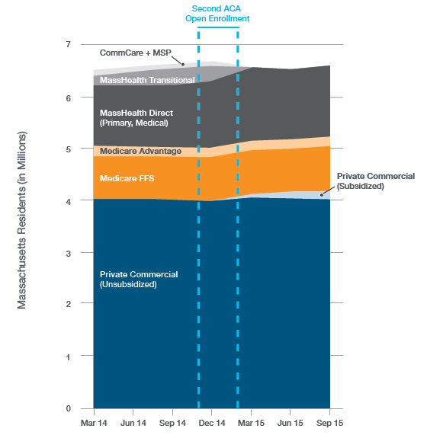
Total Massachusetts Enrollment March 2014 – September 2015

Slide 17
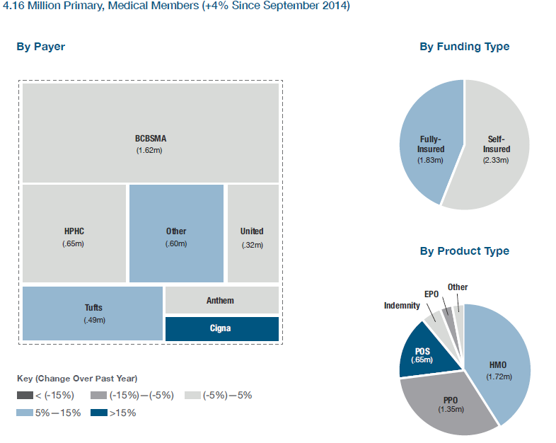
Private Commercial Enrollment September 2014 – September 2015

Slide 18
Timeline
Jan. 2016 | Feb. 2016 | Mar. 2016 | Apr. 2016 | May 2016 | June 2016 | July 2016
 | Reporting
Work with remaining payers to fix MA APCD ME files; Validate new MA APCD fields for ongoing enrollment reporting
 |  |  | March 2016 MA APCD file submissions
 |  |  |  | Supplemental reporting due (required payers)
 |  |  |  | Payer data verification
 |  |  |  |  |  | Reporting

Slide 19
Medical Expenditure
Trends

Slide 20
Financial Control Totals Follow-up
CHIA has sent (via your payer liaison) an Excel workbook in which we have asked you to provide certain key per member per month financial values generated from your internal reporting systems.
We have asked that these be returned by Thursday, February 25th.

Slide 21
Contact Information
For questions about Annual Premiums:
Contact your CHIA liaison and Kevin Meives at kevin.meives@state.ma.us
For questions about Enrollment Trends:
Contact your CHIA liaison and Ashley Storms at ashley.storms@state.ma.us
For questions about Medical Expenditure Trends:
Contact your CHIA liaison and Nathan Bosdet at nathan.bosdet@state.ma.us

Slide 22
Next Meetings
March 8, 2016 @ 2:00 pm
April 12, 2016 @ 2:00 pm

Slide 23
Questions?

