Slide 1
Massachusetts All-Payer Claims Database: Technical Assistance Group (TAG)
March 8, 2016

Slide 2
Agenda
Housekeeping
DOI Reporting Update
Annual Premiums Data Request, Enrollment Trends and Medical Expenditure Trends Updates
Wrap Up

Slide 3
Housekeeping
APCD V5 Submission Guides
Upcoming File Submission Deadlines
GIC Reporting

Slide 4
Intake Version 5.0
MA APCD Intake Process | Timeline
Data Partners Propose Version 5 Updates | November 2015
Proposals Shared/Discussed with Carriers | December 2015
Draft Submission Guides published | January 2016
Guides Reviewed at Technical Advisory Group | January 2016
Carrier Comment Period | January 2016
Administrative Bulletin and Guides Adopted | February 2016
Development/Testing | March/June 2016
Carrier Testing | July 2016
MA APCD Intake Version 5 Production | August 2016

Slide 5
Upcoming File Submission Deadlines
Files - including any resubmissions - (through March 2016) for the next CHIA data release must be in and passed intake edits by 4/30/2016. This also coincides with the Risk Adjustment final settlement.
V5 submission guides go into effect in August for July 2016 data and any resubmissions back to October 2013.

Slide 6
Update on Division of Insurance
Package sent out to reporting HMOs on Friday 3/4/16. It included:
MA ACPD based membership reports as of 12/31/14.
Detailed specifications
Draft of the sign off report that CHIA will send on a quarterly basis
Report detailing how the DOI membership reports differ from CHIA’s enrollment trends report

Slide 7
Responses Needed by April 29th
Do the MA APCD membership reports reasonably reflect your business as of 12/31/14?
If not, please state the variance(s) and any explanation(s).
Do you agree that you would expect that using CHIA’s specifications with your APCD submissions will reasonably result in reports that reflect your business in the coming years?
If not, what modifications to the specifications are needed?

Slide 8
Calendar for Balance of Reports
Utilization Reports
Out to carriers late summer 2016
Feedback needed 8 weeks after receipt of reports
Enrollment logic in Claims report
Out to carriers late summer 2016
Feedback needed 5 weeks after receipt of reports
Migration plan developed by DOI and CHIA
Simulations? Based on carrier feedback

Slide 9
CHIA Reporting Updates:
Annual Premiums Data Request, Enrollment Trends, and Medical Expenditure Trends
Ashley Storms | Senior Health System Policy Analyst
Kevin Meives | Senior Health System Policy Analyst
March 8th, 2016

Slide 10
Annual Premiums Data Request

Slide 11
2016 Annual Premiums Data Request Update
Submission materials available at: http://www.chiamass.gov/information-for-data-submitters-premiums-data/
Submissions due to Dianna Welch of Oliver Wyman Consulting at dianna.welch@oliverwyman.com by May 10th
Limited Network Definition
Timeline

Slide 12
Limited Network Definition
In response to payer feedback, CHIA removed the requirement that a plan offer a certain level of cost (premium) savings to qualify as a Limited Network plan.
Revised definition only requires that a plan offer a “reduced or selective provider network.”
Please see the Data Submission Manual for full definition.

Slide 13
Timeline
April 2016 | May 2016 |  | June 2016 |  | July 2016 |  | August 2016
Payer TAG #2 (April 12th) | Submissions Due (May 10th)
 |  | Anomaly Identification & Resolution |  |  |  | Follow-up for 2015 “3R” and MLR amounts
 |  |  |  |  |  |  |  | CHIA’s 2016 Annual Report finalized

Slide 14
Enrollment Trends

Slide 15
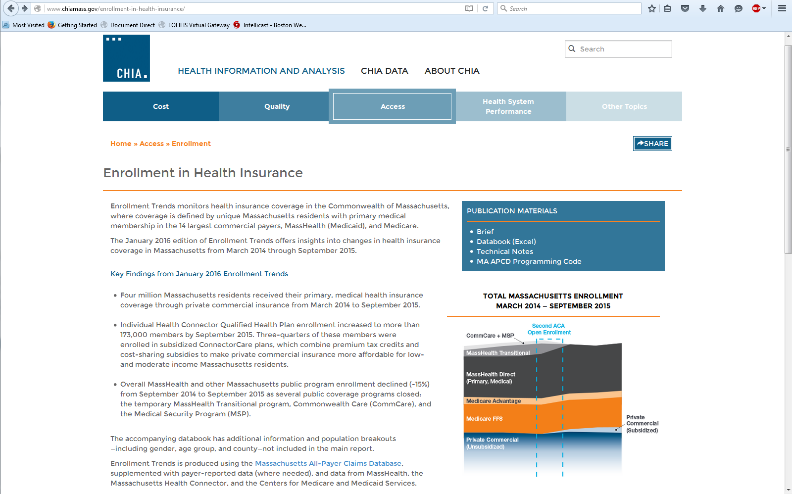
Enrollment Trends (Feb. 2016 edition) is now online
http://www.chiamass.gov/enrollment-in-health-insurance/

Slide 16
Selected Findings
From September 2014 to September 2015:
Enrollment increased 4% in private commercial plans and 9% in MassHealth MCO plans.
Massachusetts Medicare enrollment increased 3%, with Medicare Advantage membership growing at twice the rate of Medicare FFS (Parts A and B).
Membership increased in POS (+33%) and HMO (+5%) products, while PPO membership declined (-5%).

Slide 17
Situs Field (PR018)
Field captures “the state where the product was issued” and was implemented with intake version 4.0.
This spring, we will begin assessing the completeness and quality of PR018.
This work will inform Enrollment Trends reporting and is also a step towards transitioning Annual Premiums data to the MA APCD.

Slide 18
Timeline
Mar. 2016 | Apr. 2016 | May 2016 | June 2016 | July 2016
Work with individual payers to fix remaining reporting issues; validate new MA APCD fields for ongoing enrollment reporting
 | March 2016 MA APCD file submissions
 |  | Supplemental reporting due (required payers)
 |  | Payer data verification
 |  |  |  | Reporting

Slide 19
Medical Expenditure
Trends

Slide 20
Financial Control Totals Follow-up
CHIA asked you to provide certain key per member per month financial values generated from your internal reporting systems.
Thank you for your responses.
We are currently using the data that you reported to assess the accuracy and completeness of the medical claims reported to the MA APCD.

Slide 21
Field Logic & Data Verification Request
As mentioned on previous TAGs, the Financial Control Totals data table was the first of two requests.
The second—a Field Logic & Data Verification workbook which has been or will soon be sent via your payer liaison—asks you to complete two main tasks:
Verify the accuracy and completeness of aggregate and PMPM APCD medical claims data
Select which APCD MC fields should be used to calculate “core” medical expenditure values (payer- and patient-paid amounts)

Slide 22
Contact Information
For questions about Annual Premiums or Medical Expenditure Trends:
Contact your CHIA liaison and Kevin Meives at kevin.meives@state.ma.us
For questions about Enrollment Trends:
Contact your CHIA liaison and Ashley Storms at ashley.storms@state.ma.us

Slide 23
Next Meetings
April 12, 2016 @ 2:00 pm
May 10, 2016 @ 2:00 pm

Slide 24
Questions?

