Slide 1
Massachusetts All-Payer Claims Database: Technical Assistance Group (TAG)
April 12, 2016

Slide 2
Agenda
Housekeeping
Annual Premiums Data Request, Enrollment Trends and Medical Expenditure Trends Updates
Wrap Up

Slide 3
Housekeeping
APCD V5 Submission Guides
Upcoming File Submission Deadlines
GIC Reporting
TME Reporting

Slide 4
Intake Version 5.0
MA APCD Intake Process | Timeline
Data Partners Propose Version 5 Updates | November 2015
Proposals Shared/Discussed with Carriers | December 2015
Draft Submission Guides published | January 2016
Guides Reviewed at Technical Advisory Group | January 2016
Carrier Comment Period | January 2016
Administrative Bulletin and Guides Adopted | February 2016
Development/Testing | March/June 2016
Carrier Testing | July 2016
MA APCD Intake Version 5 Production | August 2016

Slide 5
Upcoming File Submission Deadlines
Files - including any resubmissions - (through March 2016) for the next CHIA data release must be in and passed intake edits by 4/30/2016. This also coincides with the Risk Adjustment final settlement.
V5 submission guides go into effect in August for July 2016 data and any resubmissions back to October 2013.
Responses needed by April 29th for the DOI membership reporting.

Slide 6
GIC Reporting
PV002 – Plan Provider ID: Same in APCD as in GIC Clinical Performance Improvement Initiative (CPII)?

Slide 7
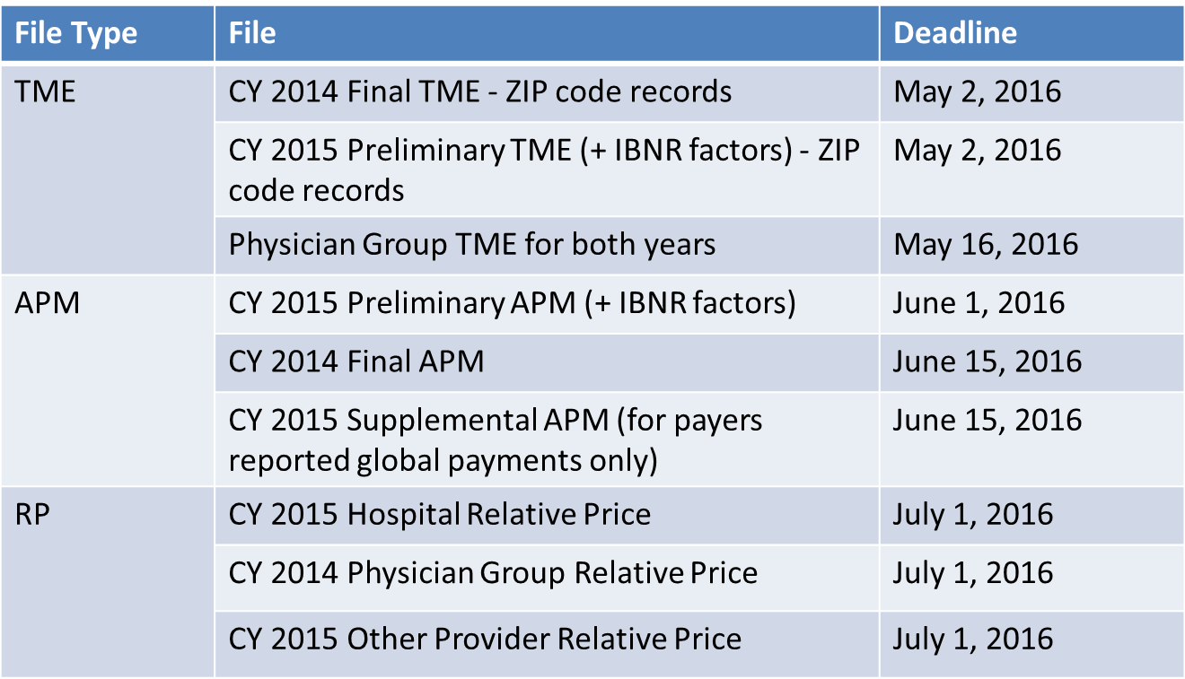
TME/APM/RP Reporting

Slide 8
CHIA Reporting Updates:
Annual Premiums Data Request, Enrollment Trends, and Medical Expenditure Trends
Ashley Storms | Senior Health System Policy Analyst
Kevin Meives | Senior Health System Policy Analyst
April 12th, 2016

Slide 9
Annual Premiums Data Request

Slide 10
2016 Annual Premiums Data Request Update
Submission materials available at: http://www.chiamass.gov/information-for-data-submitters-premiums-data/
Submissions due to Dianna Welch of Oliver Wyman Consulting at dianna.welch@oliverwyman.com by May 10th
Behavioral Health, Dental, and Vision Claims
Timeline

Slide 11
Behavioral Health, Dental, and Vision Claims
Q: Should data related to behavioral health, dental, and vision claims be reported?
A: Payers should include all expenses that are part of a comprehensive medical policy, either as part of the base policy itself or an attached rider.
Incurred and allowed claims should reflect all benefits that are covered by the premium that is paid so that the premiums and claims that are reported reflect consistent benefits.
If the behavioral health, dental, or vision benefits are part of the comprehensive medical policy, either the base policy or attached as a rider, they should be included in the reported premium and claims amounts.
If, however, the behavioral health, dental or vision benefits are sold entirely separately as standalone policies, then these would fall under the category of “other non-primary, non-medical business” and thus be excluded.

Slide 12
Timeline
May 2016 |  | June 2016 |  | July 2016 |  | August 2016
Submissions Due (May 10th)
 | Anomaly Identification & Resolution |  |  |  | Follow-up for 2015 “3R” and MLR amounts
 |  |  |  |  |  |  | CHIA’s 2016 Annual Report finalized

Slide 13
Enrollment Trends

Slide 14
Supplemental Reports
Reminder: Payers will receive Supplemental Report requests shortly (as needed), to be returned in late May
Supplemental Reports collect aggregate data on the portion of the Enrollment Trends population that cannot be reliably sourced from the MA APCD

Slide 15
Timeline
Mar. 2016 | Apr. 2016 | May 2016 | June 2016 | July 2016
Work with individual payers to fix remaining reporting issues; validate new MA APCD fields for ongoing enrollment reporting
 | March 2016 MA APCD file submissions
 |  | Supplemental reporting due (required payers)
 |  |  | Payer data verification
 |  |  |  | Reporting

Slide 16
Medical Expenditure
Trends

Slide 17
MET Requests
Financial Control Totals
Thank you for your responses.
We are currently using the data that you reported to assess the accuracy and completeness of the medical claims reported to the MA APCD.
Field Logic & Data Verification
Verify the accuracy and completeness of aggregate and PMPM APCD medical claims data
Select which APCD MC fields should be used to calculate “core” medical expenditure values (payer- and patient-paid amounts)

Slide 18
Contact Information
For questions about Annual Premiums or Medical Expenditure Trends:
Contact your CHIA liaison and Kevin Meives at kevin.meives@state.ma.us
For questions about Enrollment Trends:
Contact your CHIA liaison and Ashley Storms at ashley.storms@state.ma.us

Slide 19
Next Meetings
May 10, 2016 @ 2:00 pm
June 14, 2016 @ 2:00 pm

Slide 20
Questions?

