Slide 1
Massachusetts All-Payer Claims Database: Technical Assistance Group (TAG)
July 12, 2016

Slide 2
Agenda
APCD Compliance Updates
Annual Premiums Data Request, Enrollment Trends and Medical Expenditure Trends Updates
Wrap Up

Slide 3
Intake Version 5.0
MA APCD Intake Process | Timeline
Data Partners Propose Version 5 Updates | November 2015
Proposals Shared/Discussed with Carriers | December 2015
Draft Submission Guides published | January 2016
Guides Reviewed at Technical Advisory Group | January 2016
Carrier Comment Period | January 2016
Administrative Bulletin and Guides Adopted | February 2016
Development/Testing | March/June 2016
Carrier Testing | July 2016
MA APCD Intake Version 5 Production | August 2016

Slide 4
APCD Version 5.0 Intake
APCD V5 carrier testing begins in July
Production data begins in August for July data
Any resubmissions from Oct 2013 forward will need to be in V5 format beginning in August
Variance workbooks will be sent to carriers this month

Slide 5
File Submission Deadlines
Files - including any resubmissions - (through June 2016) must be in and passed intake edits by 7/31/2016 for the next Risk Adjustment simulation.

Slide 6
CHIA Reporting Updates:
Annual Premiums Data Request, Enrollment Trends, and Medical Expenditure Trends
Ashley Storms | Senior Health System Policy Analyst
July 12th, 2016

Slide 7
Annual Premiums Data Request

Slide 8
2016 Annual Premiums Data Request Update
Thank you for submitting the 2016 Request.
We will continue following up on any outstanding questions related to premiums data submissions.
Oliver Wyman will reach out for 2015 “3R” amounts within the next two weeks. Payers will also have the opportunity to provide input on some preliminary state trends at this time.

Slide 9
Timeline
June 2016 | July 2016 |  | August 2016
Anomaly Identification & Resolution
 |  | Follow-up for 2015 “3R” and MLR amounts
 |  |  |  | CHIA’s 2016 Annual Report finalized

Slide 10
Enrollment Trends

Slide 11
Enrollment Trends Update
Thank you for submitting data, responding to follow-up questions, and reviewing enrollment counts prior to publication.
July 2016 Enrollment Trends will report membership from December 31, 2013 through March 31, 2016.
Look for the latest Report, Databook, Technical Appendix, MA APCD Programming Code, and Health Plan Member Atlas later this month.

Slide 12
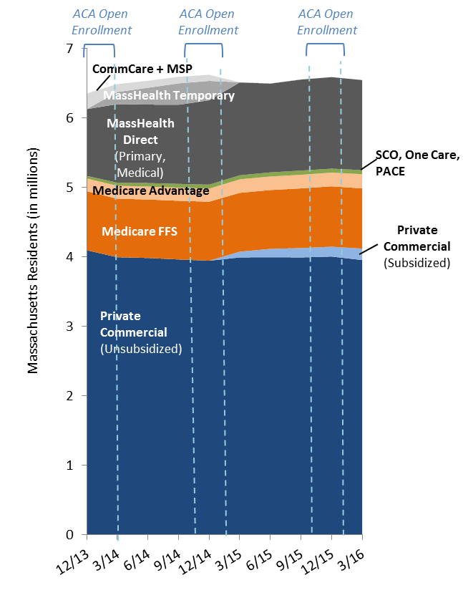
Enrollment Trends Preview
Total Massachusetts Enrollment

Slide 13
Timeline
Mar. 2016 | Apr. 2016 | May 2016 | June 2016 | July 2016
Work with individual payers to fix remaining reporting issues; validate new MA APCD fields for ongoing enrollment reporting
 | March 2016 MA APCD file submissions
 |  | Supplemental reporting due (requested payers)
 |  |  | Payer APCD data verification
 |  |  |  | Reporting

Slide 14
Medical Expenditure
Trends

Slide 15
Medical Expenditure Trends Data Review
CHIA’s first Medical Expenditure Trends report (July/August 2016) will profile a limited number of data points.
Summary data (from either Financial Control Totals or MA APCD Medical Claims submissions) has been sent to payers for review along with some clarifying questions.
Please respond to any questions by the date indicated in the email.

Slide 16
Timeline
Feb. 2016 | Mar. 2016 |  | Apr. 2016 | May 2016 | June 2016 | July 2016 | Aug. 2016
Financial Control Totals Request
 | Field Logic and Verification Workbooks
 |  | CHIA MA APCD Analysis
 |  |  |  |  | Payers Sent Data for Review
 |  |  |  |  |  | Reporting

Slide 17
Contact Information
For questions about Annual Premiums or Medical Expenditure Trends:
Contact your CHIA liaison and Kevin McAvey at kevin.mcavey@state.ma.us
For questions about Enrollment Trends:
Contact your CHIA liaison and Ashley Storms at ashley.storms@state.ma.us

Slide 18
Next Meetings
August 9, 2016 @ 2:00 pm
September 13, 2016 @ 2:00 pm

Slide 19
Questions?

