Slide 1
Massachusetts All-Payer Claims Database: Technical Assistance Group (TAG)
August 9, 2016

Slide 2
Agenda
APCD Compliance Updates
Annual Premiums Data Request, Enrollment Trends and Medical Expenditure Trends Updates
Wrap Up

Slide 3
Intake Version 5.0
MA APCD Intake Process | Timeline
Data Partners Propose Version 5 Updates | November 2015
Proposals Shared/Discussed with Carriers | December 2015
Draft Submission Guides published | January 2016
Guides Reviewed at Technical Advisory Group | January 2016
Carrier Comment Period | January 2016
Administrative Bulletin and Guides Adopted | February 2016
Development/Testing | March/June 2016
Carrier Testing | July 2016
MA APCD Intake Version 5 Production | August 2016

Slide 4
APCD Version 5.0 Intake
APCD V5 carrier testing ongoing
Production data begins in August for July data – due 8/31/16
Any resubmissions from Oct 2013 forward will need to be in V5 format beginning in August
V5 Variance workbooks should be returned to your liaison for review/loading prior to production data submission.

Slide 5
CHIA Reporting Updates:
Annual Premiums Data Request, Enrollment Trends, and Medical Expenditure Trends
Ashley Storms | Associate Analytic Reporting Manager
August 9, 2016

Slide 6
2016 Annual Premiums Data Request Update
Thank you for submitting to the 2016 Annual Premiums Data Request.
Payer data is currently being incorporated into CHIA’s upcoming 2016 Annual Report on the Performance of the Massachusetts Health Care System.
Work on the 2017 Request will begin this fall; more information will be forthcoming.

Slide 7
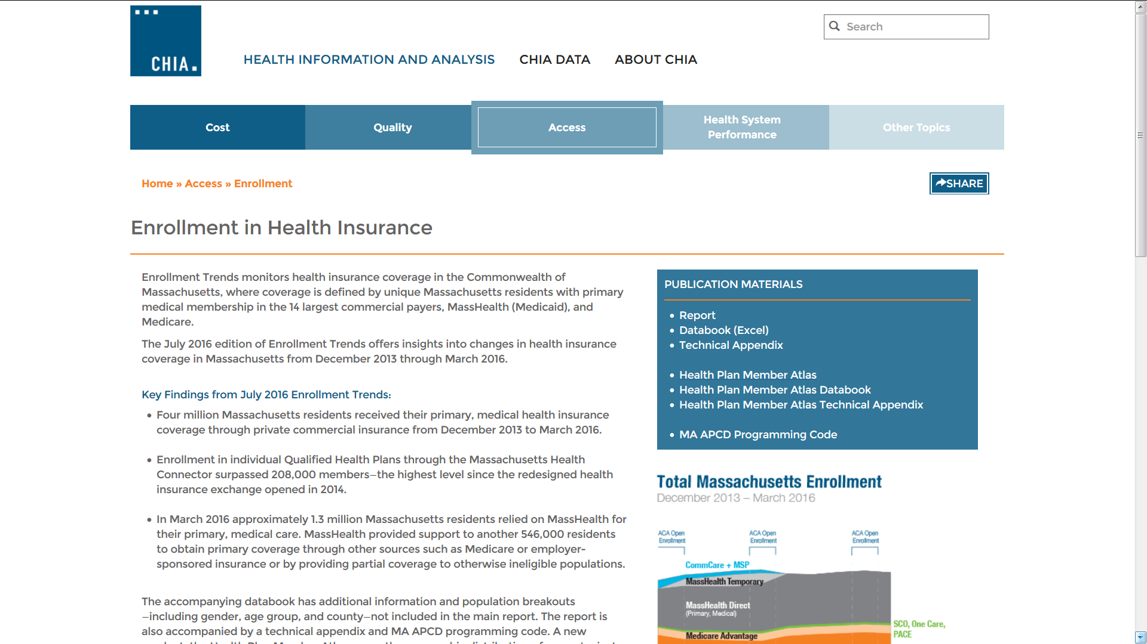
Enrollment Trends Update
The latest Enrollment Trends Report, Databook, Technical Appendix, Programming Code, and Health Plan Member Atlas were released last month: http://www.chiamass.gov/enrollment-in-health-insurance/

Slide 8
Enrollment Trends Update

Slide 9
Enrollment Trends Update

Slide 10
Enrollment Trends Update
Do you have thoughts about the future direction of Enrollment Trends? We want to hear them!
Payer feedback on data collection, data verification, and reporting is always welcome.

Slide 11
Medical Expenditure Trends Update
CHIA’s first Medical Expenditure Trends report (late summer) will profile a limited number of data points.
Data will be sourced either from MA APCD or payer-submitted Financial Control Totals (on a payer-by-payer basis).
Thank you for helping us move towards claims-based reporting from the MA APCD. Payer support is very much appreciated!

Slide 12
Contact Information
For questions about Annual Premiums, Enrollment Trends or Medical Expenditure Trends:
Contact your CHIA liaison and Ashley Storms at ashley.storms@state.ma.us

Slide 13
Next Meetings
September 13, 2016 @ 2:00 pm
October 11, 2016 @ 2:00 pm

Slide 14
Questions?

