Slide 1

Massachusetts All-Payer Claims Database:
Technical Assistance Group (TAG)
January 10, 2017

Slide 2
Agenda
Annual Premiums Data Request, Enrollment Trends and Medical Expenditure Trends Updates
APCD Version 6.0 Submission Guides
FileSecure (SENDS+ Replacement)
Housekeeping Items
Wrap Up

Slide 3

CHIA Reporting Updates:
Annual Premiums Data Request,
Enrollment Trends, and Medical Expenditure Trends
Ashley Storms | Analytic Reporting Manager
Dianna Welch | Principal at Oliver Wyman
January 10, 2017

Slide 4
Annual Premiums Data Request

Slide 5
Annual Premiums Data Request
Overview
Proposed Format Changes
Proposed Content Changes
Timeline

Slide 6
Data Request Overview
Purpose
  To assess contract-membership coverage and cost trends in the Massachusetts commercial market
Data
  Aggregated member months, premiums, and claims data
  Breakouts by Funding Type, Market Sector, Product Type (HMO, PPO, POS, Other), and Benefit Design Type (HDHPs, Tiered Networks, Limited Networks)
  Covers previous three years (2014, 2015, 2016)

Slide 7
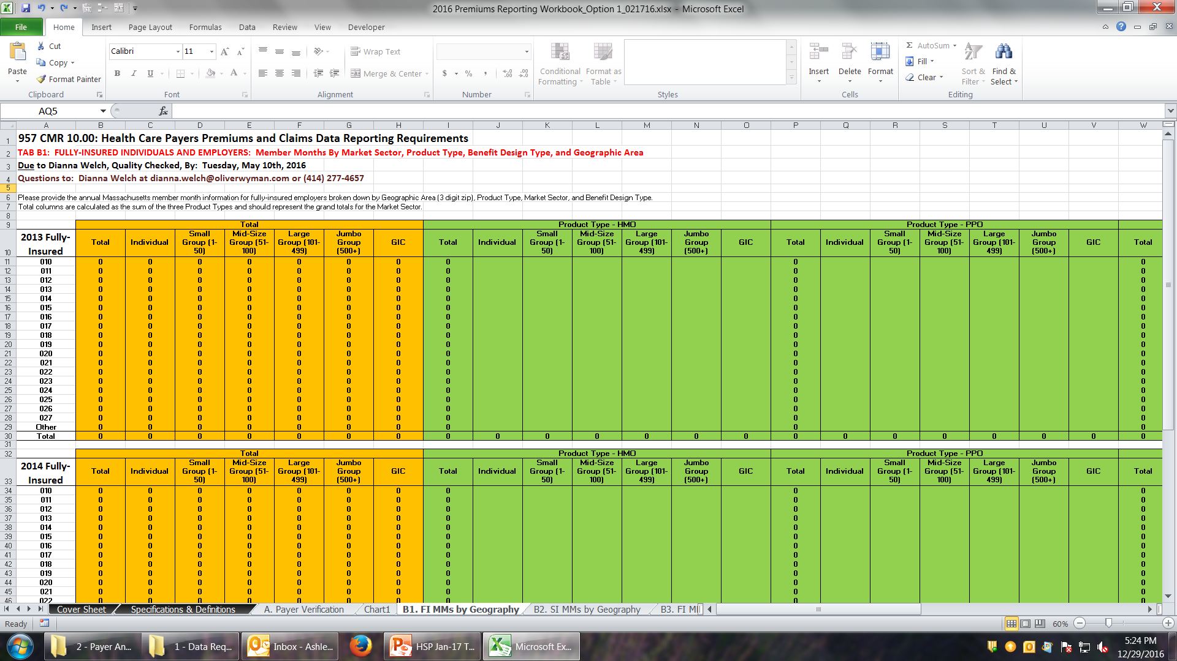
Old Submission Workbook Format

Slide 8
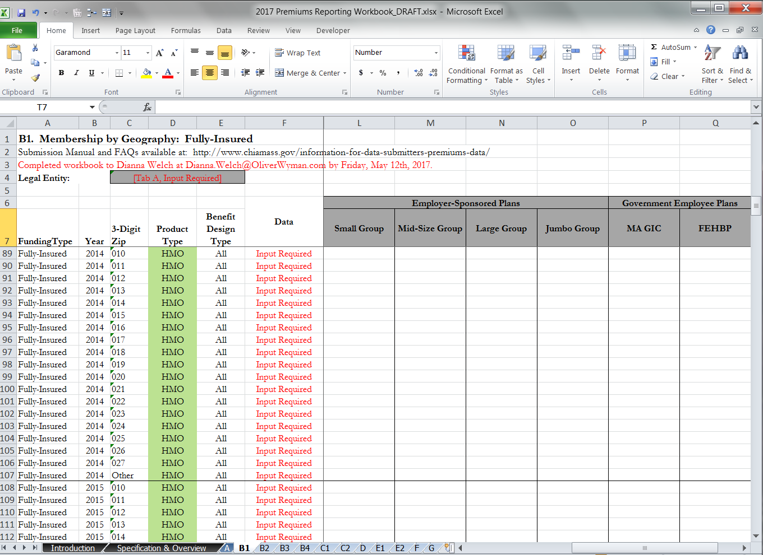
Proposed Submission Workbook Format

Slide 9
Proposed Format Changes
Streamlined “flatter file” workbook submission format
Reduced opportunities for human error (copy/paste errors)
Once implemented, will simplify data entry for submitters
Data is more analytically ready, facilitating faster, more responsive analysis

Slide 10
Proposed Content Changes
Split former “Individual” market sector to report membership and financials for members receiving APTC and Cost-Sharing Reduction subsidies
Direct Purchasers without subsidies [non-Student Health plans]
Direct Purchasers with Advanced Premium Tax Credit (APTC) subsidy
Direct Purchasers with APTC + Cost-Sharing Reduction (CSR) subsidies

Slide 11
Proposed Content Changes
Report as distinct market sectors, as with Group Insurance Commission:
Student Health Plans [reported under “Direct Purchasers”]
Federal Employees Health Benefits Program (FEHBP) [reported under “Government Employee Plans”]

Slide 12
Proposed Content Changes
Add Point-of-Service (POS) Plans as product type
POS plans require members to coordinate care through a primary care provider and use in-network providers for the lowest cost-sharing. As with a PPO plan, out-of-network providers are covered, though at a higher cost to members.

Slide 13
Payer Comment Period
Drafts of the 2017 Annual Premiums Data Request Data Submission Manual and Data Submission Workbook will be distributed to payers within the next week.
Please submit any questions or comments to Ashley Storms at ashley.storms@state.ma.us by January 31st.

Slide 14
2017 Annual Premiums Request Timeline
Jan. 2017 | Feb. 2017 | Mar. 2017 | Apr. 2017 | May 2017 | Jun. 2017 | Jul. 2017
Draft request comment period
 | CHIA distributes 2017 Premiums Request
 |  |  |  | Submissions due
 |  |  |  |  | CHIA distributes 3R Addendum Request
 |  |  |  |  |  | 3R Addendum submissions due

Slide 15
Enrollment Trends

Slide 16
Enrollment Trends Update
Thank you to all who reviewed MA APCD data for the upcoming Enrollment Trends report. Your support is critical for the reporting of accurate and timely enrollment data.
The next Enrollment Trends report will be released in February 2017.

Slide 17
Enrollment Trends Timeline
Oct. 2016 | Nov. 2016 | Dec. 2016 | Jan. 2017 | Feb. 2017
Data collection, profiling, and analysis
Sept. 2016 Member Eligibility file submission
 | Supplemental reports due (identified payers)
 |  | Payers review APCD enrollment counts
 |  |  | Reporting

Slide 18
Medical Expenditure
Trends

Slide 19
Medical Expenditure Trends Update
CHIA is beginning to compare payer-submitted Financial Control Totals to MA APCD membership and financial data for state fiscal year 2015.
We will be in touch with next steps over the coming months.

Slide 20
Contact Information
For Annual Premiums technical questions and data submission:
Contact Dianna Welch at dianna.welch@oliverwyman.com
For other questions about Annual Premiums, Enrollment Trends, or Medical Expenditure Trends:
Contact your CHIA liaison and Ashley Storms at ashley.storms@state.ma.us

Slide 21
Intake APCD Version 6.0
MA APCD Intake Process | Intake 6.0 Timeline
Proposals Shared/Discussed with Carriers | December 2016/January 2017
New sftp testing | January 2017
Draft Submission Guides published | January 2017
Guides Reviewed at Technical Advisory Group | January 2017
Carrier Comment Period | January 2017
New sftp PROD | February 2017
Administrative Bulletin and Guides Adopted | January/February 2017
Development/Testing | February/June 2017
Carrier Testing – new guides and new transmission process | July 2017
Removal of Patient Identifying Information from CHIA internal data | July 2017
MA APCD Intake Version 6 Production | August 2017

Slide 22
APCD Version 6.0 Submission Guides
CHIA is proposing changes that will affect:
• What is submitted
• How it is submitted
• How it is protected
• How historical data will be handled
• How data linkage will be maintained
• How continuity across years will be maintained

Slide 23
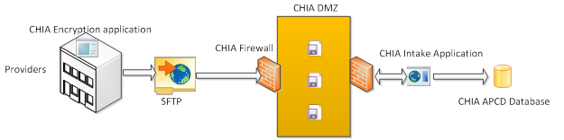
APCD Version 6.0 Intake Changes
How it is submitted: SENDS+/INET Changes
CHIA will be using a new method of sending files which will replace SENDS+/INET. The new method will include a new web portal and be a standard SFTP client for data submitters.
The MA APCD files will be encrypted using AES-256 encryption.

Slide 24
APCD Version 6.0 Intake Changes
How it is protected: Hashing Member Eligibility Data
FileSecure - mask member eligibility patient identifying information before transmission
NIST certified SHA-3 hashing algorithm with a CHIA defined 128-bit SALT
Unique encryption keys built inside the executable to encrypt the file before transmission
Download from the web portal and will reside within the carrier’s local PC or network
Fields to be hashed include SSNs, DOB, member and subscriber names

Slide 25
Upcoming File Submission Deadlines
Files (through December 2016) for the next Risk Adjustment simulation must be in and passed intake edits by 1/31/2017.
Files (through March 2017) for the Risk Adjustment final settlement must be in and passed intake edits by 4/30/2017.
V6 submission guides go into effect in August for July 2017 data and any resubmissions back to October 2013.

Slide 26
DOI Reporting from MA APCD
2016Q2 membership report: discussion with select carriers ongoing to address feedback/questions/issues.
2016Q3 membership reports sent to carriers in November and responses were due 1/6/17.
Parallel submission period until both DOI and carrier agree to move to MA APCD-only membership reporting.

Slide 27
Next Meetings
February 14, 2017 @ 2:00 pm
March 14, 2017 @ 2:00 pm

Slide 28
Questions?

