Slide 1

Massachusetts All-Payer Claims Database:
Technical Assistance Group (TAG)
February 14, 2017

Slide 2
Agenda
APCD Version 6.0
Payer Data Reporting: TME, APM, RP
Annual Premiums Data Request, Enrollment Trends and Medical Expenditure Trends Updates
Housekeeping Items
Wrap Up

Slide 3
Intake APCD Version 6.0
MA APCD Intake Process | Intake 6.0 Timeline
Proposals Shared/Discussed with Carriers | December 2016/January 2017
New sftp testing | January 2017
Draft Submission Guides published | January 2017
Guides Reviewed at Technical Advisory Group | January 2017
Carrier Comment Period | January 2017
New sftp PROD | February 2017
Administrative Bulletin and Guides Adopted | February 2017
Development/Testing | February/June 2017
Carrier Testing – new guides and new transmission process | July 2017
MA APCD Intake Version 6 Production | August 2017

Slide 4
APCD Version 6.0 Submission Guides
One change to the current redline Submission Guides based on carrier feedback and internal CHIA needs:
Member State will remain in the Member Eligibility and Claims files

Slide 5
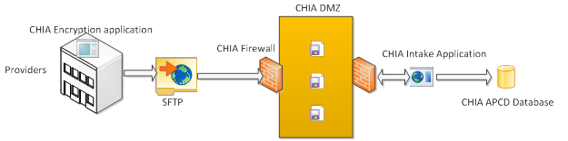
APCD Version 6.0 Intake Changes
How it is submitted: SENDS+/INET Changes
CHIA will be using a new method of sending files which will replace SENDS+/INET. The new method will include a new web portal and be a standard SFTP client for data submitters.
The MA APCD files will be encrypted using AES-256 encryption.

Slide 6
Payer Data Reporting: TME, APM, RP
Deadlines
Deadline | Data File Due
Monday, May 1, 2017 | CY 2015 Final TME (Zip Code + Physician Group)
 | CY 2016 Preliminary TME (Zip Code + Physician Group)
Monday, May 15, 2017 | Supplemental Filing: Prescription Drug Rebates (tentative)
Friday, June 2, 2017 | CY 2015 Final APM (Zip Code + Physician Group)
 | CY 2016 Preliminary APM (Zip Code + Physician Group)
Tuesday, August 1, 2017 | CY 2016 Hospital and Other Provider RP
 | CY 2015 Physician Group RP

Slide 7
Payer Data Reporting: TME, APM, RP
Next Steps
Timeline | Task
Today | Circulate updated Provider OrgID list to payers
Early March | Finalize any changes to data collection requirements
Mid-March | Post updated data specifications
 | Host all-payer webinar on data specs
May 1st | TME Due

Slide 8

CHIA Reporting Updates:
Annual Premiums Data Request,
Enrollment Trends, and Medical Expenditure Trends
Ashley Storms | Analytic Reporting Manager
February 14, 2017

Slide 9
Annual Premiums Data Request

Slide 10
Annual Premiums Data Request Update
Thank you to all who provided feedback on the draft 2017 Annual Premiums Data Request. We are in the process of following up with those payers who asked specific questions.
CHIA will finalize the 2017 Request by the end of February and post to our website.
Participating payers will submit data in May 2017.

Slide 11
Summary of Proposed Changes to 2017 Annual Premiums Data Request
Content:
Split former “Individual” market sector to report membership and financials for members receiving APTC and Cost-Sharing Reduction subsidies
Report Student Health and Federal Employees Health Benefits Program (FEHB) plans as distinct market sectors
Report Point-of-Service (POS) plans as distinct product type
Format:
Streamlined “flatter file” workbook submission format

Slide 12
2017 Annual Premiums Request Timeline
Jan. 2017 | Feb. 2017 | Mar. 2017 | Apr. 2017 | May 2017 | Jun. 2017 | Jul. 2017
Draft request comment period
 | CHIA distributes 2017 Premiums Request
 |  |  |  | Submissions due
 |  |  |  |  | CHIA distributes 3R Addendum Request
 |  |  |  |  |  | 3R Addendum submissions due

Slide 13
Enrollment Trends

Slide 14
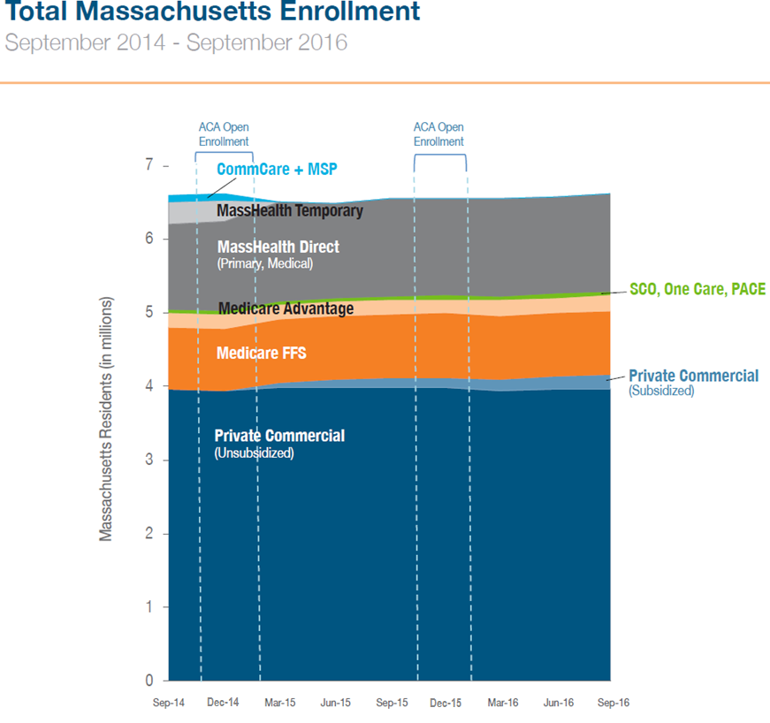
Enrollment Trends Update
The next Enrollment Trends report will be released later this month, profiling enrollment from September 2014 to September 2016 (additional dates available in databook).
Sourced from payers’ September 2015, December 2015, March 2016, and September 2016 Member Eligibility submissions to the MA APCD.
Source: MA APCD, supplemental payer data, Massachusetts Health Connector, CMS

Slide 15
Enrollment Trends Timeline
Feb. 2017 | Mar. 2017 | Apr. 2017 | May 2017 | Jun. 2017 | Jul. 2017
Reporting
 |  | Payers submit March 2017 MA APCD files
 |  |  | Supplemental enrollment reports due (select payers)
 |  |  |  | MA APCD enrollment counts sent to payers
 |  |  |  | Payers review MA APCD enrollment counts
 |  |  |  |  | Reporting

Slide 16
Medical Expenditure
Trends

Slide 17
Medical Expenditure Trends Update
CHIA is beginning to compare payer-submitted Financial Control Totals to MA APCD membership and financial data for state fiscal year 2015.
We will be in touch with next steps over the coming months.

Slide 18
Contact Information
For Annual Premiums technical questions and data submission:
Contact Dianna Welch at dianna.welch@oliverwyman.com
For other questions about Annual Premiums, Enrollment Trends, or Medical Expenditure Trends:
Contact your CHIA liaison and Ashley Storms at ashley.storms@state.ma.us

Slide 19
Housekeeping Items
Files (through March 2017) for the Risk Adjustment final settlement must be in and passed intake edits by 4/30/2017.
RACP Flag Indicator column added to Member Month Tracker reports beginning with October 2016.
V6 submission guides go into effect in August for July 2017 data and any resubmissions back to October 2013.
Next month’s TAG: DOI membership reporting discussion.

Slide 20
Next Meetings
March 14, 2017 @ 2:00 pm
April 11, 2017 @ 2:00 pm

Slide 21
Questions?

