Slide 1

Massachusetts All-Payer Claims Database:
Technical Assistance Group (TAG)
March 21, 2017

Slide 2
Agenda
APCD Version 6.0
File Secure SFTP Project
Payer Data Reporting: TME, APM, RP
Annual Premiums Data Request, Enrollment Trends and Medical Expenditure Trends Updates
Housekeeping Items
Wrap Up

Slide 3
Intake APCD Version 6.0
MA APCD Intake Process | Intake 6.0 Timeline
Proposals Shared/Discussed with Carriers | December 2016/January 2017
New sftp testing | January 2017
Draft Submission Guides published | January 2017
Guides Reviewed at Technical Advisory Group | January 2017
Carrier Comment Period | January 2017
New sftp Pilot | March 2017
Administrative Bulletin and Guides Adopted | February 2017
Development/Testing | February/June 2017
Carrier Testing – new guides and new transmission process | July 2017
MA APCD Intake Version 6 Production | August 2017

Slide 4
CHIA File Secure SFTP PROGRAM
March, 2017

Slide 5
CHIA File Secure SFTP Program: Overview
This program updates the CHIA File Secure process providing a secure, robust, supportable environment for file transfers between:
    CHIA internal customers i.e., Mass Health
    CHIA external customers.. BCBS et al
  Objectives:
    Deploy a new, secure file application for CHIA customers to
    use that meets today’s security standards
    Provide a more robust method of receiving APCD files to reduce/eliminate re-transmissions
    Enable faster processing of APCD data
    Strengthen the CHIA DMZ environment

Slide 6
CHIA File Secure Program: Scope …
What’s in scope for this project ?
    Stand up the infrastructure environment
    Pilot the new environment with up to 4 CHIA customers
  What’s out of scope for this project?
    Hospital Casemix data is not in scope for this project.

Slide 7
CHIA File Secure SFTP Program Requirements:
What are the major requirements to use the new program?
CHIA Customer will need:
An encryption application to encrypt the APCD data file prior to submission. CHIA will provide this.
An SFTP client (like FileZilla, WinSCP, Putty etc.) to transmit the encrypted file. Carrier will need to provide this
NOTE: SENDS+ application is no longer needed. SENDS+ will be retired once all carriers migrate to the new CHIA File Secure SFTP program
CHIA Provides a new URL for customer to upload file

Slide 8
CHIA File Secure SFTP Program…
QUESTIONS??????????????????????

Slide 9
Payer Data Reporting: TME, APM, RP
Deadlines
Deadline | Data File Due
Monday, May 1, 2017 | CY 2015 Final TME
 | CY 2016 Preliminary TME
Friday, June 2, 2017 | CY 2015 Final APM
 | CY 2016 Preliminary APM
Friday, June 16, 2017 (tentative) | Supplemental Filing: CY 2014, 2015, 2016 Prescription Drug Rebates
Friday, June 30, 2017 | CY 2016 Hospital RP
Friday, July 14, 2017 | CY 2016 Other Provider RP
 | CY 2015 Physician Group RP

Slide 10
Payer Data Reporting: TME, APM, RP
Next Steps
Timeline | Task
Week of March 20th | Distribute data specifications
 | Circulate draft specification: Prescription Drug Rebates
Early April (date TBD) | Issue final data specification: Drug Rebates
 | Host all-payer webinar on Drug Rebate data specifications
Month of April | Individual calls with payers
May 1st | CY 2015 Final and CY 2016 Preliminary TME Due

Slide 11

CHIA Reporting Updates:
Annual Premiums Data Request,
Enrollment Trends, and Medical Expenditure Trends
Ashley Storms | Analytic Reporting Manager
March 21, 2017

Slide 12
Annual Premiums Data Request

Slide 13
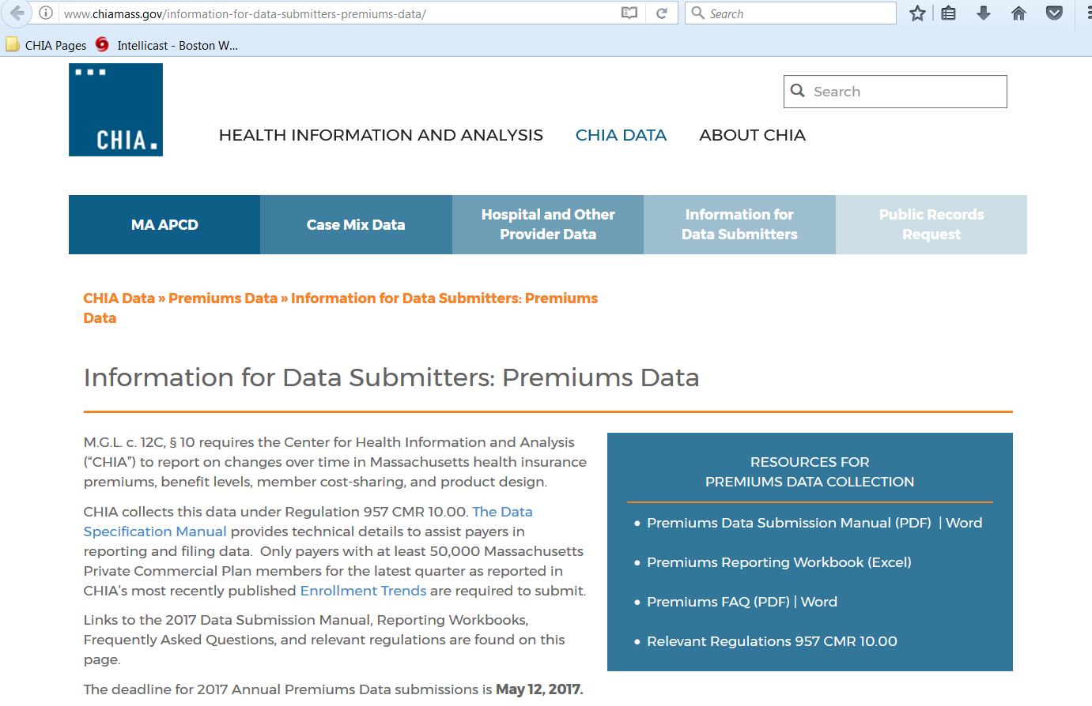
Annual Premiums Data Request Update
All participating payers should have received links to the finalized data request last month. Materials are also available on CHIA’s website at http://www.chiamass.gov/information-for-data-submitters-premiums-data.

Slide 14
Annual Premiums Data Request Update
Completed workbooks (one for each legal entity) should be submitted to Dianna Welch by May 12th, 2017.
CHIA recognizes that payers will not yet know their 2016 “3R” amounts* for merged market enrollees. A smaller “3R Addendum” request will be distributed to payers in June to collect this data.
*Risk adjustment, risk corridors, reinsurance

Slide 15
2017 Annual Premiums Request Timeline
Jan. 2017 | Feb. 2017 | Mar. 2017 | Apr. 2017 | May 2017 | Jun. 2017 | Jul. 2017
Draft request comment period
 | CHIA distributes 2017 Premiums Request
 |  |  |  | Submissions due
 |  |  |  |  | CHIA distributes 3R Addendum Request
 |  |  |  |  |  | 3R Addendum submissions due

Slide 16
Enrollment Trends

Slide 17
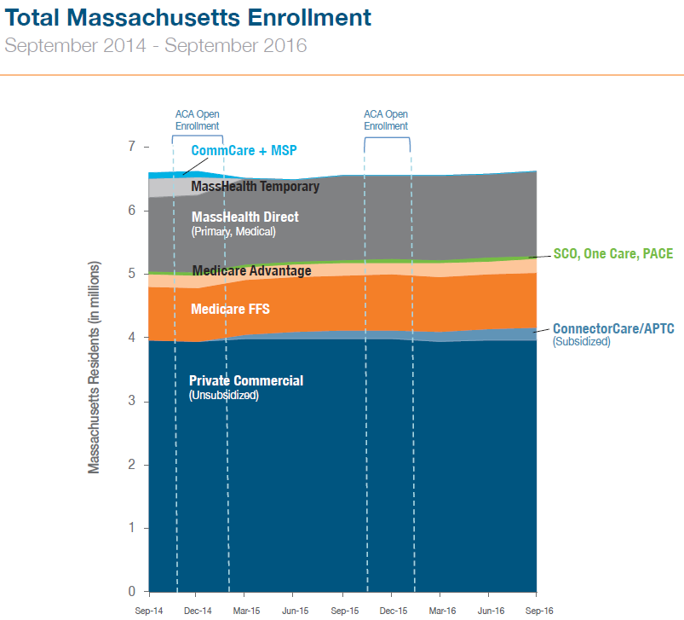
Enrollment Trends Update
Supplemental enrollment data requests for the next round of Enrollment Trends (data through March 15, 2017) will be sent to payers, where relevant, later this month. These will be due in May 2017.
Supplemental enrollment reporting is requested where populations cannot be accurately sourced from the MA APCD.
Source: MA APCD, supplemental payer data, Massachusetts Health Connector, CMS
Find Enrollment Trends reporting on CHIA’s website:
http://www.chiamass.gov/enrollment-in-health-insurance

Slide 18
Enrollment Trends Timeline
Mar. 2017 | Apr. 2017 | May 2017 | Jun. 2017 | Jul. 2017
Reporting
 | Payers submit March 2017 MA APCD files
 |  | Supplemental enrollment reports due (select payers)
 |  |  | MA APCD enrollment counts sent to payers
 |  |  |  | Reporting

Slide 19
Medical Expenditure
Trends

Slide 20
Medical Expenditure Trends Update
CHIA is beginning to compare payer-submitted Financial Control Totals to MA APCD membership and financial data for state fiscal year 2015.
We will be in touch with next steps over the coming months.

Slide 21
Contact Information
For Annual Premiums technical questions and data submission:
Contact Dianna Welch at dianna.welch@oliverwyman.com
For other questions about Annual Premiums, Enrollment Trends, or Medical Expenditure Trends:
Contact your CHIA liaison and Ashley Storms at ashley.storms@state.ma.us

Slide 22
Housekeeping Items
Files (through March 2017) for the Risk Adjustment final settlement must be in and passed intake edits by 4/30/2017.
DOI membership reporting: signoff for Q4 is due 4/21.
V6 submission guides go into effect in August for July 2017 data and any resubmissions back to October 2013.

Slide 23
Next Meetings
April 11, 2017 @ 2:00 pm
May 9, 2017 @ 2:00 pm

Slide 24
Questions?

