Slide 1

Massachusetts All-Payer Claims Database:
Technical Assistance Group (TAG)
February 12, 2019

Slide 2
Agenda
MA APCD – 2019 Submission Guide Changes
Annual Premiums Data Request
TME, APM, Prescription Drug Rebates, RP Reporting
DOI Reporting
Questions

Slide 3
MA APCD 2019 Submission Guide Changes
2019 Draft (Redline) MA APCD Submission Guides posted to CHIA’s website.
Payer feedback due by February 22nd.
Next steps: Administrative Bulletin notification later this month and final versions of the 2019 Submission Guides posted.

Slide 4
MA APCD 2019 Submission Guide Changes
Element | Element Name | Guideline Change | Reason
ME033 | Member Language Preference | Update Format/Length and limit lookup categories to English, Spanish, Other and Unknown | Reduce footprint of patient identifying information
ME135 | Aid Category (MassHealth only) | Remove and update category/threshold/length | Reduce footprint of patient identifying information
MC015, PC015, DC015 | Member State | Remove and update category/threshold/length | Reduce footprint of patient identifying information
MC016, PC016, DC016 | Member Zip Code | Remove and update category/threshold/length | Reduce footprint of patient identifying information

Slide 5
MA APCD 2019 Submission Guide Changes
Why is CHIA removing some patient identifying information from the claims files?
In an effort to make the most robust set of health care data more readily available to the widest audience while complying with applicable state and federal privacy laws, CHIA worked with an external team to assist in the creation of a de-identified data set, as defined by the HIPAA Privacy Rule, from the MA APCD, consisting of medical, pharmacy, dental claims, and insurance eligibility for the majority of the Massachusetts population.
There are various aspects of an individual’s demographics that can distinguish them in a population. Given the level of detail that CHIA is relying upon to receive and share information about individuals, it was deemed that these data elements should not be transferred to CHIA from carriers per the updated 2019 APCD submission guides. CHIA has no plans at this time to collect that data through other means.

Slide 6
MA APCD Intake Version 2019
MA APCD Intake Process | 2019 Intake Timeline
Proposals Shared/Discussed with Carriers | December 2018/January 2019
Draft Submission Guides published | January/February 2019
Guide Changes Reviewed at Technical Advisory Group | January /February 2019
Carrier Comment Period | February 2019
Administrative Bulletin and Guides Adopted | February 2019
Development/Testing | February/July 2019
Carrier Testing – new guides and transmission process changes (if any) | July 2019
MA APCD Intake Version 2019 Production (July 2019 data) | August 2019

Slide 7
2019 Payer Data Reporting
Annual Premiums Data Request
February 12, 2019

Slide 8
Annual Premiums Data Request
Purpose
To assess health insurance coverage and cost trends in the Massachusetts market, based on contract-membership (MA situs)
Data Overview
Aggregate member months, premiums, claims amounts
Breakouts by Funding Type (fully-/self-insured), Market Sector (group size), Product Type (HMO, PPO, POS, Other), and Benefit Design Type (HDHP, Limited Network, Tiered Network)
Covers previous three calendar years (2016, 2017, 2018)

Slide 9
Data Submitters
Per 957 CMR 10.00, only payers with at least 50,000 Massachusetts Private Commercial Plan members are required to submit. For the May 2019 Submission, this includes the following payers:
Aetna AllWays Health Partners BCBSMA BMCHP Cigna Fallon HPHC (incl. HPI) | HNE NHP Tufts Health Plan Tufts Public UniCare United

Slide 10
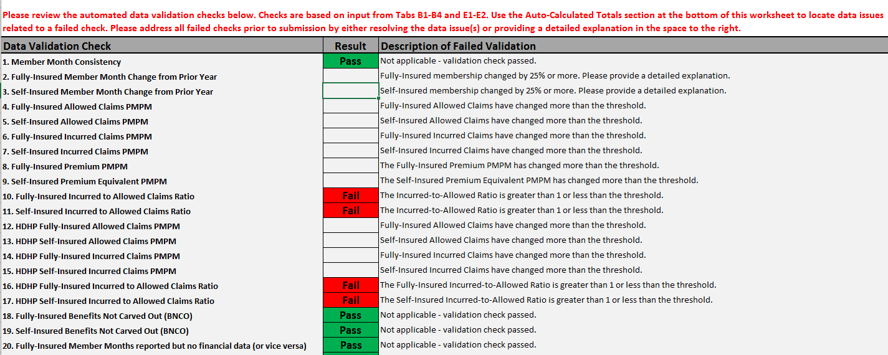
Summary of Proposed Changes
Additions/Alterations
Tab A includes additional data validation checks to identify potential data errors prior to submission.

Slide 11
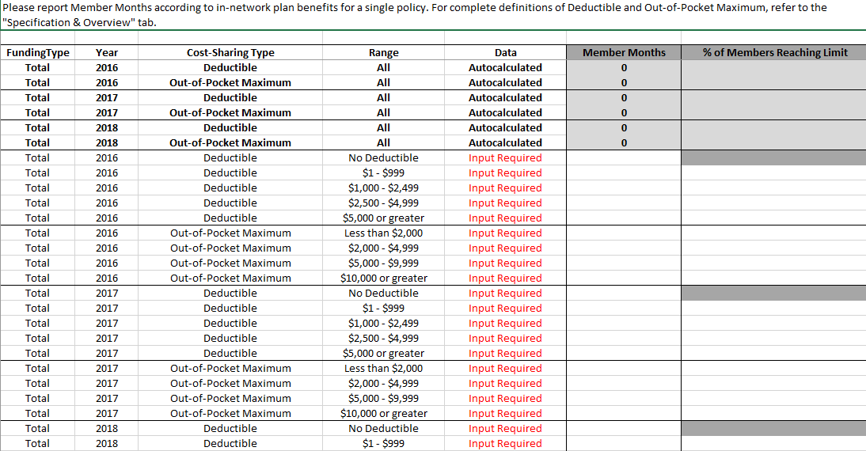
Summary of Proposed Changes
Additions/Alterations
CHIA will collect data on deductible and out-of-pocket spending levels in new “Member Months by Cost-Sharing Limits” tab.

Slide 12
Summary of Proposed Changes
Deletions
• CHIA will no longer collect “Member Months by Rating Size Bands.”
• CHIA will no longer collect Benefit Design Type member months by Geographic Area (3-digit ZIP code).

Slide 13
Next Steps: Payer Review Period
Draft versions of the Data Submission Manual and Reporting Workbook (Excel template) will be distributed to payers following the TAG meeting.
Please reach out to Ashley Storms at ashley.storms@state.ma.us with questions, comments, or concerns. We request that feedback be submitted by Tuesday, February 26th.

Slide 14
Next Steps: Data Submission Period
Finalized Data Submission Manual and Reporting Workbook will be posted on CHIA’s website in March.
Completed Workbooks should be sent to CHIAData@gormanactuarial.com no later than Friday, May 17th.

Slide 15
2019 Annual Premiums Request Timeline
Feb. 2019 | Mar. 2019 | Apr. 2019 | May 2019 | Jun. 2019 | Jul. 2019 | Aug. 2019 | Sept. 2019
Payers review draft materials
 | Final 2019 Premiums Request released
 |  |  | Submissions due
 |  |  |  | Data analysis and reporting
 |  |  |  |  | 2018 Risk Adjustment data due
 |  |  |  |  |  |  | CHIA’s Annual Report

Slide 16
2019 Payer Data Reporting
Total Medical Expenses (TME)
Alternative Payment Methods (APM)
Prescription drug rebates
Relative Price (RP)
February 12, 2019

Slide 17
Total Medical Expenses-Alternative Payment Methods
Combined Filing for 2019
Combining TME and APM submissions into one excel based filing
Payers will now submit one TME-APM file in May. The excel template will include:
    Front tab
    Zip code tab
    Physician group tab
    Summary tabs
The separate June APM filing will be eliminated

Slide 18
Total Medical Expenses-Alternative Payment Methods
Field Additions/Changes
Added a flag to identify providers that are MassHealth Accountable Care Organizations (ACOs)
Updated response options for Insurance Category and Product Type fields
Updated Non-Claims categories in the Physician Group tab
Some questions from previous optional APM supplemental file will be included in the TME-APM template
    Added a field for Risk Type in the Physician Group tab

Slide 19
Total Medical Expenses-Alternative Payment Methods
Data Quality
Adding a front page tab to the TME-APM template with submission overview and data quality questions
Adding summary tabs to automatically calculate aggregate results
    Top level metrics: calculates total expenses, total member months, TME PMPM, etc.
    Trends: shows differences between the two submission tabs, as well as year over year trends

Slide 20
Total Medical Expenses-Alternative Payment Methods
Data Submission Process
Moving from requiring data submissions through INET to Excel submissions through the CHIA Submissions portal
Payers will be able to upload the excel file directly
  CHIA Submissions log-in will be the same credentials used for INET

Slide 21
Payer Filing Schedule
Data Type | Data File Due | Deadline
TME-APM | CY 2017 Final TME-APM | May 17, 2019
 | CY 2018 Preliminary TME-APM | May 17, 2019
Prescription Drug Rebates | CY 2017 Prescription Drug Rebates | June 3, 2019
 | CY 2018 Prescription Drug Rebates | June 3, 2019
Relative Price | CY 2018 Hospital RP | June 28, 2019
 | CY 2018 Other Provider RP | July 12, 2019
 | CY 2017 Physician Group RP | July 12, 2019

Slide 22
Next Steps
Draft versions of the Data Submission Manual and TME-APM Excel template will be distributed to payers following the TAG meeting
Please reach out to Erin Bonney at erin.bonney@state.ma.us with questions, comments, or concerns. We request that feedback be submitted by Tuesday, February 26th.
Final Data Submission Manual and Reporting template will be posted on CHIA’s website in March.
CHIA staff will work with data submitters between now and May to introduce new CHIA submissions platform and provide additional materials

Slide 23
DOI Reporting
Q4 2018 HMO Membership reports and 2018 Annual Membership reports should be distributed by the end of February. Carrier signoff due dates will be communicated when reports are sent.
Claims report in development – code under review and testing is ongoing. Initial reports will be shared with select carriers in the coming weeks.

Slide 24
Next Meetings
March 12, 2019 @ 2:00 pm
April 9, 2019 @ 2:00 pm

Slide 25
Questions?

