Slide 1

Massachusetts All-Payer Claims Database:
Technical Assistance Group (TAG)
March 12, 2019

Slide 2
Agenda
MA APCD – 2019 Submission Guides
TME, APM, Prescription Drug Rebates, RP Reporting
Annual Premiums Data Request
DOI Reporting
Questions

Slide 3
MA APCD 2019 Submission Guide Updates
Final MA APCD 2019 Submission Guides are now available on CHIA’s website (along with the Redline versions).
Administrative Bulletin 19-02 posted to CHIA’s website (highlighting the changes previously discussed and reflected in the 2019 Submission Guides).
Changes effective for July 2019 data due in August.

Slide 4
MA APCD Intake Version 2019
MA APCD Intake Process | 2019 Intake Timeline
Proposals Shared/Discussed with Carriers | December 2018/January 2019
Draft Submission Guides published | January/February 2019
Guide Changes Reviewed at Technical Advisory Group | January /February 2019
Carrier Comment Period | February 2019
Administrative Bulletin and Guides Adopted | February 2019
Development/Testing | February/July 2019
Carrier Testing – new guides and transmission process changes (if any) | July 2019
MA APCD Intake Version 2019 Production (July 2019 data) | August 2019

Slide 5
2019 Payer Data Reporting
Total Medical Expenses (TME)
Alternative Payment Methods (APM)
Prescription drug rebates
Relative Price (RP)
March 12, 2019

Slide 6
TME-APM
Data Specification Updates and Clarifications
  Reported pharmacy dollars should be net of the coverage gap discount
    Applicable only to payers with Medicare business
  ACO Indicator: “0” if provider is not an ACO or payer has no Medicaid business
  Renamed Insurance Category 2 from “Medicaid & Medicaid Managed Care (MCO)” to “Medicaid (e.g., ACO, MCO)”
  Provider List Updates: added NPIs, removed parent to local provider relationships

Slide 7
TME-APM
Data Submission File – Front Tab
  Input required for Contact Name and Email to verify that all data in workbook is correct
  Payer Name in a dropdown list which will automatically populate Payer OrgID
  Please fill out all other questions on the front page completely, including the carved-out benefits table for payers with Commercial Partial business
  Once all tabs are populated and reviewed, click the red “Save and Name” button on front page

Slide 8
TME-APM
Data Submission File – Zip Code and Physician Group Data
  All columns must have a value input
    Files with blank columns will not be saved
  Refer to the reference tables on the last tab for coding values for columns

Slide 9
TME-APM
Data Submission File – Summary Tabs
  The Summary and Summary Trends tabs will automatically generate aggregated spending amounts and data trends using the zip code and physician group tabs
  Tables will not populate until all data is filled out
  These tables should be carefully reviewed prior to data submission and will serve as a replacement for the iNet PDF reports

Slide 10
Prescription Drug Rebates
Data Submission File and Process
Submission process consistent with prior years; Excel templates should be emailed to Erin Bonney by Monday June 3.
  Updates to the template include drop down options for easier completion, additional data check fields added
  New data field for Coverage Gap discount

Slide 11
Relative Price (RP)
Data Submission File and Process
RP will be submitted through INET for CY2018 Hospital, CY2017 Physician, and 2018 Other Provider files
  Data elements consistent with prior years; asking payers to review provider list at beginning of data collection cycle
  Webinar to review calculation of multipliers will be offered on Thursday March 28th, 10am-11am

Slide 12
Payer Filing Schedule
Data Type | Data File Due | Deadline
TME-APM | Provider List Feedback | April 19, 2019
TME-APM | CY 2017 Final TME-APM | May 17, 2019
 | CY 2018 Preliminary TME-APM | May 17, 2019
Prescription Drug Rebates | CY 2017 Prescription Drug Rebates | June 3, 2019
 | CY 2018 Prescription Drug Rebates | June 3, 2019
Relative Price | CY 2018 Hospital RP | June 28, 2019
 | CY 2018 Other Provider RP | July 12, 2019
 | CY 2017 Physician Group RP | July 12, 2019

Slide 13
Next Steps
Webinar information on RP reporting will be distributed to payers following the TAG meeting
Final TME-APM Data Submission Manual, Reporting template, Provider list, and CHIA submissions guide will be posted on CHIA’s website.
Please reach out to Erin Bonney at erin.bonney@state.ma.us with questions, comments, or concerns.

Slide 14
2019 Payer Data Reporting
Annual Premiums Data Request
March 12, 2019

Slide 15
Annual Premiums Data Request
Data Submitters
Per 957 CMR 10.00, only payers with at least 50,000 Massachusetts Private Commercial Plan members are required to submit. For the May 2019 Submission, this includes the following payers:
Aetna AllWays Health Partners BCBSMA BMCHP Cigna Fallon HPHC (incl. HPI) | HNE NHP Tufts Health Plan Tufts Public UniCare United

Slide 16
Annual Premiums Data Request
Data Specification Updates and Clarifications
  Tab C (Member Months by Cost-Sharing Limits):
  Member months should be classified based on the single (individual) policy deductible or out-of-pocket limit, even for members enrolled in family policies
  CHIA is no longer requesting data on the percent of members reaching their deductible or out-of-pocket limits
  All member months reported in tabs B1 – B4 should also be reported on tab C

Slide 17
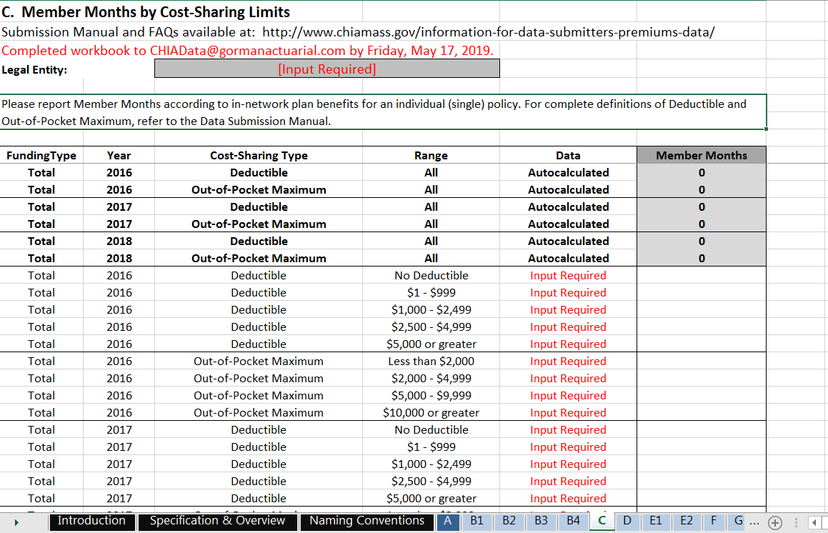
Annual Premiums Data Request
Data Specification Updates and Clarifications
Based on single (individual) policy levels
No longer requesting Percent of Members Reaching Limit

Slide 18
Annual Premiums Data Request
Timeline
Feb. 2019 | Mar. 2019 | Apr. 2019 | May 2019 | Jun. 2019 | Jul. 2019 | Aug. 2019 | Sept. 2019
Payers review draft materials
 | Final 2019 Request released
 |  |  | Submissions due
 |  |  |  | Data analysis and reporting
 |  |  |  |  | 2018 Risk Adjustment data due
 |  |  |  |  |  |  | CHIA’s Annual Report

Slide 19
Annual Premiums Data Request
Next Steps
Finalized Data Submission Manual and Reporting Workbook will be posted on CHIA’s website.
Completed Workbooks should be sent to CHIAData@gormanactuarial.com no later than Friday, May 17th.
Please reach out to Ashley Storms at ashley.storms@state.ma.us with questions, comments, or concerns.

Slide 20
DOI Reporting
Q4 2018 HMO Membership reports sent 3/1. Responses due 4/15.
2018 Annual Membership reports under internal CHIA review and will be distributed shortly.
Claims report in development – code under review and testing is ongoing. Initial reports will be shared with select carriers in the coming weeks.

Slide 21
Next Meetings
April 9, 2019 @ 2:00 pm
May 14, 2019 @ 2:00 pm

Slide 22
Questions?

