Slide 1
Massachusetts All-Payer Claims Database: Technical Assistance Group (TAG)
May 10, 2022

Slide 2
Agenda
MA APCD
Enrollment Trends
DOI Reporting
Questions

Slide 3
MA APCD Intake
All APCD submissions through March 2022 were due by April 30^{th.} This includes any re-submissions.
Please work with your liaison in submitting any overdue files and alert them if you expect any further delays.
Data will be used for Q1 2022 DOI membership, Mar-2022 bi-annual claims utilization and quarterly Enrollment Trends reporting.
CHIA is revisiting Medical Claim versioning methods with select payers. We’ll reach out when we have examples to share with each company.

Slide 4
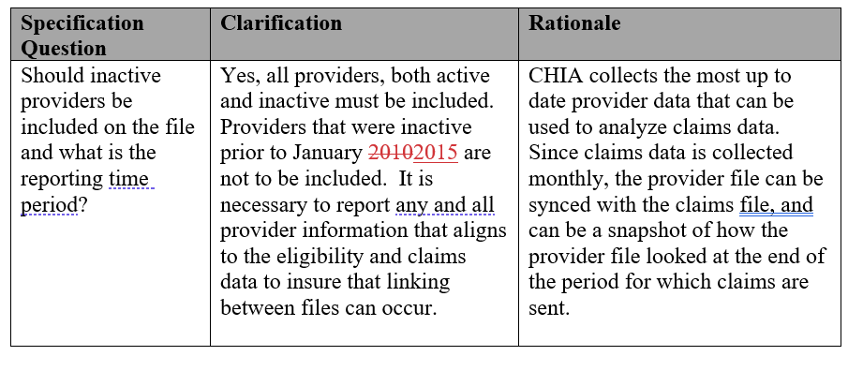
MA APCD – 2022 Provider Submission Guide Update (Page 9)

Slide 5
MA APCD – 2022 Pharmacy Claims Submission Guide Update (Page 21)

Slide 6
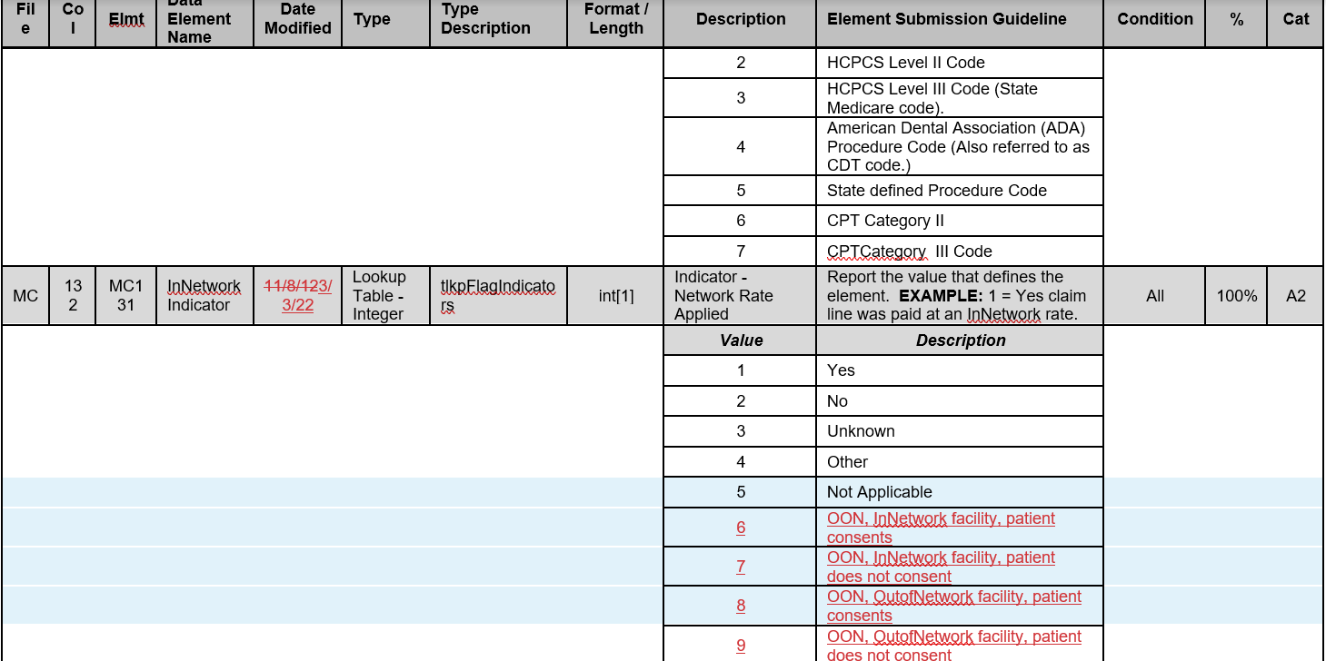
MA APCD – 2022 Medical Claims Submission Guide Update (Page 48)

Slide 7
MA APCD Intake Version 2022
Final versions of the updated submission guides should be posted to CHIA’s website this week. No change from draft versions.
APCD submitters may send test files in July 2022. Please work with your liaison if you want to do this.
Production files with submission guide changes are due by 8/31 for July 2022 data.
There is no change to the version field in the header record – it remains ‘2019’.

Slide 8
Enrollment Trends Update
The next Enrollment Trends reporting cycle will be based on data through March 2022 and is scheduled to be published in August 2022.
CHIA requested Supplemental Data from certain payers last month. The due date for Supplemental Data through March 2022 is May 13, 2022.
Payers will be sent MA APCD-sourced enrollment counts for review in June 2022.
For questions on Enrollment Trends: Contact your CHIA liaison.

Slide 9
Enrollment Trends Timeline
Apr 2022 | May 2022 | Jun 2022 | Jul 2022 | Aug 2022
Payers submit March 2022 MA APCD files
 | Supplemental enrollment reports due (select payers)
 |  | MA APCD enrollment counts sent to payers for review
 |  |  | Reporting

Slide 10
DOI Reporting
Q1 2022 HMO Membership reports will be sent later this month.
CY2021 Membership reports were sent on 3/16. Signoff was due by 4/29.
Claims/Utilization:
Reports using data through September 2021 were sent on 3/7. Signoff was due by 5/7.
Reports using data through March 2022 are in process.
We continue to meet with select payers to reconcile differences in certain report categories.

Slide 11
Next Meetings
June 14, 2022 @ 2:00 pm
July 12, 2022 @ 2:00 pm

Slide 12
Questions?

