Slide 1
MA Center for Health Information & Analysis
MA APCD User Workgroup
December 20, 2016

Slide 2
Agenda
Announcements
  Updates on FY15 Case Mix release
What’s Coming in 2017
Questions Answered by CHIA
Q&A

Slide 3
MA APCD Release 5.0
Application forms are posted on the APCD website: http://www.chiamass.gov/application-documents\
Data is ready for release now
Release documentation (including full data specifications and release documentation) has been posted to the APCD website: http://www.chiamass.gov/ma-apcd/

Slide 4
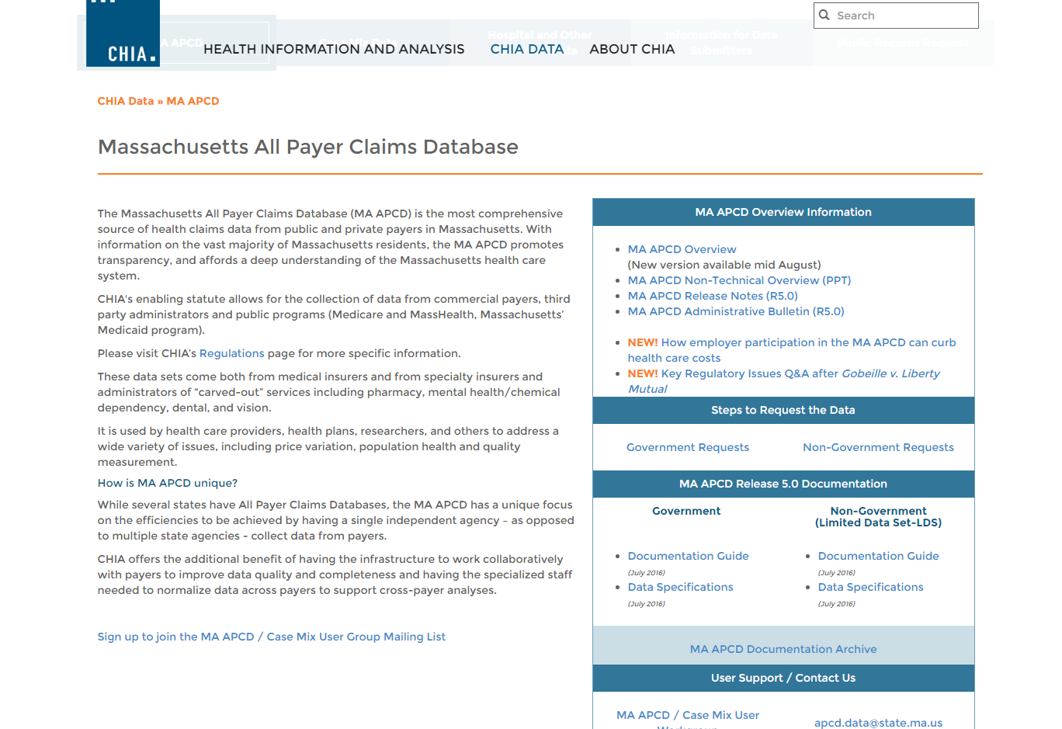
Release Documentation

Slide 5
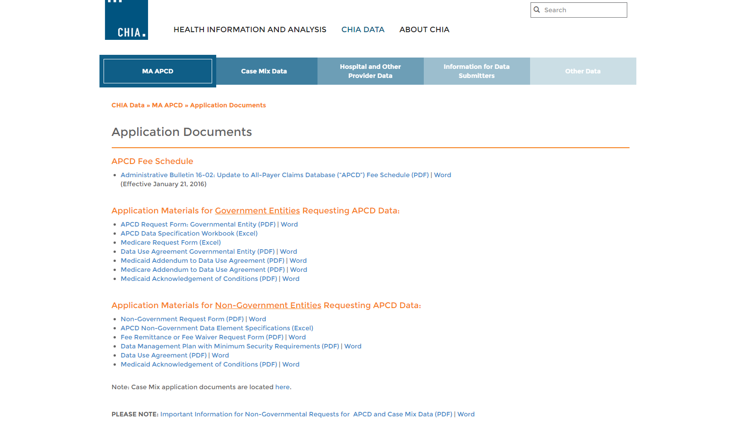

Revised Application Forms
Posted here: http://www.chiamass.gov/application-documents

Slide 6
Case Mix FY15 Release Update
Inpatient Data (HIDD) is going out the door now
Emergency Department (ED) fulfillment began earlier this month and is ongoing
Outpatient Observation (OOD) release date is still TBD
Apply for all files now and we will fulfill them as they become available.

Slide 7
Application Reminders
Don’t forget to upload CVs/Resumes for the “core project team” (even if you’ve previously been approved for data)
Don’t forget to upload IRB documentation (even if it’s been determined that you are not subject to IRB review)
Don’t forget to upload your Research Methodology, per Section II of the application (recently updated). This is required for ALL applicants.

Slide 8
Application Reminders
FEE WAIVERS
Supporting Documentation: If the waiver you are requesting requires additional documentation, don’t forget to include this in your IRBNet package.
(incudes waivers for financial hardships and projects purporting to evaluate or improve a current state initiative)
Financial Hardships: We expect applicants will have made an attempt to find funding, rather than relying on receiving a financial hardship waiver.

Slide 9
Coming in 2017
Applicants will now be able to request future years of data (for specific projects)
Change will be made to the application forms around January 1st
Applies to both APCD and Case Mix
Fees will still apply
Future years of data for these approved projects will not require repeat Data Privacy Committee (DPC) or Data Release Committee (DRC) review
Exception: if the application is later revised/amended and the committees need to re-determine if the public interest or minimum necessary data requirements are still met

Slide 10
Coming in 2017 cont’d
Fee Schedule Changes
Expecting new Administrative Bulletins for both APCD and Case Mix fees to be published effective February 1st
No changes to the actual fees
Revised Fee Waiver criteria
Revised definitions (i.e. “multiple use”, “reseller”, etc.)
Pay per year of data (rather than per extract)
[**applies to Case Mix only**]

Slide 11
Coming in 2017 cont’d
Fee Schedule Changes
CHIA will send out an eblast in January announcing the posting of the new Admin Bulletins to the CHIA website
We will be answering any questions people have about the new fee schedules at the January Case Mix User Workgroup and the Februrary APCD User Workgroup
(will be asking for questions to be sent in ahead of time)

Slide 12
QUESTIONS?

Slide 13

Question: How Do I Determine Provider Networks Using the APCD Limited Data Set?
Answer: In a recent paper, Keith Marzilli Ericson and Amanda Starc used the Massachusetts APCD for “Measuring Consumer Valuation of Limited Provider Networks”* to garner network attributes not readily available in the APCD. They linked the unencrypted National Service Provider Identifier (MC026) to several external sources and also used physician name and service provider location ZIP code from those external sources to link to an additional source.
External Sources for Network Attributes
American Medical Association Physician Masterfile Data
American Hospital Association Data
Massachusetts Health Quality Partners (MHQP) Data, as MHQP’s Director of Analytic Applications states, “aggregates providers into practices, practices into medical groups and medical groups into networks”.
* Ericson KM, Starc A: Measuring Consumer Valuation of Limited Provider Networks. American Economic Review, Vol 105, Issue 5, May 2015, Pages 115-119

Slide 14
Question: How Do I Determine Provider Networks Using the APCD Limited Data Set?
A follow-up related question: How well populated is APCD Health Care Home National Provider ID (ME036)?
Answer: ME036 is reported when ME035 (Health Care Home Assigned Flag) is ‘Yes’. For MA residents, 618,510 distinct MEIDs (3.8% of the records) have a ‘Yes’ response. For these records flagged as ‘Yes’, ME036 is populated 41.8% of the time for 259,006 distinct MEIDs.

Slide 15


Question: How Reliable is MC023 (Discharge Status) and Discharge Status in Case Mix Data? Both calendar year 2015 MA APCD and fiscal year 2015 Case Mix Data show higher than inpatient previous years.
Answer: Massachusetts death certificate data reported by CDC’s National Center for Health Statistics corroborates an increase in deaths in 2015. Both the male and female death rates reached a 5 year high in 2015. By place of death, the largest increases occurred in Hospice facilities.
5-Year Change in Massachusetts Age-Adjusted Death Rate per 100,000 population by Gender*
5-Year Change in Number of Massachusetts Deaths by Place of Death*
Place of Death | 2011 | 2012 | 2013 | 2014 | 2015
Decedent's home | 13,818 | 14,369 | 14,934 | 14,942 | 14,423
Hospice facility | 123 | 153 | 172 | 871 | 2,630
Medical Facility - Dead on Arrival | 530 | 624 | 617 | 641 | 603
Medical Facility -Inpatient | 16,624 | 16,226 | 16,279 | 16,427 | 16,984
Medical Facility – Outpatient or ER | 3,958 | 3,725 | 4,015 | 4,174 | 4,425
Medical Facility – Status unknown | suppressed | suppressed | suppressed | suppressed | suppressed
Nursing home/long term care | 15,893 | 15,333 | 15,593 | 15,345 | 16,103
Other | 2,749 | 2,706 | 2,932 | 2,784 | 2,631
Place of death unknown | 15 | 41 | 25 | 16 | suppressed
*Source: Centers for Disease Control and Prevention, National Center for Health Statistics. Underlying Cause of Death 1999-2015 on CDC WONDER Online Database, released December, 2016.

Slide 16

Question: I am applying for the APCD LDS. What is the Quality of the Medical Claims Service Provider Specialty Data?
Answer: In APCD Release 5.0, for the highest version paid claims, the service provider specialty is populated 68% of the time for 853,988,145 claim lines. Approximately 56% of the populated specialty codes use either Medicare’s 2-digit specialty code or the more specific provider taxonomy code and 40% of the populated codes have values in the carrier specific lookup table.
Due to the lack of full complete standardization in the specialty codes and to the 32% missing, applicants approved to use data requiring specialty codes sometimes request the Unencrypted Service Provider NPI (MC026) to link the CMS NPI Registry which is a free downloadable directory of all active National Provider Identifier (NPI) containing 329 fields which include the provider's name, credentials, multiple specialty (taxonomy) fields and multiple practice locations.
CMS has available the following of regularly updated file types:
    Full Replacement Monthly NPI File
    Full Replacement Monthly NPI Deactivation File
    Weekly Incremental NPI Files
Current APCD filing specifications ask that carriers submit standardized taxonomy instead of carrier specific codes for service provider specialty.

Slide 17


Question: Falls are one of the leading causes of death. I want to analyze the cost of outpatient rehabilitation care for falls. What is the availability of E-Codes in APCD Release 5?
Answer: When an injury is the result of external cause (and not caused by illness or disease) an external cause (E-code) is used in combination with the injury or poisoning diagnosis code.
APCD Release 5.0 contains approximately 50 million highest version claim lines with a principal ICD-9-CM diagnosis code within the range of injury and poisoning (ICD-9-CM 800-999). Approximately 1% of those claims have a code in the dedicated E-code field. The Massachusetts case mix data continues to have one of the highest E-coding rates in the nation, over 95% E-coded for injury diagnosis.

Slide 18

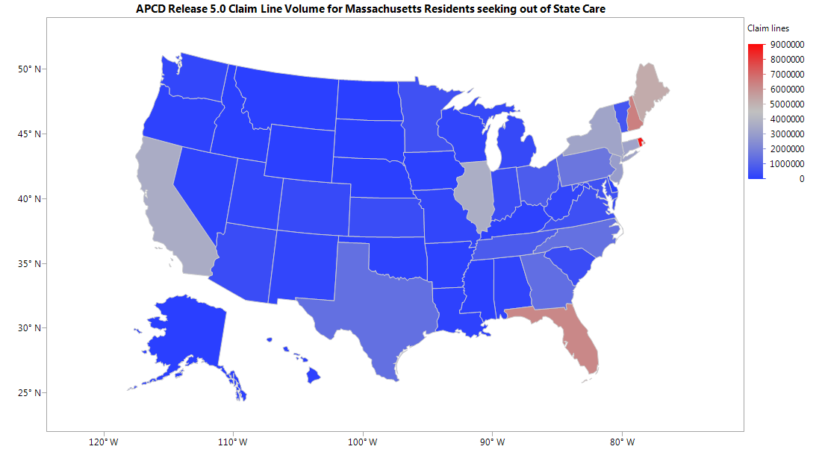
Question: Should I use APCD or Case Mix data for inpatient analysis?
Answer: Approximately 80% of claims in the MA APCD are for outpatient care. The APCD Limited Data Set is packaged as a product which does not allow applicants to request data by type of care setting. If your focus is on acute care, the inpatient case mix data would have the advantage of including all payers (public and private), high quality E-coding, several versions of high quality DRG coding, and high quality race and ethnicity data. However, if your focus is on the non-Medicare population and includes a component looking at care transitions, transfers that interstate transfers for Massachusetts residents that fall of the radar in case mix data can be seen in the APCD. While 96% of claim lines are for care provided in Massachusetts, 4% of care for MA residents is received in other states (see map below).
APCD Release 5.0 Claim Line Volume for Massachusetts Residents Receiving Out of State Care

Slide 19
Questions?
Questions related to APCD: (apcd.data@state.ma.us)
Questions related to Case Mix: (casemix.data@state.ma.us)
REMINDER: Please include your IRBNet ID#, if you currently have a project using CHIA data

Slide 20
Call for Topics and Presenters
If there is a TOPIC that you would like to see discussed at an MA APCD or Case Mix workgroup in 2017, contact Adam Tapply [adam.tapply@state.ma.us]
If you are interested in PRESENTING at an MA APCD or Case Mix workgroup in 2017, contact Adam Tapply [adam.tapply@state.ma.us]
  You can present remotely from your own office, or in-person at CHIA.

