Slide 1
MA Center for Health Information & Analysis
MA APCD User Workgroup
February 28, 2017

Slide 2
Agenda
Announcements
Overview of Admin Bulletin 16-13 (Updated APCD Fee Schedule)
New Data Release Policies
Overview of New/Revised Application Forms
User Questions
Q&A

Slide 3
MA APCD Release 5.0
Application forms are posted on the APCD website: http://www.chiamass.gov/application-documents\
Data is ready for release now
Release documentation (including full data specifications and release documentation) has been posted to the APCD website: http://www.chiamass.gov/ma-apcd/

Slide 4
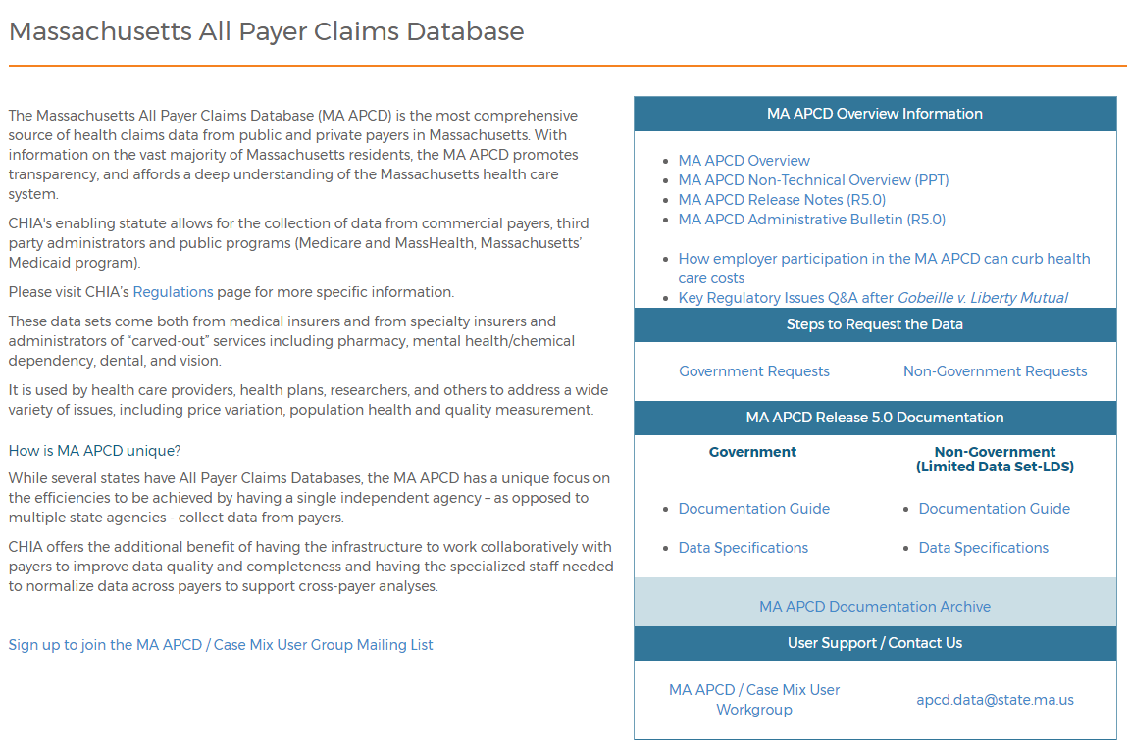
Release Documentation

Slide 5
Support for Old APCD Releases
Due to the amount of IT resources necessary to store and maintain old APCD Releases (Release 3.0 and earlier), our ability to assist users with those datasets is limited
  The data is no longer available, so we can’t give you additional data from those datasets
  If you’re seeing confusing data, or want to confirm what you’re seeing isn’t an anomaly, our support team isn’t able to go into the dataset and confirm what you’re seeing is correct or not (unless it’s a previously identified issue)

Slide 6
Administrative Bulletin 16-13
Update to the APCD Fee Schedule (effective 2/1/2017)
Key Changes:
    Definitions have been simplified / brought into line with the Case Mix Fee Schedule (also updated effective 2/1)
    Researchers are required to demonstrate that the funding source for their research does not cover the cost of the data to be eligible for a full or partial fee waiver.
    Resellers have been clearly defined and may only qualify for a partial fee waiver if they are nonprofits and can demonstrate their project, report or product is in beta stage and not generating any income.
Link: http://www.chiamass.gov/assets/docs/g/chia-ab/16-13.pdf

Slide 7
Revised Data Release Policy
Applicants can now request FUTURE YEARS OF DATA
Initial project requires Data Privacy Committee and Data Release Committee review
Additional years (up to 5 years) or release versions of data will be released upon availability and the Recipient’s completion of a Certificate of Continued Need (Exhibit B of the revised DUA)
No additional review required for these additional years of data
Normal data fees still apply

Slide 8
Revised Data Release Policy
Applicants will now be able to request authorization to use the data they have received for one project for SUBSEQUENT PROJECTS
Must complete new application for subsequent project – will require Data Privacy Committee and Data Release Committee review
If approved, will not require a new extract – can begin using data already in possession immediately (upon execution/amendment of DUA)
Normal data fees still apply

Slide 9
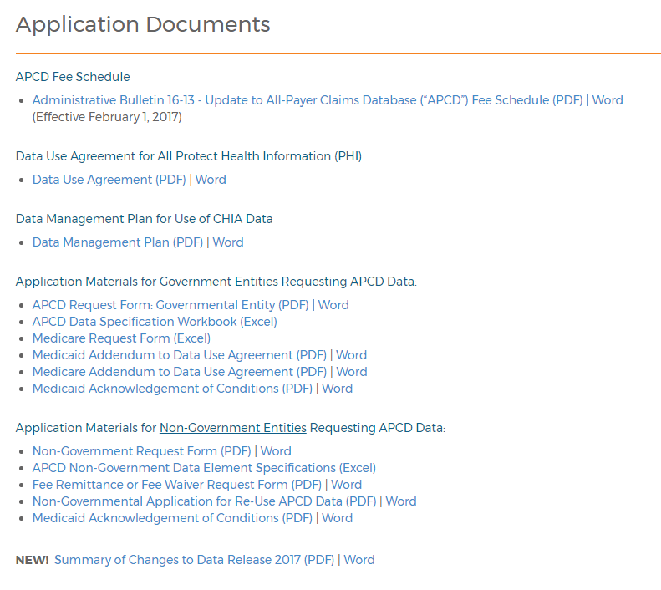

Revised Application Forms
Posted here: http://www.chiamass.gov/application-documents

Slide 10
Which forms have changed?
Revised Data Use Agreement: http://www.chiamass.gov/assets/Uploads/data-apps/Non-Government-Data-Use-Agreement.pdf
  One DUA for both Gov’t and Non-Gov’t applicants
Revised Non-Gov’t APCD Request Form: http://www.chiamass.gov/assets/Uploads/data-apps/Non-Government-APCD-Application.docx
NEW Application for Re-Use of APCD Data: http://www.chiamass.gov/assets/Uploads/data-apps/Non-Government-Re-Use-APCD-Application.docx
**Similar changes have been made to the Case Mix forms**

Slide 11
Application Reminders
Applicants should not use “de-identified” in their application in referring to the data received from CHIA. CHIA datasets are not de-identified as the term is defined by HIPAA.
  Applicants have done this recently in their IRB reviews and research methodologies
Make sure you are requesting ALL the data you need. We have received several amendment requests in the past couple months because applicants didn’t check the box(es) for data they needed for their project.

Slide 12
QUESTIONS?

Slide 13
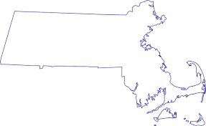

Question: Why does my count of Distinct Member Link EIDs (MEIDs) exceed the Massachusetts 2010 Census
Population of 6,547,629 and Massachusetts 2016 Census Estimate of 6,811,779?
Answer: An unfiltered count of distinct MEIDs for each in the Member Eligibility file averages 10 million records.
However, when the data is filtered by Massachusetts residency (standardized_memberstateorprovince = 'MA' ), eliminate beneficiaries who have died (date of death is null), limit to those who have medical coverage (medicalcoverage = '1') with a clearly insurance product (insurancetypecodeproduct <> '‘), and a geocoded address (standardized_membercounty <> '' ) and who are under 65 (memberage <65), you will see a close alignment with the census population. The alignment improves after adjusting for the Census count of remaining uninsured population under age 65. The margin of percent difference between the Census County populations ranges from +3.8% to -5.7% (see Table below).
Comparison of Census 2010 County Population to APCD Member Eligibility Distinct MEIDs Age <65 Years with Select Filters
COUNTY | Total Massachusetts 2010 Census Population | Census Population Age=>65 | Census Population Age<65 | APCD Year 2011 | APCD Year 2012 | APCD Year 2013 | APCD Year 2014 | APCD Year 2015 | Percent Diff 2010 Census and APCD Year 2011 | Census 2010 Percent Population Age<65 Uninsured | Percent Difference After Adjusting for Census 2010 Percent Age<65Uninsured
Barnstable | 215,888 | 53,879 | 162,009 | 171,728 | 174,589 | 172,787 | 173,871 | 174,594 | 6% | 6% | 0.0%
Berkshire | 131,219 | 24,386 | 106,833 | 110,283 | 112,993 | 113,235 | 114,088 | 114,311 | 3% | 3.9% | -0.7%
Bristol | 548,285 | 77,879 | 470,406 | 470,063 | 480,034 | 480,061 | 487,554 | 494,269 | 0% | 4.5% | -4.6%
Dukes | 16,535 | 2,699 | 13,836 | 15,300 | 16,156 | 16,133 | 16,431 | 16,702 | 11% | 9.9% | 0.7%
Essex | 743,159 | 105,083 | 638,076 | 680,365 | 700,462 | 700,727 | 713,432 | 721,717 | 7% | 4.4% | 2.2%
Franklin | 71,372 | 10,878 | 60,494 | 62,967 | 65,619 | 65,460 | 66,596 | 66,845 | 4% | 3.9% | 0.2%
Hampden | 463,490 | 65,745 | 397,745 | 424,230 | 434,563 | 440,508 | 448,160 | 454,183 | 7% | 4.6% | 2.1%
Hampshire | 158,080 | 20,022 | 138,058 | 125,268 | 135,649 | 136,342 | 134,182 | 133,838 | -9% | 3.6% | -5.7%
Middlesex | 1,503,085 | 197,015 | 1,306,070 | 1,360,781 | 1,406,270 | 1,405,090 | 1,432,748 | 1,447,816 | 4% | 3.7% | 0.5%
Nantucket | 10,172 | 1,227 | 8,945 | 10,054 | 10,679 | 10,862 | 11,477 | 12,052 | 12% | 8.6% | 3.8%
Norfolk | 670,850 | 97,304 | 573,546 | 604,694 | 617,916 | 618,943 | 628,638 | 633,948 | 5% | 2.5% | 2.9%
Plymouth | 494,919 | 68,846 | 426,073 | 441,279 | 448,599 | 447,708 | 453,257 | 458,230 | 4% | 3.8% | -0.2%
Suffolk | 722,023 | 75,726 | 646,297 | 676,431 | 714,838 | 719,437 | 746,100 | 775,051 | 5% | 5.4% | -0.7%
Worcester | 798,552 | 102,035 | 696,517 | 724,426 | 741,668 | 739,089 | 747,572 | 750,556 | 4% | 3.7% | 0.3%
Population | 6,547,629 | 902,724 | 5,644,905 | 5,877,869 | 6,060,035 | 6,066,382 | 6,174,106 | 6,254,112

Slide 14
Question: Which organizations are with the Medicaid/Health Safety Net Indicator and do they include Medicaid Managed Care Organizations?
Answer: Eleven organizations have the Medicaid/HSN indicator and they do include
Medicaid Managed Care Organizations (see below).
APCD Release 5.0 Member Eligibility File Organizations with True in Medicaid/HSN Indicator Field
OrgID | OrganizationName | INSURANCE TYPE CODE PRODUCT
11541 | Health Safety Net | Health Safety Net Trust Fund
3156 | MassHealth | Medicaid
3505 | Boston Medical Center HealthNet Plan | Medicaid
4962 | Network Health | Medicaid
10920 | Celticare of Massachusetts | Medicaid
296 | Fallon Community Health Plan | Medicaid Managed Care Organization
301 | Health New England, Inc. | Medicaid Managed Care Organization
3735 | Neighborhood Health Plan | Medicaid Managed Care Organization
4962 | Network Health | Medicaid Managed Care Organization
10920 | Celticare of Massachusetts | Medicaid Managed Care Organization
12122 | Fallon Total Care | Other
296 | Fallon Community Health Plan | Senior Care Option
8647 | Tufts Health Plan | Senior Care Option
9913 | Senior Whole Health | Senior Care Option
10926 | United Healthcare Insurance Company - Medicare Advantage | Senior Care Option

Slide 15
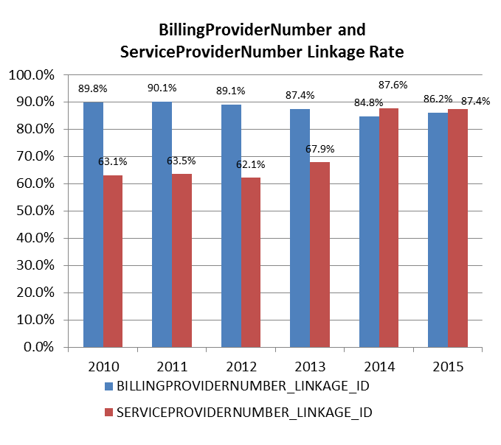
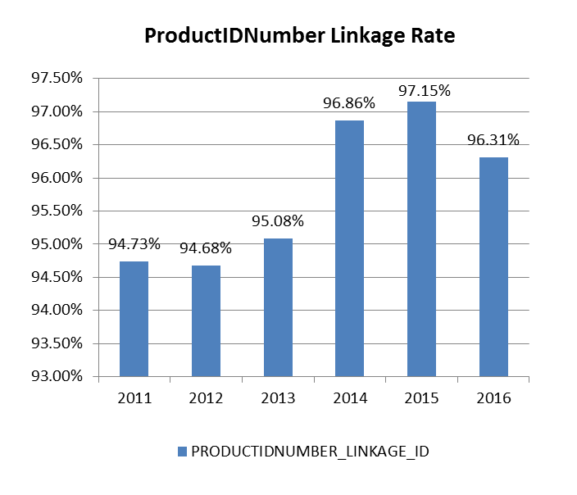
Question: Which Medical Claims Linking ID has the highest rate (Billing Provider or Service Provider) and what is the linkage rate of the ProductID ?
Answer: From 2010 to 2013 the Billing Provider had a higher linkage rate than
the service provider. In 2014 the Service Provider linkage rate increased to over 85%.
The Product ID has consistently had an over 90% linkage rate.
SERVICEPROVIDERNUMBER_LINKAGE_ID (MC Link to PV)
BILLINGPROVIDERNUMBER_LINKAGE_ID (MC link to PV)
PRODUCTIDNUMBER_LINKAGE_ID (MC link to PR)

Slide 16
Questions?
Questions related to APCD: (apcd.data@state.ma.us)
Questions related to Case Mix: (casemix.data@state.ma.us)
REMINDER: Please include your IRBNet ID#, if you currently have a project using CHIA data

Slide 17
Call for Topics and Presenters
If there is a TOPIC that you would like to see discussed at an MA APCD or Case Mix workgroup in 2017, contact Adam Tapply [adam.tapply@state.ma.us]
If you are interested in PRESENTING at an MA APCD or Case Mix workgroup in 2017, contact Adam Tapply [adam.tapply@state.ma.us]
  You can present remotely from your own office, or in-person at CHIA.

