Slide 1
Apcd user workgroup
Adam Tapply (Manager of Accounts)
Sylvia Hobbs (Manager of User Support)
July 23, 2019
CENTER FOR HEALTH INFORMATION AND ANALYSIS

Slide 2
Agenda
Announcements:
  APCD Release 8.0 Updates
  FY18 Case Mix Release Updates
Application Reminders
Compliance Reminders
User Support Questions
Q&A

Slide 3
MA APCD Release 7.0
  Available NOW
  Encompasses data from January 2013 – December 2017 with six months of claim runout (includes paid claims through 6/30/18)
  Release Documentation and Data Specifications have been posted to the website: http://www.chiamass.gov/ma-apcd/
  Apply now by listing 2017 (and any other years you want from Release 7.0) in the “Years Requested” section of the current application form
  Available here: http://www.chiamass.gov/application-documents

Slide 4
MA APCD Release 8.0
  Available Winter 2019/2020
  **Please hold off on submitting Release 8.0 requests for now**
  Will encompasses data from January 2014 – December 2018 with six months of claim runout (includes paid claims through 6/30/19)
  Will be linkable to Release 7.0 via crosswalk
  Additional information on highlights and enhancements will be presented in future APCD User Workgroups.

Slide 5
Case Mix FY18 Release
*CURRENT* RELEASE TIMEFRAMES FOR EACH FILE:
  Inpatient (HIDD)
  July (END OF JULY)
  Emergency Department (ED)
  August
  Outpatient Observation (OOD)
  September

Slide 6
Case Mix FY18 Release
REPEAT APPLICANTS:
  For those applicants with previously approved projects who indicated they would like to receive data annually, we are currently accepting Certificates of Continued Need and Compliance (Exhibit B of your DUA)
  After receiving this, we will send you an invoice for the FY18 data and release data to you once payment is received and the data is ready.
  If you are making any changes to your project, you must go through the amendment process first.

Slide 7
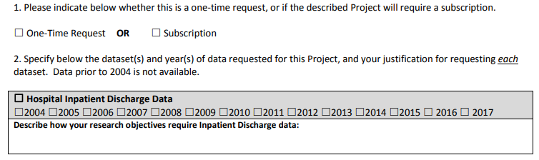
Case Mix FY18 Release
NEW APPLICANTS / NEW PROJECTS:
  We will continue to accept new applications on a rolling basis.
  If you are requesting FY18 data, just click the box for “Subscription” on p. 3 of the application form:

Slide 8
Application reminders

Slide 9
Top Application Reminders
  Answer EVERY question on the Application form and Data Management Plan.
  Remember to submit your Research Methodology or IRB Protocol (not just the IRB approval letter) (per Section IV in the Application form).
  Make sure your IRB approval is up-to-date. If it’s expiring soon, let us know of your plans to make sure it’s renewed.
  Submit Data Management Plans for any organization that will be storing CHIA data (including contractors).
  Provide as much information on proposed linkages as possible (per Section IX)
  Make sure your Application and Data Management Plan have the required signatures before submitting on IRBNet.
  If requesting a financial hardship waiver, make sure you submit supporting documentation.

Slide 10
COMPLIANCE reminders

Slide 11
Top Compliance Reminders
  You are only allowed to use CHIA data for the approved purposes described in your application.
  All individuals, whether they are employees, contractors or agents of your organization, who will have access or use the data, must sign a Confidentiality Agreement prior to accessing the data.
  You must maintain an up-to-date access log of individuals who use or access the data.
  You are not allowed to move, transmit, or disclose your data except as authorized by your DUA and approved data management plan.
  Absent express written authorization from CHIA, you shall not attempt to link records included in the Data to any other information.
  Adhere to CHIA cell suppression policies when you publish research.
  Respond to CHIA data audits in a timely manner.

Slide 12
Compliance Reminders
  Additional information on CHIA’s data compliance efforts and recent DUA audits can be found in the last APCD workgroup presentation from May 2019:
  http://www.chiamass.gov/assets/Uploads/APCD-User-Workgroup-May-2019.pdf

Slide 13
USER questions

Slide 14

Referring Provider ID
Question: Referral ID in the Medical Claims (MC) does not appear to link to Provider ID in the Provider table (PV) – based on the documentation it should be a linking variable but we are having problems with this merge. How should we proceed?
Answer: In the Referring Provider ID (MC121), carriers report the identifier of the provider that submitted the referral for the service or ordered the test that is on the claim. This field is required to be populated when the Referral Indicator (MC118) equals ‘1’ (Yes). To link the MC referring provider to their information in the PV table, the two critical linking fields in the MC table are the OrgID and the Referring ProviderID LinkageID, and the two critical linking fields in the PV table are the OrgID and the Linking ProviderID. The MC OrgID links to the PV OrgID, and the MC Referring ProviderID LinkageID links to the PV Linking ProviderID. While the linkage rates vary by carrier, for both MA APCD Release 6 and MA APCD Release 7, the expected linkage rate is 89% (see Table 1 below). Factors that contribute to linkage failure are related to inconsistent formatting and truncation of critical linkage variables.
Linkage Variables in Medical Claims and Provider Table for Referring Providers
Medical Claims OrgID and
Referring ProviderID Linkage_ID
Provider Table OrgID and
Linking ProviderID
Table 1. Expected Linkage Rates for Referring Providers
COUNT TYPES | MA APCD Release 6 | MA APCD Release 7
MC Distinct OrgIDs + Referring ProviderID_Linkage_IDs | 1,138,567 | 1,207,301
MC to PV Linkage of Distinct OrgID and Referrring ProviderID_Linkage_ID TO Linking ProviderID | 1,018,285 | 1,086,127
Linkage Rate of MC to PV | 89.44% | 89.96%
CHECK FORMATTING and FIELD SIZE!
Two Common Errors that Prevent Linkage:
Linkage variables are formatted differently
Linkage variables have been truncated

Slide 15

Question: Our client is interested in evaluating racial differences in medical care sought for family planning services. We understand that race/ethnicity data is not available in the MA APCD. What is the trade-off in the magnitude of family planning services reported in the Case Mix data in comparison to the MA APCD?
Family Planning
Services
Answer: While the Case Mix data does contain race/ethnicity data, in comparison to the MA APCD, the MA APCD contains a wider range of family planning service providers, family planning service locations, and the family planning services.
  Examples of Family Planning Services Reported in Case Mix
  The use of Case Mix limits your study to family planning services provided in emergency department of 77 Massachusetts hospital emergency departments which primarily, for example, in the past year, included encounters for pregnancy testing, supervision and monitoring of existing pregnancy, emergency prescription for contraception, monitoring of threatened abortions and the emergency removal of intrauterine devices. The hospital inpatient services provided in 64 Massachusetts acute care hospitals primarily include deliveries, pregnancy supervision, sterilization, general counseling/advice, and elective termination of pregnancy.
  Examples of Family Planning Services Reported in the MA APCD
  The MA APCD is not limited by care setting nor by state geographic boundary and includes over 40,000 providers throughout the US of family planning services, including hospitals, community health centers, reproductive care organizations, genetic counseling organizations, primary care physicians, fertility clinics, women health service centers, visiting nurses and private practitioners. The MA APCD includes data on a wider range of services including all of the same services found in Case Mix, in addition to more data on assisted reproductive fertility procedures, more data on patients receiving testing for genetic disease carrier status for procreative management, more data on the initiation of contraceptives with pharmaceutical data on the specific type of contraceptive, and more data on encounters for other procreative investigation and testing.
By using Case Mix instead of the MA APCD, the trade-off for high quality race/ethnicity data is a loss of information on the magnitude of services. In this instance, the MA APCD can be used with census data to impute demographic area measures.

Slide 16
Question: The billing, service, and rendering providers numbers (MC076, MC024, and MC134) in the Medical Claims (MC) file have NPIs (MC026, MC077, MC242). However, the MC file does not contain NPIs for the referring (MC112), attending (MC125) and provider location (MC135). Given the Provider (PV) file contains two NPI fields (PV039 National Provider ID and PV040 National Provider ID 2), how well populated are the NPIs for the referring, attending, and provider location in the PV file?
NPI
National Provider
Identifier
Answer: In comparing only medical claim lines where the carrier’s billing, service, rendering provider numbers were populated and the carrier’s OrgID and provider number in the MC file successfully linked to PV file, for all provider numbers, the NPI in the PV file was populated at a higher rate than the MC file (See table below). The percent populated was based on a linkage of distinct OrgIDs + provider numbers for only records that linked.
Medical Claims NPIs
Provide File NPIs
Comparison of MC file NPIs to PV file NPIs

Slide 17

Question: I am preparing an NIH application to study the efficacy and toxicity of specific medications to treat arthritis. Clinical trials can be expensive. It is also time-consuming to find, recruit, and match study participants. Is it feasible to use the MA APCD to retrospectively study drug efficacy and toxicity?
Answer: Several studies^{1, 2, 3, 4} using other claims databases to study arthritis, comparing the effects of steroid, biologic, nonsteroidal anti-inflammatory drugs (NSAIDs) to conventional disease-modifying anti-rheumatic drugs (DMARDs), such as methotrexate, leflunomide, mycophenolate, azathioprine, sulfasalazine, cyclophosphamide, hydroxychloroquine, and cyclosporine have already demonstrated the feasibility of using ICD-9-CM diagnoses in medical claims linked to pharmacy claims prescription data for medical efficacy/toxicity analysis.
Efficacy
Toxicity
The limitation of some of these studies has been the ability to evaluate complications and comorbidities due to the low number of diagnosis codes in the databases used. This issue is less of a problem in the MA APCD, which allows for up to 25 diagnosis codes and now has ICD-10-CM, which contains several thousand new codes to describe adverse effects, sequelae, effects of underdosing, specific medication induced immune responses, medication induced osteonecrosis specific to named joints by laterality, initial and subsequent encounter for specific reactions, even a code for intentional medication underdosing due to financial hardship.
When applying for data from CHIA, it is important to keep in mind that the MA APCD cannot be used to recruit study subjects for a clinical trial.
References
Myung, G., Nelson, W. W., & McMahon, M. A. (2017). Effects of Repository Corticotropin Injection on Medication Use in Patients With Rheumatologic Conditions: A Claims Data Study. The Journal of pharmacy technology : jPT : official publication of the Association of Pharmacy Technicians, 33(4), 151–155. doi:10.1177/8755122517709825
Dunn, J.D. and Pill, M.W., 2009. A claims-based view of health care charges and utilization for commercially insured patients with steoarthritis. Manag Care, 18(12), pp.44-50
Wu, E., Chen, L., Birnbaum, H., Yang, E. and Cifaldi, M., 2008. Retrospective claims data analysis of dosage adjustment patterns of TNF antagonists among patients with rheumatoid arthritis. Current medical research and opinion, 24(8), pp.2229-2240.
Lodi S, Evans SJ, Egger P, Carpenter J. Is there an anti‐inflammatory effect of statins in rheumatoid arthritis? Analysis of a large routinely collected claims database. British journal of clinical pharmacology. 2010 Jan;69(1):85-94.

Slide 18
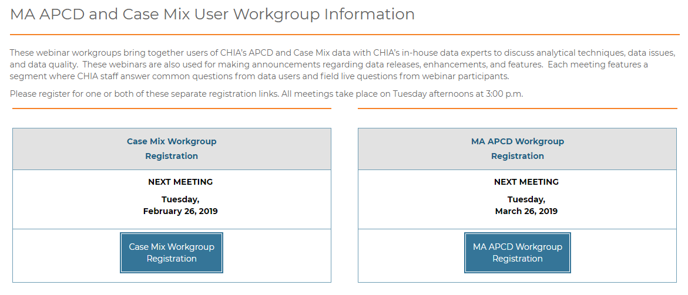
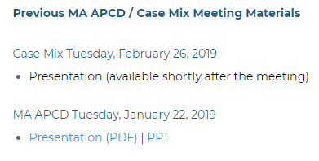
Where can I find old User Workgroup Presentations?
http://www.chiamass.gov/ma-apcd-and-case-mix-user-workgroup-information/

Slide 19
Questions?
Questions related to MA APCD:
apcd.data@state.ma.us
Questions related to Case Mix:
casemix.data@state.ma.us
REMINDER: Please include your IRBNet ID#, if you currently have a project using CHIA data.

Slide 20
Call for Topics and Presenters
If there is a TOPIC that you would like to see discussed at an MA APCD or Case Mix workgroup in 2019, contact Adam Tapply [adam.tapply@state.ma.us]
If you are interested in PRESENTING at an MA APCD or Case Mix workgroup in 2019, contact Adam Tapply [adam.tapply@state.ma.us]
You can present remotely, or in-person at CHIA.

