Slide 1
APCD user workgroup
Amy Wyeth (Special Projects Analyst)
Don Kirkwood (Manager of Data Release and Procurement)
Sylvia Hobbs (Manager of User Support)
Scott Curley (Manager Privacy & Compliance)
July 28, 2020
CENTER FOR HEALTH INFORMATION AND ANALYSIS

Slide 2
Agenda
Announcements:
  APCD Release 8.0 Updates
  FY19 Case Mix Release Projections
  Data Release and Application Update
Website Updates
Application Reminders
User Support Questions
  Differences between newborn data in the MA APCD and in case mix
  Underdosing in the MA APCD compared to case mix
  APCD ID Code in Release 8
  NAIC Code
Q&A

Slide 3
MA APCD Release 8.0
  Available NOW
  Applicants with approved projects that require updated APCD data (Release 8.0) should submit to CHIA a completed Exhibit B (Certificate of Continued Need and Compliance) of the Data Use Agreement. After submitting a completed Exhibit B you will receive an invoice (if applicable) for the requested data. Upon payment of the invoice the order for the data will be placed.
  Release 8.0 includes data on services from January 2014 – December 2018 with six months of claim runout (includes paid claims through 6/30/19).
  Will be linkable to Release 7.0 via crosswalk
  Additional information on highlights and enhancements will be presented in future APCD User Workgroups.

Slide 4

Case Mix FY19 Release
*CURRENT* RELEASE TIMEFRAMES FOR EACH FILE:
  Inpatient (HIDD)
  Available for request
  Emergency Department (ED)
  Available for request
  Outpatient Observation (OOD)
  Available for request
  Applicants with approved projects that require newly available year(s) of Case Mix Data (e.g., FY 19) should submit to CHIA a completed Exhibit B (Certificate of Continued Need and Compliance) of the Data Use Agreement. After submitting a completed Exhibit B you will receive an invoice (if applicable) for the requested data. Upon payment of the invoice the order for the data will be placed.

Slide 5
Data Release and Application Updates
Due to Governor Baker’s emergency actions to limit the spread of COVID-19 CHIA’s workforce will be remote, for now. This arrangement will limit CHIA’s ability to produce and deliver data extracts. At this time it is unknown when CHIA will be able to fulfill data requests but CHIA is exploring alternative data delivery options in order to maintain business as usual. CHIA will continue to do its best to limit the impact of our energy response to data requestors.
During this time, CHIA will continue to accept and review data applications for both Case Mix and All-Payer Claims Database (MA APCD) datasets. Review committees, DRC and DPC, will continue their meetings remotely as necessary.
Due to CHIA’s physical office being closed, applications will be accepted without a fee. After receipt of the application, CHIA will issue an invoice which will allow applicants to remit payment online.
If you are a Data User that has a CHIA hard drive in your possession, please keep the hard drive at this time while CHIA’s physical office is closed.

Slide 6
Website Release Updates
  Updates on the production of APCD and Case Mix databases and status of data requests are now posted to CHIA’s website!
    Aim #1 is to provide weekly or bi-weekly status update on CHIA data products as they are in development.
    Aim #2 is to provide applicants with information about expected fulfillment status for individual data requests.
    Request IDs will be communicated to Data Requestors via email.
  Please visit http://www.chiamass.gov/status-of-data-requests/ to see the current status of releases.

Slide 7
Application reminders

Slide 8
Fee Waiver Request Reminders
  If you’re submitting a request for a fee waiver, remember to include the fee remittance form in your application package on IRBNet.
  Remember to submit supporting documentation (if required).
  If you’re requesting a financial hardship waiver, remember to submit information detailing your project’s financial situation (examples: project budget, grant funding, organizational / departmental funding). Also request to pay a specific price that you reasonably believe you’re able to afford to contribute.
  CHIA generally does not offer full financial hardship fee waivers. We expect all applicants to have made an attempt to find funding to cover the full cost of the data fees.
  Fee waiver requests can take some time to process – especially financial hardship requests.

Slide 9
USER questions

Slide 10

Question: I am having problems trying to distinguish newborns in the medical claims. What is the difference between MA APCD medical claims and the case mix hospital inpatient discharge data (HIDD) in terms of different types of data available on newborns?
Newborns
Answer: One of the key differences in newborn data available between the HIDD
and the MA APCD is that HIDD has a dedicated field for newborn birth weight. The HIDD filing specifications explain that birth weight in grams must be present for discharges:
    If type of admission is 'newborn'
    If type of admission is other than 'newborn’ and age is less than 29 days
HIDD also has a newborn age in weeks field. Therefore, newborns can be easily distinguished in HIDD if the birth weight field is populated and the newborn age in weeks is ‘0’ . Massachusetts Department of Public Health submits annual birth data to the Centers for Disease Control and Prevention (CDC). When comparing the calendar year CDC birth data for Massachusetts to the fiscal year newborn data in case mix HIDD (see Figure 1 below), even though one provides calendar year statistics and another fiscal year, the newborn counts are still very close.
continued

Slide 11

Newborns
Answer (Continued): While the MA APCD does not have a dedicated field for birth
weight, it is possible to determine whether the claim is associated with a newborn by
provider’s use of diagnosis codes to record birth weight in grams (see Table 1 below)
and the use of revenue codes to record hospital room and board nursery level (see
Table 2 below). As seen in both the CDC data and the case mix HIDD, the annual birth
rate for Massachusetts is in the seventy thousands. In fact, if a simple query is run
filtering on the newborn nursery revenue codes alone by year of service during the pre-Gobeille period (CY2011 to 2015), the MA APCD volume of infants is also in the seventy thousands. This number is slightly higher because non-resident infants cared for at hospitals outside of Massachusetts are also included.
Fig 1. MA APCD Infants using Nursery Services
Table 1. ICD-10-CM Codes for Birth Weight Ranges
ICD-10-CM Diagnosis Codes |  |  | Birth Weight (grams)
P05.00 | P05.10 | P07.00, P0.710 | Unspecified weight
P05.01 | P05.11 | P07.01 | Less than 500
P05.02 | P05.12 | P07.02 | 500-749
P05.01 | P05.11 | P07.01 | Less than 500
P05.02 | P05.12 | P07.02 | 500-749
P05.03 | P05.13 | P07.03 | 750- 999
P05.04 | P05.14 | P07.14 | 1,000-1,249
P05.05 | P05.15 | P07.15 | 1,250-1,499
P05.06 | P05.16 | P07.16 | 1,500-1,749
P05.07 | P05.17 | P07.17 | 1,750-1,999
P05.08 | P05.18 | P07.18 | 2,000-2,499
Table 2. Revenue Codes for Nursery Services
Revenue Codes | Description
0170 | Room and board nursery
0171 | Newborn Level I
0172 | Newborn Level II
0173 | Newborn Level III
0174 | Newborn Level IV

Slide 12
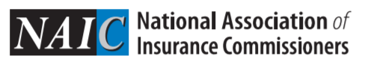
Question: I am including the medical claims and member eligibility files in my application requesting the MA APCD. I am considering adding the product file to my request but wanted to know how complete the NAIC Codes (PR017)are?
NAIC Code
National Association of Insurance Commissioners Code
Answer: The NAIC code is the number that the National Association of Insurance Commissioner's (NAIC) assigns to insurance carriers and can be used to lookup more detailed information on the product line of business. The product file in MA APCD release 8.0 has 8,987,978 records submitted for 96 OrgIDs. Sixty of the 96 OrgIDs have NAIC Codes for 3,312,158 records (37% of the product file records). The completeness of the NAIC codes in MA APCD release 8.0 in comparison to previous releases of the MA APCD has significantly improved. In MA APCD release 5, the codes were 14% complete, in release 6 (17% complete) and in release 7 (18% complete).
Reference: National Association of Insurance Commissioners: https://content.naic.org/

Slide 13

Underdosing
Question: I am interested in using the MA APCD pharmacy data to analyze patterns in the failure of patients to refill prescriptions due to financial barriers to make the co-pay and how coupons and rebates are used to help patients. I understand that the pharmacy claims file has a diagnosis code field. Have any diagnosis codes associated with underdosing been entered into this field or would I also have to apply for the medical claims to get this information?
Answer: At this time, the diagnosis code field in the pharmacy claims file is not well populated and only has a 1% reporting threshold. The pharmacy claims file has 869,524,971 records and only 5,804,922 (0.67%) records contain a diagnosis code. However, the principal diagnosis code field in the medical claims file has a 99% reporting threshold and the first associated diagnosis code has a 70% reporting threshold. Therefore, if you intend to analyze medical conditions associated with therapeutic drugs, you would need to apply for the medical claims data. With regards to the use of underdosing codes, we recently compared the latest release of the MA APCD to the latest release of case mix data to analyze the extent to which new ICD-10-CM codes that did not previously exist in ICD-9-CM had been deployed. ICD-10-CM has 995 new codes for different components of underdosing, none of these codes have been used in the pharmacy claims diagnosis code field. However, they have been used in the both the MA APCD and case mix data. In the case mix data, 117 of the 995 underdosing codes are being used and in the MA APCD medical claims, 147 of the underdosing codes are being used. The specific ICD-10-CM code Z91120 for patient's intentional underdosing of medication regimen due to financial hardship is being used in both the MA APCD medical claims and in CHIA’s case mix data.

Slide 14
Question: I understand that the APCD ID code is now available to non-government data applicants. In which MA APCD file is it included and how well populated is it?
APCD ID CODE
Answer: Yes, the APCD ID Code is now available to approved applicants as part of the limited data set. In this field, carriers report the value that describe the member’s/subscriber’s enrollment into one of the predefined categories. Those categories are as follows:
The APCD ID Code is included in the medical claims, dental claims, pharmacy claims, and member eligibility files. In all four files, the code has a 100% reporting threshold and is well populated at 99.9%.
APCD ID Code Categories
Value | Description
1 | FIG - Fully-Insured Commercial Group Enrollee
2 | SIG - Self-Insured Group Enrollee
3 | GIC - Group Insurance Commission Enrollee
4 | MCO - MassHealth Managed Care Organization Enrollee
5 | Supplemental Policy Enrollee
6 | ICO - Integrated Care Organization or SCO – Senior Care Option
7 | ACO – Accountable Care Organization Enrollee (MassHealth only – unless approved by CHIA)
0 | Unknown / Not Applicable

Slide 15
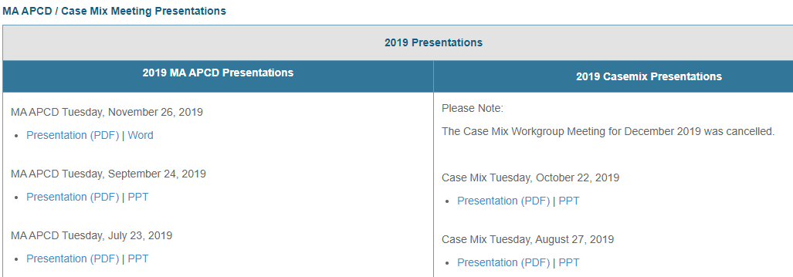
Where can I find past User Workgroup Presentations?
http://www.chiamass.gov/ma-apcd-and-case-mix-user-workgroup-information/

Slide 16
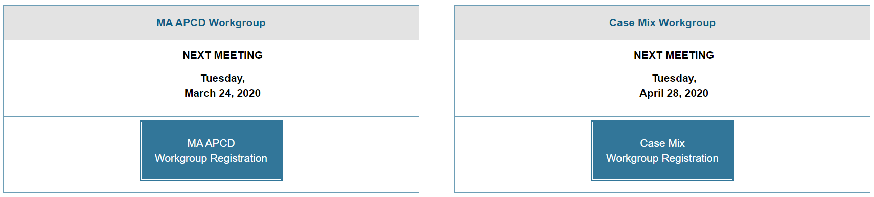
When is the next User Group meeting?
The next User Group will meet Tuesday, August 25.
http://www.chiamass.gov/ma-apcd-and-case-mix-user-workgroup-information/

Slide 17
Questions?
Questions related to MA APCD:
apcd.data@state.ma.us
Questions related to Case Mix:
casemix.data@state.ma.us
REMINDER: Please include your IRBNet ID#, if you currently have a project using CHIA data.

Slide 18
Call for Topics and Presenters
If there is a TOPIC that you would like to see discussed at an MA APCD or Case Mix workgroup in 2020, contact Amy Wyeth [amy.wyeth@state.ma.us]
If you are interested in PRESENTING at a MA APCD or Case Mix workgroup in 2020, contact Amy Wyeth [amy.wyeth@state.ma.us]
You can present remotely, or in-person at CHIA
We may be reaching out to some data users with invitations to present, and hope you will consider this!

