Slide 1
MA Center for Health Information & Analysis
MA APCD User Workgroup
June 28, 2016

Slide 2
Agenda
Announcements
APCD Release 5.0:
  Important Dates
  Highlights of the Release
  Revised Application Forms
Questions Submitted by Users
Q&A

Slide 3
Announcement
New CHIA Executive Director – Ray Campbell
  Commissioner (Acting E.D.) at the GIC and former CEO of MA Health Data Consortium
  Will be starting August 1st
Steve McCabe, CHIA’s current Deputy Executive Director of Health Analytics and Finance will be the Interim Executive Director

Slide 4
Case Mix FY15 Release
We are accepting applications for FY15 Case Mix data NOW
Inpatient Data is scheduled to be ready for release on 6/30
  Emergency Department ready in August
  Outpatient Observation ready in September
Apply for all files now and we will fulfill them as they become available.
FY15 Case Mix data in LDS format
FY04-FY14 available in old “Levels” format (can request on the same application form)

Slide 5
MA APCD Release 5.0
Timeline:
Apply for data NOW – application forms are posted on the APCD website: http://www.chiamass.gov/application-documents\
Data should be ready to go out the door by July 31st
Release documentation (release notes, full data specifications, etc.) will be posted over the next couple of weeks)
No change in fees or fee waiver provisions with this release

Slide 6
MA APCD Release 5.0
Highlights of Release 5.0 Include:
Data is available for dates of service from January 1, 2011 to December 31, 2015 as paid through March 31, 2016.
  Data submitted to CHIA after March 2016 is not included in the files
Comprehensive and recently updated data, including resubmissions from several large carriers
Versioning for additional carriers beyond those carriers from APCD Release 4.0 (Blue Cross Blue Shield of Massachusetts, Tufts Health Plan, Harvard Pilgrim, and MassHealth)
  A full list of Carriers versioned will be available closer to release implementation

Slide 7
MA APCD Release 5.0
Additional Highlights of Release 5.0:
Government users may request both Level 2 and Level 3 elements, including MassHealth Enhanced Eligibility file and Benefit Plan file data
Non-Government users may request groups of Level 2 data elements, as curated by CHIA into Limited Data Sets (same as Release 4.0).
Some data elements have been derived by CHIA from submission data elements or have been added to the database to aid in versioning and identifying claims (e.g. Unique Record IDs and status flags).
  More information will be available in the MA APCD Data Elements Reference Guide closer to the release date (will be posted with release documentation on the APCD website

Slide 8
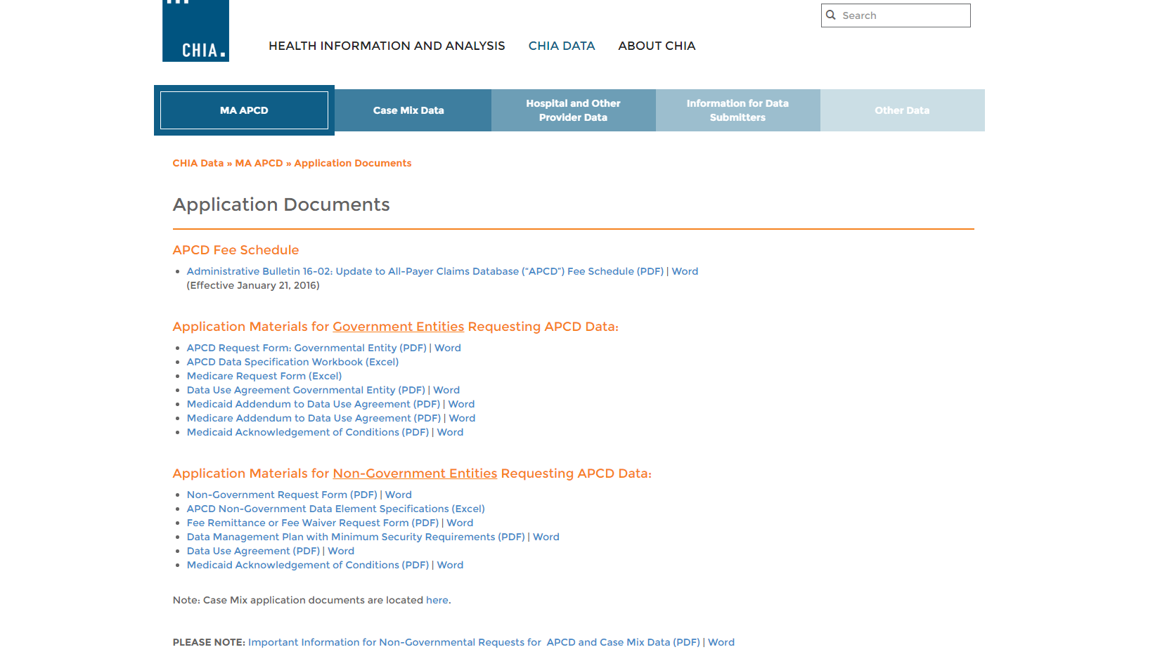
Revised Application Forms
Posted here: http://www.chiamass.gov/application-documents

Slide 9
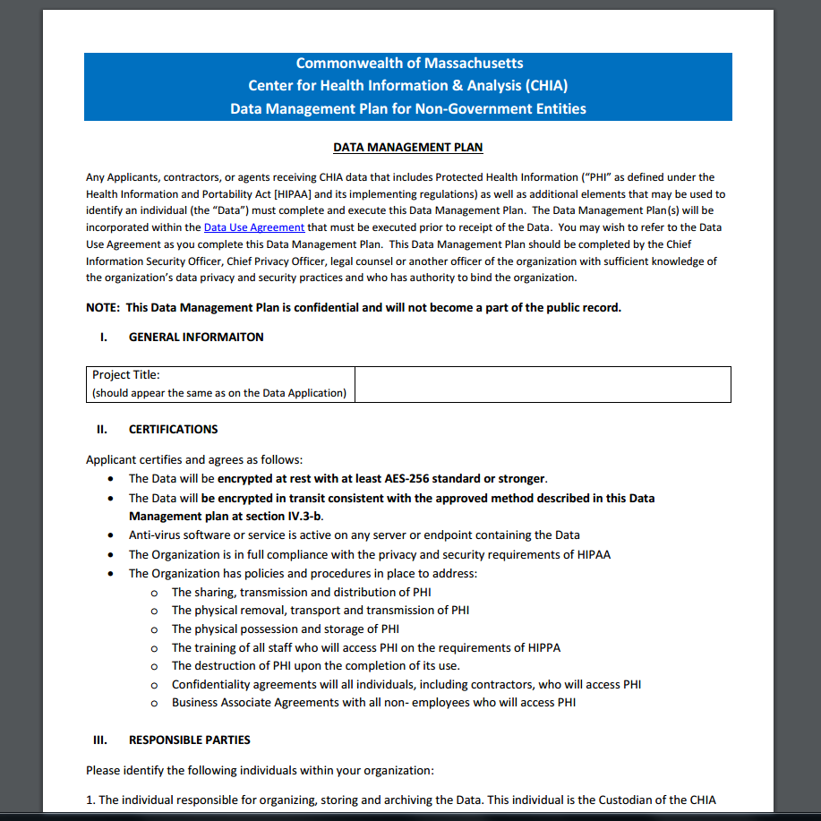
Revised Data Management Plan
Posted here: http://www.chiamass.gov/assets/Uploads/data-apps/Data-Managment-Plan-for-Non-Government-Entities.docx

Slide 10
QUESTIONS?

Slide 11
Questions Submitted by APCD Users
(and answered by CHIA)

Slide 12

Question: Is it possible to identify the type of origin and destination for ambulance claims in APCD Release 4.0? We want to limit our analysis to home-to-hospital ambulance trips.
Answer: Yes, HCPCS procedure code modifiers combining two alpha characters indicate the origin and destination for each ambulance trip.
    The first position alpha code equals origin and the second position alpha code equals destination
      D Diagnostic or therapeutic site
      E Residential facility site (nursing home, prisons, etc.)
      G Hospital dialysis site
      H Hospital
      I Interfacility transfer sites (helipads, airports, etc.)
      J Non-hospital-based dialysis site
      N Skilled Nursing Facility
      P Physician's Office (includes HMO non-hospital facility, clinic, etc.)
      R Home Residence
      S Accident or Acute Event Scene
      X Intermediate stop in route to hospital
    For further information see CMS billing guideline for Modifiers Specific to Ambulance
[APCD Release 4.0]

Slide 13
Question: How reliable is the information on inpatient deaths in the APCD discharge status (MC023) field in APCD Release 4.0?
Answer: Since the APCD available to Non-Government entities does not include the entire Medicare population (only Medicare dual-eligibles), as an indicator of reliability, it is expected that APCD inpatient deaths would be lower than the inpatient deaths reported in the State Annual DPH death file. In comparing 5 years of APCD inpatient deaths to 5 years of DPH inpatient deaths, as expected, the APCD did not exceed the DPH.
Comparison of APCD Medical Claims File Inpatient Deaths to MDPH Inpatient Deaths
Year | APCD MC File Inpatient Deaths for All MEIDs | APCD MC File Inpatient Deaths for Massachusetts Resident MEIDs | MDPH Inpatient Deaths
2010 | 15,595 | 14,766 | 20,736
2011 | 15,680 | 14,873 | 20,582
2012 | 15,356 | 14,535 | 19,951
2013 | 14,501 | 13,447 | 20,294
2014 | 17,124 | 16,001 | 20,601
[APCD Release 4.0]

Slide 14
Question: In analyzing Insurance Product Type (ME003) in the Member Eligibility file in APCD Release 4.0, for a single year, would most of the MEIDs have one product?
Answer: In looking at the Member Eligibility file for distribution of multiple products Massachusetts
residents within a single year (2014), for the 16.5 million Massachusetts resident MEID records, there were 7.4 million distinct MEIDs with the following distribution of multiple products within a single year:
Number of Products | Number of Distinct MEIDs | Distribution
1 | 2,227,876 | 29.829%
2 | 2,858,763 | 38.276%
3 | 1,374,610 | 18.405%
4 | 675,722 | 9.047%
5 | 242,754 | 3.250%
6 | 69,737 | 0.934%
7 | 16,135 | 0.216%
8 | 2,857 | 0.038%
9 | 372 | 0.005%
10 | 44 | 0.001%
[APCD Release 4.0]

Slide 15
Questions?
Questions related to APCD : (apcd.data@state.ma.us)
Questions related to Case Mix: (casemix.data@state.ma.us)
REMINDER: Please include your IRBNet ID#, if you currently have a project using CHIA data

Slide 16
Call for Topics and Presenters
If there is a TOPIC that you would like to see discussed at an MA APCD or Case Mix workgroup, contact Adam Tapply [adam.tapply@state.ma.us]
If you are interested in PRESENTING at an MA APCD or Case Mix workgroup, contact Adam Tapply [adam.tapply@state.ma.us]
  You can present remotely from your own office, or in-person at CHIA.

