Slide 1
CHIA User Workgroup
Donald Kirkwood, Manager of Data Release and Procurement
Anne Medinus, Senior Research Account Specialist
Sylvia Hobbs, Associate Director of Data Strategy and User Support
June 25, 2024

Slide 2
Agenda
Announcements:
  FY2023 Case Mix Release Update
  Case Mix Documentation and Release Notes
  MA APCD Releases CY2021 and CY2022
  Update to the MA APCD Application
Website Updates
  How to Check the Status of Your Release
  Data Applications Received and Commenting
  Past User Support Presentations
User Support Questions
  Site of Service for Prison/Correctional Facility Healthcare
  Doulas
  Insect Activity and Climate Change
Q&A

Slide 3
Announcements

Slide 4

Case Mix FY2023 Release
*NEW* RELEASE AVAILABLE FOR THE FOLLOWING FILE:
  Hospital Inpatient Discharge Data (HIDD)
  FY2023 Now Available for Request
  Applicants with approved projects using previous years data (e.g., FY 2022, FY2021) that require newly available year(s) of case mix data (e.g., FY 2023) should submit to CHIA a completed Exhibit B (Certificate of Continued Need and Compliance) of the Data Use Agreement. After submitting a completed Exhibit B you will receive an invoice (if applicable) for the requested data. Upon payment of the invoice the order for the data will be placed.

Slide 5
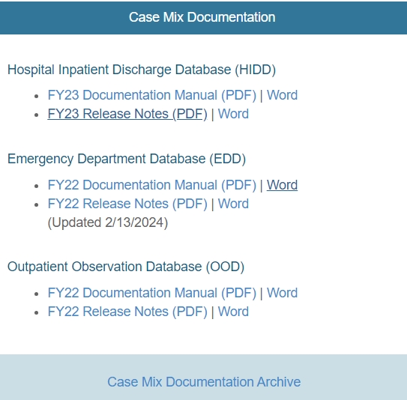

Case Mix Release Documentation
Review Documentation and Release Notes
Data users are advised to review CHIA’s comprehensive case mix documentation manuals and release notes which provide information on data quality issues connected with certain data elements and includes background on the database’s development and the DRG Groupers. The release notes also contains hospital-reported discrepancies received in response to the data verification process. Also, twenty-four years of historical documentation are available online on the documentation archive website
https://www.chiamass.gov/case-mix-data/
https://www.chiamass.gov/case-mix-data-documentation-archive/
The documentation archive contains outpatient emergency department, outpatient observation stay, and hospital inpatient discharges documents dating back to fiscal year 2000.
Link to Archive

Slide 6

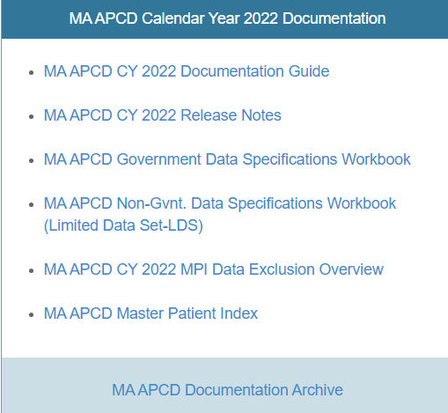
MA APCD CY2021 and CY2022 Releases
CY2021 and CY2022 Available for Request
  CY 2021 Data which includes medical, pharmacy, and dental claims incurred between January 1, 2017, and December 31, 2021, and it includes six (6) months of run-out (paid claims through June 30, 2022) and the new CY 2022 Data which includes claims incurred from January 1, 2018, through December 31, 2022, and includes six (6) months of run-out (paid claims through June 30, 2023) are available for request. In addition to claims data, the releases contain relevant reference files including member eligibility, providers, products, and benefit plans. This data encompasses public and private payers as well as fully-insured and self-insured plans. Keep in mind that due to the Supreme Court decision, Gobeille v. Liberty Mutual, the self-insured plans are severely reduced starting in 2016. The releases also includes MassHealth Medicaid data.
  https://www.chiamass.gov/ma-apcd/
  Applicants with approved projects that require updated MA APCD data (CY 2021 Data or CY2022) should submit to CHIA a completed Exhibit B (Certificate of Continued Need and Compliance) of the Data Use Agreement. After submitting a completed Exhibit B, you will receive an invoice (if applicable) for the requested data. Upon payment of the invoice the order for the data will be placed.
  The new CY 2022 MA APCD Documentation Guide and Release Notes are available on CHIA’s website for your review before using the data. The CY2021 MA APCD Documentation are available online in the documentation archive.

Slide 7
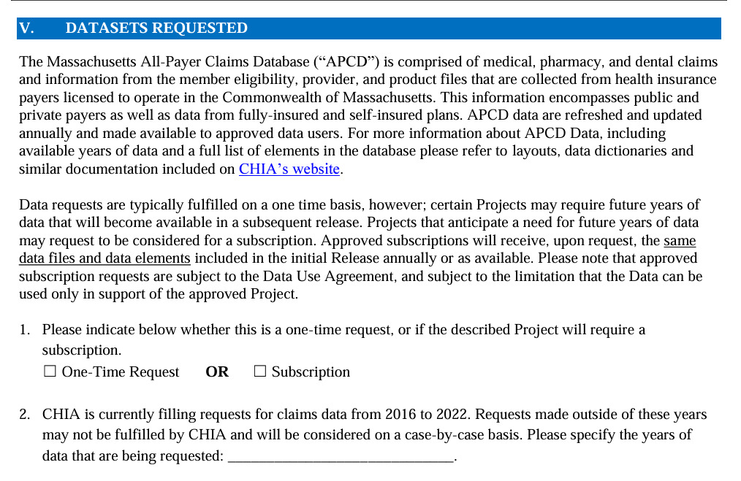
Updates to the MA APCD Application
When applying for CHIA data, always check the website to download and use the most recent version of the data request application. For example, the MA APCD application was last revised in December 2023 to update the full year date ranges available for purchase.
See application excerpt below.

Slide 8
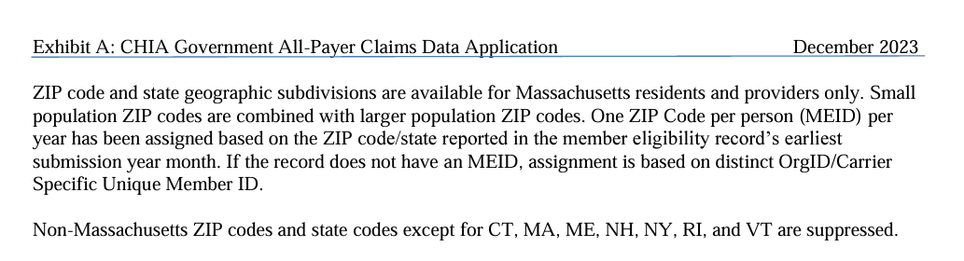
Updates to the MA APCD Application (continued)
In addition, the December 2023 revision to MA APCD application specifies that the member ZIP code geographic data is now only released at the level of one ZIP code per person per year based on the member’s ZIP code reported in the member’s earliest submission year month.
See application excerpt below.

Slide 9
Website Updates

Slide 10
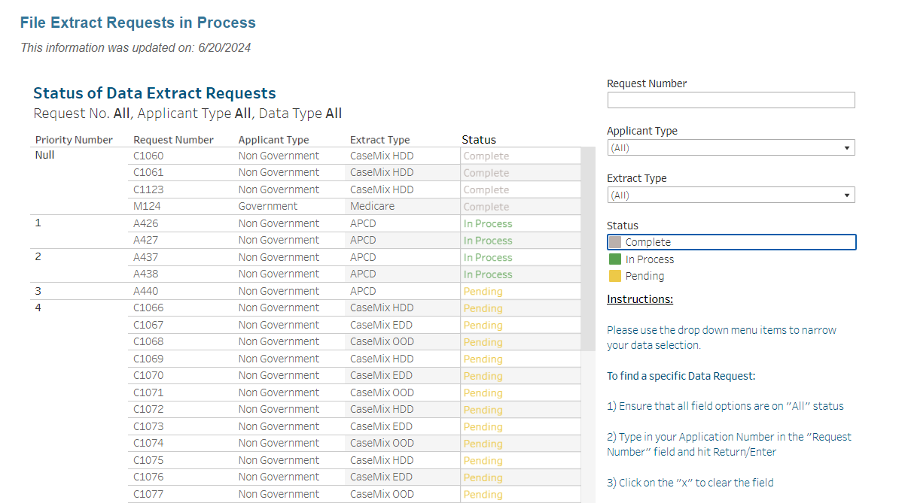
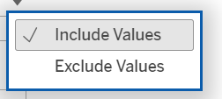
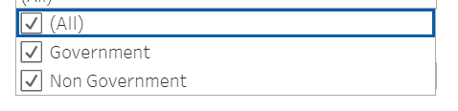
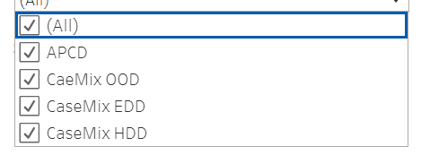
How to Check the Status of Your Release
  You can visit the CHIA website http://www.chiamass.gov/status-of-data-requests/ to check the status of data extracts and releases. The status website has drop down menus, as shown below, which allow you to narrow your search by request number, applicant type, and extract type.

Slide 11
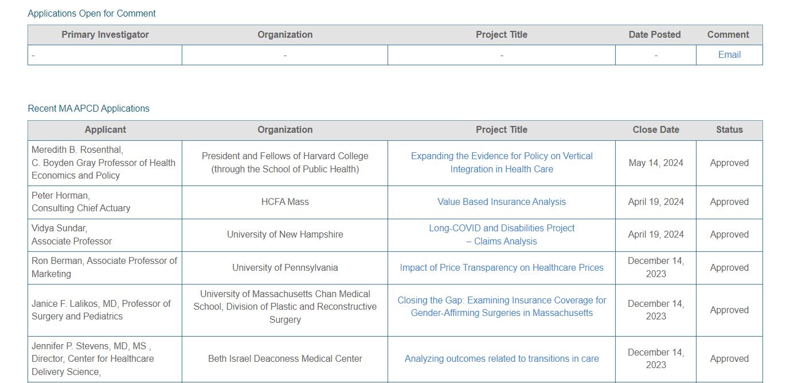
Data Applications Received and Commenting
  You can visit the CHIA website https://www.chiamass.gov/apcd-application-received-and-commenting/
  to check non-government applications received, awaiting public comments, and approved.

Slide 12
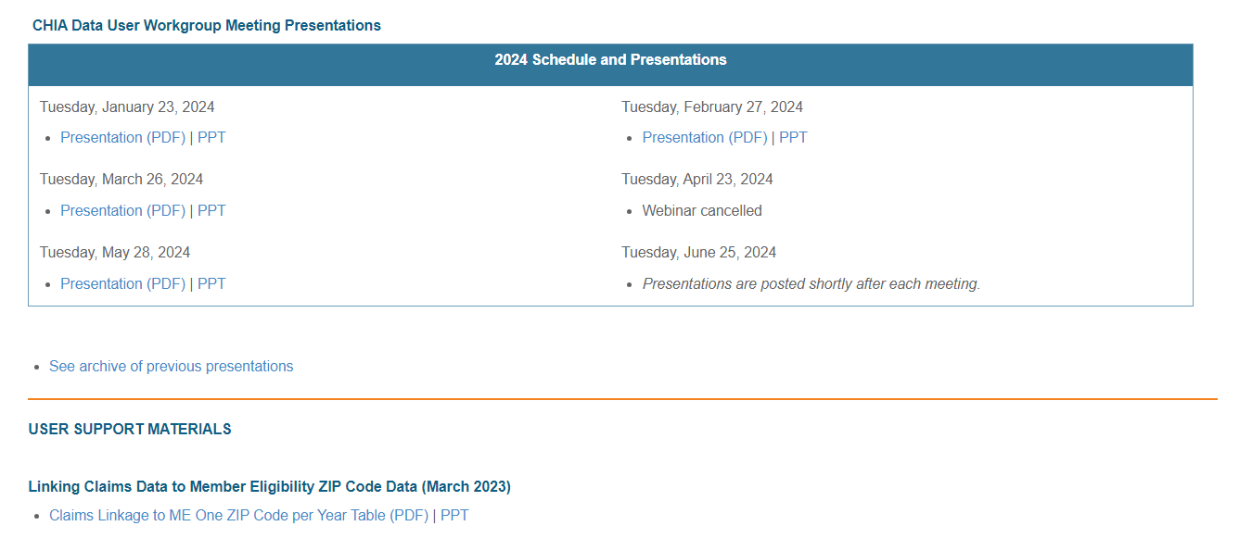
Past User Support Presentations Online
  You can visit the CHIA website http://www.chiamass.gov/ma-apcd-and-case-mix-user-workgroup-information/ to access past user support webinar presentations and other user support materials.

Slide 13
User Support Questions

Slide 14
Question: Does the MA APCD contain data on prison healthcare?
Answer: The medical claims file contains a field called “Site of Service - on NSF/CMS 1500 Claims” (MC037) where carriers are asked to report the two-digit value that defines the Place of Service on a professional claim. Populating this field is required when MC094 (Type of Claim) equals code ‘001’ for professional claim.
One of the two-digit coding values for MC037 is code ’09’. The MA APCD medical claims contains records using this code.
  Code 09 is used when the site of service is a “Prison/Correctional Facility. A prison, jail, reformatory, work farm, detention center, or any other similar facility maintained by either Federal, State or local authorities for the purpose of confinement or rehabilitation of adult or juvenile criminal offenders.”
Tangentially related, the MA APCD provider table contains a taxonomy code field (PV022) where carriers report “the standard code that defines this provider for this line of service. Taxonomy values allow for the reporting of many types of clinicians, assistants and technicians, where applicable, as well as Physicians, Nurses, Groups, Facilities, etc.” There is a provider taxonomy code field ‘173000000X’. The MA APCD provider table contains records using this code.
  Taxonomy code 173000000X’ is used when the provider’s specialty is associated with legal medicine including Forensic Pathology (e.g. performing autopsies, collecting and analyzing evidence in criminal and civil cases); Clinical Forensic Medicine (e.g. evaluating injuries in cases of assault, abuse, or accidents and providing medical care to individuals in custody, assessing the competency and mental state of individuals involved in legal proceedings); Forensic Toxicology (e.g. analyzing biological samples and interpreting toxicological findings for legal investigations); Medical-Legal Consultation (e.g. advising legal professionals on standard of care and potential malpractice); Public Health and Epidemiology (e.g. investigating the legal implications of disease outbreaks and legal aspects of public health interventions).

Slide 15

Question: Does the MA APCD contain data on Doula providers?
Answer: Only 2.1% of the Massachusetts area Doulas listed in the CMS National Plan and Provider Enumeration System NPI Registry are in the MA APCD. There is a specific taxonomy code for Doulas.
  The taxonomy code 374J000000X is for Doulas, classified under Nursing Service-Related Providers who offer continuous physical, emotional, and informational support to a mother before, during, and shortly after childbirth.
However, not all Doulas use this taxonomy code. The different taxonomy codes for providers whose entity name includes Doula and who have an NPI are:
  374J00000X - Doula
  174H00000X - Health Educator
  171W00000X - Contractor
  193400000X - Single Specialty Group
  193200000X - Multi-Specialty Group
  172V00000X - Community Health Worker
  171M00000X - Case Manager/Care Coordinator

Slide 16
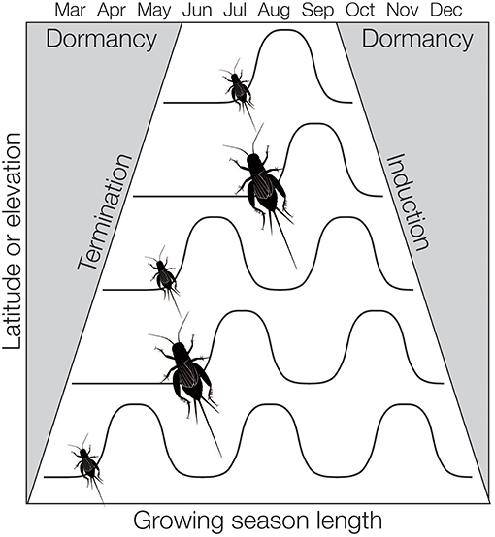
Question: As part of my climate change study, I would like to use the outpatient emergency department (ED) to analyze the association between warmer and wetter weather conditions with any decrease or insect activity. Is there a meaningful volume of data related to insect activity in the ED data?
Answer: From FY2018 through FY2023, there have been 1,983 distinct ICD-10-CM codes used in the ED data for health effects of insect related activity. It is important to note that much of the data is attributable to granularity afforded by ICD-10-CM in coding specificity describing the exact anatomic location and laterality, and initial or subsequent episode of care for insect bites. Beyond insect bites, additionally the following ICD-10-CM diagnosis codes have been used which encompass a variety of infectious diseases potentially transmitted by arthropods, including mosquitoes and ticks, which serve as vectors for viral pathogens.
DX Code Description
  A938 Other specified arthropod-borne viral fevers
  A90 Dengue fever [classical dengue]
  A920 Chikungunya virus disease
  A848 Other tick-borne viral encephalitis
  A849 Tick-borne viral encephalitis, unspecified
  A9230 West Nile virus infection, unspecified
  A832 Eastern equine encephalitis
  A925 Zika virus disease
  A984 Ebola virus disease
  A94 Unspecified arthropod-borne viral fever
Number of Insect Activity Principal and Associated Diagnosis Codes Used in FY2018 through FY2023 ED Data

Slide 17
When is the next User Group meeting?
  The next User Group will meet Tuesday July 23, 2024.
  http://www.chiamass.gov/ma-apcd-and-case-mix-user-workgroup-information/

Slide 18
Questions?
Questions related to MA APCD email:
apcd.data@chiamass.gov
Questions related to Case Mix email:
casemix.data@chiamass.gov
REMINDER
CHIA still receives a high volume of email from data users who do not include their IRBNet ID. If you are in the process of or have already submitted a data application to CHIA through IRBNet https://www.irbnet.org/release/home.html, due to the volume of email CHIA receives, please remember to always include your IRBNET ID# in the subject line of your email. Doing so facilitates tracking your application and expediting responses to any questions.

