Slide 1
Apcd user workgroup
Amy Wyeth (Special Projects Analyst)
Don Kirkwood (Manager of Data Release and Procurement)
Sylvia Hobbs (Manager of User Support)
Scott Curley (Manager Privacy & Compliance)
March 24, 2020
CENTER FOR HEALTH INFORMATION AND ANALYSIS

Slide 2
Agenda
Announcements:
  APCD Release 8.0 Updates
  FY19 Case Mix Release Projections
  Data Release and Application Update
Website Updates
Application Reminders
User Support Questions
  Comparison cause codes before and after ICD-10-CM implementation
  Pharmacy Claims
Q&A

Slide 3
MA APCD Release 7.0
  Available NOW
  Encompasses data on services from January 2013 – December 2017 with six months of claim runout (includes paid claims through 6/30/18)
  Release Documentation and Data Specifications have been posted to the website: http://www.chiamass.gov/ma-apcd/
  Apply now by listing 2017 (and any other years you want from Release 7.0) in the “Years Requested” section of the current application form available here: http://www.chiamass.gov/application-documents

Slide 4
MA APCD Release 8.0
  Available NOW
  Applicants with approved projects that require updated APCD data (Release 8.0) should submit to CHIA a completed Exhibit B (Certificate of Continued Need and Compliance) of the Data Use Agreement. After submitting a completed Exhibit B you will receive an invoice (if applicable) for the requested data. Upon payment of the invoice the order for the data will be placed.
  Release 8.0 includes data on services from January 2014 – December 2018 with six months of claim runout (includes paid claims through 6/30/19).
  Will be linkable to Release 7.0 via crosswalk
  Additional information on highlights and enhancements will be presented in future APCD User Workgroups.

Slide 5

Case Mix FY19 Release
*CURRENT* RELEASE TIMEFRAMES FOR EACH FILE:
  Inpatient (HIDD)
  July 2020
  Emergency Department (ED)
  August 2020
  Outpatient Observation (OOD)
  October 2020

Slide 6
Data Release and Application Updates
Due to Governor Baker’s emergency actions to limit the spread of COVID-19 CHIA’s workforce will be remote, for now, until April 6th. This arrangement will limit CHIA’s ability to produce and deliver data extracts. At this time it is unknown when CHIA will be able to fulfill data requests but CHIA is exploring alternative data delivery options in order to maintain business as usual. CHIA will continue to do its best to limit the impact of our energy response to data requestors.
During this time, CHIA will continue to accept and review data applications for both Case Mix and All-Payer Claims Database (MA APCD) datasets. Review committees, DRC and DPC, will continue their meetings remotely as necessary.
Due to CHIA’s physical office being closed, applications will be accepted without a fee. After receipt of the application, CHIA will issue an invoice which will allow applicants to remit payment online.
If you are a Data User that has a CHIA hard drive in your possession, please keep the hard drive at this time while CHIA’s physical office is closed.

Slide 7
AVAILABLE NOW: Website Release Updates
  Updates on the production of APCD and Case Mix databases and status of data requests are now posted to CHIA’s website!
    Aim #1 is to provide weekly or bi-weekly status update on CHIA data products as they are in development.
    Aim #2 is to provide applicants with information about expected fulfillment status for individual data requests.
    Request IDs will be communicated to Data Requestors via email.
  Please visit http://www.chiamass.gov/status-of-data-requests/ to see the current status of releases.

Slide 8
Application reminders

Slide 9
Fee Waiver Request Reminders
  If you’re submitting a request for a fee waiver, remember to include the fee remittance form in your application package on IRBNet.
  Remember to submit supporting documentation (if required).
  If you’re requesting a financial hardship waiver, remember to submit information detailing your project’s financial situation (examples: project budget, grant funding, organizational / departmental funding). Also request to pay a specific price that you reasonably believe you’re able to afford to contribute.
  CHIA generally does not offer full financial hardship fee waivers. We expect all applicants to have made an attempt to find funding to cover the full cost of the data fees.
  Fee waiver requests can take some time to process – especially financial hardship requests.

Slide 10
USER questions

Slide 11

Question: Since the transition from ICD-9-CM to ICD-10-CM has there been any improvement in the completeness of cause of injury coding in the MA APCD. Historically, we have used the case mix outpatient emergency department data and inpatient hospital discharge data for injury and poisoning surveillance due to the high completeness (over 90%) of cause codes associated with injury diagnosis .
Injury Cause
Answer: To answer your question, we compared injury claims in two different versions of the MA APCD containing ICD-9-CM and ICD-10-CM.
    STEP 1: We determined the percent of MA APCD Release 5.0 highest version medical claim lines for Massachusetts residents with a principal diagnosis code of injury or poisoning (ICD-9-CM 800-999) accompanied by an external cause of injury code (E-code) in the designated E-code field or any associated diagnosis field for a 4-year ICD-9-CM period (CY2011 through CY2014).
Answer continued

Slide 12
    STEP 2: We compared the percent of MA APCD Release 5.0 injury claims with a cause of injury code to the percent of MA APCD Release 7.0 with an principal diagnosis injury or poisoning code range (ICD-10-CM S00-S99, T00-T88) accompanied by a cause code (V00-Y89) in the cause field or any associated diagnosis field.
  RESULTS: During the ICD-9-CM period, 12% of injury claims had a cause diagnosis. After ICD-10-CM implementation, there was a significant increase in cause coding to 19% of injury claim lines having a cause code. See table 1 below.
Injury Cause
Table 1. Comparison of ICD-9-CM vs ICD-10-CM Cause Coding in MA APCD Medical Claims
Note: Decrease in 2016, 2017 Injury Claims due to Gobeille

Slide 13

Question: What is day’s supply (PC034)? How is it determined and why are there sometimes negative values?
Answer:
Day’s Supply is defined as the number of days a prescription will last if taken as prescribed.
Quantity Limits define how much of a drug you can fill during a specific time period. Different limits apply to different drugs.
Insurance plans use quantity limits to ensure patient safety and control costs
Usually, plans review clinical and FDA literature to decide how much of a drug they will cover in a certain time period.
Not all prescriptions have quantity limits, but many do based on the following reasons:
  They are FDA approved only for short-term use
  They may cause side effects when overused
  They carry the risk of being inappropriately overused
Negative values are associated with claims reversal, for example, instances when a patient does not pick up a prescription that has been prepared.

Slide 14
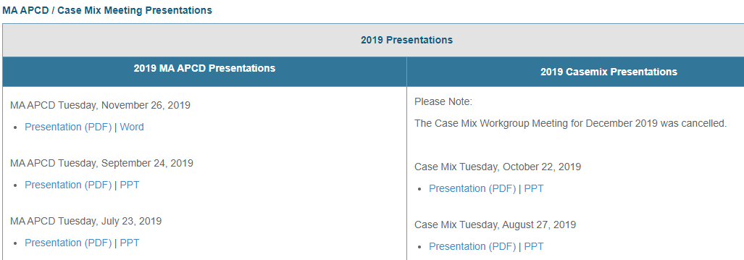
Where can I find past User Workgroup Presentations?
http://www.chiamass.gov/ma-apcd-and-case-mix-user-workgroup-information/

Slide 15
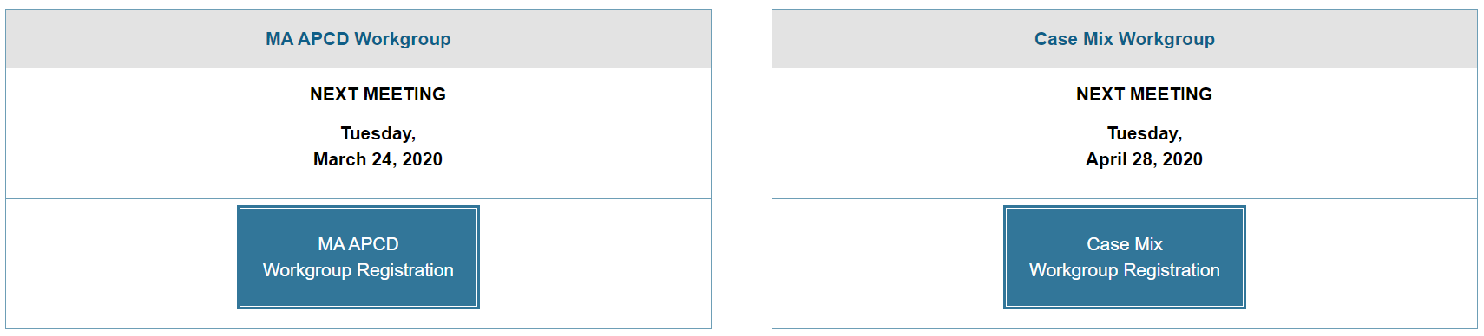
When is the next User Group meeting?
The next APCD User Group will meet Tuesday, March 24.
http://www.chiamass.gov/ma-apcd-and-case-mix-user-workgroup-information/

Slide 16
Questions?
Questions related to MA APCD:
apcd.data@state.ma.us
Questions related to Case Mix:
casemix.data@state.ma.us
REMINDER: Please include your IRBNet ID#, if you currently have a project using CHIA data.

Slide 17
Call for Topics and Presenters
If there is a TOPIC that you would like to see discussed at an MA APCD or Case Mix workgroup in 2020, contact Amy Wyeth [amy.wyeth@state.ma.us]
If you are interested in PRESENTING at a MA APCD or Case Mix workgroup in 2020, contact Amy Wyeth [amy.wyeth@state.ma.us]
You can present remotely, or in-person at CHIA
We may be reaching out to some data users with invitations to present, and hope you will consider this!

