Slide 1
APCD user workgroup
Amy Wyeth (Special Projects Analyst)
Don Kirkwood (Manager of Data Release and Procurement)
Sylvia Hobbs (Manager of User Support)
Scott Curley (Manager Privacy & Compliance)
May 26, 2020
CENTER FOR HEALTH INFORMATION AND ANALYSIS

Slide 2
Agenda
Announcements:
  APCD Release 8.0 Updates
  FY19 Case Mix Release Projections
  Data Release and Application Update
Website Updates
Application Reminders
User Support Questions
  Member Relationship to Subscriber Codes
  Obesity and Bariatric Procedures
  Currency Data Questions Continued
  Version Flags
  APCD ID Code in Release 8
Q&A

Slide 3
MA APCD Release 7.0
  Available NOW
  Encompasses data on services from January 2013 – December 2017 with six months of claim runout (includes paid claims through 6/30/18)
  Release Documentation and Data Specifications have been posted to the website: http://www.chiamass.gov/ma-apcd/
  Apply now by listing 2017 (and any other years you want from Release 7.0) in the “Years Requested” section of the current application form available here: http://www.chiamass.gov/application-documents

Slide 4
MA APCD Release 8.0
  Available NOW
  Applicants with approved projects that require updated APCD data (Release 8.0) should submit to CHIA a completed Exhibit B (Certificate of Continued Need and Compliance) of the Data Use Agreement. After submitting a completed Exhibit B you will receive an invoice (if applicable) for the requested data. Upon payment of the invoice the order for the data will be placed.
  Release 8.0 includes data on services from January 2014 – December 2018 with six months of claim runout (includes paid claims through 6/30/19).
  Will be linkable to Release 7.0 via crosswalk
  Additional information on highlights and enhancements will be presented in future APCD User Workgroups.

Slide 5

Case Mix FY19 Release
*CURRENT* RELEASE TIMEFRAMES FOR EACH FILE:
  Inpatient (HIDD)
  July 2020
  Emergency Department (ED)
  August 2020
  Outpatient Observation (OOD)
  October 2020
  Applicants with approved projects that require newly available year(s) of Case Mix Data (e.g., FY 19) should submit to CHIA a completed Exhibit B (Certificate of Continued Need and Compliance) of the Data Use Agreement. After submitting a completed Exhibit B you will receive an invoice (if applicable) for the requested data. Upon payment of the invoice the order for the data will be placed.

Slide 6
Data Release and Application Updates
Due to Governor Baker’s emergency actions to limit the spread of COVID-19 CHIA’s workforce will be remote, for now. This arrangement will limit CHIA’s ability to produce and deliver data extracts. At this time it is unknown when CHIA will be able to fulfill data requests but CHIA is exploring alternative data delivery options in order to maintain business as usual. CHIA will continue to do its best to limit the impact of our energy response to data requestors.
During this time, CHIA will continue to accept and review data applications for both Case Mix and All-Payer Claims Database (MA APCD) datasets. Review committees, DRC and DPC, will continue their meetings remotely as necessary.
Due to CHIA’s physical office being closed, applications will be accepted without a fee. After receipt of the application, CHIA will issue an invoice which will allow applicants to remit payment online.
If you are a Data User that has a CHIA hard drive in your possession, please keep the hard drive at this time while CHIA’s physical office is closed.

Slide 7
Website Release Updates
  Updates on the production of APCD and Case Mix databases and status of data requests are now posted to CHIA’s website!
    Aim #1 is to provide weekly or bi-weekly status update on CHIA data products as they are in development.
    Aim #2 is to provide applicants with information about expected fulfillment status for individual data requests.
    Request IDs will be communicated to Data Requestors via email.
  Please visit http://www.chiamass.gov/status-of-data-requests/ to see the current status of releases.

Slide 8
Application reminders

Slide 9
Fee Waiver Request Reminders
  If you’re submitting a request for a fee waiver, remember to include the fee remittance form in your application package on IRBNet.
  Remember to submit supporting documentation (if required).
  If you’re requesting a financial hardship waiver, remember to submit information detailing your project’s financial situation (examples: project budget, grant funding, organizational / departmental funding). Also request to pay a specific price that you reasonably believe you’re able to afford to contribute.
  CHIA generally does not offer full financial hardship fee waivers. We expect all applicants to have made an attempt to find funding to cover the full cost of the data fees.
  Fee waiver requests can take some time to process – especially financial hardship requests.

Slide 10
USER questions

Slide 11

Question: I am applying for the MA APCD to study pediatric asthma in children ages 5 years old and younger. Asthma often runs in the family, therefore I plan to model for familial risk factors using the individual relationship code in the member eligibility file. Does the individual relationship code provide enough information to determine the exact familial relationship of the child to the subscriber?
Individual Relationship
Code
Answer: No, there is not enough granularity in the individual relationship codes to determine the exact familial relationship of the member to subscriber. As shown in Fig. 1 below, in MA APCD Release 7 member eligibility file (ME) for years 2014 to 2018, over 95% of ME records for children ages 5 years old and younger have the relationship code self or child. While it is not possible to link children to medical co-morbidities of exact family members, both ICD-9-CM and ICD-10-CM have family history diagnosis codes. ICD-10-CM has a single
diagnosis code Z825 for
“family history of asthma
and other chronic lower
respiratory diseases.” In
ICD-9-CM, this history is
Coded as two separate
diagnosis codes. V175 is
defined as “family history
of asthma” and V176 as
“family history of other
chronic respiratory
conditions.”
Fig. 1: Individual Relationship Codes for children ages
5 years old and younger in MA APCD Release 7

Slide 12

Question: I am interested in applying for CHIA data to
study differences over time in medical outcomes, efficacy
and demographic attributes of patients who receive
bariatric surgical procedures such as gastric bypass,
gastric sleeve, or lap band. I am trying to determine whether it
would suffice to only apply for the case mix inpatient
hospital discharge or the MA APCD. I am concerned that by limiting my application to case mix I might miss some procedures that are performed as outpatient surgery.
Answer: Bariatric procedures can be found in both the case mix inpatient hospital discharge data (performed at 31 of 75 hospitals) and the outpatient observation stay data (performed at 1 of the same hospitals performing inpatient surgery). The MA APCD contains data on a higher number of bariatric procedures performed at a wider range of bariatric surgical care settings, this includes 95 different inpatient and outpatient bariatric surgical care settings. Because the MA APCD contains data on billable procedures regardless of care setting, the data facilitates monitoring the efficacy of bariatric procedures based on the continuum of changes in the patient’s body mass index before surgery, during the outpatient rehabilitation and data over time on changes in body mass index recorded during routine outpatient post-surgical follow-up care. See Figure 1 below.
Figure 1: MA APCD Contains Data on the Continuum Changes in the Patient’s Body Mass Index
Outpatient Pre-surgery Body Mass Index
Body Mass Index at time of surgery
Outpatient Post-surgery Body Mass Index

Slide 13
Question: I keep confusing the indicator flags in the MA APCD and cannot decide which codes to use for my payment analysis. What are the version flags and how are they used?
VERSION
FLAGS
Answer: Claim versioning allows CHIA to identify specific attributes in claims that may have multiple versions over time and claim type. The HIGHEST VERSION INDICATOR flag shows claim lines that are the highest version claim line and whether the claim line was paid. The following are relevant versioning flags and their meanings:
The VERSIONINDICATOR flag helps data users determine the highest version of a claim line that was “paid”. Table 1 below defines the Version values for the VERSIONINDICATOR
Table 1: VERSIONINDICATOR Flag
Typically a value of one means that the line was directly paid; however, note that depending on carrier specific logic it is sometimes possible that payment for that specific line was actually denied. However in such a case, a value of one indicates that the service was covered and the payment was included as part of the payment on another line in the same claim collection.
:
VALUE | MEANING
1 | Highest Version Paid
0 | Not Highest Version Paid
9 | Versioning Not Applied

Slide 14
Answer (continued) : The HIGHESTVERSIONDENIED flag is used to identify claim lines within a claim that have been denied. A value of 1 indicates that the claim line was both highest version and payment was denied. . The HIGHESTVERSION INDICATOR flag shows claim lines that are the highest version claim line, whether the claim line was paid Tables 2 and 3 below define the Version values for the HIGHESTVERSIONDENIED and HIGHESTVERSIONINDICATOR flags:
HIGHESTVERSIONDENIED Flag
VERSION
FLAGS
Table 2: HIGHESTVERSIONDENIED Flag
If HIGHESTVERSIONDENIED =1 and the “VERSIONINDICATOR” = 1, then that means that while this specific claim line was denied, payment for this line was likely included with payment on another line (bundled payment).
If HIGHESTVERSIONDENIED =1 and “VERSIONINDICATOR” = 0, then that means that this claim line was denied, and that this claim line is the highest version of the claim line.
Table 3: HIGHESTVERSIONINDICATOR Flag
For additional information on versioning see pages 19 and 20 of the MA APCD Release Documents: https://www.chiamass.gov/assets/docs/p/apcd/apcd-7.0/MA-APCD-Release-7.0-Documentation-Guide.pdf
VALUE | MEANING
1 | Is Highest Version Denied
0 | Is not Highest Version Denied
9 | Highest Version Denied Flag Not Applied
VALUE | MEANING
1 | Highest Version claim line
0 | Not Highest Version claim line
9 | Versioning Not Applied

Slide 15
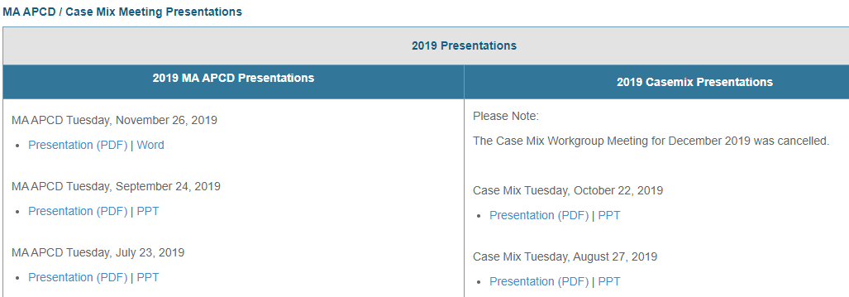
Where can I find past User Workgroup Presentations?
http://www.chiamass.gov/ma-apcd-and-case-mix-user-workgroup-information/

Slide 16
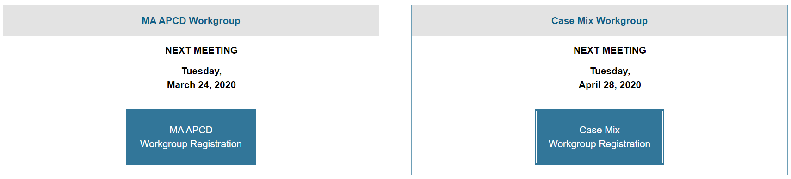
When is the next User Group meeting?
The next User Group will meet Tuesday, June 23.
http://www.chiamass.gov/ma-apcd-and-case-mix-user-workgroup-information/

Slide 17
Questions?
Questions related to MA APCD:
apcd.data@state.ma.us
Questions related to Case Mix:
casemix.data@state.ma.us
REMINDER: Please include your IRBNet ID#, if you currently have a project using CHIA data.

Slide 18
Call for Topics and Presenters
If there is a TOPIC that you would like to see discussed at an MA APCD or Case Mix workgroup in 2020, contact Amy Wyeth [amy.wyeth@state.ma.us]
If you are interested in PRESENTING at a MA APCD or Case Mix workgroup in 2020, contact Amy Wyeth [amy.wyeth@state.ma.us]
You can present remotely, or in-person at CHIA
We may be reaching out to some data users with invitations to present, and hope you will consider this!

