Slide 1
Apcd user workgroup
Adam Tapply (Manager of Accounts)
Scott Curley (Manager of Privacy & Compliance)
Sylvia Hobbs (Manager of User Support)
May 28, 2019
CENTER FOR HEALTH INFORMATION AND ANALYSIS

Slide 2
Agenda
Announcements:
  APCD Release 7.0
  Timeline for FY18 Case Mix Release
DUA, Compliance, and Audit Overview
User Support Questions
Q&A

Slide 3
MA APCD Release 7.0
  Available NOW
  Encompasses data from January 2013 – December 2017 with six months of claim runout (includes paid claims through 6/30/18)
  Release Documentation and Data Specifications have been posted to the website: http://www.chiamass.gov/ma-apcd/
  Apply now by listing 2017 (and any other years you want from Release 7.0) in the “Years Requested” section of the current application form
  Available here: http://www.chiamass.gov/application-documents

Slide 4
MA APCD Release 7.0 Highlights
  Contains ICD-10-CM procedure and diagnosis codes. ICD indicator flag indicates whether codes are reported in ICD-9 or ICD-10 format.
    NOTE: the ICD indicator flag is as reported by carriers and is not 100% accurate.
  Accountable Care Partnership Plans will be denoted starting in 2018 as follows:
    Insurance Type Code/Product (ME003, MC003, PC003, DC003) use the new value of 30 to denote ACO.
  A subset of MassHealth Enhanced Eligibility (MHEE LDS) data is now available to all approved recipients of MassHealth data for the first time. The MHEE LDS data provides a view of a member on any given day.

Slide 5
MA APCD Release 7.0 Highlights
  Updated Master Patient Index
    A small percentage of records may not have a MEMBERLINKEID due to inconsistencies and inaccuracies in carrier reporting. Please see the MA APCD Release 7.0 Master Patient Index (MPI) Data Exclusion document for a complete list.
    Created a MEMBERLINKEID crosswalk to enable users to apply Release 7.0 IDs to prior Release 6.0. This is available upon request.

Slide 6
Release 7.0 Carrier Highlights
  As a result of the Supreme Court Gobeille ruling, several carriers have removed some or all self-insured data from their MA APCD data submissions, resulting in a drop in members and claims in 2016 onward. At the end of 2017 reporting period, approximately 75% (or about 1.75 million members) of self-insured Member Eligibility data is missing from the MA APCD. Several carriers actively poll their employer groups for inclusion in MA APCD.
  Several small carriers have stopped submitting due to the Supreme Court Gobeille decision or have otherwise left the MA market. CHIA has retained their data for earlier years but users should note that data will be sporadic for the year they exited the MA APCD (consult the Release 7.0 Documentation Guide for full list of payers affected).

Slide 7
Release 7.0 Carrier Highlights
  Several carriers resubmitted data, improving data linkage between their file types.
  Three new submitters are included in Release 7.0.
  Additional carrier-specific highlights (by OrgID) can be found in the Release 7.0 Release Notes:
  http://www.chiamass.gov/assets/docs/p/apcd/apcd-7.0/MA-APCD-Release-7.0-Release-Notes.pdf

Slide 8
Case Mix FY17 Release
*CURRENT* RELEASE TIMEFRAMES FOR EACH FILE:
  Inpatient (HIDD)
  June [Completed]
  Emergency Department (ED)
  November [Completed]
  Outpatient Observation (OOD)
  February [Completed]

Slide 9
Case Mix FY18 Release
*CURRENT* RELEASE TIMEFRAMES FOR EACH FILE:
  Inpatient (HIDD)
  June
  Emergency Department (ED)
  August
  Outpatient Observation (OOD)
  September

Slide 10
Case Mix FY18 Release
REPEAT APPLICANTS:
  For those applicants with previously approved projects who indicated they would like to receive data annually, we began accepting Certificates of Continued Need and Compliance (Exhibit B of your DUA) starting on May 1st.
  After receiving this, we will send you an invoice for the FY18 data and release data to you once payment is received and the data is ready.
  If you are making any changes to your project, you must go through the amendment process first.

Slide 11
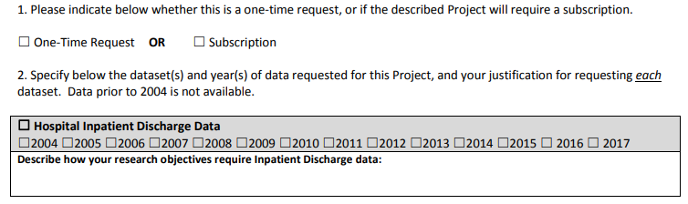
Case Mix FY18 Release
NEW APPLICANTS / NEW PROJECTS:
  We will continue to accept new applications on a rolling basis.
  If you are requesting FY18 data, just click the box for “Subscription” on p. 3 of the application form:

Slide 12
DUA, compliance, and audit overview

Slide 13

Data Use Agreements
Prior to the release of data, Data Applicants must have a CHIA Data Use Agreement executed.
CHIA does not accept revisions or comments to its Data Use Agreement.
Data Applicants should consult their legal, compliance, Research Administration, or Sponsored Programs office about the terms and conditions of CHIA’s Data Use Agreement before they submit a Data Application to CHIA for review.
Data Applicants should consult these offices to determine if its organization has a current Data Use Agreement with CHIA, prior to submitting a Data Application to CHIA for review.

Slide 14

Compliance
It is the responsibility of each organization holding CHIA Data to:
  Monitor responsible parties’ (Investigators, Data Custodians, IT) compliance with the Data Use Agreement requirements.
  Assess each instance of suspected or alleged non-compliance and, where appropriate, conduct investigation.
  Actively pursue non-compliance with a range of technical, administrative and educational response options.
  Inform CHIA immediately of any Data Use Agreement violation.

Slide 15
Compliance
Your obligations, in accordance with the Data Use Agreement, include but are not limited to the following:
Anyone who comes into contact with the data | → | Must sign the confidentiality agreement
All individuals, whether they are employees, contractors or agents of your organization, who have accessed or used the data, must sign a Confidentiality Agreement.
All such individuals must sign the Confidentiality Agreement prior to accessing CHIA Data. You must keep the original signed Confidentiality Agreements on file.
“Access” means the ability, or the means necessary, to read, write, modify, or communicate data/information or otherwise use any system resource.

Slide 16
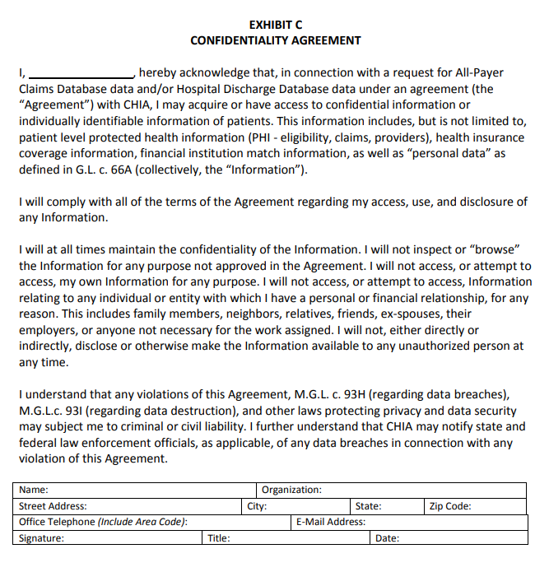

Slide 17
Compliance
Your obligations, in accordance with the Data Use Agreement, include but are not limited to the following:
Anyone who uses the data | → | Must be added to Organization’s Access Log
Your organization is required under the terms of the Data Use Agreement to create and maintain data access logs.
Maintain an up-to-date access log of individuals who use or access the Data, including the date they signed the Confidentiality Agreement, when they were granted access to the Data, and when (if applicable) their access to the Data was terminated.

Slide 18
Compliance
Your obligations, in accordance with the Data Use Agreement, include but are not limited to the following:
Prevent Unauthorized Use or Access | → | Must Abide by the Data Management Plan
You are required to establish appropriate administrative, technical, and physical safeguards.
You are required to abide by the Data Management Plan, as approved by CHIA and incorporated into each Data Application, at all times during the Agreement.
Data may not be transmitted, disclosed or physically moved from the site(s) approved by CHIA, except as authorized by your Data Use Agreement or Data Management Plan. If your organization plans to make any change that may impact the security or integrity of the Data (i.e. a change to any of the information security, encryption, technical and physical controls) you are required to request and receive prior approval from CHIA in writing.

Slide 19
Compliance
Your obligations, in accordance with the Data Use Agreement, include but are not limited to the following:
Ensure that Data is used solely for the Project | → | Must Abide by the objectives and research as described in the Data Application
Each Data Application sets forth a specific project for which the Data will be used and that project’s purpose and objective.
The Data released under a Data Application may be used solely for the Project set forth in that Data Application.
Absent express written authorization from CHIA, the Recipient shall not attempt to link records included in the Data to any other information.
The Recipient shall not use the Data to attempt to identify individuals.

Slide 20
Compliance
Your obligations, in accordance with the Data Use Agreement, include but are not limited to the following:
Upon Completion of Project | → | Must File the Certification of Project Completion and Data Destruction with CHIA
Upon completion of the approved research project (as described in the approved Data Application), data Recipients are responsible for promptly complying with specific obligations under the Data Use Agreement, including:
  Destruction of the Data in accordance with the requirements of the Data Use Agreement, and
  Completion and return of a Certificate of Project Completion and Data Destruction.
  Data destruction, of original extracts and any complete or partial copies thereof, must comply with the requirements of M.G.L. c. 93 I.

Slide 21
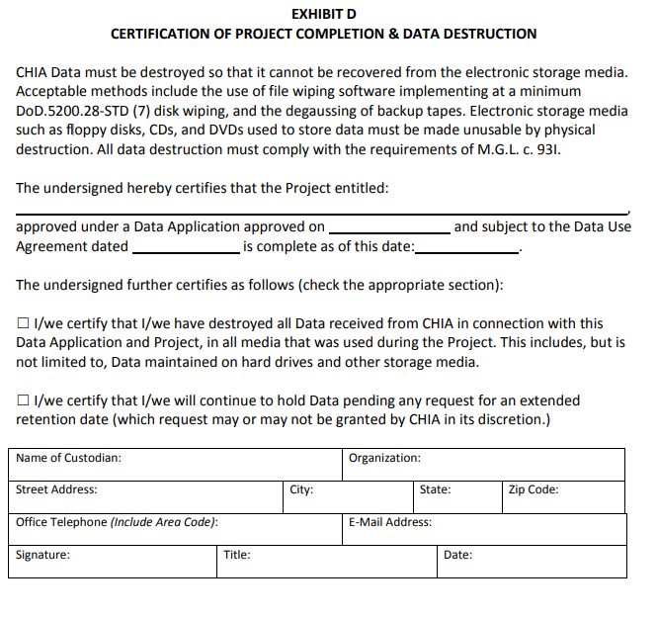

Slide 22

CHIA Data Use Agreement Audits
In accordance with the Data Use Agreement, Recipients are required to promptly respond to any request by CHIA to verify a Recipient’s compliance with the terms of the Data Use Agreement
Data Recipients are also responsible to secure, monitor and report on the compliance of any agent, contractor or third party to whom the Recipient disclosed CHIA Data.
In 2015 CHIA began conducting formal audits of all Recipients of CHIA Data.
These audits may be in the format designate by CHIA. To this point, audits have been in written form designed to get essential information while minimizing the burdens on Data Recipients.
The goal of these audits is to ensure that data is used as allowed under a Data Application and is security as required under the Data Use Agreement and Data Management Plan.
Responses to date have been varied, but some responses have indicated that better understanding of the Data Use Agreement and increase attention to compliance are needed.

Slide 23

General Areas of Non-Compliance
Timeliness:
  Recipients should be able to substantively respond to an Audit request within ten (10) business days.
Data Access Log:
  Incomplete or insufficient information.
Confidentiality Agreements:
  Lack of executed Confidentiality Agreements for current and past employees.
Security:
  Unauthorized transmittal of data; Data may note be physically moved, transmitted or disclosed in any way from or by the site approved by CHIA.
  Unsecured transmittal of data; the use unsecured telecommunications, including the Internet, to transmit individually identifiable or deducible information derived from the Data is prohibited.
Publication:
  Violation of CHIA Cell Suppression policy.
  Unauthorized use.

Slide 24
General Areas of Non-Compliance:
Issue: Lack of Confidentiality Agreements (CA)
CHIA conducted an Audit of a Data Use Agreement with Hospital for a research team using CHIA Data.
After review a review of the Audit materials, CHIA determined that several members of the research team had access to CHIA Data, but had not signed a CHIA Confidentiality Agreement.
Root Cause: A lack of systematic controls or procedures for accessing CHIA Data.
Resolution: The research team created a checklist of required action items (including signing a CA) to be completed prior to an employee being provided access to CHIA Data. The new forms are now included for that research teams onboarding process for new hires.
Issue: Unsecured Transmittal of CHIA Data
CHIA received from a Recipient an encrypted hard drive containing CHIA Data. Accompanying the hard drive was a printed email with the hard drive password. Encrypted media and passwords should never be transmitted together.
Root Cause: Recipient’s information and security policies and procedures addressed the secure storage and transmission of protected health information. However, the procedures did not contain highly specific details relevant to addressing physical handling of the mode of transmission CHIA employs.
Resolution: Revision of Recipient’s policies and procedures to:
  Make it explicit that passwords or encryption keys are never to be printed or recorded in hard copy
  Require the inspection of portable storage devices and accompanying material by two people, one of whom is a designated compliance lead, prior to shipment

Slide 25
General Areas of Non-Compliance:
Issue: Improper Cell Suppression
In reviewing supporting material for a Data Application renewal, CHIA discovered that a digital health company tool was revealing small cell sizes. No cell (e.g., admittances, discharges, patients, services) less than 11 may be displayed.
Root Cause: Cell suppression functionality within the Recipient’s software application was not applied to reports. The Recipient determined that the violation occurred due to a lack of sufficient oversight of the product manager for the software.
Resolution: The Recipient implemented new policies and procedures which require additional review of reports and products by senior executives for compliance with the terms of each of its client's data use agreements prior to actual production.
Issue: Unauthorized Use of CHIA Data
CHIA regularly reviews for publications that cite the use of CHIA Data and requests a list of these publications as part of its auditing. On multiple occasions, CHIA has discovered publications on topics that are clearly not consistent with an approved use described in a Primary Investigator’s Data Application.
Resolution: CHIA demanded prompt destruction of all copies of the data released, a Certificate of Destruction, and notice be given to the institution’s office of Sponsored Programs or Research Administration.

Slide 26
Inventory
Data Inventory
Data Type | Received Date | Destroyed Date | Certificate Submission Date | Study Name | DUA Date
Case Mix and Charge Data |  |  |  | CHIA DATA APPLICATION TITLE
ED, 2004-2010
Observation, 2004-2010
Inpatient, 2004-2010
All Payer Claims Data Release 3.0 , 2010-2013 |  |  |  | CHIA DATA APPLICATION TITLE
Medical Claims
Pharmacy Claims
Member Eligibility
Provider
Medicaid
Case Mix and Charge Data |  |  |  | CHIA DATA APPLICATION TITLE
Inpatient, 2010-2011
Observation, 2010-2011
ED, 2010-2011

Slide 27
Access
Anyone who uses the data | → | Must be added to Organization’s Access Log
Name | Role on Project | Status on Project (active/inactive/ terminated) | Data Access Level | Study Name | Signed Confidentiality Agreement Date | Data Access Granted | Data Access Terminated | Action
NAME | Requestor/Director Sponsored Programs | active | no data access | 1. CHIA DATA APPLICATION TITLE 2. CHIA DATA APPLICATION TITLE | --
NAME | Receipient/Data Custodian/Associate Professor/PI | active | full data access | 1. CHIA DATA APPLICATION TITLE 2. CHIA DATA APPLICATION TITLE
NAME | Contact/Research Project Manager | active | full data access | 1. CHIA DATA APPLICATION TITLE 2. CHIA DATA APPLICATION TITLE
NAME | Primary Investigator/Professor | active | no data access | 1. CHIA DATA APPLICATION TITLE 2. CHIA DATA APPLICATION TITLE | --
NAME | Co-Investigator/Professor | active | no data access | 1. CHIA DATA APPLICATION TITLE 2. CHIA DATA APPLICATION TITLE | --

Slide 28
What Happens If Our Organization Fails an Audit?
Depending on the severity of the DUA violation that was uncovered in the audit process, data Recipients may be instructed:
  To explain deficiencies and informally amend documentation, practices and/or oversight
  To formally conduct a Root Cause Analysis and submit a responsive Corrective Action Plan
  To remove or replace individual violators
  To return and/or destroy all CHIA Data and any copies thereof, and to certify the data destruction
In the case of clear misconduct or misuse of CHIA Data, CHIA will consider suspension of data release to the individual researcher, as well as their host institution.

Slide 29
USER questions

Slide 30

Question: Since the Centers for Disease Control and Prevention (CDC) launched their human papillomavirus (HPV) Vaccine #PreventCancerTogether campaign, we are interested in applying for the MA APCD to evaluate demographic and provider trends in following the CDC’s recommendations to HPV vaccinate children ages 11 or 12. Is there enough information in the MA APCD to conduct this type of study?
Answer: Yes, there is. The CDC’s National Immunization Survey data for Massachusetts (MA) estimates that 82% of MA adolescents ages 13 to 17 have had one or more HPV vaccines. Using MA APCD medical claims Release 7 to look at the minimal age by unique member link EID for adolescents who had their first HPV vaccine, the highest is 91% which occurs at the CDC’s recommended age of 12 years old for all MA resident adolescents (see Fig. 1), with 12 year old females having a higher percent than males (98% vs 84%). Males however have an older age of first time HPV vaccination than females with 59% of 17 year old males vs 32% of females (see Figures 2 and 3).
Fig. 1 - Percent of All Vaccinated MA Adolescents by Age
Fig. 2 - Percent of Vaccinated MA Female Adolescents by Age
Fig. 3 - Percent of Vaccinated MA Male Adolescents by Age

Slide 31

Question: Part of my thesis involves analyzing pharmaceuticals prescribed to the behavioral health population. I would like to minimize the data I apply for and only apply for the pharmacy claims file without the medical claims file. How well populated is the medical diagnosis field in the pharmacy claims file?
Answer: The pharmacy claims field PC114 (Diagnosis Code) has a low filing threshold. In MA APCD Release 7, the field is only 1% populated, specifically 768,787,684 of 771,771,439 pharmacy claim lines do not have a diagnosis code. Although anxiety disorders and major depressive disorders rank in the top 10 medical conditions in those pharmacy claims with the diagnosis code field populated (see Table 1 below), the volume is not representative of the behavioral health diagnosis that would be obtained by applying for the medical claims file and linking it to the pharmacy claims table.
Table 1. Top 10 Medical Conditions Populating
Pharmacy Claims Diagnosis Code Field
Rank | Medical Condition
1 | Essential Hypertension
2 | Type 2 Diabetes
3 | Hyperlipidemia
4 | Gastroesophageal Reflux Disease
5 | Hyperthyroidism
6 | Anxiety Disorder
7 | Major Depressive Disorder
8 | Chronic Obstructive Pulmonary Disease
9 | Encounter for Issue of Repeat Prescription
10 | Cough

Slide 32

What is Minimum Data Use?
Question: The census data and GIS software have hundreds of fields I might want to use and require linkage with CHIA data. Why do I have to provide CHIA with a full list of new data elements that would be added CHIA data after data linkage?
Answer: While data linkage brings together two or more sets from potentially different sources to maximize their scientific value in a merged data set, a list of all data elements is requested in order to ensure minimal use.
Minimum data use involves use of the minimally feasible number of data elements by an applicant in order to reduce the risk of inadvertently re-identifying individuals. There a data elements removed from the limited data set in order reduce the risk of re-identifying individuals. However, the addition of more data elements risks adding back data elements that were removed from the limited data set and the addition of any data element can incrementally increase re-identification. CHIA requires that the application be accompanied by a signed Data Use Agreement specifying the applicant agrees to use the data only for approved objectives and that the applicant will not attempt to re-identify individuals.

Slide 33

TIPS ON EXPLAINING YOUR USE OF DATA LINKAGE ON YOUR APPLICATION
Clearly describe why the project requires data linkage
Make sure that the information augmentation does not include the addition of patient identifiers
Determine whether linkage is at the person level or facility level
    Example of Person-Level: Linkage of ZIP code to Contextual Data:
      Census data – population & housing
      EPA data – Environmental air quality
      State level data – generosity of Medicaid payments
  Example of Facility-Level: Linkage of Hospital Name to Hospital Characteristic Data:
      American Hospital Associations Annual Survey of Hospital
If you intend to run CHIA data through an enhancement software product such as a GIS, that is considered data linkage and you must include data elements added by the software.

Slide 34

Question: I am having a problem separating out claims for emergency department care. The volume I have is lower than what I expected. Can you explain which fields can be used to filter for emergency department care?
Answer: Below is a list of five data elements that can to used to analyze emergency department care.
Revenue Codes
For Emergency Room Use
0450, 0451, 0452, 0456, 0459, 0981 = Professional fees-Emergency room
Site of Service - on NSF/CMS 1500 Claims (for Professional Claims only)
23 = Emergency Room-hospital
HCPCS procedure codes
For Emergency Room Evaluation & Management
99281, 99282 , 99283, 99284, 99285, 99291, 99292
Admission Source
Inpatient Claims for patient referred through Emergency Room
7 = Emergency Room
MC054
MC037
MC055
Can be used as an Indicator of a Claim for Prior Emergency Room Care
MC021

Slide 35
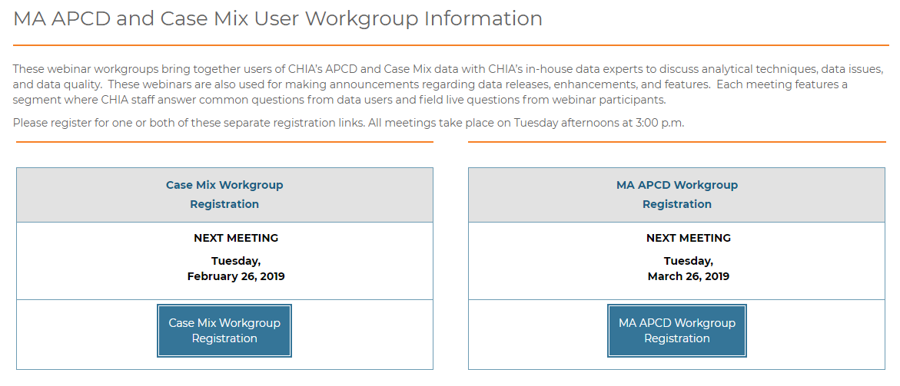
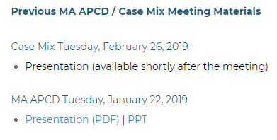
Where can I find old User Workgroup Presentations?
http://www.chiamass.gov/ma-apcd-and-case-mix-user-workgroup-information/

Slide 36
Questions?
Questions related to MA APCD:
apcd.data@state.ma.us
Questions related to Case Mix:
casemix.data@state.ma.us
REMINDER: Please include your IRBNet ID#, if you currently have a project using CHIA data.

Slide 37
Call for Topics and Presenters
If there is a TOPIC that you would like to see discussed at an MA APCD or Case Mix workgroup in 2019, contact Adam Tapply [adam.tapply@state.ma.us]
If you are interested in PRESENTING at an MA APCD or Case Mix workgroup in 2019, contact Adam Tapply [adam.tapply@state.ma.us]
You can present remotely, or in-person at CHIA.

