Slide 1
MA Center for Health Information & Analysis
MA APCD User Workgroup
October 25, 2016

Slide 2
Agenda
Announcements
  Updates on FY15 Case Mix release
New Online Tutorial: “How to submit an application on IRBNet”
Workaround for Missing MEIDs
Questions Answered by CHIA
Q&A

Slide 3
MA APCD Release 5.0
Application forms are posted on the APCD website: http://www.chiamass.gov/application-documents/
Data is ready for release now
Release documentation (including full data specifications and release documentation) has been posted to the APCD website: http://www.chiamass.gov/ma-apcd/
No change in fees or fee waiver provisions with this release

Slide 4
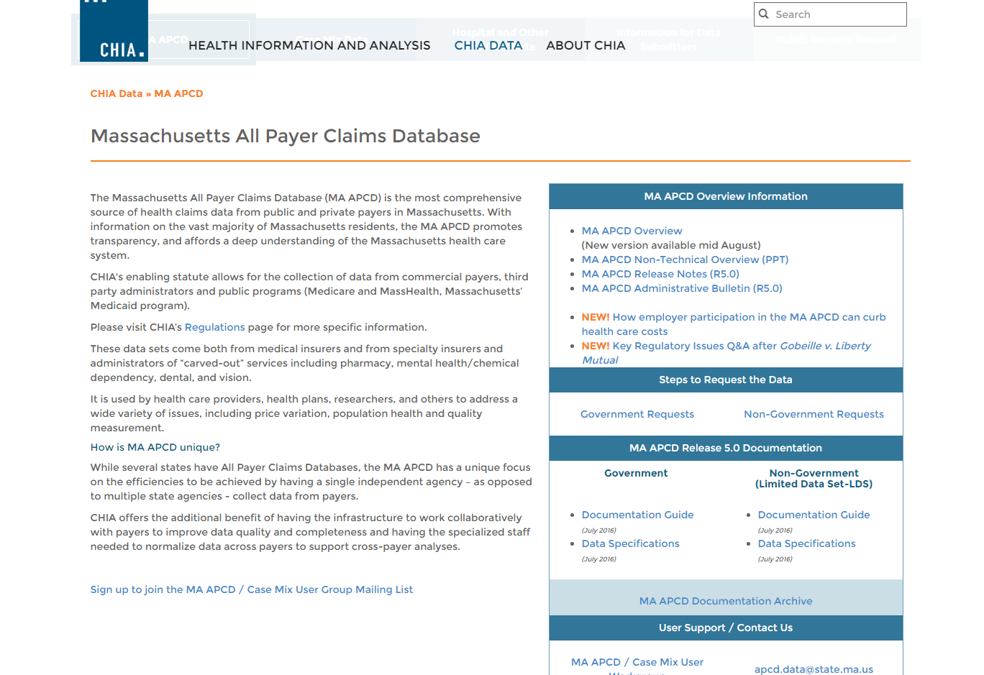
Release Documentation

Slide 5
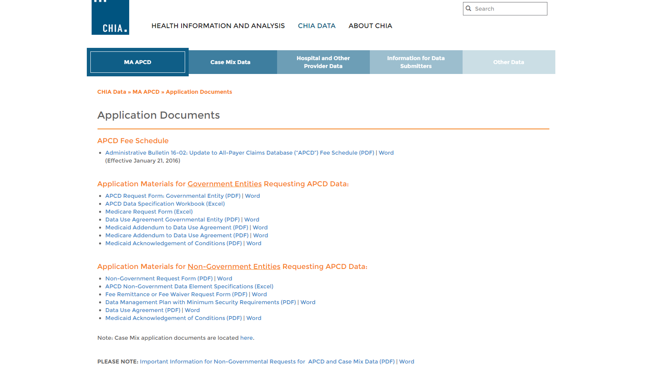

Revised Application Forms
Posted here: http://www.chiamass.gov/application-documents

Slide 6
Case Mix FY15 Release
We are accepting applications for FY15 Case Mix data NOW
Inpatient Data is going out the door now
  Emergency Department ready in late November
  Outpatient Observation release date is TBD right now
Apply for all files now and we will fulfill them as they become available.
FY15 Case Mix data in LDS format
FY04-FY14 available in old “Levels” format (can request on the same application form)

Slide 7
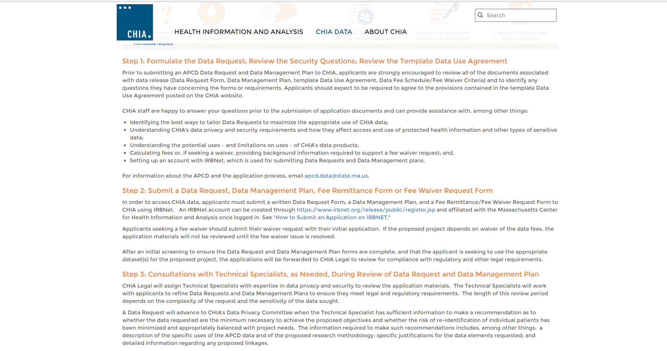
Tutorial: How to submit an application on IRBNet
New PDF tutorial can be found on both the APCD and Case Mix webpages:
http://www.chiamass.gov/non-government-agency-apcd-requests/
http://www.chiamass.gov/non-government-agency-case-mix-requests/
Under “Step 2”
Direct Link:
http://www.chiamass.gov/assets/Uploads/data-apps/Application-Submission-IRBNet-Tutorial.pdf

Slide 8
Application Reminders
Don’t forget to upload CVs/Resumes for the “core project team” (even if you’ve previously been approved for data)
Don’t forget to upload IRB documentation (even if it’s been determined that you are not subject to IRB review)
Don’t forget to upload your Research Methodology, per Section II of the application (recently updated). This is required for ALL applicants.

Slide 9
QUESTIONS?

Slide 10

Question: What should I do if the Member Link Entity Identifier (MEID) is missing?
Answer: APCD Releases 3.0, 4.0, and 5.0 include a derived MEID that intended to identify a unique person common across all Carriers and over time within a release. When the MEID is missing for any given subset of eligibility or claims records, an alternative way to achieve linkage is to use the Carrier’s OrgID number plus the Carrier Specific Unique Member ID as a concatenated key:
    For APCD Release 5.0
    ORGID + CHIACARRIERSPECIFICUNIQUEMEMBERID
    For APCD Release 3.0 and 4.0
    ORGID + HASHCARRIERSPECIFICUNIQUEMEMBERID
This key will identify a unique member within a Carrier, and will be constant across member eligibility (ME) and all medical (MC), pharmacy (PC), and dental claims (DC) data files.
Please note that these OrgID and Carrier Specific Unique Member ID data elements (columns) are present on every record (row) across all filing types. There are some caveats, in that the reported Carrier Specific Unique Member ID is subject to a small percentage of error as reported by the carrier. Again, while the MEID identifies a unique person across all Carriers, the concatenated key identifies a unique person within a Carrier.

Slide 11
Question: I would like to do geographic analysis of medical procedures. My study does not require data from the eligibility file. However, since member ZIP code data is in both the claims file and eligibility file, are there any differences in the completeness of member ZIP code data in different APCD file types?
Answer: In APCD Release 5.0, for Massachusetts residents, the ZIP Code data for the different file types is over 90 percent complete with the Member Eligibility file having the highest percent completeness (99.99% complete) where for 9,778,160 distinct MA resident MEIDs, only 806 MEIDs are missing ZIP code data. So for the small percent of instances where the ZIP Code data is missing in the claims file, that data would likely be available in the eligibility file which has a high percent of completeness.
File Type | Percent Completeness of Member ZIP Code for Massachusetts Residents
Member Eligibility | 99.99%
Dental Claims | 97.60%
Pharmacy Claims | 92.09%
Medical Claims | 90.63%

Slide 12
Question: Is death data available in Case Mix and APCD?
Answer: The specification for currently released case mix data have information on expired during inpatient , outpatient ED or observation stay care, on dead on arrival to the ED. The APCD contains data on expired patients but also includes medical setting and non-medical setting hospice deaths. The date of death in the eligibility file is only released to approved Government data users.
Case Mix
Discharge Status
  Hospital Inpatient Discharge - Code 20 – Expired
Departure Status
  Hospital Outpatient Observation Stay - Code 5 - Expired
  Hospital Outpatient Emergency Department - Code 0 – Died During ED Visit
  Hospital Outpatient Emergency Department - Code 9 – Dead on Arrival
APCD Medical Claims
Discharge Status
20 Expired
    40 Expired at home (hospice claims only)
    41 Expired in a medical facility hospice (Hospice claims only)
    42 Expired - place unknown (Hospice claims only)
APCD Member Eligibility
Member Date of Death
This Date is only released to approved Government Data Users

Slide 13
Question: How can I determine Massachusetts residents who belong to a Patient Centered Medical Home and the providers who care for them?
Answer: The Member Eligibility file Limited Data Set file contains three home health related fields:
Code | Field Name | Definition
ME035 | Health Care Home Assigned Flag | Carriers report the value that defines whether a Member has an assigned approved patient centered medical home for this coverage period. For example, the Code 1 = Yes.
ME036 | Health Care Home Number | When ME035 = 1, report the submitter assigned patient centered medical home number. It is anticipated that this will be the same data submitter number used in reporting servicing provider. The number of the member’s healthcare home must also be in the Provider File in PV002, Provider ID.
ME038 | Health Care Home National Provider ID (NPI) | Report the National Provider Identification (NPI) number for the entity or individual serving as the medical home.
For those with a Flag of Code 1 for ‘Yes’ in MEO35, the Home Health Care Home Number has a 90% filing Threshold. However, the quality of this field exceeds its threshold and is 100% populated and can be used for linking to medical claims and the provider file. ME038 has a filing threshold of 10% and is 8% populated. Therefore it is better to rely on the Home Health Care Home Number for determining providers who care for members belonging to a Patient Centered Medical Home.

Slide 14
Question: How well populated is the type of facility field?
In Release 5.0, the Type of Facility data has a high percent completeness (see frequencies below) and is another field that can be used to determine care setting.
Definition | Type of Facility Code | Number of Claim | Frequency
Invalid Code | 0 | 7205 | 0.00%
General Acute Care Facility | 1 | 85076261 | 41.51%
Skilled Nursing Facility/Long Term Care Facility | 2 | 3490844 | 1.70%
Intermediate Care Facility | 3 | 396859 | 0.19%
Hospice Facility | 4 | 124762 | 0.06%
Designated Cancer Center | 5 | 842828 | 0.41%
Designated Inpatient Children's Hospital | 6 | 170556 | 0.08%
Inpatient Rehabilitation Facility | 7 | 1022213 | 0.50%
Inpatient Psychiatric Hospital | 8 | 1424106 | 0.69%
Critical Access Hospital | 9 | 308420 | 0.15%
VNA/Home Care | 10 | 48756 | 0.02%
Other Type of Facility | 70 | 112021814 | 54.66%

Slide 15
Questions?
Questions related to APCD: (apcd.data@state.ma.us)
Questions related to Case Mix: (casemix.data@state.ma.us)
REMINDER: Please include your IRBNet ID#, if you currently have a project using CHIA data

Slide 16
Call for Topics and Presenters
If there is a TOPIC that you would like to see discussed at an MA APCD or Case Mix workgroup, contact Adam Tapply [adam.tapply@state.ma.us]
If you are interested in PRESENTING at an MA APCD or Case Mix workgroup, contact Adam Tapply [adam.tapply@state.ma.us]
  You can present remotely from your own office, or in-person at CHIA.

