Slide 1
APCD user workgroup
Don Kirkwood (Manager of Data Release and Procurement)
Sylvia Hobbs (Manager of User Support)
Scott Curley (Manager Privacy & Compliance)
October 27, 2020
CENTER FOR HEALTH INFORMATION AND ANALYSIS

Slide 2
Agenda
Announcements:
  APCD Release 8.0 Updates
  FY19 Case Mix Release Projections
  Data Release and Application Update
Website Updates
Application Reminders
User Support Questions
  Municipal Ambulance Billing
  ICU utilization
  Blood draw and transfusion
  Patient status
Q&A

Slide 3
MA APCD Release 8.0
  Available NOW
  Applicants with approved projects that require updated APCD data (Release 8.0) should submit to CHIA a completed Exhibit B (Certificate of Continued Need and Compliance) of the Data Use Agreement. After submitting a completed Exhibit B you will receive an invoice (if applicable) for the requested data. Upon payment of the invoice the order for the data will be placed.
  Release 8.0 includes data on services from January 2014 – December 2018 with six months of claim runout (includes paid claims through 6/30/19).
  Will be linkable to Release 7.0 via crosswalk
  Additional information on highlights and enhancements will be presented in future APCD User Workgroups.

Slide 4

Case Mix FY19 Release
*CURRENT* RELEASE TIMEFRAMES FOR EACH FILE:
  Inpatient (HIDD)
  Available for request and delivery
  Emergency Department (ED)
  Available for request and delivery
  Outpatient Observation (OOD)
  Available for request
  Applicants with approved projects that require newly available year(s) of Case Mix Data (e.g., FY 19) should submit to CHIA a completed Exhibit B (Certificate of Continued Need and Compliance) of the Data Use Agreement. After submitting a completed Exhibit B you will receive an invoice (if applicable) for the requested data. Upon payment of the invoice the order for the data will be placed.

Slide 5
Data Release and Application Updates
Due to Governor Baker’s emergency actions to limit the spread of COVID-19 CHIA’s workforce will be remote, for now. This arrangement will limit CHIA’s ability to produce and deliver data extracts. At this time, CHIA is releasing data and providing extracts to requestors.
During this time, CHIA will continue to accept and review data applications for both Case Mix and All-Payer Claims Database (MA APCD) datasets. Review committees, DRC and DPC, will continue their meetings remotely as necessary.
Due to CHIA’s physical office being closed, applications will be accepted without a fee. After receipt of the application, CHIA will issue an invoice which will allow applicants to remit payment online.
If you are a Data User that has a CHIA hard drive in your possession, please keep the hard drive at this time while CHIA’s physical office is closed.

Slide 6
Website Release Updates
  Updates on the production of APCD and Case Mix databases and status of data requests are now posted to CHIA’s website!
    Aim #1 is to provide weekly or bi-weekly status update on CHIA data products as they are in development.
    Aim #2 is to provide applicants with information about expected fulfillment status for individual data requests.
    Request IDs will be communicated to Data Requestors via email.
  Please visit http://www.chiamass.gov/status-of-data-requests/ to see the current status of releases.

Slide 7
Application reminders

Slide 8
Fee Waiver Request Reminders
  If you’re submitting a request for a fee waiver, remember to include the fee remittance form in your application package on IRBNet.
  Remember to submit supporting documentation (if required).
  If you’re requesting a financial hardship waiver, remember to submit information detailing your project’s financial situation (examples: project budget, grant funding, organizational / departmental funding). Also request to pay a specific price that you reasonably believe you’re able to afford to contribute.
  CHIA generally does not offer full financial hardship fee waivers. We expect all applicants to have made an attempt to find funding to cover the full cost of the data fees.
  Fee waiver requests can take some time to process – especially financial hardship requests.

Slide 9
USER questions

Slide 10

Question: I am using the decrypted 10-digit National Provider Identifier (NPI) in the MA APCD to link to the NPIs in the CMS National Plan and Provider Enumeration System (NPPES) Registry to obtain organization names and am having a problem finding the names for ambulance services. Many MA APCD medical claims with HCPCS procedure codes (‘A04%’) associated prehospital emergency ambulance care, in the NPI Registry’s Organization Name, sometimes only have a city or town name.
Answer: As of July 2020, Massachusetts has 317 licensed ambulance services and 67% of those ambulance services are based in fire departments operating under municipal government budgets. Therefore, on both their state license application name with MDPH and on their NPI organization name with CMS, the municipality is listed as the Provider Organization’s Legal Business Name. In the NPI Registry, in on order to obtain the specific name of the ambulance service when it is not listed as the legal business name, you can download the Provider Other Organization Doing Business as Name. Table 1 below shows examples from the NPI registry where you can see that while the municipality is listed as the legal business name, a fire department or ambulance service is listed as the other organization name with the Fire Chief as authorized official’s title.
Table 1. Example from CMS NPI Registry of Provider Organization Legal Business Name and Other Name
Provider Organization Name (Legal Business Name) | Provider Other Organization Name | Authorized Official Title or Position
CITY OF ARLINGTON | ARLINGTON FIRE DEPARTMENT | FIRE CHIEF
CITY OF LAWRENCE | CITY OF LAWRENCE FIRE DEPARTMENT | FIRE CHIEF
CITY OF NEWTON | NEWTON FIRE DEPARTMENT | FIRE CHIEF
TOWN OF AGAWAM | AGAWAM AMBULANCE SERVICE | FIRE CHIEF
TOWN OF AMHERST | TOWN OF AMHERST AMBULANCE SERVICE | FIRE CHIEF
TOWN OF ANDOVER | ANDOVER FIRE DEPARTMENT | FIRE CHIEF
TOWN OF AVON | AVON FIRE DEPARTMENT | FIRE CHIEF
TOWN OF BOYLSTON | BOYLSTON FIRE DEPARTMENT AMBULANCE | FIRE CHIEF
TOWN OF BRIDGEWATER | BRIDGEWATER FIRE DEPARTMENT | FIRE CHIEF
TOWN OF BURLINGTON | BURLINGTON AMBULANCE SERVICE | FIRE CHIEF
TOWN OF DUDLEY | DUDLEY FIRE AND EMERGENCY SERVICES | FIRE CHIEF
TOWN OF NEEDHAM | NEEDHAM AMBULANCE SERVICE | FIRE CHIEF
TOWN OF WHITMAN | WHITMAN AMBULANCE SERVICE | FIRE CHIEF
TOWN OF WRENTHAM | WRENTHAM FIRE DEPARTMENT | FIRE CHIEF

Slide 11
Answer (continued): As of October 2020, when you download and decompress the CMS NPPES
ZIP file, it will extract to 8 reference files containing NPI data. CMS has conveniently created a
smaller lookup file (called “othername_pfile”) which contains only 3 fields: the NPI, the Provider
Other Organization (i.e. the Doing Business as Name) and the Provider Other Organization
Type Code. Linking the MA APCD decrypted NPI to this smaller CMS “othername_pfile” is
the quickest way to obtain the names of ambulance services.
In the MA APCD, there are medical claims from ambulance services located in every state in the U.S. You will find the same combination in other states where services may fall under the licensing jurisdiction of a city, town or, in some instances, a village. While in Massachusetts, there are more municipal ambulance services that provide coverage for their specific city or town (and mutual aid to other cities and towns when needed) (see Figure 1 below), private ambulance services have more vehicles and wider geographic range (see Figure 2 below). For example, the non-profit private ambulance service Boston Medflight has 14 vehicles including critical care ground transport vehicles, helicopters and a fixed wing twin-engine aircraft, the latter has geographic coverage capability of 1,380 land miles and has transported patients from Midwest and Southeastern U.S.
105 Services
684 Vehicles
212 Services
1,286 Vehicles
* Source: Massachusetts Department of Public Health Ambulance Licensing Database as of July 2020

Slide 12

Question: I applied for, was approved and received the Provider file. But my extract is missing copies of I expected to receive. When I looked at the filing specifications, the provider file has at least 60 fields but my extract only has about a dozen fields. Why are all of those fields collected and not released?
Answer: Non-government researchers applying for the MA APCD should always
defer to fields listed on the LDS spreadsheet available on the CHIA website at:
https://www.chiamass.gov/assets/docs/p/apcd/apcd-8.0/APCD-Release-8-Non-Govt-Request-LDS-Data-Specification-Workbook-Vers-2.3.xlsx
While the filing specifications are a useful tool for finding definitions and lookup values of particular data elements, they are not intended to provide information on the exact selection of elements in the products released to data applicants. The larger selection of fields are collected for government use only. It is a common oversight on non-government data applications not to heed the exact limited number of data elements available in the LDS provider file. See list below.
MA APCD Limited Data Set (LDS) Provider File
Release Level | Data Element Source | Data Element Name
2 | PV039 | National Provider ID
2 | PV039 | National Provider ID - Masked
2 | PV040 | National Provider2 ID
2 | PV040 | National Provider2 ID - Masked
2 | Derived | Release ID
2 | Derived | Provider Delegate
2 | Derived-LDS | CMS Provider Type (1= Individual (Physician), 2= Non-Individual (Entity), Null= Missing linkage or not present on NPI table
2 | Derived | Submission Year Month
2 | Derived | Submission Control ID
2 | Derived | Provider ID
2 | PV001 | Submitter
2 | PV002 | Plan Provider ID
2 | PV015 | Provider DOB (Year Only)
2 | PV021 | ZIP Code

Slide 13

Question: I am applying for the MA APCD medical claims data. I see that the medical claims has a “discharge status.” Does that field only relate to inpatient acute care or discharge it include discharge from any inpatient care setting?
Answer: In the discharge status field (MC023), carriers are required to populate the
field when type of claim (MC094) equals facility (code 002) and discharge date
(MC069) is populated. May be present without discharge date when the type of
claim equals facility populated when and the discharge status code equals code 30
(still a patient). The reporting of discharge status is not limited acute care facilities. General acute care hospitals have a higher volume of facility claims. That is the reason it might appear that discharge status is limited to acute care. In looking at all of the medical claims in MA APCD Release 7.0 by type of facility (MC245), in addition to general acute care, as you can see in Table 1 below, the discharge status field is populated in 10 other inpatient facility types.
Table 1. Frequency of Discharge Status Field Use by Facility Type
Value | Description | Frequency
1 | General Acute Care Facility | 66.16%
70 | Other Type of Facility | 19.65%
10 | VNA/Home Care | 7.77%
2 | Skilled Nursing Facility/Long Term Care Facility | 3.66%
7 | Inpatient Rehabilitation Facility | 0.82%
5 | Designated Cancer Center | 0.51%
8 | Inpatient Psychiatric Hospital | 0.44%
9 | Critical Access Hospital | 0.34%
4 | Hospice Facility | 0.26%
3 | Intermediate Care Facility | 0.25%
6 | Designated Inpatient Children’s Hospital | 0.15%

Slide 14
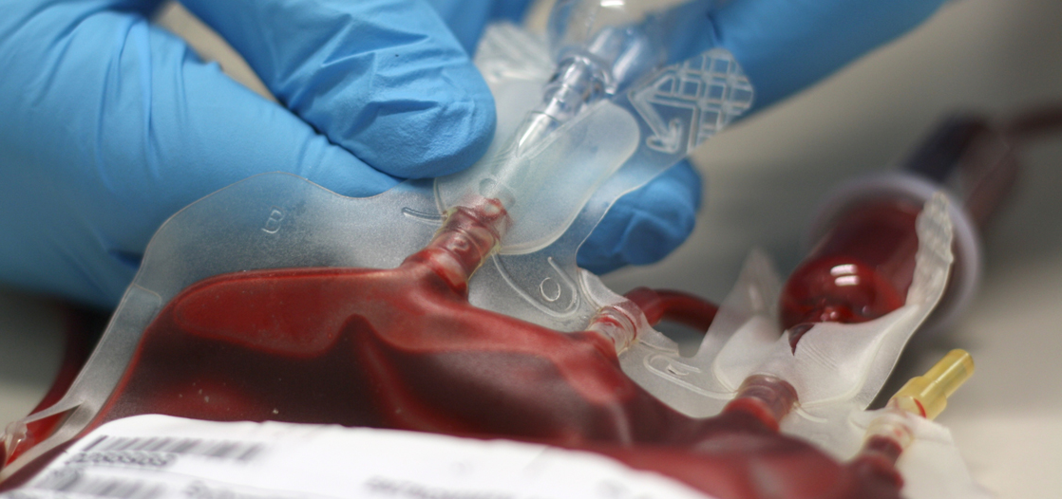
Question: I am applying for the MA APCD to study blood transfusion related adverse reactions, including adverse reaction rates for different transfused components, diagnostic and therapeutic interventions for different types of adverse reactions, and analyze the blood transfusion chain in both the outpatient and inpatient care settings. I wanted to verify that the MA APCD medical claims had a specific field from which I would be able to quantify the units of blood transfused.
Answer: Yes, the limited data set released to non-government data applicants does contain 14 fields that with information on blood transfusion and units of blood. Government data users can apply for additional fields with information such as on donations on a patient’s behalf contain in the value code fields, and related information in the occurrence code and condition code fields.
  Non-Government Limited Data Set
  MC054 Revenue Code
  MC061 Quantity
  MC055 Procedure Code
  MC056 Procedure Modifier - 1
  MC057 Procedure Modifier - 2
  MC108 Procedure Modifier - 3
  MC109 Procedure Modifier - 4
  MC058 ICD-CM Procedure Code
  MC083 Other ICD-CM Procedure Code - 1
  MC084 Other ICD-CM Procedure Code - 2
  MC085 Other ICD-CM Procedure Code - 3
  MC086 Other ICD-CM Procedure Code - 4
  MC087 Other ICD-CM Procedure Code - 5
  MC088 Other ICD-CM Procedure Code - 6

Slide 15
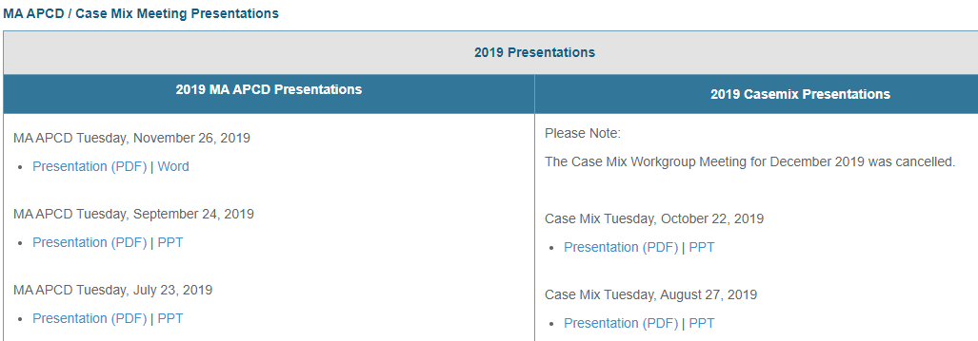
Where can I find past User Workgroup Presentations?
http://www.chiamass.gov/ma-apcd-and-case-mix-user-workgroup-information/

Slide 16
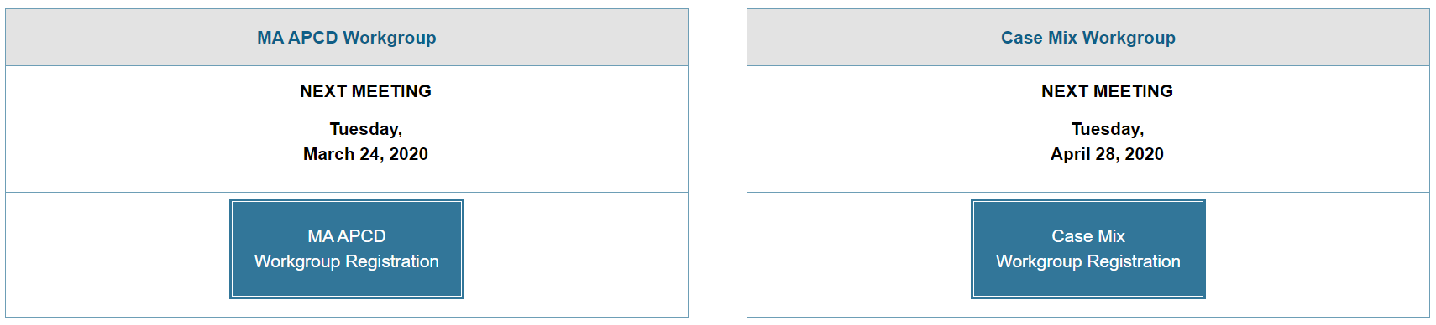
When is the next User Group meeting?
The next User Group will meet Tuesday, November 24.
http://www.chiamass.gov/ma-apcd-and-case-mix-user-workgroup-information/

Slide 17
Questions?
Questions related to MA APCD:
apcd.data@state.ma.us
Questions related to Case Mix:
casemix.data@state.ma.us
REMINDER: Please include your IRBNet ID#, if you currently have a project using CHIA data.

Slide 18
Call for Topics and Presenters
If there is a TOPIC that you would like to see discussed at an MA APCD or Case Mix workgroup in 2020, contact Amy Wyeth [amy.wyeth@state.ma.us]
If you are interested in PRESENTING at a MA APCD or Case Mix workgroup in 2020, contact Amy Wyeth [amy.wyeth@state.ma.us]
You can present remotely, or in-person at CHIA
We may be reaching out to some data users with invitations to present, and hope you will consider this!

