Slide 1
MA Center for Health Information & Analysis
MA APCD User Workgroup
September 25, 2018

Slide 2
Agenda
Announcements / Updates
  MA APCD Release 7.0
  FY17 Case Mix
More Info on Summarized Data Reports
User Support Slide Topics:
  Determining payments made by patients
  GIS data linkage
Q&A

Slide 3
MA APCD Release 6.0
Encompasses data from January 2012 – December 2016 with six months of claim runout
Release Documentation and Data Specifications are now available online
Available here: http://www.chiamass.gov/ma-apcd/
Apply now by listing 2016 (and any other years you want from Release 6.0) in the “Years Requested” section of the current application form
Available here: http://www.chiamass.gov/application-documents

Slide 4
MA APCD Release 7.0
Expected to be available Late 2018
  Attend our monthly APCD/Case Mix User Workgroups for updates each month
  Sign up for the APCD Eblast list for important announcements
Will encompass data from January 2013 – December 2017 with six months of claim runout
COMING SOON:
  Information on how/when to apply
  Information on new data enhancements
  Data updates
  New LDS data elements

Slide 5
Case Mix FY17 Release Calendar
  *CURRENT* RELEASE TIMEFRAMES FOR EACH FILE:
  Inpatient (HIDD)
  JUNE [COMPLETED]
  Emergency Department (ED)
    SEPTEMBER
  Outpatient Observation (OOD)
    OCTOBER

Slide 6
Summarized Data Reports
Will contain only aggregate data (data summaries) and De-identified Data, sourced from MA APCD and Case Mix data
  Will be subject to CHIA’s cell suppression policy (no cell less than 11 will be displayed)
Request form can be found on the MA APCD Application Documents page: http://www.chiamass.gov/application-documents
  Data Management Plan and Data Use Agreement are not required.
A support/production fee of $140/hour will be charged
  **We will let you know the expected number of hours required, as well as when we expect to complete the work, prior to proceeding**

Slide 7
What goes into creating a report?
Summarized Data Reports take, on average, 10 hours of CHIA resource time to complete.
Steps include:
Initial review to determine feasibility and spot potential issues
Additional review and revisions with applicant to determine final specifications
Final review and Approval to proceed with the report request
Create documentation, including code, on steps to complete request
Independent code review and QA of results
Create documentation for the recipient
Produce final cut of data / report results

Slide 8
QUESTIONS?

Slide 9

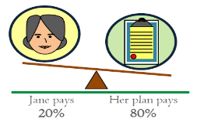
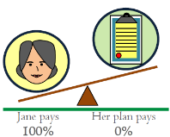
Question: The MA APCD Medical Claims file has lots of currency fields. What data elements can I use to identify the payments made by the patients?
Answer: The MA APCD Medical Claims file has twenty-five currency data elements (See Table 1 below). There are 4 data elements that can be used to identify the amount the member/patient is responsible to pay: MC065 (Copay Amount), MC066 (Coinsurance Amount), MC067 (Deductible Amount) and MC121 (Patient Total Out of Pocket Amount) (See Table 2 Below).
Table 1: Currency Data in MA APCD Medical Claims
Table 2: Currency Data on amount Patient is Responsible to Pay
Data Element | Description
MC062 | Charge Amount
MC063 | Paid Amount
MC064 | Prepaid Amount
MC065 | Copay Amount
MC066 | Coinsurance Amount
MC067 | Deductible Amount
MC096 | Other Insurance Paid Amount
MC097 | Medicare Paid Amount
MC098 | Allowed amount
MC099 | Non-Covered Amount
MC114 | Excluded Expenses
MC116 | Withhold Amount
MC121 | Patient Total Out of Pocket Amount
MC192 | Value Amount - 1
MC194 | Value Amount - 2
MC196 | Value Amount - 3
MC198 | Value Amount - 4
MC200 | Value Amount - 5
MC202 | Value Amount - 6
MC204 | Value Amount - 7
MC206 | Value Amount - 8
MC208 | Value Amount - 9
MC210 | Value Amount - 10
MC212 | Value Amount - 11
MC214 | Value Amount - 12
MC065 Copayment Amount : The carrier’s preset, fixed amount for the claim line that the patient is responsible to pay. For example, during a routine primary care visit, you might see a sign saying, “Your Co-Pay is Due at Time of Service”.
MC066 Coinsurance Amount : The carrier’s calculated percentage amount for claim line service that the patient is responsible to pay. Coinsurance is the calculated percent of the allowed amount for the service. The patient typically pays coinsurance plus any deductibles. For example*, if the coinsurance is 20% and the allowed amount for the visit is $100, the patient would pay $20 and the health plan pays the rest of the allowed amount 80% ($80).
MC067 Deductible Amount : The carrier’s preset, fixed amount for the claim line that the patient is responsible to pay. For example, if the deductible is $1,000 and the service is $999.99, the plan’s coinsurance would not apply until after the deductible has been reached. The deductible may not apply to all services.
* Reference: https://www.cms.gov/CCIIO/Resources/Files/Downloads/uniform-glossary-final.pdf

Slide 10

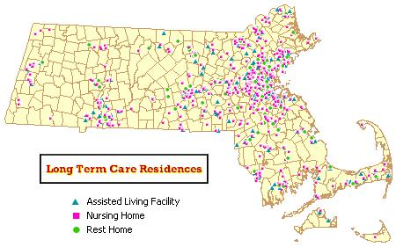
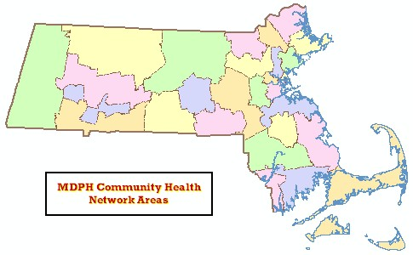
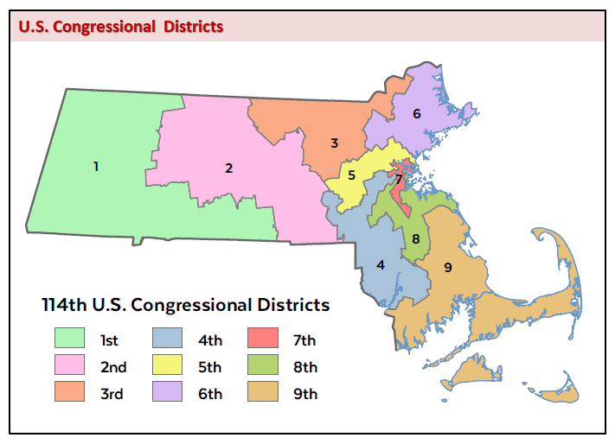
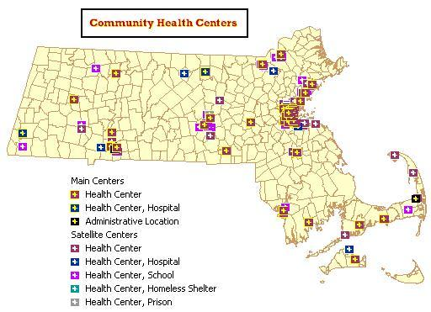
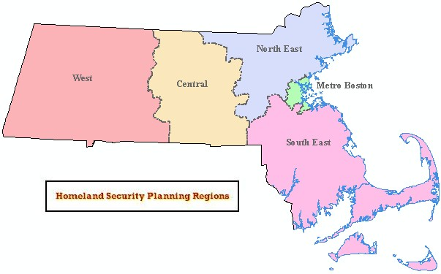
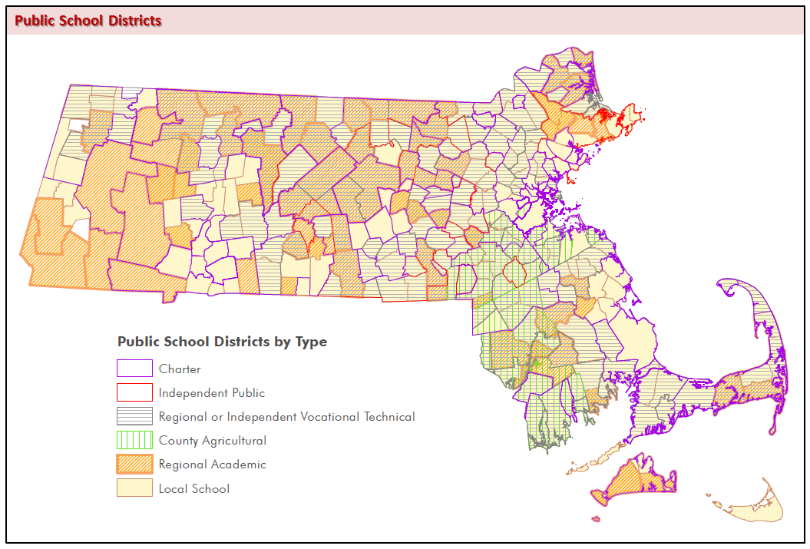
Question: I am filling out the data linkage section of my application and wanted to know if using geographic information systems (GIS) is considered “data linkage”?
Answer: Yes. GIS involves linking CHIA data to add spatial data layer attributes (see Data Layer examples below). Whenever data linkage is involved, you should provide a list all of the data elements that will be added and determine whether linkage is at the person level or facility level.
Example of Person-Level: Linkage of ZIP code to Contextual Data:
      Census data – population & housing
      EPA data – Environmental air quality
      State level data – generosity of Medicaid payments
  Example of Facility-Level: Linkage of Hospital Name to Hospital Characteristic Data:
      American Hospital Associations Annual Survey of Hospital
gis

Slide 11
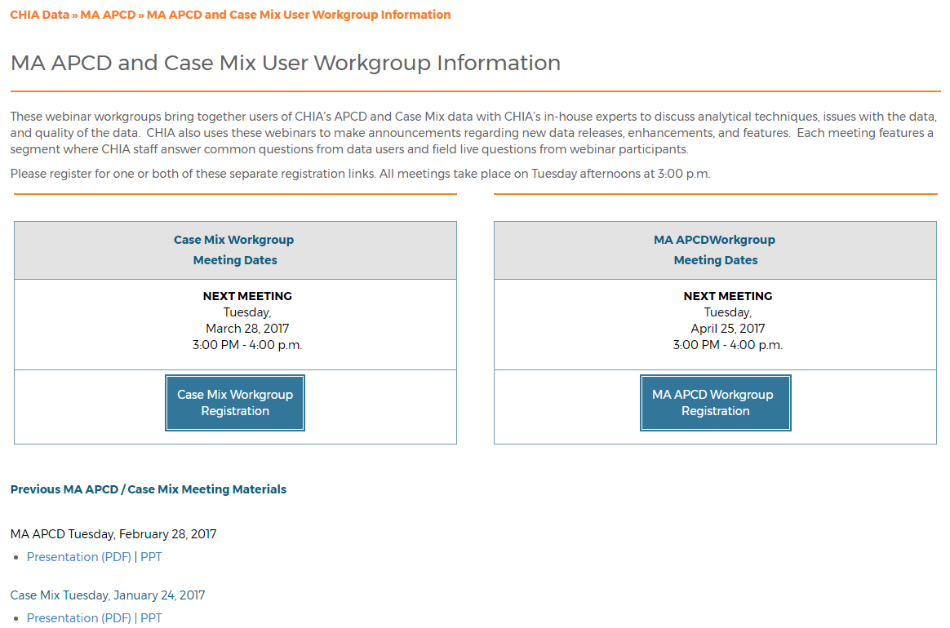
Where can I find old User Workgroup presentations?
http://www.chiamass.gov/ma-apcd-and-case-mix-user-workgroup-information/

Slide 12
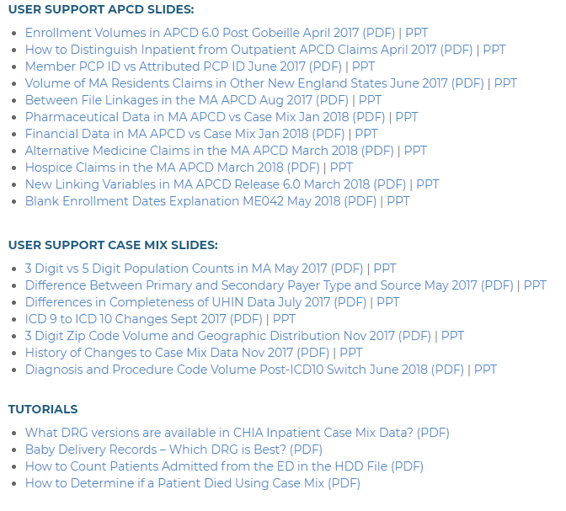
NEW! Updates to the User Workgroup Webpage
User Support slides and tutorials are now available to view and download separately from the presentations.
We will continue to update this page as new presentations happen from month to month.
Link: http://www.chiamass.gov/ma-apcd-and-case-mix-user-workgroup-information/

Slide 13
Questions?
Questions related to MA APCD: (apcd.data@state.ma.us)
Questions related to Case Mix: (casemix.data@state.ma.us)
REMINDER: Please include your IRBNet ID#, if you currently have a project using CHIA data

Slide 14
Call for Topics and Presenters
If there is a TOPIC that you would like to see discussed at an MA APCD or Case Mix workgroup in 2018, contact Adam Tapply [adam.tapply@state.ma.us]
If you are interested in PRESENTING at an MA APCD or Case Mix workgroup in 2018, contact Adam Tapply [adam.tapply@state.ma.us]
  You can present remotely from your own office, or in-person at CHIA.

