Slide 1
CHIA Data User Workgroup
Donald Kirkwood, Manager of Data Release and Procurement
Anne Medinus, Senior Research Account Specialist
Sylvia Hobbs, Associate Director of Data Strategy and User Support
September 24, 2024

Slide 2
Agenda
Announcements:
  FY2023 Case Mix Release Update
  Case Mix Documentation and Release Notes
  MA APCD Releases CY2021 and CY2022
  ZIP Code Data in MA APCD Application
Website Updates
  Check the Status of Releases
  Data Applications Received and Commenting
Data User Support Questions
  Consolidation Strategies for Insurance Type Product Codes across Medical, Pharmacy, and Dental Claims
  Analyzing Colonoscopy Care Settings in Case Mix and MA APCD
  Grouping Outpatient Hospital Claims
  Breast Reconstruction Surgery using MA APCD
Q&A

Slide 3
Announcements

Slide 4

All Case Mix FY2023 Releases Now Available
*NEW* RELEASE AVAILABLE FOR THE FOLLOWING FILE:
  Hospital Inpatient Discharge Data (HIDD)
  Outpatient Emergency Department Visit Data (EDD)
  Outpatient Observation Stay Data (OSD)
  FY2023 Now Available for Request
  Applicants with approved projects using previous years data that require newly available year 2023 case mix data should submit to CHIA a completed Exhibit B (Certificate of Continued Need and Compliance) of the Data Use Agreement. After submitting a completed Exhibit B you will receive an invoice (if applicable) for the requested data. Upon payment of the invoice the order for the data will be placed.

Slide 5
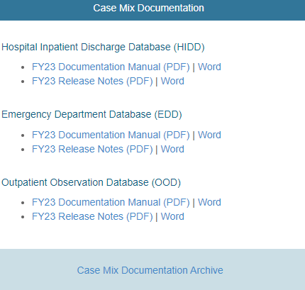

Case Mix Release Documentation
Review Documentation and Release Notes
Data users are advised to review CHIA’s comprehensive case mix documentation manuals and release notes which provide information on data quality issues connected with certain data elements and includes background on the database’s development and the DRG Groupers. The release notes also contains hospital-reported discrepancies received in response to the data verification process. Also, twenty-four years of historical documentation are available online on the documentation archive website
https://www.chiamass.gov/case-mix-data/
https://www.chiamass.gov/case-mix-data-documentation-archive/
The documentation archive contains outpatient emergency department, outpatient observation stay, and hospital inpatient discharges documents dating back to fiscal year 2000.
Link to Archive

Slide 6

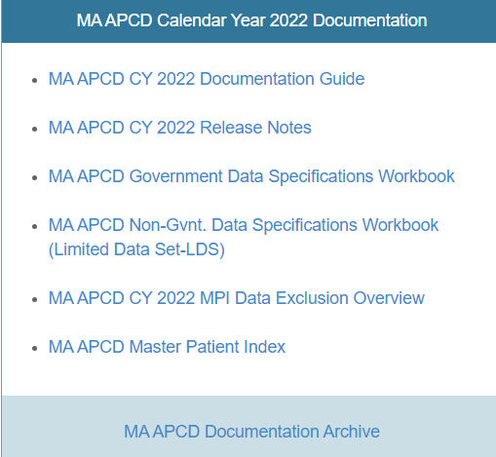
MA APCD CY2021 and CY2022 Releases
CY2021 and CY2022 Available for Request
  CY 2021 Data which includes medical, pharmacy, and dental claims incurred between January 1, 2017, and December 31, 2021, and it includes six (6) months of run-out (paid claims through June 30, 2022) and the new CY 2022 Data which includes claims incurred from January 1, 2018, through December 31, 2022, and includes six (6) months of run-out (paid claims through June 30, 2023) are available for request. In addition to claims data, the releases contain relevant reference files including member eligibility, providers, products, and benefit plans. This data encompasses public and private payers as well as fully-insured and self-insured plans. Keep in mind that due to the Supreme Court decision, Gobeille v. Liberty Mutual, the self-insured plans are severely reduced starting in 2016. The releases also includes MassHealth Medicaid data.
  https://www.chiamass.gov/ma-apcd/
  Applicants with approved projects that require updated MA APCD data (CY 2021 Data or CY2022) should submit to CHIA a completed Exhibit B (Certificate of Continued Need and Compliance) of the Data Use Agreement. After submitting a completed Exhibit B, you will receive an invoice (if applicable) for the requested data. Upon payment of the invoice the order for the data will be placed.
  The new CY 2022 MA APCD Documentation Guide and Release Notes are available on CHIA’s website for your review before using the data. The CY2021 MA APCD Documentation are available online in the documentation archive.

Slide 7
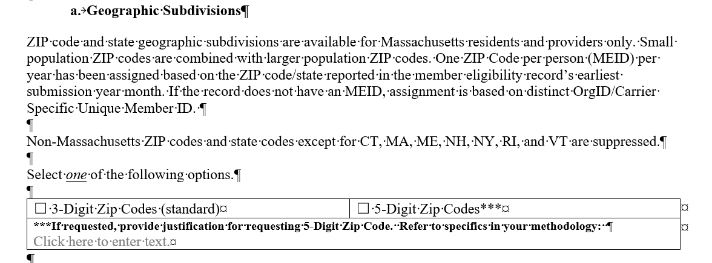
ZIP Code Data in the MA APCD Application
The December 2023 revision to MA APCD application specifies that the member ZIP code geographic data is now only released at the level of one ZIP code per person per year based on the member’s ZIP code reported in the member’s earliest submission year month.
See application excerpt below.

Slide 8
Website Updates

Slide 9
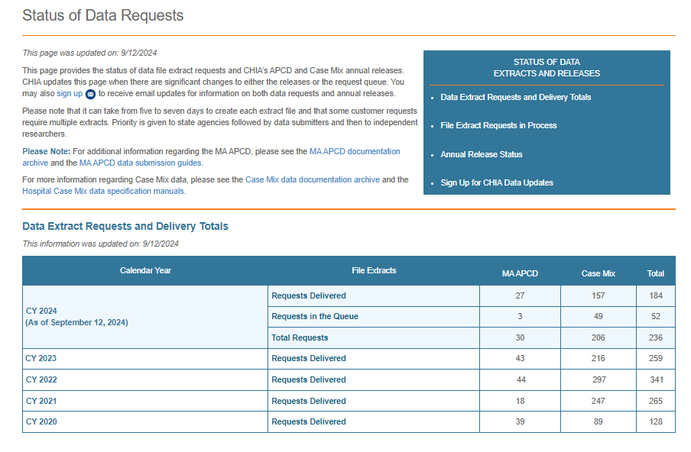
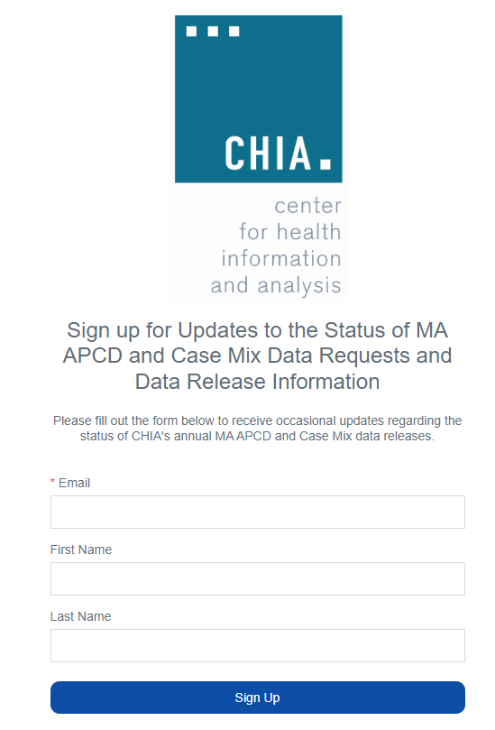
Check the Status of Release Website (Updated 9/12/2024)
  You can visit the CHIA website http://www.chiamass.gov/status-of-data-requests/ to check the status of data extracts and releases, and sign-up to receive updates of MA APCD and case mix data requests and data release information.

Slide 10
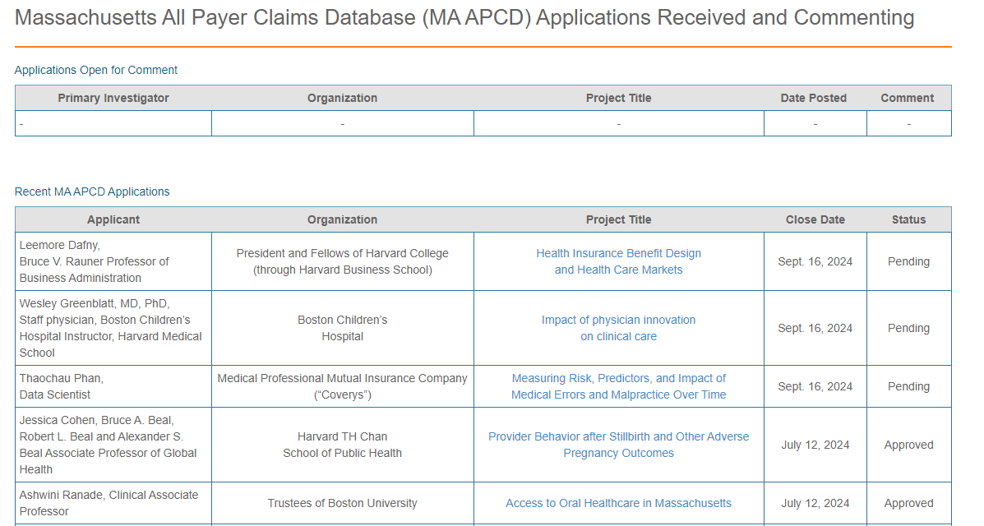
Data Applications Received and Commenting
  You can visit the CHIA website https://www.chiamass.gov/apcd-application-received-and-commenting/
  to check non-government applications received, awaiting public comments, and approved.

Slide 11
Data User Support Questions

Slide 12

Question: We are trying to classify every claim by insurance type in broad classes Commercial, Medicaid, Medicare, and Other. However, a significant number of dental claims (57%) are associated with Medicare. This seems like too many for dental claims. What is the expected distribution of dental claims products types?
Insurance Type Code Product
Answer: In MA APCD CY2021 and CY2022 releases, Medicare is less than 1% of the annual dental claim line volume. The highest proportion of insurance type products in the dental claims are Medicaid, followed by Preferred Provider Organization (See Table 1 below).
Table 1. MA APCD Dental Claim Line Volume by Insurance Type Code Product
continued

Slide 13

Answer (continued): The Insurance Type Code Product field is in the member eligibility file (ME003)
that defines the type of insurance under which the member's eligibility is maintained. The medical claims
(MC003), dental claims (DC003), and pharmacy claims (PC003) code is the type of insurance under
which this patient's claim line was processed. The product line of business (PR004) is the line of
business that the product follows. Data users should review the look-up values in the submission
guide. The values differ by file type. For example, the dental claims field (DC003) contains the value 17
(Dental Maintenance Organization) not present in the medical claims look-up values. See below.
Dental Claims Insurance Type Code Product Lookup Values
Code 17 is unique to Dental Claims
continued

Slide 14
Answer (continued): The submission guide look-up values for the Insurance Type Code Products can be found at the following link: https://www.chiamass.gov/apcd-data-submission-guides/. The literature shows the most common aggregations are Commercial (Private), Public, and Other (see Table 1 below). Within these common aggregations, there have been sub-category stratifications, for example, metal level (ME121) benefits in member’s eligibility file used in risk assessment, with Bronze plans having the lowest premiums but highest out-of-pocket costs and Platinum plans offering the highest premiums with the lowest out-of-pocket costs (see Table 2 below) and products line of business in the eligibility file (ME055, See Table 3 below).
Table 1. Common Aggregations of Insurance Type Code Products
Table 2. Metal Level Sub-Category Aggregation
1. Commercial (Private) Insurance:
  Preferred Provider Organization (PPO)
  Health Maintenance Organization (HMO)
  Exclusive Provider Organization (EPO)
  Point of Service (POS)
  Indemnity Insurance
  Other High-Deductible Health Plans
  Blue Cross / Blue Shield
2. Public Insurance:
  Medicare (Part A, Part B, Part C/Medicare Advantage, Part D)
  Medicaid (including Medicaid Managed Care Organizations)
  Veterans Health Administration (VA) and TRICARE/CHAMPUS
  State-specific programs like Commonwealth Care, Senior Care Options, etc.
  Dual-eligibility for Medicare and Medicaid
3. Other / Uninsured / Miscellaneous:
  Workers' Compensation
  Automobile Medical (Medical Pay in auto insurance)
  Disability Insurance
  Other Federal Programs (e.g., Black Lung)
  Other Non-Federal Programs
  Supplemental Insurance (Medigap, for example)
  Uninsured or Self-Pay
Bronze
Silver
Gold
Platinum
Catastrophic
Unknown / Not Applicable
Table 3. Line of Business Sub-Category Aggregation
Risk Holder
TPA - Third Party Administrator
DBA - Delegated Business Administrator
PBM - Pharmacy Benefit Manger
DBM - Dental Benefit Manager
CSO - Computer Service Organization
Other
Unknown / Not Applicable

Slide 15
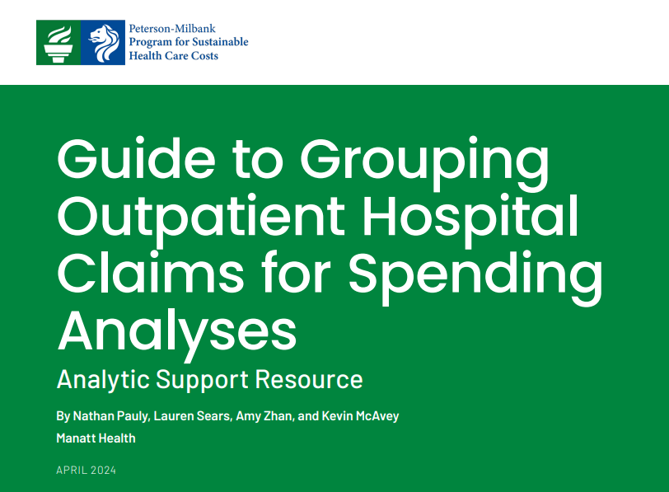
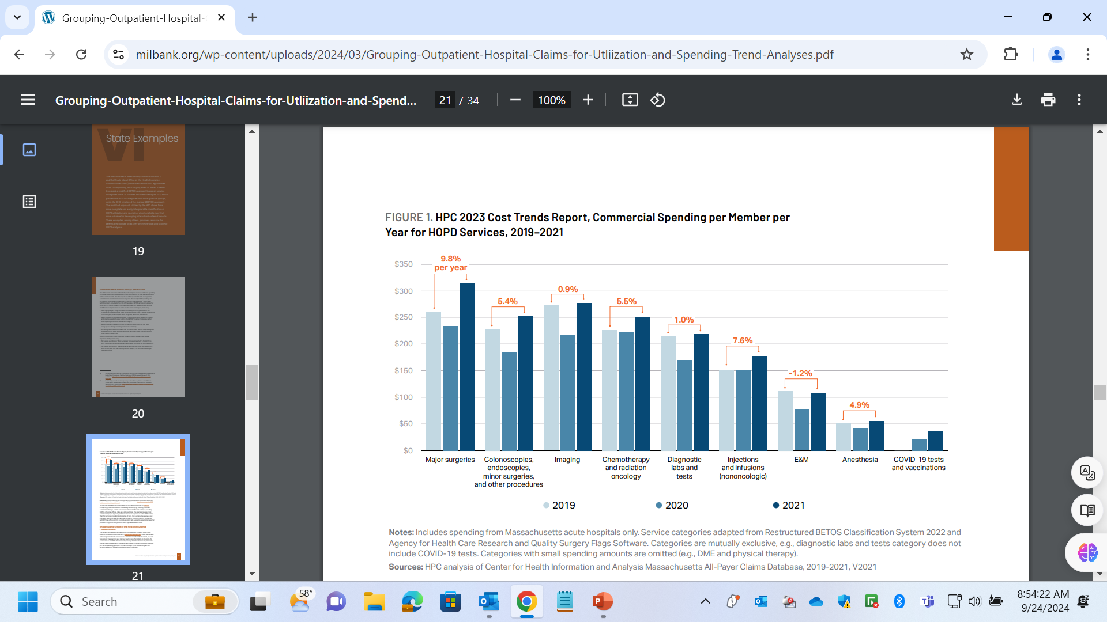
New Guide to Grouping Outpatient Hospital Claims for Spending Analyses
https://www.milbank.org/wp-content/uploads/2024/03/Grouping-Outpatient-Hospital-Claims-for-Utliization-and-Spending-Trend-Analyses.pdf
A new guide authored by Manatt Health provides a comprehensive framework for using APCDs in conjunction with the Centers for Medicare & Medicaid Services’ (CMS) restructured Berenson-Eggers Type of Service (BETOS) Classification System. This grouping schema facilitates organizing claims into distinct service categories enhancing the interpretability of hospital outpatient claims analyses. The BETOS classification categories are standardized and meticulously maintained by CMS to ensure their consistency. The guide is noteworthy because it incorporates use cases from the Massachusetts Health Policy Commission’s 2023 Annual Health Care Cost Trends Report (see Figure 1 below).
The Massachusetts Health Policy Commission’s stratification of commercial spending per member per year for hospital outpatient department services demonstrates the use of a modified BETOS approach assigning BETOS service categories for some HCPCS codes that were not classified by BETOS, as well as several other modifications implemented to make results easier to interpret. For more information, see the Technical Appendix to the Health Policy Commission 2023 Annual Health Care Cost Trends Report which can be downloaded from the following link: https://www.mass.gov/doc/2-trends-in-spending-and-care-delivery-2023-ctr/download

Slide 16

Question: I am seeking to study access to outpatient colonoscopy procedures. How does the volume of available data vary between case mix outpatient data and all-payer claims data across different care settings, and which data source offers greater feasibility for conducting such a study?
Answer: Access to outpatient colonoscopies is critical in public health efforts to prevent and early-detect colorectal cancer, ultimately reducing morbidity and healthcare costs associated with advanced-stage diagnoses. The MA APCD contains an exceptionally high volume of colonoscopy procedures, reporting over 300,000 in 2022, compared to fewer than 500 found in the case mix outpatient observation stay (OSD). The MA APCD primary sites of service for colonoscopies include community health centers, outpatient hospital clinics, ambulatory surgery centers, physicians' offices, and assisted living facilities. While the MA APCD offers expansive data, keep in mind that also incorporating case mix OSD procedures would enrich the dataset by including Medicare and other payer types not captured in the publicly available MA APCD. A drop in procedures in all care settings can be seen at the height of the 2020 pandemic.
Figure 1. Comparison of Colonoscopy Procedures Volume in Case Mix OSD vs all care settings in MA APCD

Slide 17

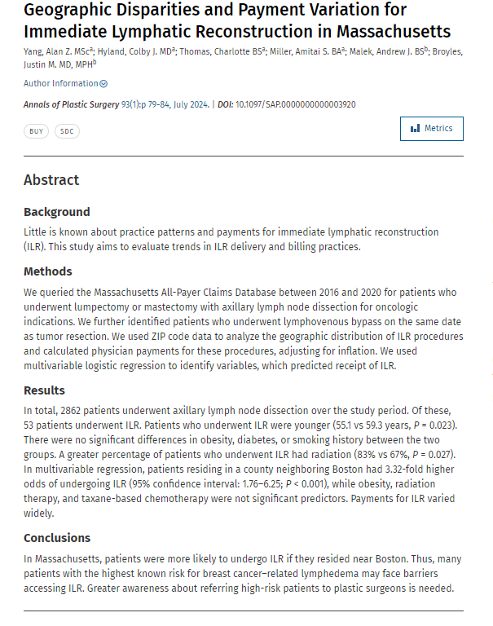
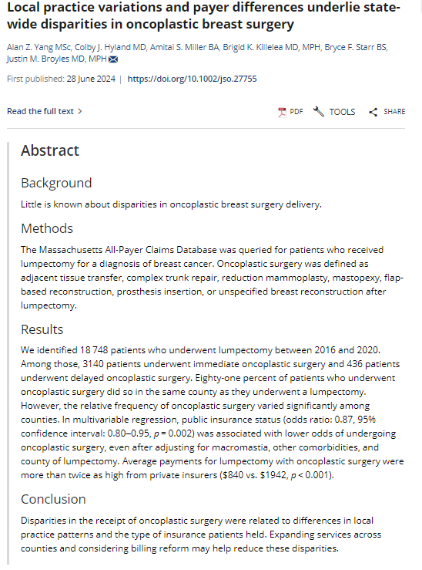
Yang AZ, Hyland CJ, Thomas C, Miller AS, Malek AJ, Broyles JM. Geographic Disparities and Payment Variation for Immediate Lymphatic Reconstruction in Massachusetts. Annals of Plastic Surgery. 2024 Jul 1;93(1):79-84.
Yang AZ, Hyland CJ, Miller AS, Killelea BK, Starr BF, Broyles JM. Local practice variations and payer differences underlie state‐wide disparities in oncoplastic breast surgery. Journal of Surgical Oncology. 2024 Aug;130(2):210-21.
New Study Alerts using the MA APCD
Two need studies have been published by Dr. Justin Broyles research team at Brigham & Women’s hospital focusing on Geographic Disparities and Payment Variation for Immediate Lymphatic Reconstruction in Massachusetts (July 2024) and Local Practice Variations and Payer Differences underlie Statewide Disparities in Oncoplastic Breast Surgery (August 2024). The goals of their use of the MA APCD are to 1) elucidate trends in practice variation and procedural differences to better characterize medically underserved areas in Massachusetts needing future intervention; 2) identify gaps in certain services as a crucial first step for healthcare initiative promoting equity; and 3) better understand drivers of practice variation, such as reimbursement differences, which may help providers and hospitals better understand disparities in receipt of certain procedures

Slide 18
When is the next Data User Group meeting?
  The next User Group will meet Tuesday, October 22, 2024.
  http://www.chiamass.gov/ma-apcd-and-case-mix-user-workgroup-information/

Slide 19
Questions?
Questions related to MA APCD email:
apcd.data@chiamass.gov
Questions related to Case Mix email:
casemix.data@chiamass.gov
REMINDER
CHIA still receives a high volume of email from data users who do not include their IRBNet ID. If you are in the process of or have already submitted a data application to CHIA through IRBNet https://www.irbnet.org/release/home.html, due to the volume of email CHIA receives, please remember to always include your IRBNET ID# in the subject line of your email. Doing so facilitates tracking your application and expediting responses to any questions.

