Slide 1
CHIA user workgroup
Don Kirkwood (Manager of Data Release and Procurement)
Sylvia Hobbs (Associate Director of Data Strategy and User Support)
Scott Curley (Manager Privacy & Compliance)
January 24, 2023
CENTER FOR HEALTH INFORMATION AND ANALYSIS

Slide 2
Agenda
Announcements:
  APCD Release CY 2021 Updates
  FY21 Case Mix Release Projections
Website Updates
User Support Questions
  Case Mix and MA APCD Comparison of Bariatric Surgery
  Case Mix and MA APCD Comparison of Arrival via Ambulance
  Case Mix and MA APCD Comparison of COVID-19 Diagnosis
  CDC WONDER addition of Massachusetts 2021 Death Data
Q&A

Slide 3
MA APCD CY 2021
  Available for request
  Applicants with approved projects that require updated APCD data (CY 2021 Data) should submit to CHIA a completed Exhibit B (Certificate of Continued Need and Compliance) of the Data Use Agreement. After submitting a completed Exhibit B you will receive an invoice (if applicable) for the requested data. Upon payment of the invoice the order for the data will be placed.
  CY 2021 Data includes data on services from January 2017 – December 2021 with six months of claim runout.

Slide 4

Case Mix FY21 Release
*CURRENT* RELEASE TIMEFRAMES FOR EACH FILE:
  Inpatient (HIDD)
  Available for request
  Emergency Department (ED)
  Available for request
  Outpatient Observation (OOD)
  Available for request
  Applicants with approved projects that require newly available year(s) of Case Mix Data (e.g., FY 19) should submit to CHIA a completed Exhibit B (Certificate of Continued Need and Compliance) of the Data Use Agreement. After submitting a completed Exhibit B you will receive an invoice (if applicable) for the requested data. Upon payment of the invoice the order for the data will be placed.

Slide 5
Website Release Updates
  Updates on the production of APCD and Case Mix databases and status of data requests are now posted to CHIA’s website!
    Aim #1 is to provide weekly or bi-weekly status update on CHIA data products as they are in development.
    Aim #2 is to provide applicants with information about expected fulfillment status for individual data requests.
    Request IDs will be communicated to Data Requestors via email.
  Please visit http://www.chiamass.gov/status-of-data-requests/ to see the current status of releases.

Slide 6
USER questions

Slide 7
Question: CHIA previously gave a webinar on bariatric procedures in the MA APCD. We are studying the volume of such procedures nationwide and would like to determine the extent of procedures in the case mix data versus the MA APCD.
Types of Bariatric Procedures
Answer: A wide variety of bariatric procedures coded as CPT codes are performed in outpatient observation stay but on a small volume of patients (see Table 1 below, asterisk for cell suppression of less than 11). During the pandemic, there was an increase in sleeve gastrectomy and unlisted laparoscopy stomach procedures which are newer bariatric interventions that do not yet have a code.
Table 1. FY2016 through FY2021 Outpatient Observation Stay Bariatric Procedures
continued

Slide 8
Answer (continued): Even though the volume of bariatric procedures performed in observation stay is low, the volume of observation stays who have a history of bariatric surgery (ICD-10-CM Z98.84) increased by 28% from FY2019 to FY2020 (see Figure 1 below). The top ICD-10-PCS procedures performed on observation stay patients with a history of bariatric surgery are related to endoscopic inspections and repairs (See Table 1 below).
Types of Bariatric Procedures
Figure 1. FY2016 through FY2021 Volume of Observation Stays with a History of Bariatric Surgery
Table 1. Top 15 ICD-10 Procedures Performed on Observation Stays with a History of Bariatric Surgery
continued

Slide 9
Answer (continued): In the case mix hospital inpatient discharge data from FY2018 through FY2021, the monthly volume of patients with a history of bariatric surgery has not widely varied except in April 2020 during the height of the pandemic (See Figure 1 below).
Types of Bariatric Procedures
Figure 1. FY2018 through FY2021 Monthly Volume of Inpatient Discharges with a History of Bariatric Surgery
Table 1. Top 10 ICD-10 Procedures Performed on Inpatient Discharges with a History of Bariatric Surgery
continued

Slide 10
Answer (continued): In the MA APCD Release 10, even with the impact in the reduction of claims due to Gobeille vs. Liberty Mutual, a higher volume of bariatric procedures can be found in the medical claims data (See Table 1 below). However, more pronounced than in case mix, the onset on the pandemic resulted in a significant decrease in distinct Massachusetts residents seeking bariatric procedures. See Figure 1.
Table 1. Bariatric Procedures in MA APCD Release 10 Medical Claims by Year

Slide 11

Question: It is unclear to me what level of information on ambulance services I can obtain from the case mix data versus the MA APCD. I see revenue codes for ambulance services, but no additional information.
Ambulance Billing
Answer: Some hospitals, like Boston Children’s Hospital, have their own ambulance services
and you would see the billing for the ambulance service rolled into the inpatient patient
revenue codes in the hospital inpatient discharge services file or as an HCPCS code in the
outpatient emergency department services file.
Ambulance services are separate outpatient care settings, have separate NPIs, and bill separately from the hospitals. The most detailed information on HCPCS/CPT procedures performed in ambulance, the transport distance, and billing can be found in the MA APCD. Those services can be found using the following taxonomy codes:
Ambulance Service Taxonomy Codes
3416A0800X Air Transport
3416L0300X Land Transport
3416S0300X Water Transport
Ambulance Service Revenue Codes
Revenue Code | Description
0549 | AMBULANCE - OTHER AMBULANCE
0548 | AMBULANCE - EKG TRANSMISSION
0547 | AMBULANCE - PHARMACY
0546 | AMBULANCE - NEONATAL AMBULANCE SERVICES
0545 | AMBULANCE - AIR AMBULANCE
0544 | AMBULANCE - OXYGEN
0543 | AMBULANCE - HEART MOBILE
0542 | AMBULANCE - MEDICAL TRANSPORT
0541 | AMBULANCE - SUPPLIES
0540 | AMBULANCE - GENERAL CLASSIFICATION

Slide 12
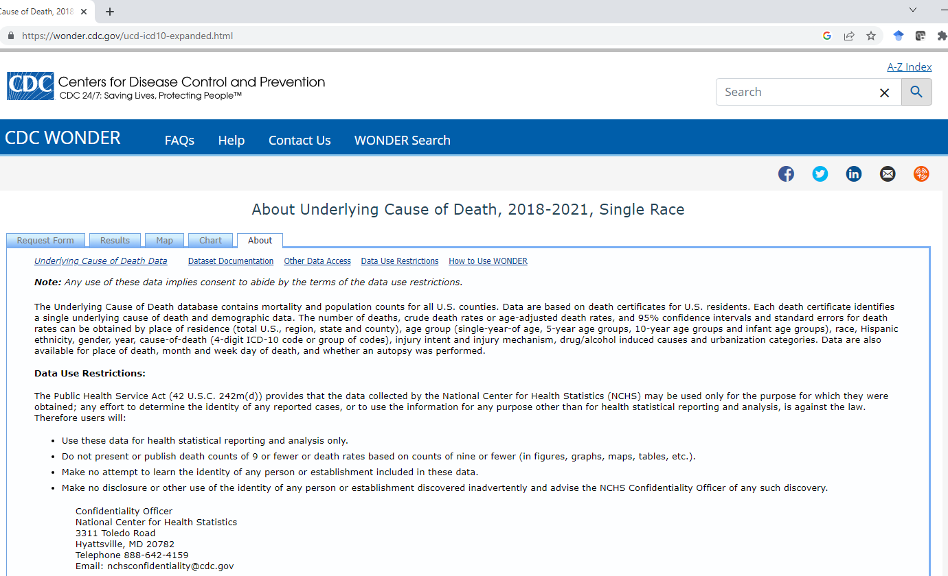
CDC Wonder Updated to Include 2021 Death Data

Slide 13
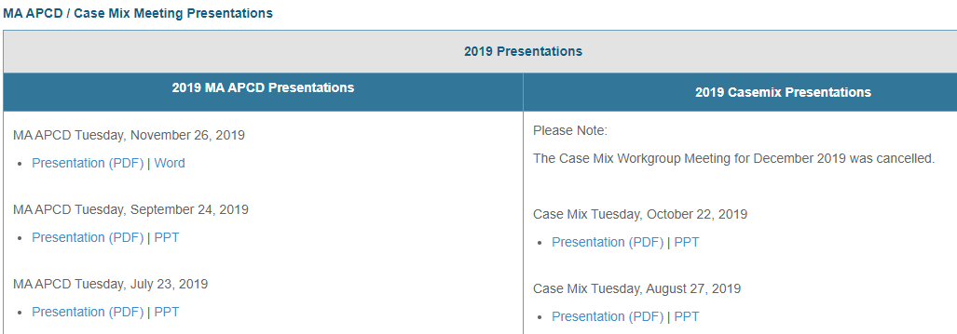
Where can I find past User Workgroup Presentations?
http://www.chiamass.gov/ma-apcd-and-case-mix-user-workgroup-information/

Slide 14
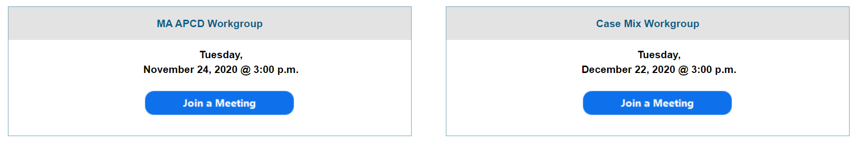
When is the next User Group meeting?
The next User Group will meet Tuesday February, 28.
http://www.chiamass.gov/ma-apcd-and-case-mix-user-workgroup-information/

Slide 15
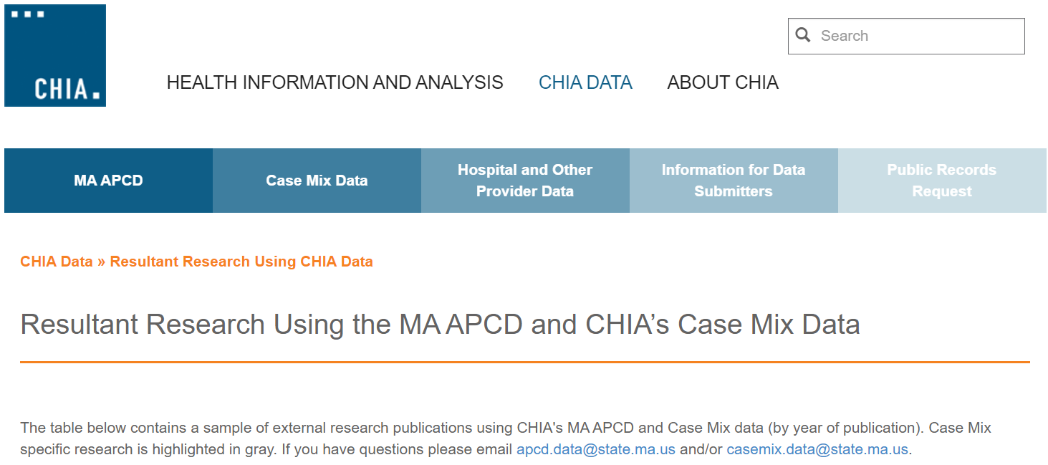
Resultant Research Using CHIA Data
https://www.chiamass.gov/resultant-research-using-chia-data

Slide 16
Questions?
Questions related to MA APCD:
apcd.data@chiamass.gov
Questions related to Case Mix:
casemix.data@chiamass.gov
REMINDER: Please include your IRBNet ID#, if you currently have a project using CHIA data.

