Slide 1
CHIA user workgroup
Don Kirkwood (Manager of Data Release and Procurement)
Sylvia Hobbs (Associate Director of Data Strategy and User Support)
Scott Curley (Manager Privacy & Compliance)
March 22, 2023
CENTER FOR HEALTH INFORMATION AND ANALYSIS

Slide 2
Agenda
Announcements:
  APCD Release CY 2021 Updates
  FY21 Case Mix Release Projections
Website Updates
User Support Questions
  Primary Care Providers
  Filtering for Accepting New Patients
  Provider Specialty Search Tools
  Pharmacy Claims Date Fields
Q&A

Slide 3
MA APCD CY 2021
  Available for request
  Applicants with approved projects that require updated APCD data (CY 2021 Data) should submit to CHIA a completed Exhibit B (Certificate of Continued Need and Compliance) of the Data Use Agreement. After submitting a completed Exhibit B you will receive an invoice (if applicable) for the requested data. Upon payment of the invoice the order for the data will be placed.
  CY 2021 Data includes data on services from January 2017 – December 2021 with six months of claim runout.

Slide 4

Case Mix FY21 Release
*CURRENT* RELEASE TIMEFRAMES FOR EACH FILE:
  Inpatient (HIDD)
  Available for request
  Emergency Department (ED)
  Available for request
  Outpatient Observation (OOD)
  Available for request
  Applicants with approved projects that require newly available year(s) of Case Mix Data (e.g., FY 19) should submit to CHIA a completed Exhibit B (Certificate of Continued Need and Compliance) of the Data Use Agreement. After submitting a completed Exhibit B you will receive an invoice (if applicable) for the requested data. Upon payment of the invoice the order for the data will be placed.

Slide 5
Website Release Updates
  Updates on the production of APCD and Case Mix databases and status of data requests are now posted to CHIA’s website!
    Aim #1 is to provide weekly or bi-weekly status update on CHIA data products as they are in development.
    Aim #2 is to provide applicants with information about expected fulfillment status for individual data requests.
    Request IDs will be communicated to Data Requestors via email.
  Please visit http://www.chiamass.gov/status-of-data-requests/ to see the current status of releases.

Slide 6
USER questions

Slide 7

Question: To what extent can the MA APCD provider data be used to determine changes over time in the volume of primary care providers (PCPs) accepting new patients? I understand that some insurance carriers require members to select a PCP. Likewise, for insurance carriers not requiring PCP selection, the carriers can attribute a PCP to a member based on their own attribution method. Can these fields be used to determine changes in the volume of attributed PCPs accepting new patients?
Accepting New
Patients
Answer: The MA APCD provider data table has a field called, “PCP Flag” (PV055). The filing condition for the PCP Flag field
is if the “Provider ID Code” (PV034) is a “Person”. The provider table also has a field called “Accepting New Patients” (PV049).
The filing condition associated with reporting data in the “Accepting New Patients” field is when the “Provider ID Code” (PV034)
is a “person” (i.e., physician, clinician, orthodontist, or any individual licensed/certified to perform health care services), a “facility” (i.e., hospital, health center, long term care, rehabilitation or any building that is licensed to transact health care services), or a “professional group” (i.e., collection of licensed/certified health care professionals practicing health care services under the same entity name and Federal Tax Identification Number). Figure 1 below lists the coding options for the PCP Flag, Provider ID Code, and Accepting New Patients fields. These fields can be used to determine PCPs accepting new patients and filtered by State Code (PV019) for Massachusetts providers, by Provider Taxonomy (PV022) (i.e., Family Medicine, Pediatrics, Internal Medicine, General Practice, Geriatrics) by count of distinct National Provider Ids (PV039).
Figure 1. Flowchart of MA APCD Provider Table Fields for Analysis of Accepting New Patients
PCP Flag (PV055)
Yes
Provider ID Code (PV034)
Person
Other
Accepting New Patients (PV049)
Yes
No
Unknown
Other
Not Applicable
Facility
Professional Group
Retail Site
E-site
Financial Parent
Transportation
No
Unknown
Other
Not Applicable
continued

Slide 8
Answer (continued) It is important to note that carriers submit data on all providers, both active and inactive, excluding
inactives prior to January 2015. Therefore, when analyzing providers by submission year and carrier, filter for carrier specific End Dates (PV038) that are either null or greater than the year you are studying. The quality of data on the number of providers accepting new patients varies from year to year. For example, Figures 2 and 3 below depict the volume of Massachusetts Family Physicians (taxonomy code 207Q00000X) and Internal Medicine Physicians (taxonomy code 207R00000X) accepting new patients. Decreases in the volume of providers coded as ‘Yes’ for accepting new patients are paralleled by increases in the use of the coding option ‘Unknown’. Also, due to the lack of Medicare fee-for-service data in the MA APCD, there could be a lower volume of family physicians who specialize in geriatrics in the provider data. For any current year of data, the Massachusetts Board of Registration in Medicine’s interactive website and the American Medical
Association’s Interactive website can be used to gauge provider volume differences with the MA APCD.
Accepting New
Patients
Figure 2. MA APCD Provider Data on Massachusetts Family Physicians Accepting New Patients
Figure 3. MA APCD Provider Data on Massachusetts Internal Medicine Physicians Accepting New Patients
continued

Slide 9
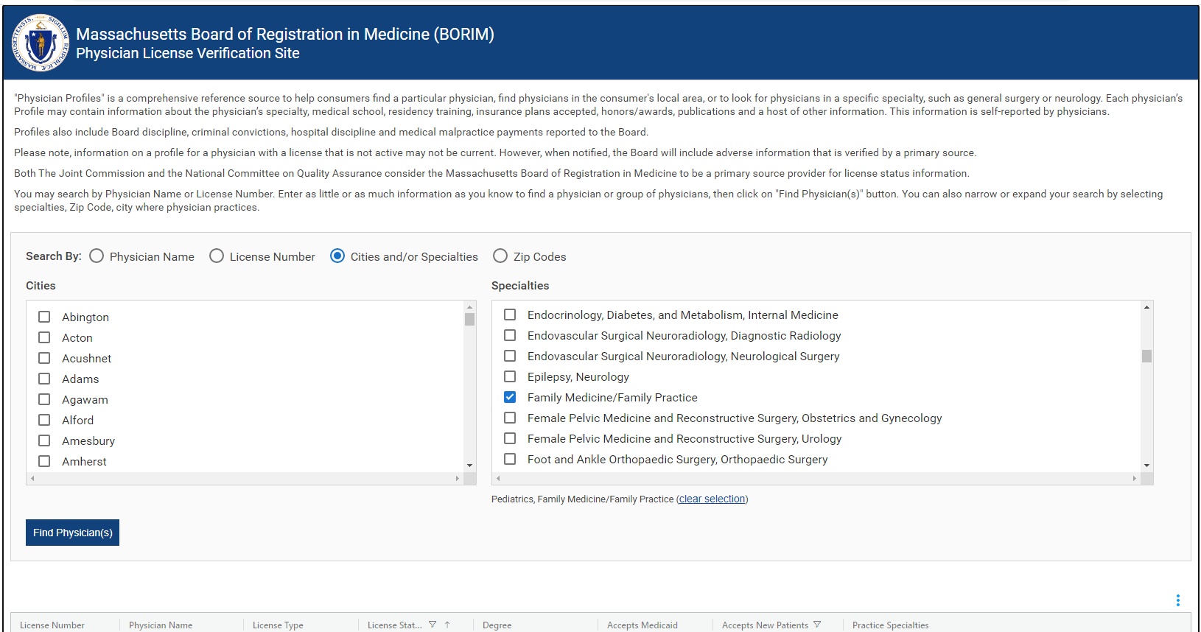
Answer (continued) The Massachusetts Board of Registration of Medicine’s interactive website at: https://www.mass.gov/check-a-physician-profile-findmydoctormassgov has selection options for searching physicians by medical specialty which includes a ‘Yes/No’ option for whether the physician is accepting new patients (see Figure 4 below). The MA APCD year 2022 provider data indicated that 2,637 Massachusetts Family Physicians were Accepting New Patients (as shown in Figure 1 on the previous page). The Massachusetts Board of Registration of Medicine’s Verification Site indicates that 2,665 Massachusetts Family Physicians are Accepting New Patients.
Accepting New
Patients
Figure 4. Massachusetts Board of Registration in Medicine (BORIM) Physician License Verification Site
continued

Slide 10
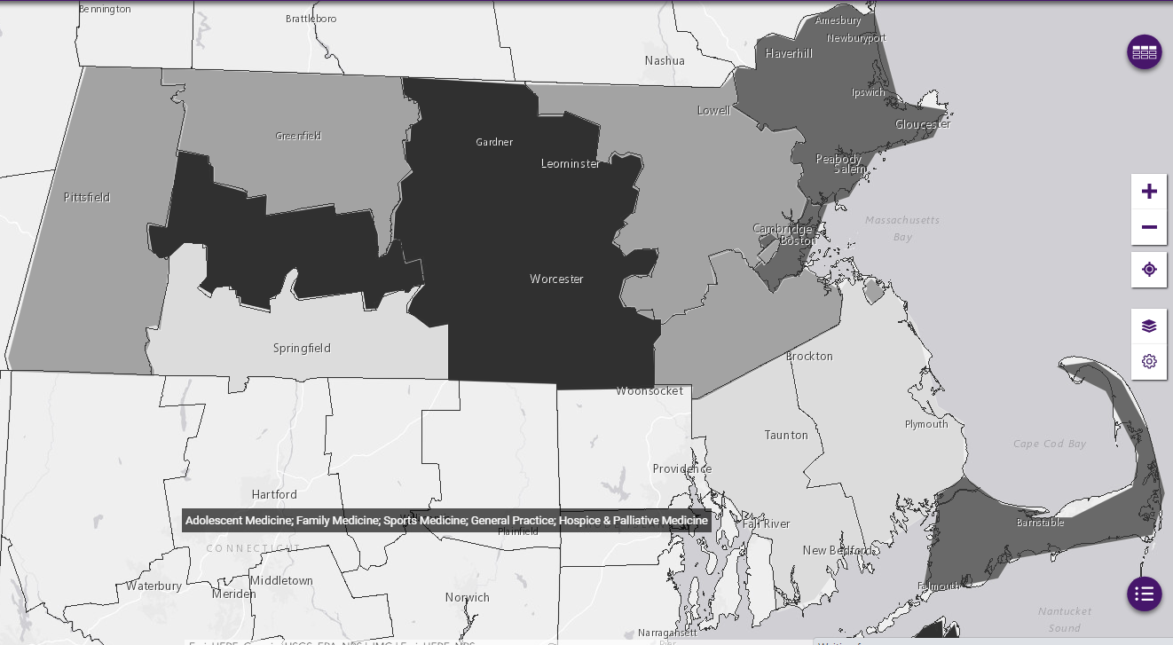
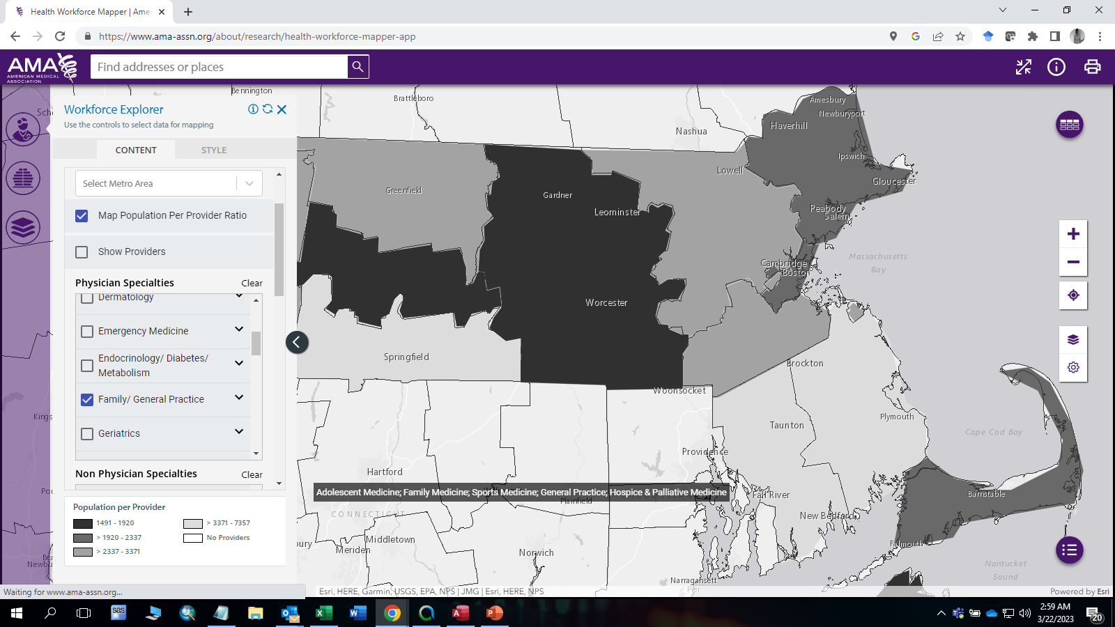

Answer (continued) Another tool available in addition to the Massachusetts Board of Registration in Medicine website is the American Medical Association’s Health Workforce Mapper, an online interactive tool to illustrate the geographic distribution of the health care workforce. This tool is available at: https://www.ama-assn.org/topics/health-workforce-mapper/. This tool stratifies health care providers by geographic boundaries including state, county, ZIP code tabulation areas, census tracts, and block groups. The tool also stratifies physicians by medical specialty, incorporates census demographic data to map population per provider ratios, has map theme options to include health care facility locations, physician practice type, and physician employment type. For example, you can create a map by county of the Massachusetts census population per number of “Family/General Practice” physicians based on the American Medical Association’s Physicians Masterfile (See Figure 5 below).
Accepting New
Patients
Figure 5. Massachusetts Population Per Provider Ratio for Family/General Practice Physicians
Source: https://www.ama-assn.org/about/research/health-workforce-mapper-app

Slide 11

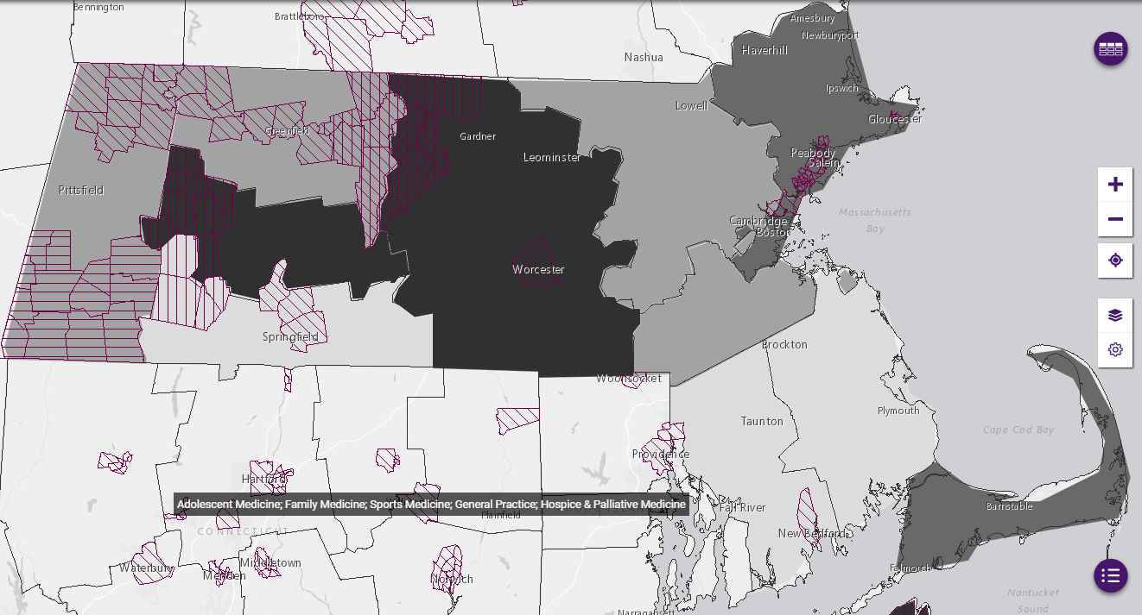

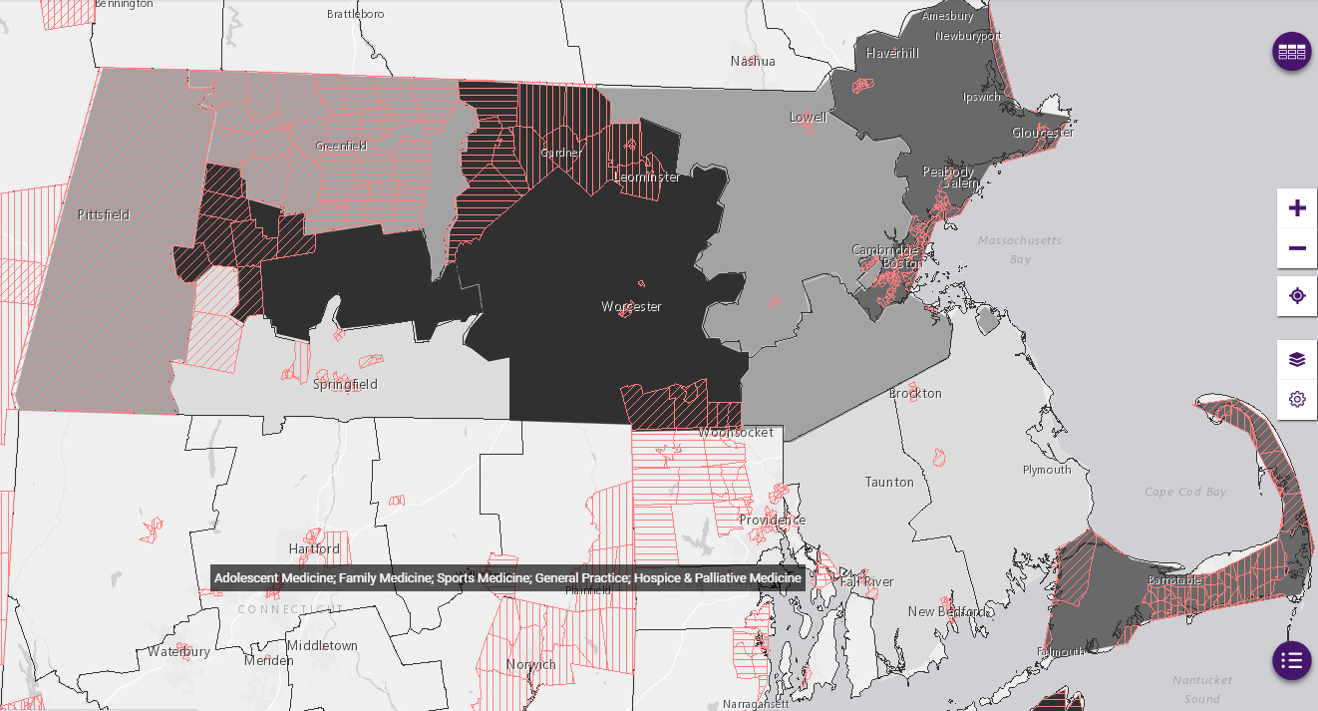
Answer (concluded) The American Medical Association’s Health Workforce Mapper has additional GIS data layers incorporating federally designated Health Resources & Services Administration (HRSA) policy aggregations including Primary Care Health Professional Shortage Areas, Dental Care Health Professional Shortage Areas, Mental Health Care Professional Shortage Areas, and Medically Underserved Areas/Populations. For example, a data layer to the previous map of family/general practice physicians showing HRSA designated Primary Care Health Professional Shortage Areas (See Figure 6 below) or Medically Underserved Areas/Populations (See Figure 7 below).
Figure 6. MA Population Per Family/General Practice Providers
in Primary Care Health Professional Shortage Areas*
* Primary Care Health Professional Shortage Areas (HPSA)
HRSA defines a geographic HPSA as a shortage of providers for an entire group of people within a defined geographic area and defines population HPSA as a shortage of providers for a specific group of people within a defined geographic area (e.g., low-income, migrant farm workers).
Figure 7. MA Population Per Family/General Practice Provider
in Medically Underserved Areas/Population**
** Medically Underserved Areas/Populations (MUA/P)
HRSA defines MUAs have a shortage of primary care health services within geographic areas such as counties or census tracts and defines MUPs as a shortage of primary care health services for a specific population subset within a geographic area. These groups may face economic, cultural, or language barriers to health care. Some examples include people who area eligible for Medicaid or experiencing homeless.
*Source: https://bhw.hrsa.gov/workforce-shortage-areas/shortage-designation

Slide 12

Question: In the MA APCD, I understand only one ZIP code per year is released in the member’s eligibility data. When linking the medical claims data to the eligibility ZIP code data for the purposes of obtaining ZIP code associated socioeconomic attributes, I link the “date of service from year” to the member eligibility year. However, in the pharmacy claims data, it is unclear whether I should use the year the ‘prescription written year’ or the ‘prescription filled year.’
Prescription Dates
Answer: The MA APCD pharmacy data filing specifications for the ‘Date Prescription Filled’ (PC032) have a higher
filing threshold than the ‘Date Prescription Written’ (PC064). See Table 1 below. Date Prescription Filled is a
Category A0 data element which means the data is required to be valid per Conditions and must meet threshold percent
with 0% variation. Therefore, for all pharmacy claim lines, the date prescription was filled should be present on 99% of
records or the submission will fail. Date Prescription Written is a Category B data element which means the data is requested and monitored for errors but any variation from the percent filing threshold will not cause the submission to fail. While the completeness of the prescription written year field is over 80% (see Figure 1 below), the prescription written year from 2015-2017 was 99.99% complete and from 2018 to 2022 was 100% complete.
Table 1. Comparison of Date Prescription Filled and Date Prescription Written Filing Specifications
Figure 1. Comparison of the Percent Completeness of Prescription Written Year and Prescription Filled Year

Slide 13
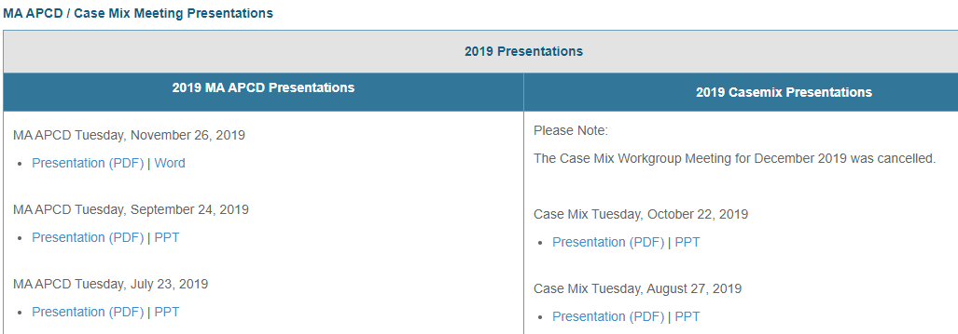
Where can I find past User Workgroup Presentations?
http://www.chiamass.gov/ma-apcd-and-case-mix-user-workgroup-information/

Slide 14
When is the next User Group meeting?
The next User Group will meet Tuesday April, 25.
http://www.chiamass.gov/ma-apcd-and-case-mix-user-workgroup-information/

Slide 15
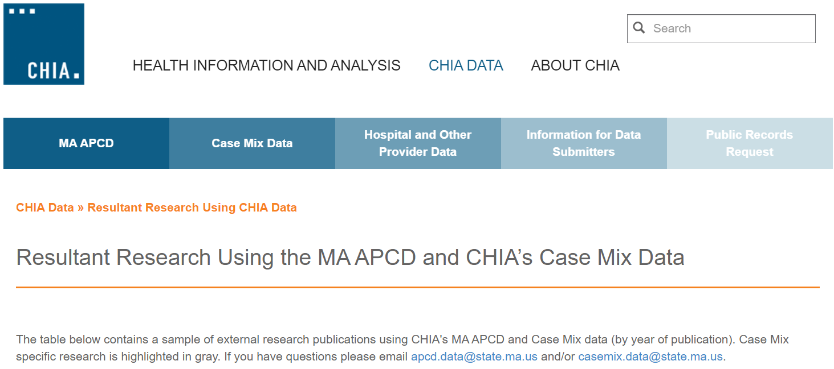
Resultant Research Using CHIA Data
https://www.chiamass.gov/resultant-research-using-chia-data

Slide 16
Questions?
Questions related to MA APCD:
apcd.data@chiamass.gov
Questions related to Case Mix:
casemix.data@chiamass.gov
REMINDER: Please include your IRBNet ID#, if you currently have a project using CHIA data.

