Slide 1
CHIA PHASE 1
Consumer Healthcare Transparency Website
SQAC
June 26, 2017

Slide 2
Agenda
Project Overview
Cost
Quality
Q&A
Notes:
Today—particular focus on quality/safety content
We’d like provider input on the quality safety measures that will be included in the Phase 1 site. We realize that you need to see the broader context and understand our mandate/objectives in order to provide meaningful feedback.
The purpose of this webinar is to provide that context.

Slide 3
Approach

Slide 4
Phase 1 Objectives and Tactics
Goal: Empower consumers to be an active partner in their health care decisions.
Objective | Tactic
Consumers understand that cost varies between provider organizations | Cost look-up tool for a defined set of shoppable services
Consumers Understand that quality varies between and within provider organizations | Quality dashboards with facility-level metrics
Support informed conversations between patient and provider | Decision Aids
Locate the appropriate agency or organization for help in resolving a problem | Troubleshooter

Slide 5
Phase 1 Timeline
Task Name | Q1 |  |  | Q2 |  |  | Q3
 | Jan | Feb | Mar | Apr | May | Jun | Jul | Aug | Sep
Project Kickoff
Wireframe Development
Stakeholder Engagement
Copy Development
Web Development

Slide 6
Site Overview
Healthcare
Transparency Site
Cost of Care
Quality of Care
Basic Health Insurance Info
Healthcare Troubleshooter
Decision Aids
Links to
Health Plan Site(s)
Links to
Provider Site(s)
Links to
Mass Connector &
Health Plan Sites
Links to
Relevant Agencies/Organizations
Links to
Relevant Agencies/Organizations
Links to Educational Materials
External Resources

Slide 7




Our Approach
Brand Identity, Consumer Messaging
User Experience(UX)/
User Interface(UI)
Research
Messaging
Naming
Content
Wire Frames
User Testing
Visual Design
Consumer Focus
Consumer Tools
COST DATA/QUALITY DATA
Procedure Costs
Provider Quality
Decision Aids
Healthcare Troubleshooting
Cost
Quality

Slide 8

Home Page Draft
Website
Understanding Healthcare
Troubleshooter
Make Informed Choices

Slide 9
Cost

Slide 10
Cost – Phase 1 Site Services
Outpatient Services Cost Data sourced from the APCD
  Provider office visits (by specialty)
  Behavioral health services
  Radiology: Mammography, MRI, CT, PET
  Diagnostic: Colonoscopy, endoscopy
  Physical and occupational therapy
  Emergency Department Visits
  Lab Tests
  Maternity (professional only, excludes facility)
    Phase one includes:
          Only payments for bundles provided by same physician
          Bundles with no procedure modifiers

Slide 11
Cost – Analytic Approach
Data Source:
  FY15 sourced from APCD
  Commercial fee-for-service claims
Services represented at CPT/HCPCS level
  Consistent provider-payer contracting
  Accounting for discounts applied to bundles, eg – colonoscopy, MRI/PET/CT
Service cost estimates reported by provider
  Payer-specific (BCBS, HPHC, Tufts, NHP, Fallon, HNE)
  Payer-agnostic (based on included payers)
Cost estimates:
  Reflect payer paid plus member cost sharing amounts (i.e., allowed amounts)
  Median cost for services rendered by each reported provider
  Anchored to facility / primary service provider, as applicable
    Professional fees bundled into cost estimates for primary service provider
    E.g., colonoscopies, mammography
Minimum service encounter threshold for provider inclusion

Slide 12
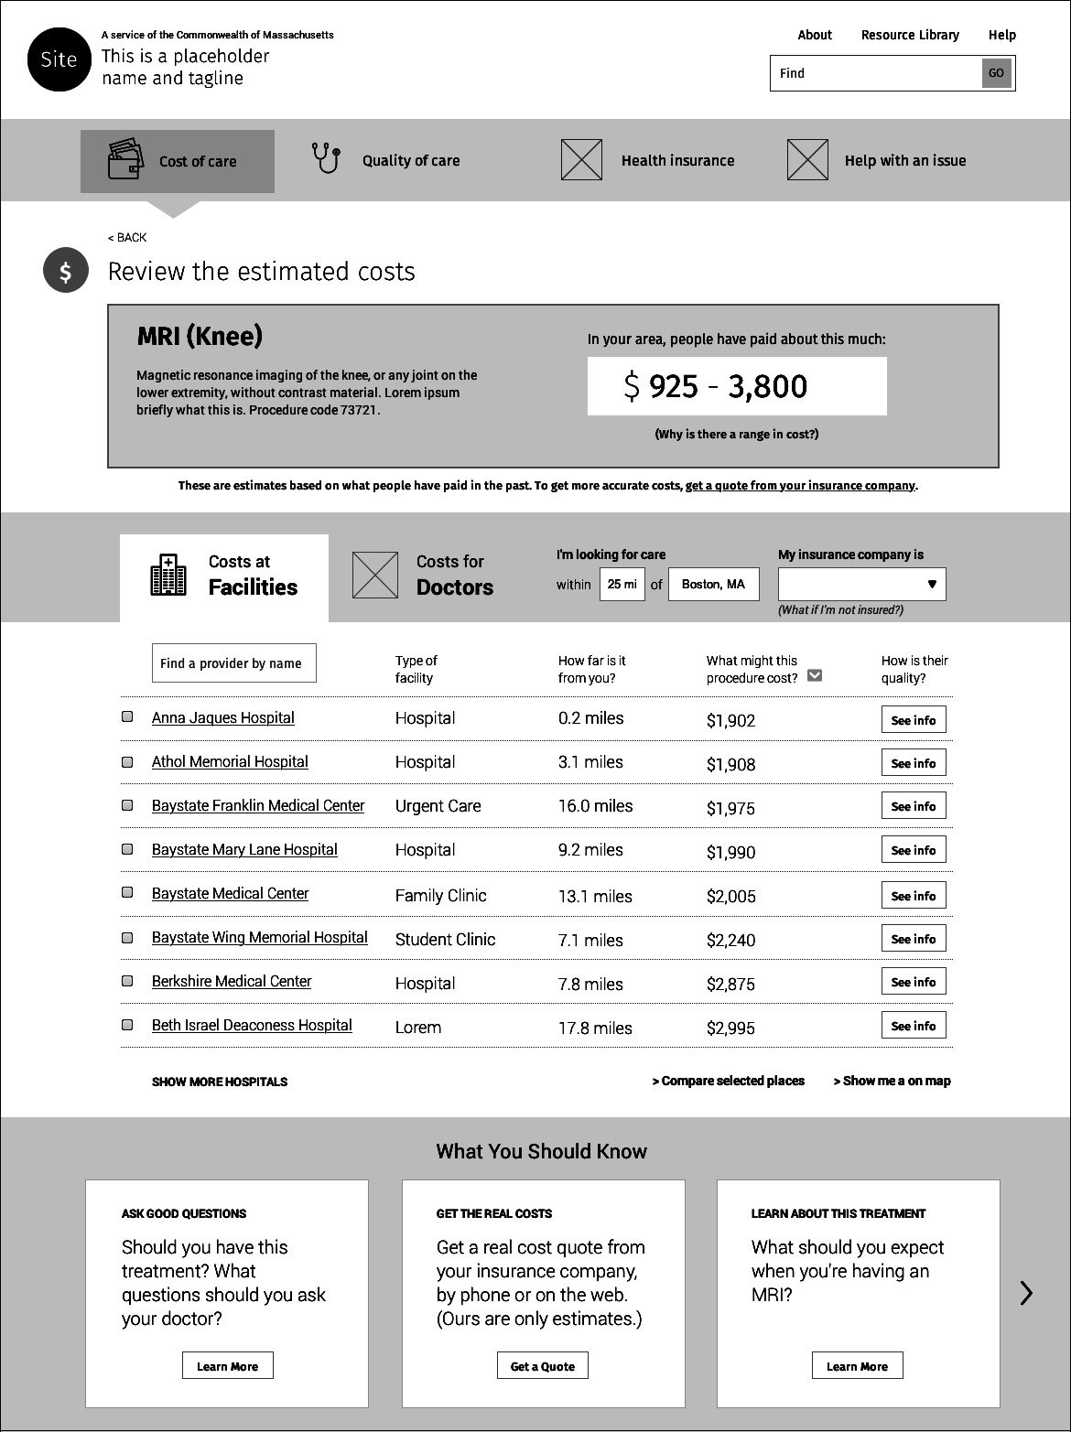
Cost Draft 2
How are they doing on Quality & Safety?
Quality & Safety
Quality & Safety
D R A F T
Quality & Safety
Quality & Safety
Quality & Safety
Quality & Safety
Quality & Safety
Quality & Safety

Slide 13
Quality

Slide 14
Quality/Safety—What’s Included in Phase 1
The Phase 1 site will include quality and patient safety dashboards for hospitals and ASCs
Dashboards will contain select quality/safety measures, mainly at the facility level (not at the procedure level)
Quality/safety dashboards will be linked from the cost estimator results, and accessible from other points throughout the website
Notes:
The site also will include physician profile information from BORIM

Slide 15
Key Considerations
Challenge: Available quality/safety metrics don’t answer many of the questions an engaged consumer might have
  Most rate a provider’s overall quality—not quality at the procedure level—so are not good predictors of individual outcomes
  Most measures are not consumer friendly
Approach: Include high-quality guidance and decision aids
  To explain what can and can’t be learned from the data
  To prompt constructive conversations with providers about health care choices

Slide 16
Principles Guiding Selection of Quality/Safety Metrics
Measures must be:
Already widely published in a format intended for consumer consumption (mainly through CMS’ Hospital Compare and Leapfrog)
Of relatively high interest to consumers (as identified through ongoing user testing)
More useful than not in making consumers aware that quality/safety of care varies across providers
Explainable to consumers through integrated messages and decision aids that highlight what can and can’t be understood from these data alone

Slide 17
Preliminary Steps Toward a Set of Phase 1 Quality/Safety Measures
Many data sources,
hundreds of possible metrics
CMS, MHQP, USNWR, Leapfrog, MA-DPH, The Joint Commission, etc.
Guiding principles for metric selection:
Already widely published for consumers
Consumer interest
Likely to increase awareness
Subject to explanation
Consumer-friendly?
No
Yes
Proc./cond.-specific readmission rates
Certain blood clot measures
Certain imaging-related measures
Feasible for Phase 1?
Are the data available to us?
Can the needed cleaning/linking/processing be completed in time for launch?
No
Yes
Volume performed for
selected procedures
Physician group quality metrics
Provisional list of Phase 1 measures for your input
Notes:
First, BLC reviewed consumer-facing health care websites from California, New Hampshire, and other states, and leveraged our Research Advisory Committee to help curate an initial set of measures--established quality/safety metrics that are both valid and useful to consumer decision-making (actionable, with meaningful variation)
Second, we held an expanded RAC meeting that included the provider associations
Now, opening up the discussion to individual providers

Slide 18
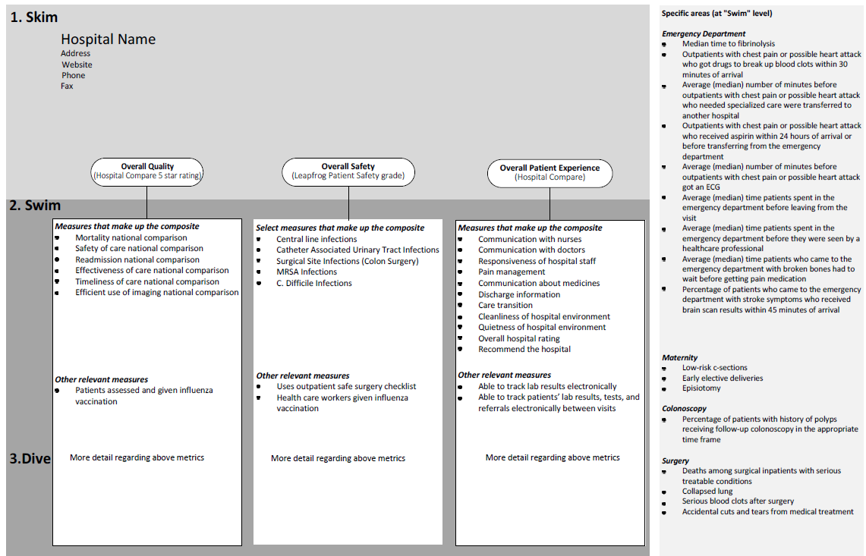

Slide 19
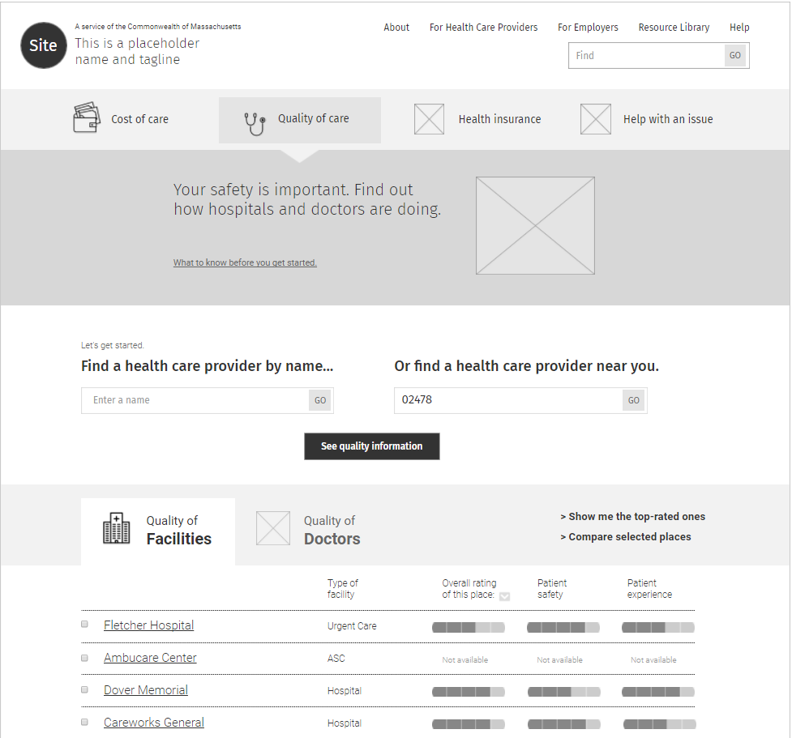
Quality Draft 1
Quality and Safety scores vary within as well as across provider organizations. Compare hospitals in your area.
Overall Quality Rating
Overall Safety Rating
Overall Patient Experience Rating

Slide 20
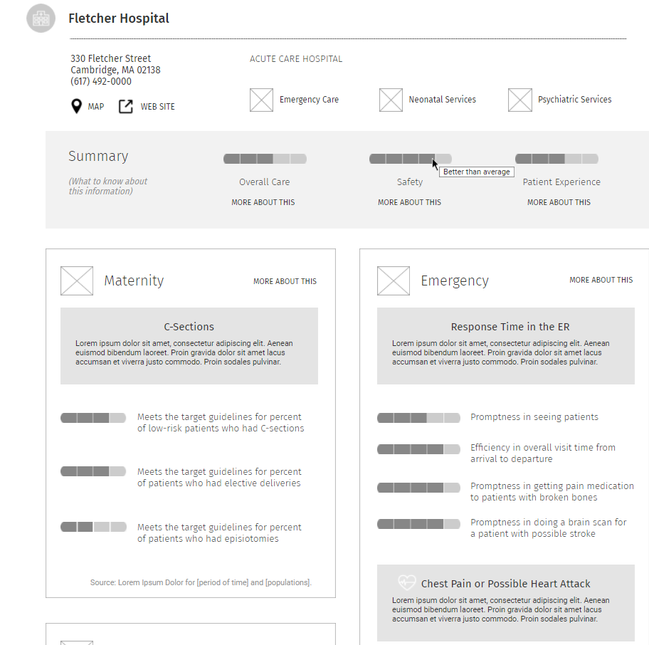
Quality Draft 2
Overall Quality Rating
Overall Safety Rating
Overall Patient Experience Rating

Slide 21
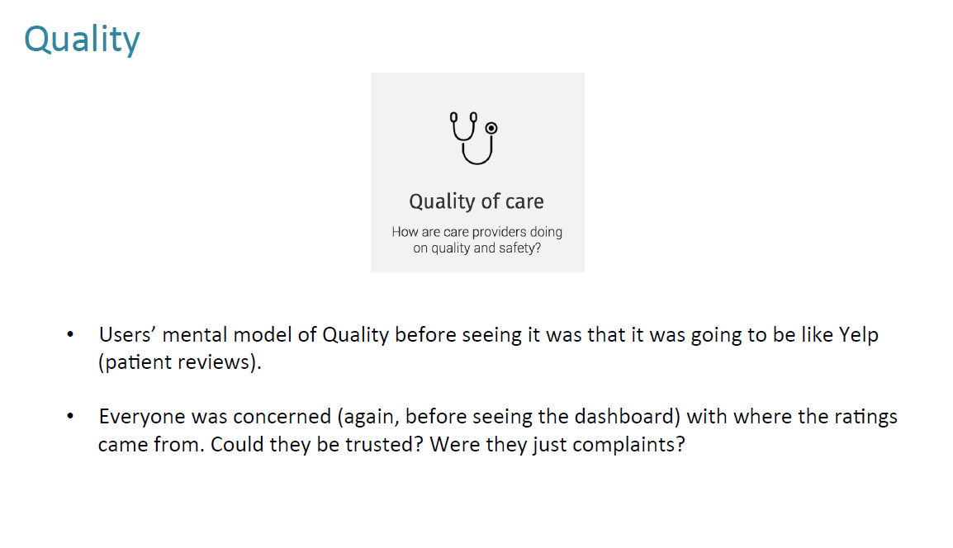
User Testing
At the outset of the user testing, consumers expressed concern over the source of the ratings.

Slide 22
Key Takeaways
CHIA is developing the transparency website through an iterative process that includes providers, payers, and consumers–supported by top designers.
We are following best practices for communicating health care information to consumers, from the design (UI/UX) process through the copywriting.
Cost estimates and quality measures will be supplemented by decision aids designed to help patients and providers have meaningful conversations about health care choices.
Following the launch of the Phase 1 site, CHIA is committed to a process of continuous improvement and upgrades.

Slide 23
Discussion

