Slide 1
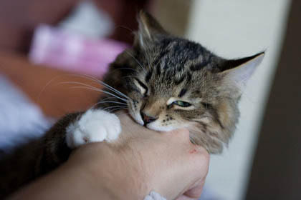
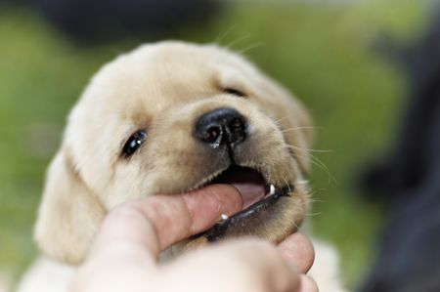
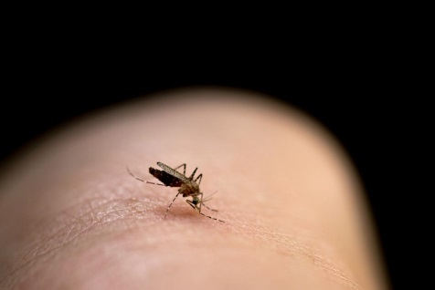
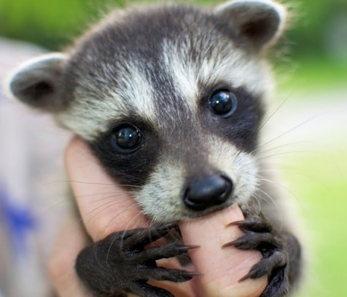
Question: I am in the process of applying for NIH grant to use the Case Mix data to conduct pediatric injury surveillance. ICD-10-CM expanded the number of cause diagnosis codes related to injury wounds from bites and I want to be able to provide information in my grant narrative on whether hospitals are using the full range of bite related codes.
Answer: Yes, the hospitals appear to be using the full range of the ICD-10-CM bite codes. We looked at the outpatient emergency department data (ED) for FY2016 to determine the extent to which bite codes were being used and for one year alone, 444 different ICD-10-CM bite codes were for used for over 30,000 bite related ED visits. The codes include bite related W-Codes (See Table 1 below) and extensive use of S-Codes.
Table 1. FY2016 Outpatient ED Visit Top ICD-10-CM W-Codes related to Bites
ICD-10-CM Code | Full Description | Rank
W57XXXA | Bitten or stung by nonvenomous insect and other nonvenomous arthropods, initial encounter | 1
W540XXA | Bitten by dog, initial encounter | 2
W5501XA | Bitten by cat, initial encounter | 3
W540XXD | Bitten by dog, subsequent encounter | 4
W5501XD | Bitten by cat, subsequent encounter | 5
W5581XA | Bitten by other mammals, initial encounter | 6
W5321XA | Bitten by squirrel, initial encounter | 7
W5381XA | Bitten by other rodent, initial encounter | 8
W57XXXD | Bitten or stung by nonvenomous insect and other nonvenomous arthropods, subsequent encounter | 9
W5311XA | Bitten by rat, initial encounter | 10
W5301XA | Bitten by mouse, initial encounter | 11
W5551XA | Bitten by raccoon, initial encounter | 12
W5511XA | Bitten by horse, initial encounter | 13
W5541XA | Bitten by pig, initial encounter | 14
W6101XA | Bitten by parrot, initial encounter | 15
W5651XA | Bitten by other fish, initial encounter | 16
W6191XA | Bitten by other birds, initial encounter | 17
W503XXD | Accidental bite by another person, subsequent encounter | 18
W5541XD | Bitten by pig, subsequent encounter | 19
W5581XD | Bitten by other mammals, subsequent encounter | 20
W5531XA | Bitten by other hoof stock, initial encounter | 21
W5911XA | Bitten by nonvenomous snake, initial encounter | 22
W540XXS | Bitten by dog, sequela | 23
W5501XS | Bitten by cat, sequela | 24
W5551XD | Bitten by raccoon, subsequent encounter | 25
W5681XA | Bitten by other nonvenomous marine animals, initial encounter | 26
W5901XA | Bitten by nonvenomous lizards, initial encounter | 27
W5301XD | Bitten by mouse, subsequent encounter | 28
W6151XA | Bitten by goose, initial encounter | 29

