Slide 1
Case Mix – Questions Submitted by Users Slides from User Workgroups

Slide 2
What DRG versions available in
CHIA Inpatient Case Mix Data?
[from 2014]

Slide 3
Review: Definition of DRG Diagnosis Related Group
A classification system that groups patients according to diagnosis, type of treatment, age, and other relevant criteria. Under the prospective payment system, hospitals are paid a set fee for treating patients in a single DRG category, regardless of the actual cost of care for the individual. Source: CMS http://www.cms.gov/apps/glossary/default.asp

Slide 4
Over the Past 30 years Multiple Versions of DRGs have been Created and Refined
The Three Most Commonly Used DRGs Decade (2004-2013) in HDD
All Patients Diagnosis Related Groups AP-DRG
All Patients Refined Diagnosis Related Groups APR-DRG
Medicare (CMS) Diagnosis Related Groups CMS-DRG

Slide 5
13 Year (2001-2013) History of Diagnosis Related Group (DRG) Versions in Massachusetts Inpatient Hospital Discharge Data (HDD)
HDD Fiscal Year | AP-DRG Version 12 | AP-DRG Version 14.1 | AP-DRG Version 18 | AP-DRG Version 21 | AP-DRG Version 25.1 | APR-DRG Version 15 | APR-DRG Version 20 | APR-DRG Version 26.1 | APR-DRG Version 30 | VHAF- DRG Version 24 | VHAF-DRG Version 25 | CMS-DRG Version 26 | CMS-DRG Version 27 | CMS-DRG Version 28 | CMS-DRG Version 29 | CMS-DRG Version 30
2013 |  |  |  | X | X |  | X | X | X |  |  |  |  |  |  | X
2012 |  |  |  | X | X |  | X | X | X |  |  |  |  |  | X
2011 |  |  |  | X | X |  | X | X | X |  |  |  |  | X
2010 |  |  |  | X | X |  | X | X | X |  |  |  | X
2009 |  |  |  | X | X |  | (available soon) | X | X |  |  | X
2008 | X |  |  | X |  |  | X |  |  |  | X
2007 | X |  |  | X |  |  | X |  |  | X
2006 | X | X | X | X |  | X
2005 | X | X | X |  |  | X
2004 | X | X | X |  |  | X
2003 | X | X | X |  |  | X
2002 | X | X | X |  |  | X
2001 | X | X | X |  |  | X

Slide 6
What is the difference between the DRG versions?

Slide 7
AP-DRG History and Massachusetts HDD Use Timeline
All Patients Diagnosis Related Groups (AP-DRG) was developed in 1987 through agreement between New York State Department of Health and 3M Health Information Systems Software in conjunction with the National Association of Children’s Hospitals and Related Institutions. AP-DRGs are similar to original DRGs developed by Yale University for CMS, but also include a more detailed DRG breakdown for non-Medicare patients, particularly newborns and children. Its development was driven by legislation instituting DRG-prospective payment for all non-Medicare patients and evaluated to ensure its applicability to neonatal, pediatric patients and patients with HIV. The features of AP-DRG categories recognize resource intensity* associated with:
Six Distinct Neonate Birth Weight Ranges
HIV in the presence or absence of 12 related infections
Complications and Comorbidities / Transplant Status
Differentiation of Forms of Substance Abuse
Pediatric modifications associated with, for example, lead poisoning and congenital anomalies
Timeline of AP-DRG Use in Massachusetts HDD
AP-DRG
Version 12
1989 - 2008
AP-DRG
Version 14.1
1994 - 2006
AP-DRG
Version 18
1994 - 2006
AP-DRG
Version 21
2006 - 2013
AP-DRG
Version 25.1
2009 - 2013
Definition of Resource Intensity - The relative volume and types of diagnostic, therapeutic, and bed services used in the management of a particular disease. (source: AHRQ https://www.hcup-us.ahrq.gov/db/nation/nis/APR-DRGsV20MethodologyOverviewandBibliography.pdf)

Slide 8
APR-DRG History and Massachusetts HDD Use Timeline
All Patients Refined Diagnosis Related Groups (APR-DRG), developed in 1990, shifts focus of DRGs from institutional resource intensity to case mix demographics, clinical complications and comorbidities, and multiple diagnoses. Existing resource intensity DRGs did not address severity of illness, risk of mortality, and the impact and interaction of multiple diagnoses on treatment difficulty. While CMS later created an MS-DRG severity adjustment to CMS-DRG, it only adjusts for single complicating factors while APR-DRG is more effective in grouping by the true complexity of multiple additional comorbidities or complications with and without their added impact on resource use. The APR-DRG includes:
Four severity of illness subgroups (Minor, Moderate, Major, Extreme)
Four risk of mortality subgroups (Minor, Moderate, Major, Extreme)
Each of the above subgroup assignments take into consideration secondary diagnosis, interaction between secondary diagnosis, age, principal diagnosis, complications, comorbidities, OR and non-OR procedures.
Focus of APR-DRG on interaction of factors
Patient Characteristics
Clinical Aspects
ICD-9-CM Diagnoses
Age
Gender
Surgical Procedures
Discharge Status
Comorbidity
Complications
Principal Diagnosis
Secondary Diagnoses
More than 50% of U.S. hospitals use APR-DRG. CMS contracted with RAND to evaluate severity-adjusted of 5 different DRG systems APR-DRG ranked superior to all other DRG classification systems.*
Timeline of APR-DRG Use in Massachusetts HDD
APR-DRG
Version 12
1990 - 1999
APR-DRG
Version 15
1994 - 2006
APR-DRG
Version 20
2007 - 2013
APR-DRG
Version 26.1
2009 - 2013
APR-DRG
Version 30
2009 - 2013
* Wynn BO, Scott M: Evaluation of Severity-Adjusted Systems. Prepared for the CMS July 2007, RAND Health.

Slide 9
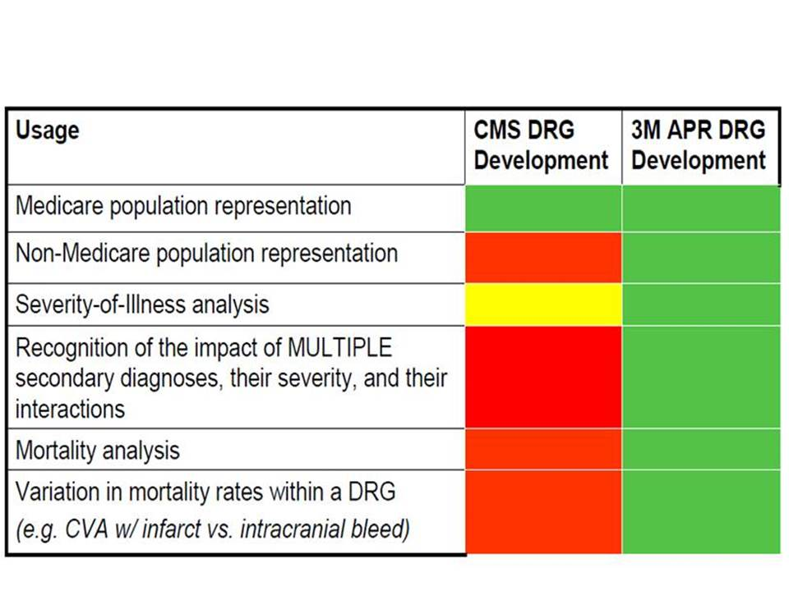
CMS-DRG History and Massachusetts HDD Use Timeline
The Health Care Financing Administration (HCFA), the predecessor agency to the Centers for Medicare and Medicaid Services, implemented HCFA-DRGs in 1983 to measure inpatient resource consumption by the Medicare population. The core of their DRG system was the healthcare “product” supplied by hospital care of a patient. The initial architects of the CMS-DRG system established 23 major diagnostic categories (MDCs) as the first level of categorizing these products.* The MDCs were then subdivided into DRGs based on factors such as surgical status, organ system, age, symptoms, comorbidities, and discharge status. While subsequent modifications to the Medicare DRGs included non-Medicare patients, the key focus of modifications has been on problems relating primarily to the elderly population. The Veterans Health Administration VHAF-DRG is based on the CMS-DRG with refinements by 3M for severity in the veterans population and non-veteran population.
How CMS-DRGs differ from APR-DRGs?**
Timeline of HCFA, VHAF, and CMS DRG Use in Massachusetts HDD
HCFA-DRG
Version 2
1988 - 1991
Annual Updates
HCFA-DRG
Version 8
1988 - 2000
VHAF-DRG Versions
24 25
CMS-
DRG
Versions
26 27 28 29 30
* Source: Dr. Brandon Bushnell: The Evolution of DRGs. American Academy of Orthopedic Surgeons, http://www.aaos.org/news/aaosnow/dec13/advocacy2.asp
** Source: All Patient Refined DRGs, a Methodology Overview, 2006, 3M HIS, https://msmedicaid.acs-inc.com/trainingMaterials/MSAPR-Methodology.pdf

Slide 10
Comparison of Some Structural* Differences between Medicare-DRG, AP-DRG, APR-DRG Versions 12
Medicare DRG
Multiple Complications and Comorbidities not recognized
Newborn Birthweight not Used
AP-DRG
Multiple Complications and Comorbidities not recognize
Newborn Birthweight Used
APR-DRG
Multiple Complications and Comorbidities recognized
Newborn Birthweight Used
No Risk of Mortality Subgroup
National Association of Children’s Hospitals Pediatric Modifications Not Included
No Risk of Mortality Subgroup
Complete use of HIV Infection MDC
Includes Risk of Mortality Subgroup
Complete Inclusion of National Association of Children’s Hospitals Pediatric Modifications
Limited Inclusion of National Association of Children’s Hospitals Pediatric Modifications
Limited use of HIV Infection MDC
Complete use of HIV Infection MDC
* Source: 3M Health Information Systems Research Report No. 5-98

Slide 11
If I want to identify the potential delivery records, which DRG is the best for me?

Slide 12
Comparison of Differences in CMS DRG Version 30 and APR DRG Version Top Ranking Delivery Groupings by Charges for Massachusetts HDD
CMS DRG | CMS Version 30 DRG
766 | Cesarean section w/o CC/MCC
775 | Vaginal delivery w/o complicating diagnoses
765 | Cesarean section w CC/MCC
774 | Vaginal delivery w complicating diagnoses
767 | Vaginal delivery w sterilization &/or D&C
776 | Postpartum & post abortion diagnoses w/o O.R. procedure
781 | Other antepartum diagnoses w medical complications
794 | Neonate w other significant problems
982 | Extensive O.R. procedure unrelated to principal diagnosis w CC
782 | Other antepartum diagnoses w/o medical complications
768 | Vaginal delivery w O.R. proc except steril &/or D&C
792 | Prematurity w/o major problems
789 | Neonates, died or transferred to another acute care facility
791 | Prematurity w major problems
793 | Full term neonate w major problems
769 | Postpartum & post abortion diagnoses w O.R. procedure
APR DRG | APR DRG* Version 30 DRG
540 | Cesarean delivery
560 | Vaginal delivery
541 | Vaginal delivery w sterilization &/or D&C
561 | Postpartum & post abortion diagnoses w/o procedure
566 | Other antepartum diagnoses
640 | Neonate birthwt >2499g, normal newborn or neonate w other problem
542 | Vaginal delivery w complicating procedures exc sterilization &/or D&C
950 | Extensive procedure unrelated to principal diagnosis
625 | Neonate bwt 2000-2499g w other significant condition
614 | Neonate bwt 1500-1999g w or w/o other significant condition
546 | Other O.R. proc for obstetric diagnoses except delivery diagnoses
639 | Neonate birthwt >2499g w other significant condition
633 | Neonate birthwt >2499g w major anomaly
544 | D&C, aspiration curettage or hysterotomy for obstetric diagnoses
626 | Neonate bwt 2000-2499g, normal newborn or neonate w other problem
621 | Neonate bwt 2000-2499g w major anomaly
580 | Neonate, transferred <5 days old, not born here
* Note: APR DRG includes additional Subclass
groupings by Category for Severity of Illness and
Risk of Mortality

Slide 13
Comparison of CMS-DRG to APR-DRG for 4 Single Liveborn Cases*
 | PDX V3000: Single liveborn, born in hospital, delivered without mention of cesarean section Admission age in days: 0 Discharge status: Home Birthweight: 500G
 | Case 1 | Case 2 | Case 3 | Case 4 | Description
Secondary Diagnoses |  | 748.4 | 748.4 770.8 | 748.4 770.8 753.0 | Congenital Cystic Lung Respiratory Failure of NB Renal Agenesis
CMS DRG APR DRG | 391 591 Subclass 1 | 390 591 Subclass 2 | 389 591Subclass 3 | 389 591 Subclass 4 | Normal Newborn/ Newborn with other significant problems/Full Term Neonate w/ Maj. Prob.
 |  |  |  |  | Neonate, birth weight 500-749G, without major procedure
CMS DRG APR DRG | 0.2560 0.1134 | 0.2892 2.6320 | 0.6430 12.8901 | 0.6430 23.1141 | Payment weights**
* Source: Lisa Lyons, An Overview of 3MTM All Patient Refined Diagnostic Related Groups (3M APR DRG), July 13, 2012, 3M HIS ** Payment weights are budget neutral and computed from a national database

Slide 14
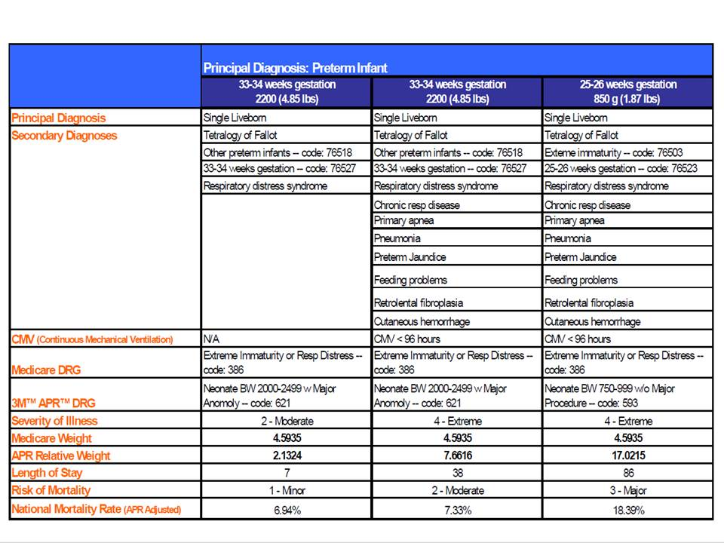
Comparison of CMS-DRG to APR-DRG for Preterm Infant*
* Source: All Patient Refined DRGs, a Methodology Overview, 2006, 3M HIS, https://msmedicaid.acs-inc.com/trainingMaterials/MSAPR-Methodology.pdf

Slide 15
QUESTION
Is it possible to determine race/ethnicity of a patient?
ANSWER
In the APCD, the eligibility file has race and ethnicity data but the completeness of that varies across carriers.
[Thresholds for Race and Ethnicity are both 3%]
Case Mix data has more complete race and ethnicity data

Slide 16
APCD / Case Mix User Questions
QUESTION
I am looking to get a comprehensive report that tells me what is the cost of a procedure when it is done in different locations / facilities / hospitals within MA. Where can I get this data?
ANSWER
If you are looking for the charges associated with different procedures performed at acute care hospitals, you should apply for Level I case mix data.

Slide 17
Question:
What Type of Data is available in Case Mix
on Substance Abuse Care?
From 2014

Slide 18
Change in Massachusetts Inpatient Hospitals Discharges by Age and Diagnosis from FY2011 to FY2013
 | 2011 | 2012 | 2013 | 2011 to 2013 Percent Change
Total Discharges
Massachusetts Residents | 804,993 | 781,351 | 757,708 | -5.9%
Non-Massachusetts Residents | 47,865 | 48,098 | 48,176 | +0.6%
Residency Unknown | 349 | 420 | 255 | -26.9%
Total Discharges by Age
0-17 years | 116,908 | 112,801 | 110,766 | -5.3%
18-24 years | 40,136 | 38,763 | 36,540 | -9.0%
25-34 years | 83,634 | 84,687 | 83,191 | -0.5%
35-44 years | 72,866 | 71,043 | 66,961 | -8.1%
45-64 years | 212,105 | 210,151 | 202,312 | -4.6%
65 years and older | 326,538 | 312,423 | 306,369 | -6.2%
Births
Single Births | 69,481 | 68,685 | 68,512 | -1.4%
Twin Births | 3,158 | 3,012 | 3,020 | -4.4%
Multiple Births | 111 | 74 | 108 | -2.7%
Total Fiscal Year Inpatient Charges | $21,195,330,387 | $20,933,822,349 | $21,895,933,982 | -3.3%
Increases in Selected Inpatient Services
Psychiatric Bed/Private | $ 519,873,229 | $ 524,614,802 | $ 531,882,704 | 2.3%
Psychiatric/Semi Private | $ 40,752,757 | $ 40,980,932 | $ 46,746,425 | 14.7%
Detoxification Bed/Private | $ 21,416,094 | $ 22,956,404 | $ 23,950,917 | 11.8%
Detoxification/Semi Private | $ 8,205,278 | $ 9,895,825 | $ 8,157,579 | -0.6%
Drugs Require Specific ID | $ 8,654,748 | $ 61,125,541 | $ 103,314,446 | 1094%
Psychiatric/Psychological Treatment and Services | $ 33,553,555 | $ 23,980,525 | $ 23,936,856 | -29%
2011
2012
2013
Percent Increase from FY2011 to FY2013
Room & Board – Private and Semi-private (Medical or General) - Detoxification
33,577 Days
36,161 Days
35,445 Days
5.6%
Inpatient Discharges
7,951
8,928
8,924
12.2%
Average Length of Detox
4.22 Days
4.05 Days
3.97 Days
-5.6%
Note that Case Mix is limited to acute care hospitals. Psychiatric and substance abuse specialty hospitals to do not submit Case Mix data to CHIA.

Slide 19
User Question: Lack of Discharge Date in Outpatient Observation (OOA File)
Question:
Observation data doesn't have a "Discharge date" variable, but has Begin_date and End_date.
Answer:
Observation Stay Data doesn’t use discharge date because patients are not admitted to Observation Stay. It is an just an outpatient stay with legally different payment rules. So the dates you would analyze for the beginning of the stay is Begin_date and the end of the stay End_date.

Slide 20
User Question: Significant Procedures in Case Mix Files
Question:
Do Significant Procedures when described on the Case Mix data application for Level 5 data denote that the dates of admission and discharge are provided for the significant procedure only (and not the associated procedure) or does it denote something else?

Slide 21
User Question: Significant Procedures in Case Mix Files
Answer:
In addition to admission date and discharge date, inpatient case mix contains distinct date fields for every procedure field. The date field is the date when the procedure was actually performed.
The rule for procedure dates is that they must not be earlier than 3 days prior to date of admission date unless admission source code is ambulatory surgery or observation stay.
The difference between the principal procedure and the associated significant procedures is that the principal procedure the procedure most related to the principal diagnosis and performed for definitive treatment of the principal diagnosis rather than for diagnostic or exploratory purposes, or necessary to treat a complication of the principal diagnosis.
The significant procedures are procedures which carry an operative or anesthetic risk or require highly trained personnel, special equipment or facilities.

Slide 22
Question: Why are there Zero Charges on Thousands of Case Mix Outpatient Emergency Department Records?
Answer: Over the past 7 years, 92% of the zero charge ED visit records are for patients who eloped, 7% for patients who left against medical advice and 1% percent for patients who met with their person physician.
FY2007 – FY2013 Age Distribution of Patients with Zero Charges who Elope or Leave Against Medical Advice (Approximately 25% attributable to those between ages 18 to 26 years old)

Slide 23
Question: If a patient is admitted from the ED or Observation Stay (OS), we understood that their services are rolled into their case mix inpatient record and will not appear in the ED or OS data release. If that is truly the case, what does OS Departure Status = 2 (Admitted to Hospital) mean?
Answer: Medicare guidelines indicate that Code 2 is used when the hospital is aware of a planned admission even if it doesn’t occur immediately after the discharge. CHIA was able to corroborate that, yes, Code 2 patients were admitted, some to the same hospital, some to different hospitals, and some not immediately after they end their observation stay. In the table below, you will see that the use of OS Code 2 has escalated in the past two years. Even with the partial calendar year 2013 data, the number is higher than previous years.
Oct – Dec
Data Pending

Slide 24
Question: Even though the ED Visit Rate has decreased since FY2012, the FY2014 ED Visit data shows a 24% increase in the ED Death Rate and 26% increase in the Dead on Arrival rate. Is that data accurate?
Answer: Hospitals review and return validation reports before CHIA releases their data. For ED Deaths, part of the increase may be attributable to deaths associated with substance abuse disorders, alcohol-related disorders, and severe open head injury wounds. For dead on arrivals, we did identify an anomaly in the use of the DOA code in FY2014 and FY2013 with a shift in reporting in ED death volume to dead on arrivals. Our State Medical Examiner’s criteria for a dead on arrival is a patient who arrives in asystole, with no cardiac electrical activity, meaning no blood is flowing to the brain or other vital organs. Based on FY2010 – FY2014 ED data, most DOAs have an LOS less than 15 minutes. The anomaly is in the length of stay for DOAs exceeding an hour suggesting an ED Death instead of a DOA.
FY2010 to FY2014 Aggregated DOA Volume by Length of Stay
Length of Stay
LOS > 1 hour
LOS < 1 hour
Dead on Arrivals*
* Small DOA Cells Suppressed

Slide 25
Question: Does CHIA have any data at all on Veterans?
Answer: Hospital inpatient discharge case mix data contains a Veterans Status indicator. This field code indicates the patient’s status as a United States veteran.
FY2012 to FY2014 Veterans Inpatient Discharge Volume
The recent decrease in Veteran Inpatient volume has paralleled the over decreasing trend in inpatient utilization.
 | FY2012 | FY2013 | FY2014
Distinct VA Patients | 43,423 | 42,815 | 39,807
Total VA Inpatient Discharges | 67,426 | 65,605 | 61,234
Also, MA APCD Medical Claims reflects the portion of payments made by private carriers for medical care provided at VA facilities.

