Slide 1
MA Center for Health Information & Analysis Case Mix User Workgroup
April 24, 2018

Slide 2
Agenda
Announcements
Expected timeframes for FY17
Updates on MA APCD Release 6.0
Summarized Data Reports
User Questions [Postponed ☹]
Q&A

Slide 3
Case Mix FY17 Release Calendar
*CURRENT* RELEASE TIMEFRAMES FOR EACH FILE:
Inpatient (HIDD)
JUNE
Emergency Department (ED)
AUGUST
Outpatient Observation (OOD)
SEPTEMBER

Slide 4
Case Mix FY17 Data Release
REPEAT APPLICANTS
For those applicants with previously approved projects who indicated they would like to receive data annually, we will begin accepting Certificates of Continued Need and Compliance (Exhibit B of your DUA) starting on May 1st.
After receiving this, we will send you an invoice for the FY17 data and release data to you once payment is received and the data is ready
If you are making any changes to your project, you must go through the amendment process first

Slide 5
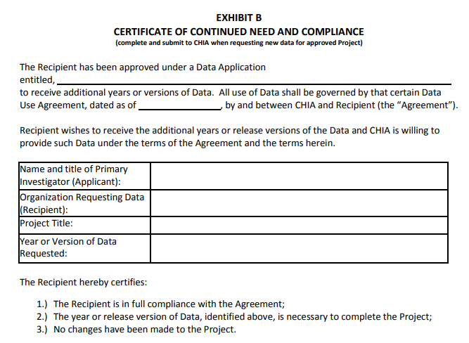

Slide 6
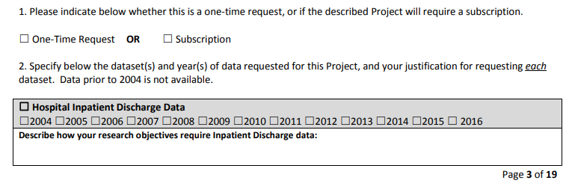
Case Mix FY17 Data Release
NEW APPLICANTS / NEW PROJECTS
We will continue to accept new applications on a rolling basis.
If you are requesting FY17 data, just click the box for “Subscription” on p. 3 of the application form:

Slide 7
MA APCD Release 6.0
Release 6.0 is available NOW
Encompasses data from January 2012 – December 2016 with six months of claim runout
Application form has been updated
Available here: http://www.chiamass.gov/application-documents

Slide 8
Summarized Data Reports
CHIA has updated our Data Release Regulations to allow for Summarized Data Reports
Will contain only aggregate data (data summaries) and De-identified Data, sourced from MA APCD and Case Mix data
Examples of Summarized Data Reports include: counts; totals; rates per thousand; index values; and other standardized metrics.
Will be subject to CHIA’s cell suppression policy (no cell less than 11 will be displayed)
Request form can be found on the MA APCD Application Documents page: http://www.chiamass.gov/application-documents

Slide 9
Summarized Data Reports
In determining whether to compile such a report, CHIA will consider the public interest served, the availability of its resources, the complexity of the request, and privacy concerns (i.e. that there is no more than a minimal risk to individual privacy in the public release of the report)
Submit the request via the new form
Data Use Agreement and Data Management Plan not required
The Executive Director (or his/her designee) will approve or deny such requests. Such approval/denial is final and not subject to further review or appeal.
A support/production fee of $140/hour will be charged

Slide 10
QUESTIONS?

Slide 11
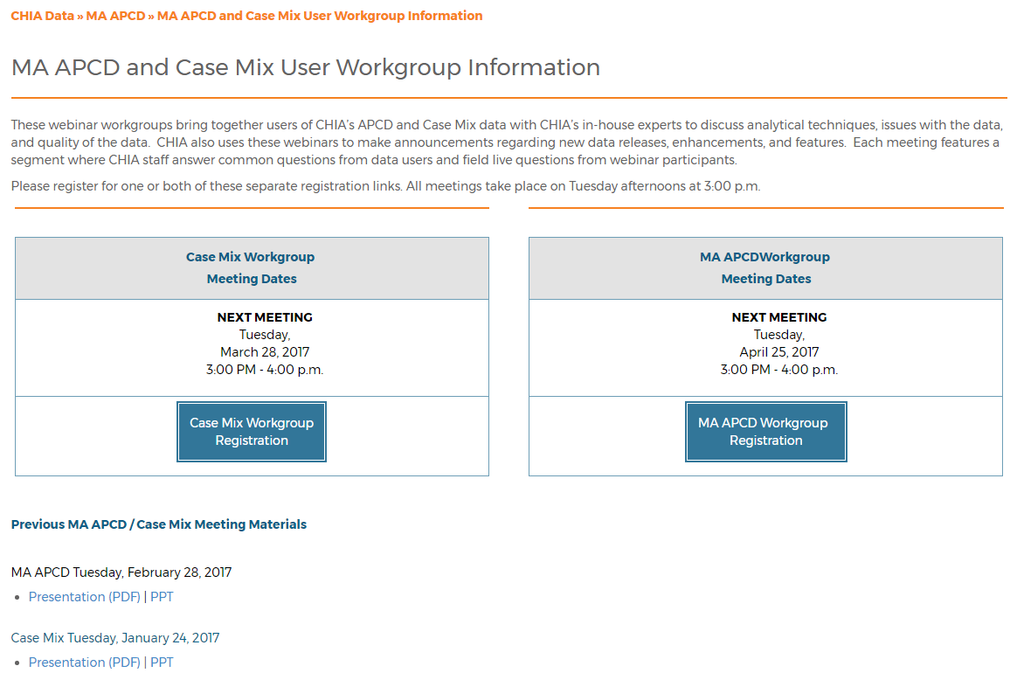
Where can I find old User Workgroup presentations?
http://www.chiamass.gov/ma-apcd-and-case-mix-user-workgroup-information/

Slide 12
Questions?
Questions related to APCD : (apcd.data@state.ma.us)
Questions related to Case Mix: (casemix.data@state.ma.us)
REMINDER: Please include your IRBNet ID#, if you currently have a project using CHIA data

Slide 13
Call for Topics and Presenters
If there is a TOPIC that you would like to see discussed at an MA APCD or Case Mix workgroup, contact Adam Tapply [adam.tapply@state.ma.us]
If you are interested in PRESENTING at an MA APCD or Case Mix workgroup, contact Adam Tapply [adam.tapply@state.ma.us]
You can present remotely from your own office, or in-person at CHIA.

