Slide 1
Case Mix user workgroup
Adam Tapply (Manager of Accounts)
Scott Curley (Manager of Privacy & Compliance)
Sylvia Hobbs (Manager of User Support)
August 27, 2019
CENTER FOR HEALTH INFORMATION AND ANALYSIS

Slide 2
Agenda
FY18 Case Mix Release Updates
Case Mix Release Roadmap
Website Updates
Answered User Questions
Q&A

Slide 3

Case Mix FY18 Release
*CURRENT* RELEASE TIMEFRAMES FOR EACH FILE:
  Inpatient (HIDD)
  Early September
  Emergency Department (ED)
  Early-Mid September
  Outpatient Observation (OOD)
  September

Slide 4
Case Mix FY18 Release
REPEAT APPLICANTS:
  For those applicants with previously approved projects who indicated they would like to receive data annually, we are currently accepting Certificates of Continued Need and Compliance (Exhibit B of your DUA)
  After receiving this, we will send you an invoice for the FY18 data and release data to you once payment is received and the data is ready.
  If you are making any changes to your project, you must go through the amendment process first.

Slide 5
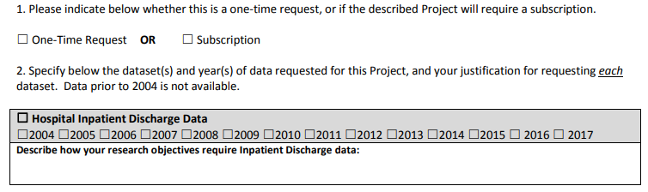
Case Mix FY18 Release
NEW APPLICANTS / NEW PROJECTS:
  We will continue to accept new applications on a rolling basis.
  If you are requesting FY18 data, just click the box for “Subscription” on p. 3 of the application form:

Slide 6
Case Mix Release “Roadmap”
  Data Submission and Compliance
  Data Intake & Internal Processing
  Quality / Release Assurance
  Data Delivery

Slide 7

COMING SOON: Live Case Mix Release Updates
  Release updates on current FY Case Mix data release will soon be on the CHIA website.
  Aiming to provide updates weekly or bi-weekly.
  What kinds of information would Case Mix users like to see?
    Current estimated release date?
    Where in the “roadmap” is CHIA currently?
    Other information?
  Very possible we will do this for upcoming APCD releases as well.

Slide 8
MA APCD Release 8.0
  Available Winter 2019/2020
  **Please hold off on submitting Release 8.0 requests for now**
  Will encompasses data from January 2014 – December 2018 with six months of claim runout (includes paid claims through 6/30/19)
  Will be linkable to Release 7.0 via crosswalk
  Additional information on highlights and enhancements will be presented in future APCD User Workgroups.

Slide 9
USER questions

Slide 10
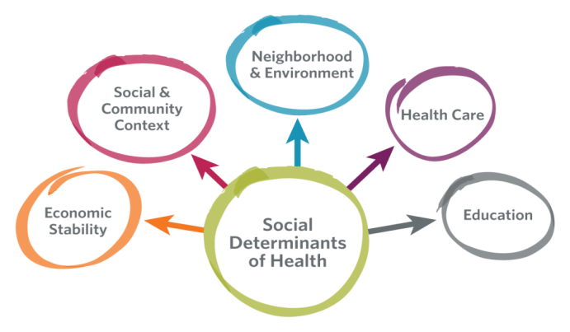
Question: We are applying for Case Mix data and propose to use the
5-digit ZIP code to link to census data to obtain area measures for the
social determinants of health. ICD-10-CM now has new coding descriptors
for the social determinants of health. What are those codes and to
what extent are they being used in Case Mix?
Answer: ICD-10-CM has over 80 diagnosis codes in the range Z55*, Z56*, Z59*, Z60*, Z62*, and Z63* that describe different components of the social determinants of health related to education, economic stability, neighborhood & environment, social and community context, and health care. A few examples of those codes are below:
Examples of ICD-10-CM Descriptors for the Social Determinants of Health
Answer
Continued

Slide 11
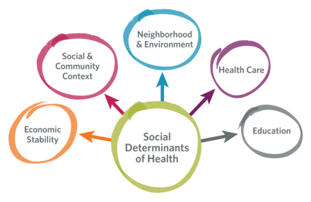
FY2016-FY2017 Top Ranking Social Determinants of Health (SODH) Based on ICD-10-CM Codes in Hospital Inpatient Discharge Data (HIDD)
Answer (continued): Seventy-two of 75 hospitals that submit HIDD use ICD-10-CM SODH coding. For all
discharges, “Homelessness” (Z590) ranks as the top SODH code (see Table 1 below). For patients who expired, “Problems related to living alone” ranks as the top (see Table 2). For children < 18 years old (see Tables 3 and 4) , a “Personal history of physical and sexual abuse in childhood” (Z62810) ranked top. For discharges with abuse coding, hospitals are also use additional ICD-10-CM codes in the range of T760*, T761*, T762*, T763*, T765* and T766* to provide more specificity on nature of maltreatment, physical abuse, sexual exploitation, psychological abuse, and neglect or abandonment. These codes also differentiate whether the episode of care was related to initial or subsequent abuse or sequela from the abuse.
Ranking of Top Ten ICD-10-CM SODH Codes for All Discharges, Patients who Expire, and Children

Slide 12


Question: Over the years, the percent of inpatient discharges with unknown race has increased. We rely on race data to evaluate disproportionately higher burden of diseases and disparities. Do you have any recommendations for handling unknowns?
Handling Unknowns
Answer: In looking at the age distribution by percent of inpatient discharges with an unknown race
over the past 14 years (FY2007 to FY2018), the highest proportion of unknowns tend to be in the
pediatric population. See Figure 1 below. This age distribution of unknowns skewed towards the pediatric population became even more pronounced in the most recent FY2018 inpatient data. See Figure 2 below. Rather than pooling the data, stratifying by age would allow you to see more clearly any distorting effect unknowns will have on disparity metrics.
Answer
Continued

Slide 13
Handling Unknowns
Answer (continued): The encrypted UHIN can be used to determine within one year or across multiple years if a specific discharge record with unknown race had previously reported race as known during another episode of care. In Figure 3 below, 14 years of Inpatient Hospital Discharge data from FY2007 to FY2018 was used to determine if patients with unknown race and a valid encrypted UHIN had previously reported race as known for another inpatient episode of care. And yes, they had. By linking any encrypted UHIN with an unknown race to encrypted UHINs with a known race, the successful linkage of the discharge to their race data in a previous inpatient record led to a monthly average 33% reduction in the number of discharges with race unknown. It is important to note that over a 14-year period 52% of unknowns do not have valid encrypted UHINs and that the greatest reduction in unknowns is achieved in the adult population.

Slide 14

Question: Our project involves a comparison of three states. Before applying to each individual state for their data, we need to know the difference between Massachusetts (MA) Hospital Inpatient Discharge data (HIDD) as released by CHIA and HIDD as released by the Agency for Healthcare Research and Quality (AHRQ) in their Healthcare Cost and Utilization Project (HCUP) State Inpatient Database (SID).
Answer: It is important to first note that access to either HCUP data or CHIA data requires completion of the required application process for approved use. Some of the key differences between HCUP SID and CHIA HIDD’s limited data set are as follows:
  The HCUP SID central distributor releases MA data by calendar year data available from CY1990 through CY2016 (January 1990 through December 2016). CHIA releases HIDD by fiscal year available from FY2004 through FY2018 (October 2003 through September 2018).
  HCUP SID is only allowed to release MA data by 3-Digit ZIP Code, CHIA HIDD is available in 5-Digit ZIP Code or 3-Digit ZIP Code format.
  HCUP SID does not include patient town of residence, CHIA HIDD does include patient town of residence.
  HCUP SID does not include revenue codes or associated units of service, days of service and line item charges. CHIA HIDD does include revenue codes, units of service, days of service and line item charges.
  HCUP SID only includes the APR-DRG. CHIA’s HIDD includes both the CMS-DRG and multiple versions of the APR-DRG.
  The HCUP SID reports age of infant’s less than 1 year old in months (0 to 12 months), CHIA report’s the age of such infants in weeks (0 to 52 weeks).
  HCUP SID includes a calculated field for median household income, CHIA HIDD does not.
For additional information on AHRQ HCUP SID data see the following links:
  List of States Participating in HCUP: https://www.hcup-us.ahrq.gov/db/PartnerParticipation_CD.pdf
  List of HCUP SID data elements: https://www.hcup-us.ahrq.gov/db/state/siddist/siddistvarnote2016.jsp

Slide 15
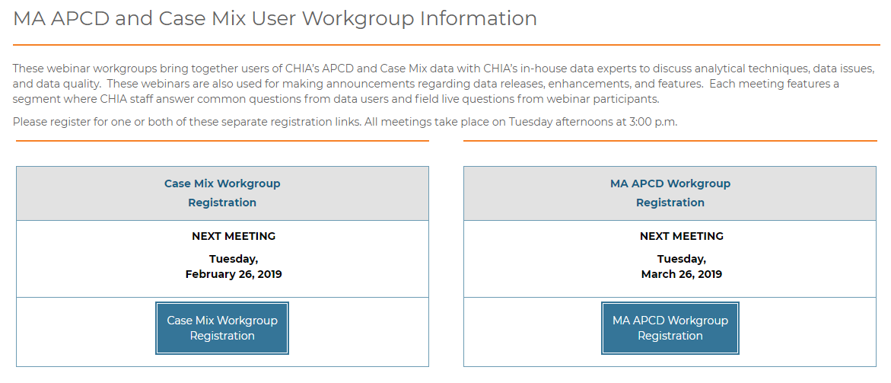
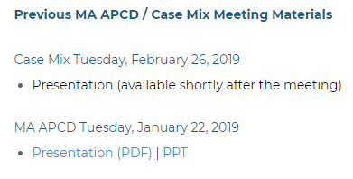
Where can I find old User Workgroup Presentations?
http://www.chiamass.gov/ma-apcd-and-case-mix-user-workgroup-information/

Slide 16
Questions?
Questions related to MA APCD:
apcd.data@state.ma.us
Questions related to Case Mix:
casemix.data@state.ma.us
REMINDER: Please include your IRBNet ID#, if you currently have a project using CHIA data.

Slide 17
Call for Topics and Presenters
If there is a TOPIC that you would like to see discussed at an MA APCD or Case Mix workgroup in 2019, contact Adam Tapply [adam.tapply@state.ma.us]
If you are interested in PRESENTING at an MA APCD or Case Mix workgroup in 2019, contact Adam Tapply [adam.tapply@state.ma.us]
You can present remotely, or in-person at CHIA.

