Slide 1
MA Center for Health Information & Analysis
Case Mix User Workgroup
February 27, 2018

Slide 2
Agenda
Announcements
  Expected timeframes for FY17
  Updates on MA APCD Release 6.0
Summarized Data Reports
Publications Using CHIA Data
User Questions
Guest Presentation: Urbano Franca, Boston Children's Hospital
"Regionalization of Definitive Pediatric Hospital Care"
Q&A

Slide 3
Case Mix FY17 Release Calendar
  *CURRENT* RELEASE TIMEFRAMES FOR EACH FILE:
  Inpatient (HIDD)
  JUNE
  Emergency Department (ED)
    AUGUST
  Outpatient Observation (OOD)
    SEPTEMBER

Slide 4
MA APCD Release 6.0
Release 6.0 is available NOW – started shipping data to applicants earlier this month
Encompasses data from January 2012 – December 2016 with six months of claim runout
Application form has been updated
Available here: http://www.chiamass.gov/application-documents

Slide 5
MA APCD Release 6.0 Highlights
New and improved Member Enterprise ID (MEID)
Master Data Management (MDM) approach updated to work with hashed patient information
Added Nickname processing for first names (Joe, Joseph)
Added NYSIIS phonetic processing for last names (Smith, Smyth)
Removed the Pharmacy Benefit Manager data from the MDM process to decrease the duplication of member data by upwards of 40%
4 additional carriers added to the claims versioning

Slide 6
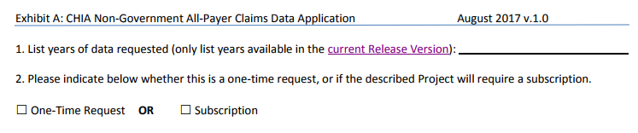
Future Years of Data
No longer required to check any boxes on the application form for future years of data
List the years you would like to request and we will fulfill all years available with the current Release
To request future years of data (no longer limited to the upcoming 5 years), just click the box for “Subscription”

Slide 7
Summarized Data Reports
CHIA has updated our Data Release Regulations to allow for Summarized Data Reports
Will contain only aggregate data (data summaries) and De-identified Data, sourced from MA APCD and Case Mix data
  Examples of Summarized Data Reports include: counts; totals; rates per thousand; index values; and other standardized metrics.
  Will be subject to CHIA’s cell suppression policy (no cell less than 11 will be displayed)
Request form can be found on the MA APCD Application Documents page: http://www.chiamass.gov/application-documents

Slide 8
Summarized Data Reports
In determining whether to compile such a report, CHIA will consider the public interest served, the availability of its resources, the complexity of the request, and privacy concerns (i.e. that there is no more than a minimal risk to individual privacy in the public release of the report)
Submit the request via a new form (to be published after the revised regulation goes into effect.
  Data Use Agreement and Data Management Plan not required
The Executive Director (or his/her designee) will approve or deny such requests. Such approval/denial is final and not subject to further review or appeal.
A support/production fee of $140/hour will be charged

Slide 9
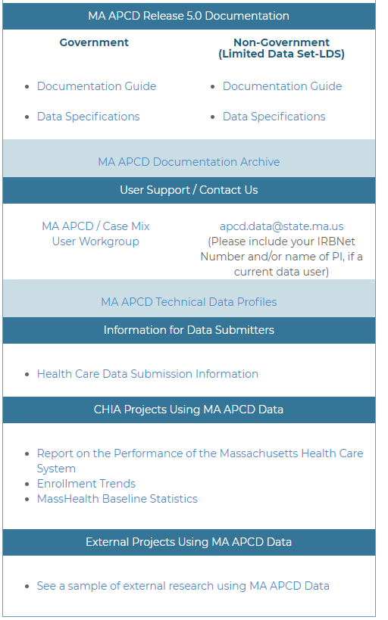
Publications Using CHIA Data
MA APCD and Case Mix websites now have galleries highlighting research completed by previous applicants for CHIA data using MA APCD and Case Mix
If you would like to be included in the list, please send the publication citation and/or hyperlink to the publication to Adam.Tapply@state.ma.us
These lists will be updated continually and will contain links to requestor’s original application form on the public comment page

Slide 10
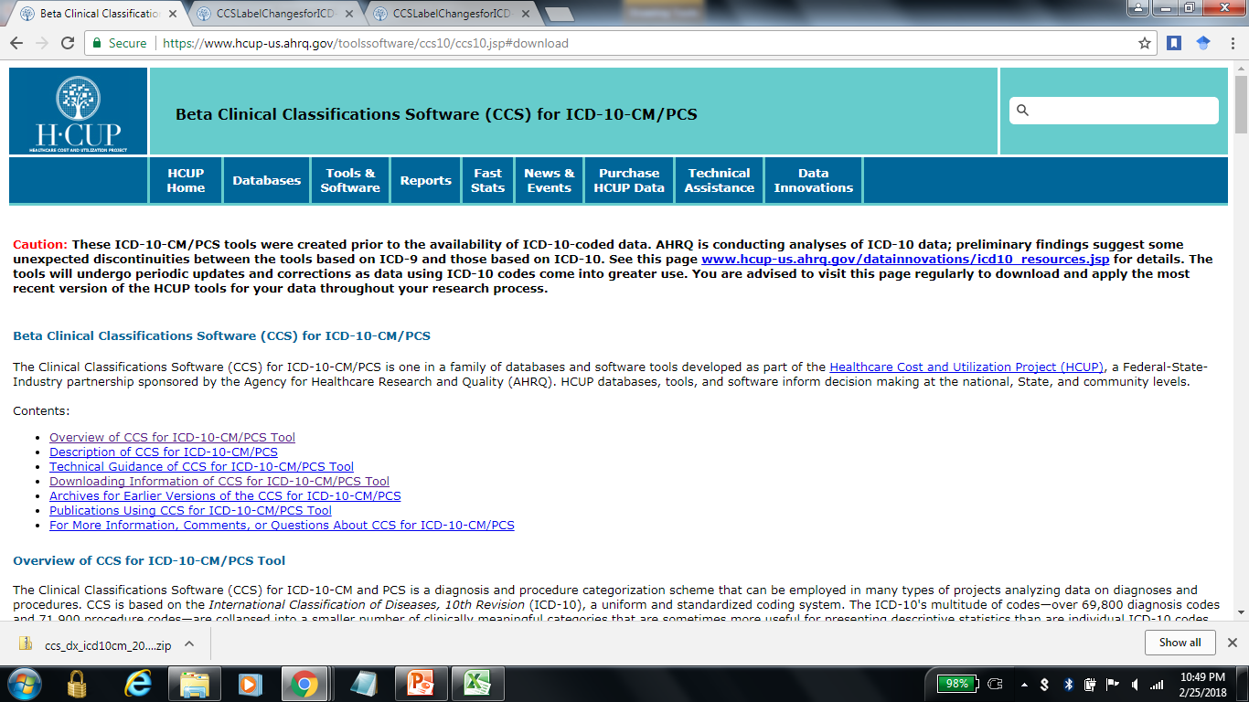
Question: CHIA has included AHRQ Clinical Classification Software (CCS) codes for grouping outpatient ED visits in past releases. How can researchers obtain this data in the future?
Answer: Data users requiring CCS codes can download them directly from the AHRQ-HCUP website. Please note that as of February 26, 2018, only a Beta version of the CCS for is available for ICD-10-CM/PCS on the AHRQ website, see:
https://www.hcup-us.ahrq.gov/toolssoftware/ccs10/ccs10.jsp .
AHRQ cautions users that AHRQ Tools undergo periodic updates and corrections. AHRQ reminds those who download data to visit the site regularly to download and apply the most recent version of their tools throughout your research process.

Slide 11
Question: I am using ED Visit Data to study visits related to tobacco use. Are there major changes in tobacco coding between ICD-9-CM and ICD-10-CM?
Answer: Yes, ICD-9-CM only refers to “tobacco use” while ICD-10-CM has new codes to distinguish “smoking” from “chewing” and harm due to “tobacco cigarettes” from “other tobacco and nicotine”. Also, ICD-10-CM distinguishes tobacco use complicating pregnancy from puerperium with specific information on the trimester of the complication. Tables 1 and 2 and Figure 1 below compare tobacco use pregnancy complications in ICD-9-CM and ICD-10-CM.
Table 1. FY2015 ICD-9-CM Pregnancy/Smoking
Table 2. FY2016 ICD-10-CM Pregnancy/Smoking
DX Code | Codes Used | Description
64903 | 1,071 | Tobacco use disorder complicating pregnancy, childbirth, or the puerperium, antepartum condition or complication
64900 | 72 | Tobacco use disorder complicating pregnancy, childbirth, or the puerperium, unspecified as to episode of care or not applicable
64904 | 25 | Tobacco use disorder complicating pregnancy, childbirth, or the puerperium, postpartum condition or complication
64901 | * | Tobacco use disorder complicating pregnancy, childbirth, or the puerperium, delivered, with or without mention of antepartum condition
DX Code | Codes Used | Description
O99331 | 778 | Smoking (tobacco) complicating pregnancy, first trimester
O99332 | 327 | Smoking (tobacco) complicating pregnancy, second trimester
O99330 | 198 | Smoking (tobacco) complicating pregnancy, unspecified trimester
O99333 | 117 | Smoking (tobacco) complicating pregnancy, third trimester
O99335 | 22 | Smoking (tobacco) complicating the puerperium
O99334 | * | Smoking (tobacco) complicating childbirth
Figure 1. FY2016 ED Visit Smoking Pregnancy Complications by Trimester

Slide 12
QUESTIONS?

Slide 13
GUEST PRESENTATION
Urbano Franca, PhD
Research Fellow / Data Scientist
Boston Children’s Hospital / Harvard Medical School
"Regionalization of Definitive Pediatric Hospital Care"

Slide 14
Regionalization of Definitive Pediatric Hospital Care
Urbano L. França, PhD
Boston Children’s Hospital
February 27, 2018
In collaboration with Michael L. McManus, MD, MPH

Slide 15
Pediatric care regionalization
Pediatric hospital care requires specialized resources and expertise.
Over the past decade, evidence of pediatric care regionalization has begun to appear, such as general surgery, otorhinolaryngology, and orthopedics.
ED in academic centers are seeing large numbers of children referred with routine medical conditions.
Pediatric inpatient transfers to academic centers are increasingly commonplace.

Slide 16
Hypothesis
Because pediatric hospital care constitutes a smaller market and requires more specialized resources than adult care, we hypothesized that the qualitative signs of increasing regionalization reflect a disproportionate reduction in the availability of pediatric care.
How to quantify this?
Hospital Capability Index (HCI)
Regionalization Index (RI)

Slide 17


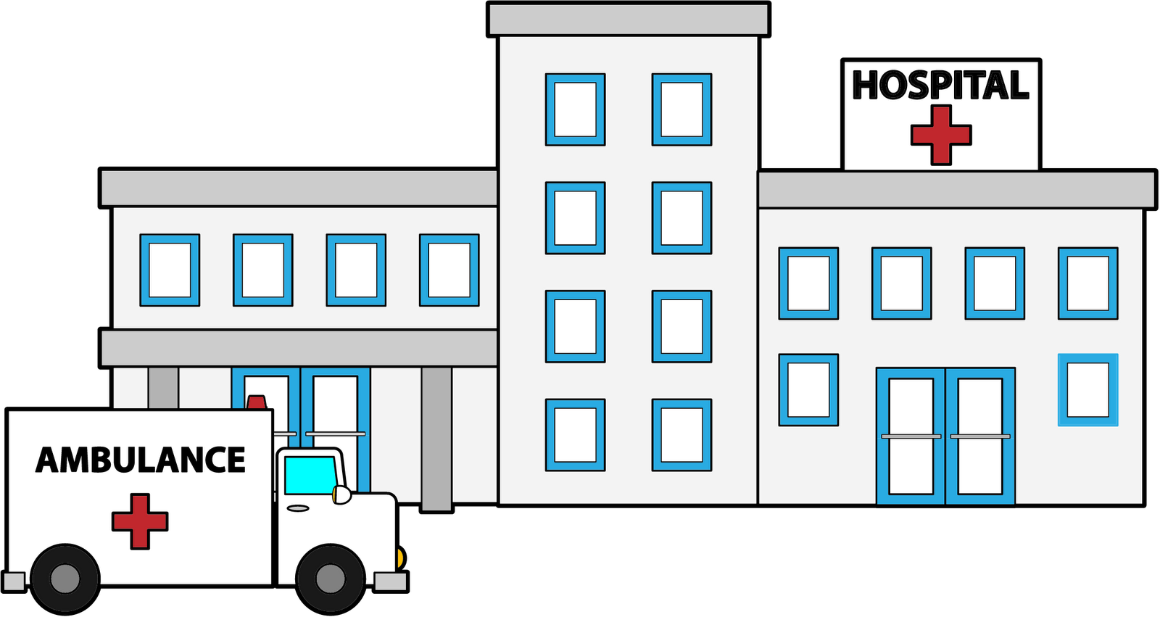
Our approach
Admission
Admission
Transfer
Transfer
Transfers and admissions as measures of definitive hospital care.

Slide 18
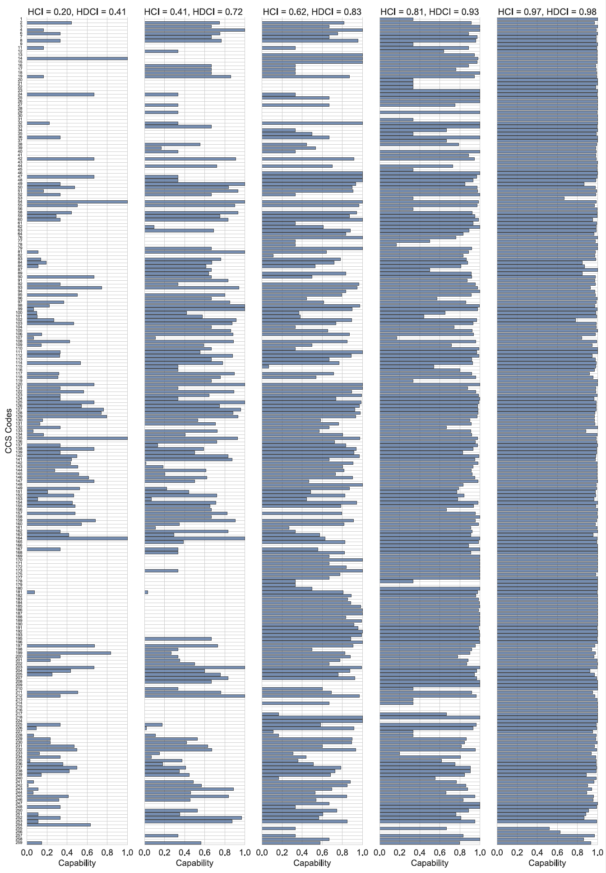
HCI 0.20 0.41 0.62 0.81 0.97
Hospital Capability Index (HCI)
Average of care completion for the different conditions seem at the State.
França & McManus, Health Services Research 2017

Slide 19
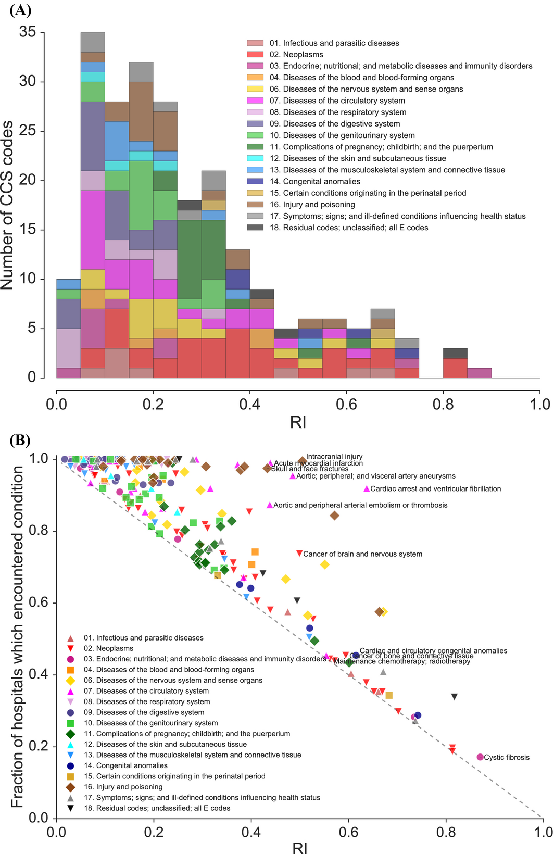
Regionalization Index (RI)
Fraction of patients who are transferred and fraction of hospitals that no longer encounter a condition.
França & McManus, Health Services Research 2017

Slide 20
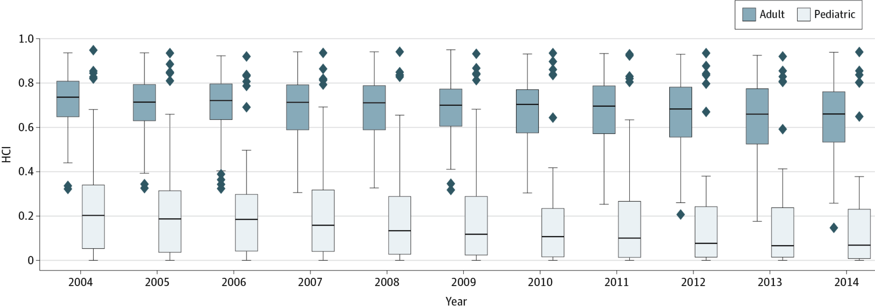
A decade of MA’s system of care
França & McManus, JAMA Pediatrics 2017
Pediatric and adult systems of care are effectively two different systems of care.

Slide 21
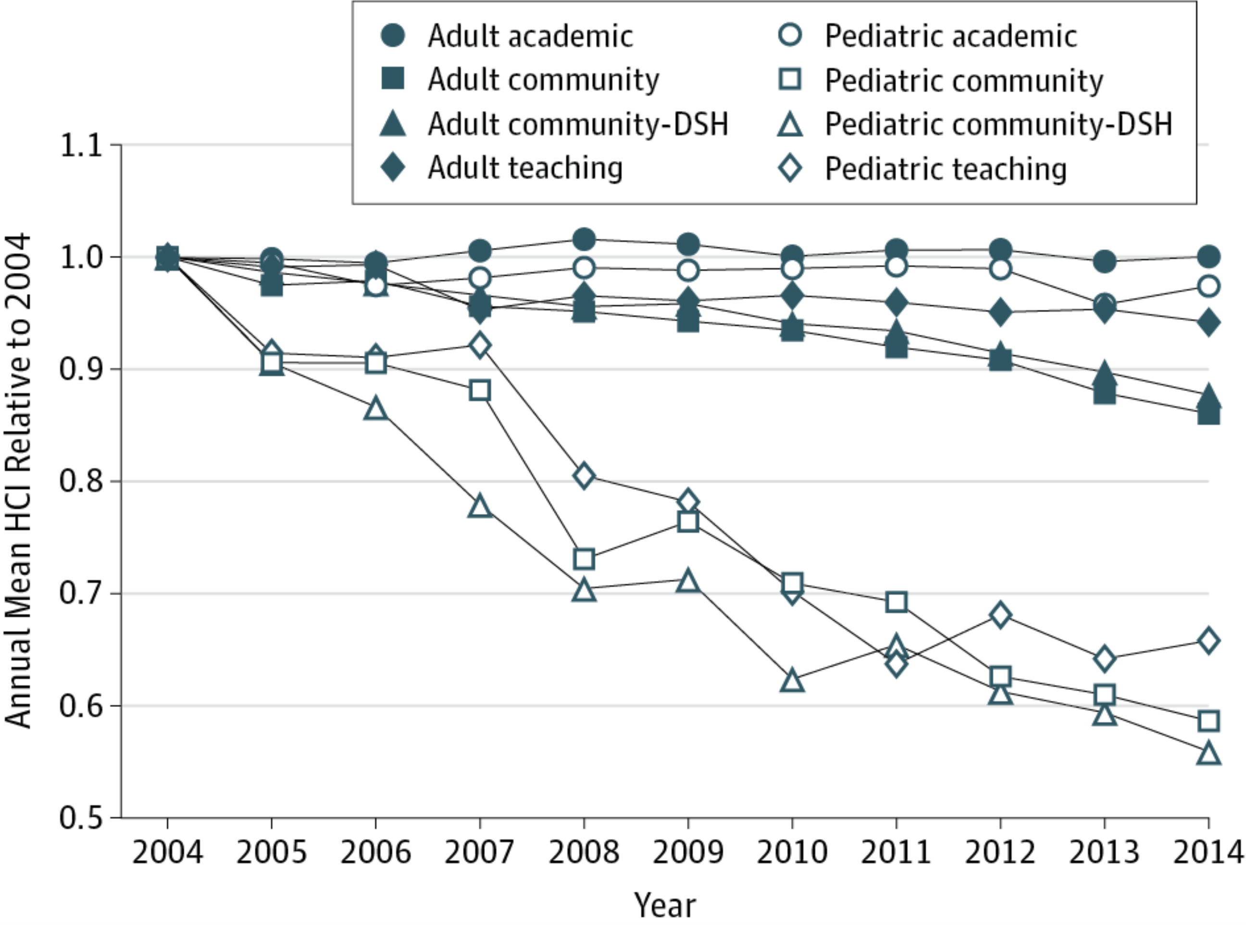
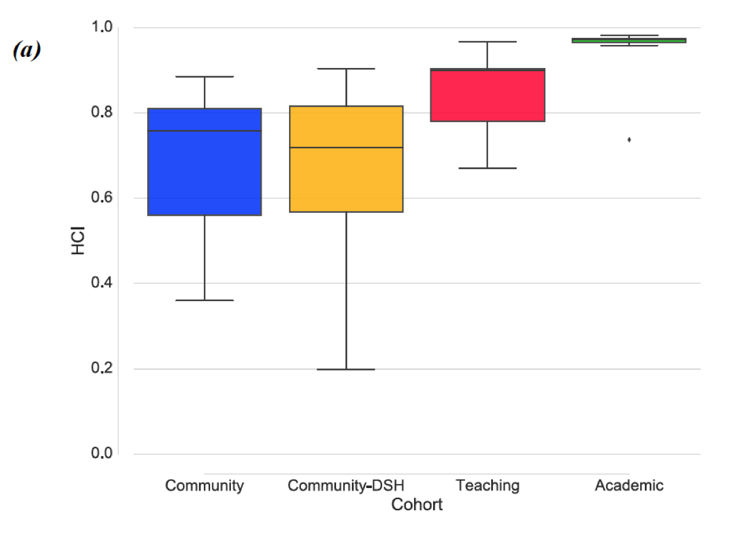
Hospital Cohorts
França & McManus, JAMA Pediatrics 2017
Significant decrease of pediatric capability in Teaching, Community, and Community–DSH hospitals.

Slide 22
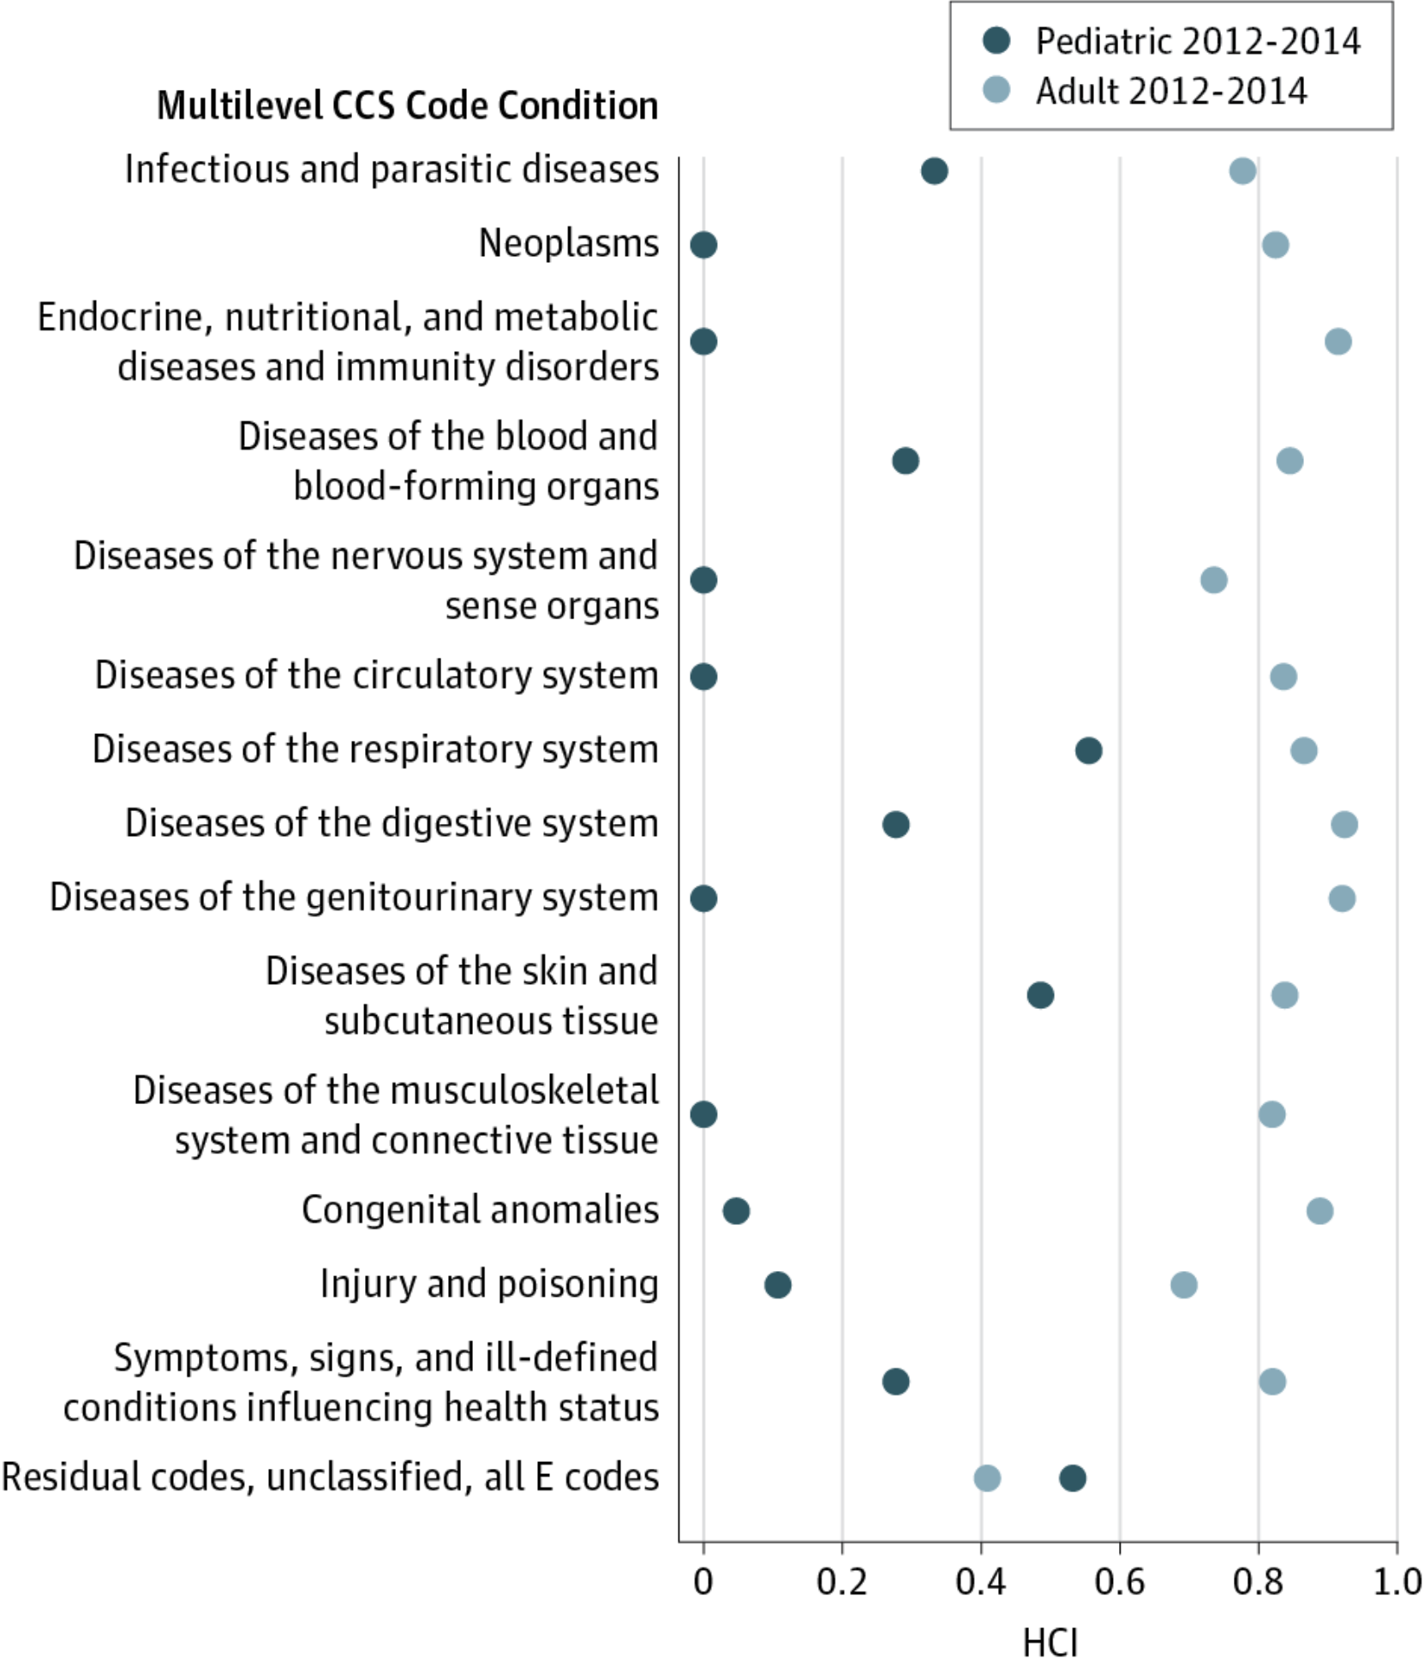
Zooming in on single hospitals and conditions
Representative Community Hospital in Massachusetts
França & McManus, JAMA Pediatrics 2017

Slide 23
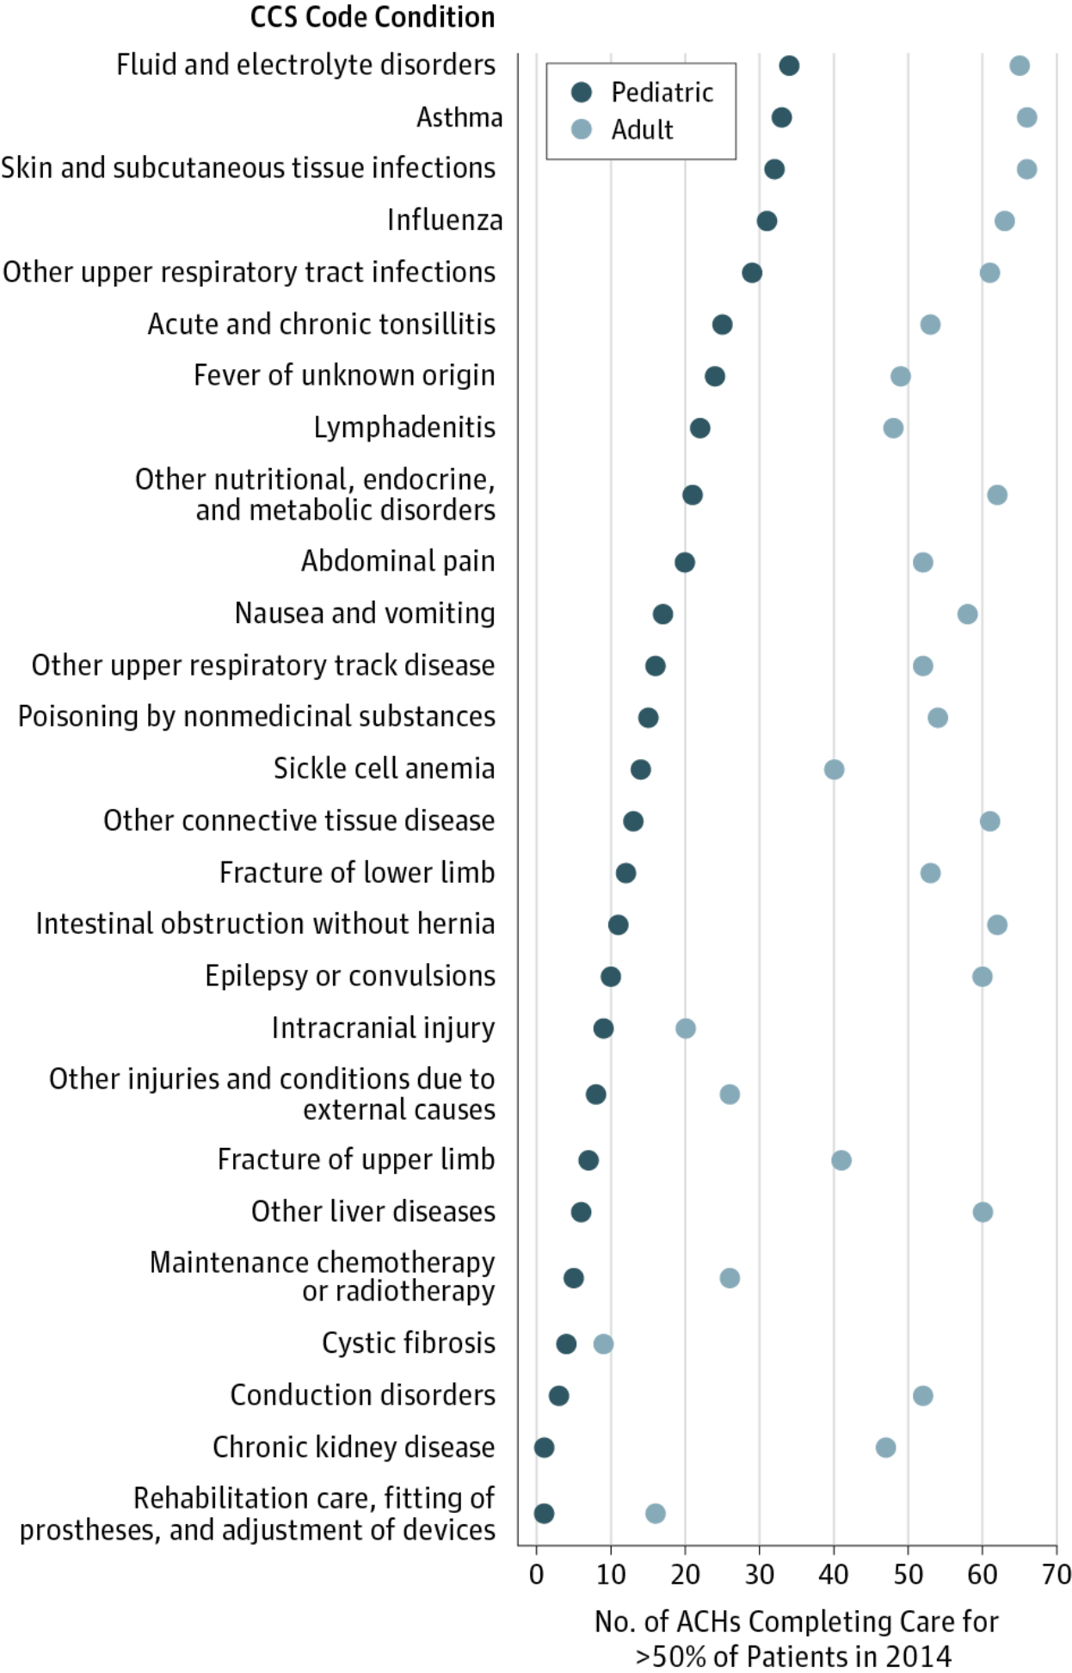
Zooming out for a bird's-eye view of the system
França & McManus, JAMA Pediatrics 2017

Slide 24
Zooming out for a bird's-eye view of the system
França & McManus, JAMA Pediatrics 2017

Slide 25
But are these results for MA generalizable?
A comparison with three other States using AHRQ’s HCUP data in CA, FL, and NY

Slide 26
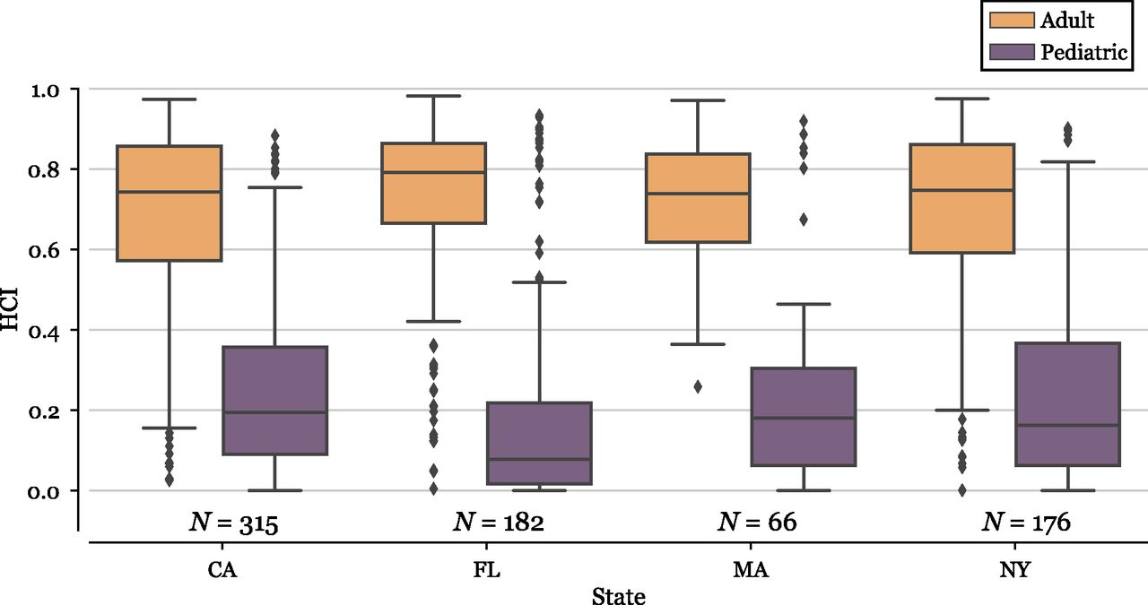
Adult vs. Pediatric Care
França & McManus, Pediatrics 2018

Slide 27
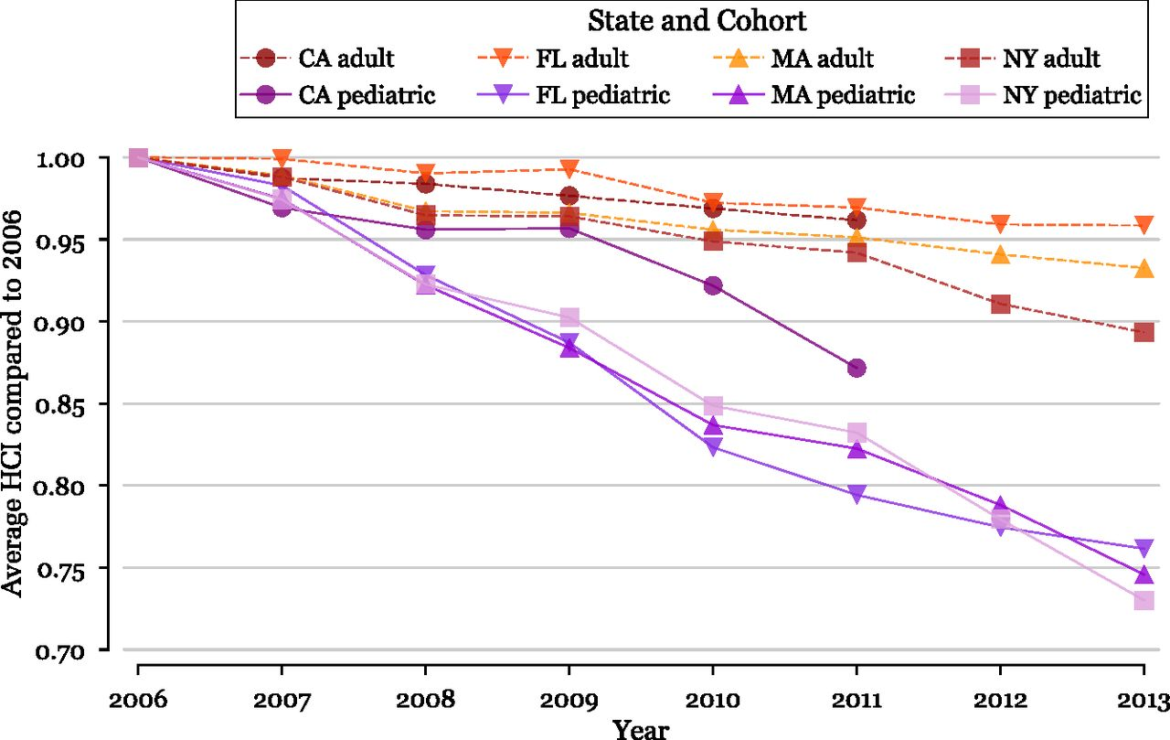
Metrics for Healthcare Systems
França & McManus, Pediatrics 2018

Slide 28
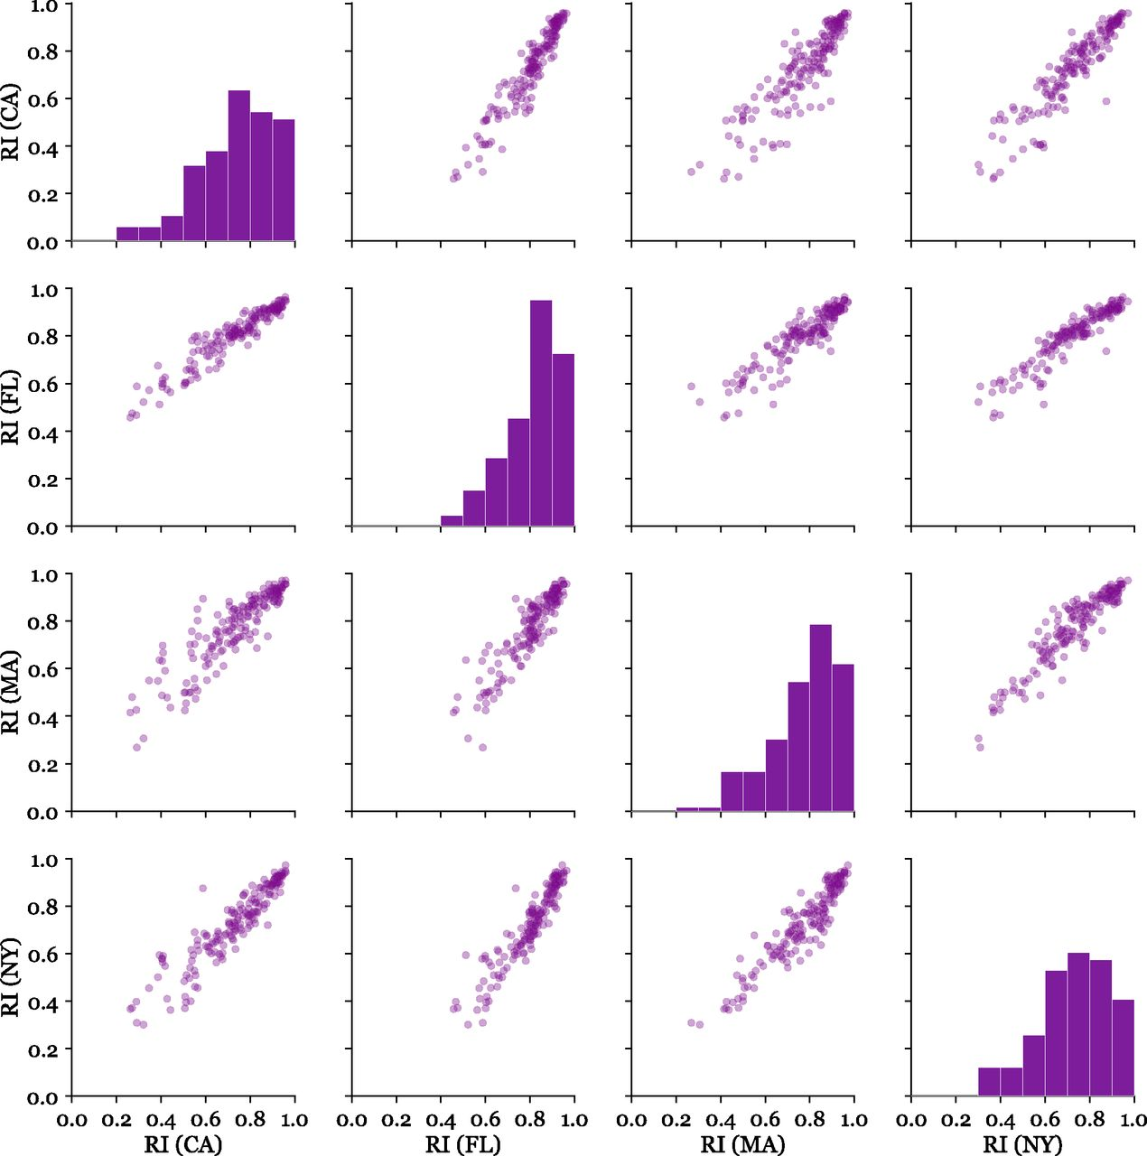
Similar regionalization
in all states
França & McManus, Pediatrics 2018

Slide 29
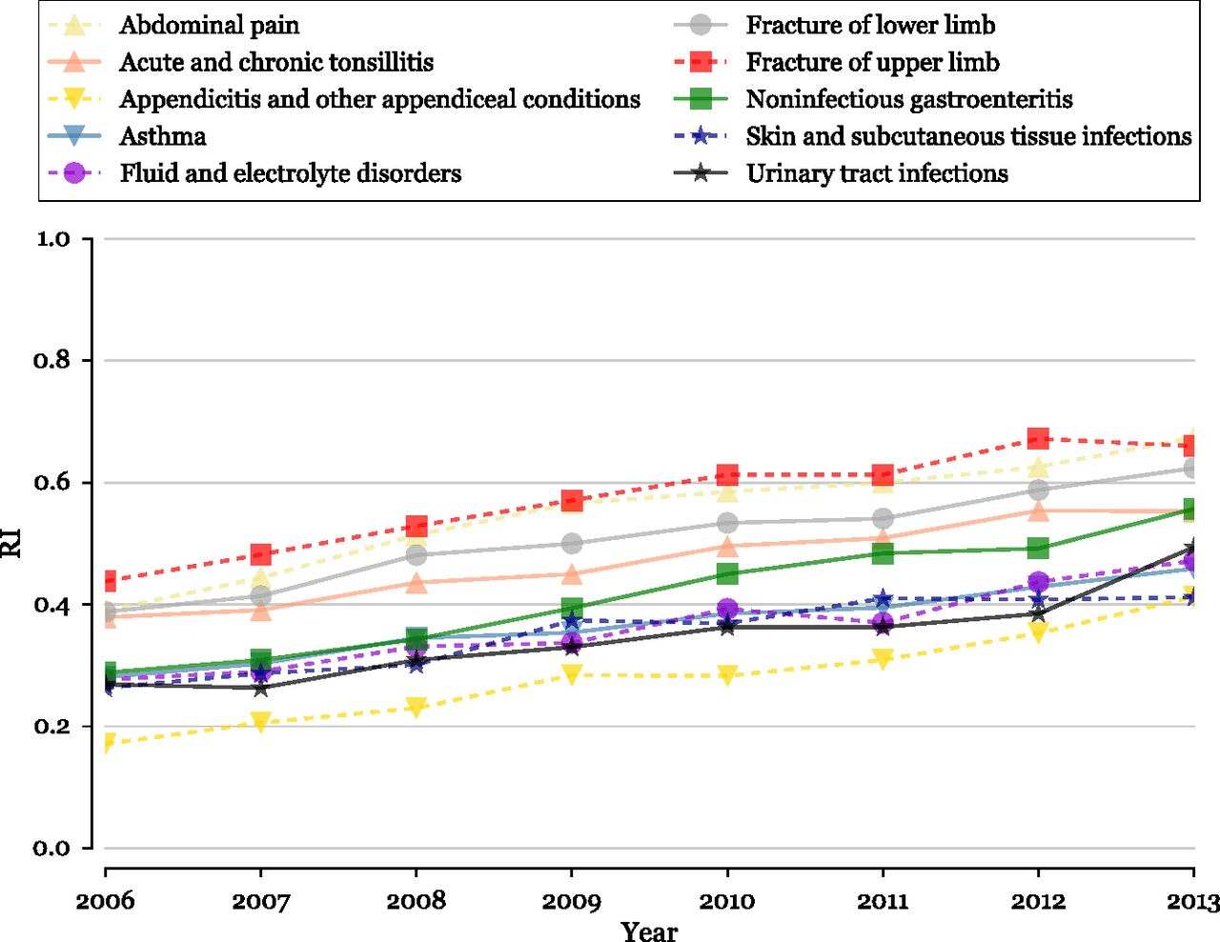
Increase in Regionalization
França & McManus, Pediatrics 2018

Slide 30
Conclusions and Future Work
Recently created metrics quantify condition specific regionalization and hospital capability.
Hospitals increasingly differ in their delivery of pediatric care and adult care.
The short- and long-term impacts of care concentration remain to be seen (quality improvement vs. crowding of specialty centers, for instance).
Network adequacy experience from adult populations is not transferrable to pediatric care.
Inform EMS decisions, network adequacy, and understanding how to better delivery care to pediatric population.

Slide 31
Thanks! urbano.franca@childrens.harvard.edu

Slide 32
References:
França UL, McManus ML. Transfer frequency as a measure of hospital capability and regionalization. Health Serv. Res. 2017;52(6):2237–2255
França UL, McManus ML. Availability of definitive hospital care for children. JAMA Pediatr. 2017;171(9):e171096
França UL, McManus ML. Trends in Regionalization of Hospital Care for Common Pediatric Conditions. Pediatrics. 2018; 141(1):e20171940
Gattu RK, Teshome G, Cai L, Wright C, Lichenstein R. Interhospital pediatric patient transfers: factors influencing rapid disposition after transfer. Pediatr Emerg Care. 2014;30(1):26-30.
Horeczko T, Marcin JP, Kahn JM, Sapien RE; Consortium of Regionalization Efforts in Emergency Medical Services for Children (CORE-EMSC). Urban and rural patterns in emergent pediatric transfer: a call for regionalization. J Rural Health. 2014;30(3):252-258.
Klein MD; Surgical Advisory Panel, American Academy of Pediatrics. Referral to pediatric surgical specialists. Pediatrics. 2014;133(2):350-356.
Li J, Monuteaux MC, Bachur RG. Interfacility transfers of noncritically ill children to academic pediatric emergency departments. Pediatrics. 2012;130(1):83-92.
Lorch SA, Myers S, Carr B. The regionalization of pediatric health care. Pediatrics. 2010;126(6):1182-1190.
Lorch SA. Ensuring access to the appropriate health care professionals: regionalization and centralization of care in a new era of health care financing and delivery. JAMA Pediatr. 2015;169(1):11-12.
Rosenthal JL, Hilton JF, Teufel RJ II, Romano PS, Kaiser SV, Okumura MJ. Profiling interfacility transfers for hospitalized pediatric patients. Hosp Pediatr. 2016;6(6):345-353.

Slide 33
Questions?
Questions related to APCD : (apcd.data@state.ma.us)
Questions related to Case Mix: (casemix.data@state.ma.us)
REMINDER: Please include your IRBNet ID#, if you currently have a project using CHIA data

Slide 34
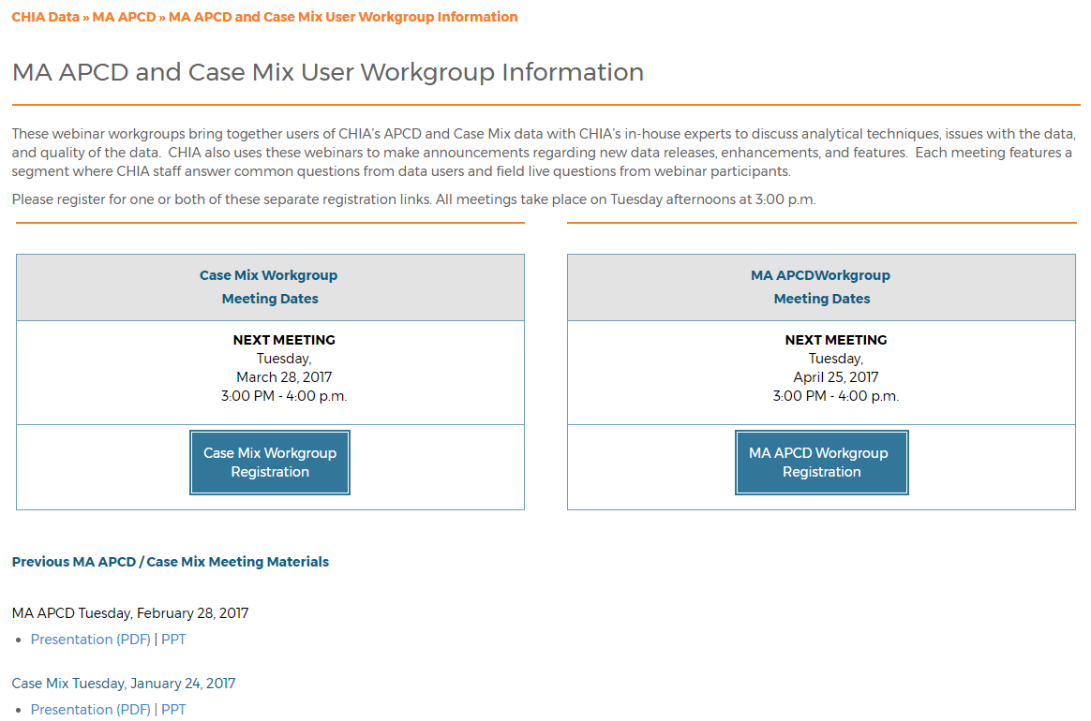
Where can I find old User Workgroup presentations?
http://www.chiamass.gov/ma-apcd-and-case-mix-user-workgroup-information/

Slide 35
Call for Topics and Presenters
If there is a TOPIC that you would like to see discussed at an MA APCD or Case Mix workgroup, contact Adam Tapply [adam.tapply@state.ma.us]
If you are interested in PRESENTING at an MA APCD or Case Mix workgroup, contact Adam Tapply [adam.tapply@state.ma.us]
  You can present remotely from your own office, or in-person at CHIA.

