Slide 1
Case Mix user workgroup
Adam Tapply (Manager of Accounts)
Sylvia Hobbs (Manager of User Support)
February 26, 2019
CENTER FOR HEALTH INFORMATION AND ANALYSIS

Slide 2
Agenda
Announcements:
  Updates on FY17 Case Mix Release
  Timeline for FY18 Case Mix Release
  APCD Release 7.0
User Questions:
  Unknowns in Demographic Fields
  Organ Transplant Coding
Q&A

Slide 3
Case Mix FY17 Release
*CURRENT* RELEASE TIMEFRAMES FOR EACH FILE:
  Inpatient (HIDD)
  June [Completed]
  Emergency Department (ED)
  November [Completed]
  Outpatient Observation (OOD)
  February – Fulfilling Now!

Slide 4
Case Mix FY18 Release
*CURRENT* RELEASE TIMEFRAMES FOR EACH FILE:
  Inpatient (HIDD)
  June
  Emergency Department (ED)
  August
  Outpatient Observation (OOD)
  September

Slide 5
Case Mix FY18 Release
REPEAT APPLICANTS:
  For those applicants with previously approved projects who indicated they would like to receive data annually, we began accepting Certificates of Continued Need and Compliance (Exhibit B of your DUA) starting on May 1st.
  After receiving this, we will send you an invoice for the FY18 data and release data to you once payment is received and the data is ready.
  If you are making any changes to your project, you must go through the amendment process first.

Slide 6
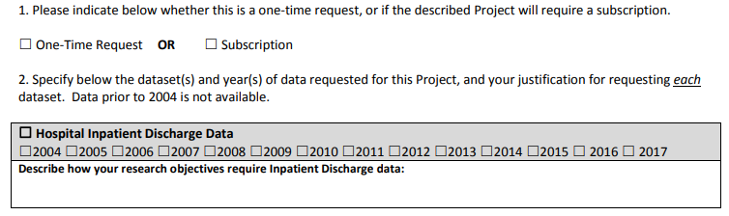
Case Mix FY18 Release
NEW APPLICANTS / NEW PROJECTS:
  We will continue to accept new applications on a rolling basis.
  If you are requesting FY18 data, just click the box for “Subscription” on p. 3 of the application form:

Slide 7
MA APCD Release 7.0
  Available NOW
  Encompasses data from January 2013 – December 2017 with six months of claim runout (includes paid claims through 6/30/18)
  Release Documentation and Data Specifications have been posted to the website: http://www.chiamass.gov/ma-apcd/
  Apply now by listing 2017 (and any other years you want from Release 7.0) in the “Years Requested” section of the current application form
  Available here: http://www.chiamass.gov/application-documents
  Additional Release 7.0 details and highlights can be found in the January 2018 APCD User Workgroup presentation available here: http://www.chiamass.gov/ma-apcd-and-case-mix-user-workgroup-information/

Slide 8
Questions submitted by users

Slide 9

Question: Each year a small number of Case Mix hospital inpatient discharge and outpatient emergency visit records are coded as “sex unknown”. Is “unknown” recorded for patients who are undergoing sex reassignment surgery?
Answer: To determine whether unknown was used for patients undergoing sex reassignment, the ICD-10-CM code Z87890 (defined as personal history of sex reassignment) was used to evaluate the historical change in the coding of the patient’s sex over the years based on the unique identifier. Whenever such cases were admitted for inpatient care, they were always coded as either male or female. When admitted for subsequent inpatient care following reassignment procedures, the sex was changed to either male or female. Only a few cases in the outpatient emergency department visit data were coded as unknown prior to inpatient reassignment surgery.
The quality of the inpatient sex data has improved over the past decade. Inpatient discharge records with unknown sex have decreased to less than 1%. Patients coded with unknown sex dropped from 56 discharges in FY2009 to 22 in the FY2017. The majority of unknown inpatient discharges are newborns (See Table 1 below). However, in the outpatient emergency department (ED) data, newborns are among the lowest coded as unknown. The ED visit data also has shown more annual fluctuations in the number of unknowns (See Table 2 below).

Slide 10
Question: The CDC and the United Network for Organ Sharing report that organ transplants in the United States have reached a record high. Is the inpatient hospital discharge data showing an increase in organ transplants for Massachusetts?
Organ
transplants
Answer: Yes. Hospital Inpatient Discharge records with a CMS DRG of transplant discharge were compared from FY2012 through FY2017. Even though there was a 3% decrease in total inpatient discharges from 829,868 in FY2012 to 808,866 in FY2017, there was a 46% increase in the number of transplant related discharges. See Figure 1 below. The number of heart and lung transplants more than doubled, followed by a 45% increase in liver and/or intestinal transplants. See Figure 2 below.
46% Increase
* Note: The counts in Figures 1 and 2 exclude autologous and allogenic bone marrow transplants. The Figure 1 annual totals include pancreas transplants and the Figure 2 comparison does not due to little variation.

Slide 11
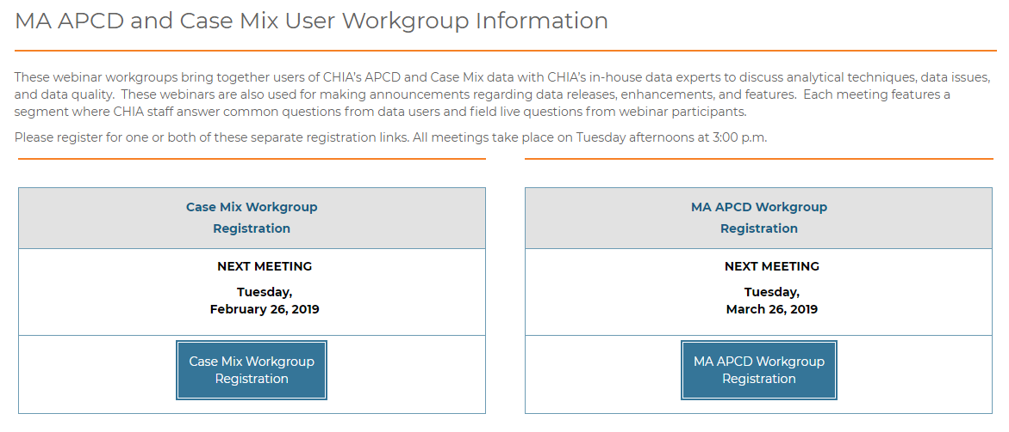
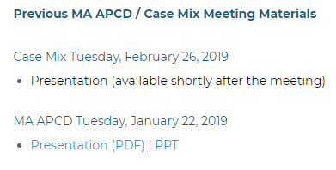
Where can I find old User Workgroup Presentations?
http://www.chiamass.gov/ma-apcd-and-case-mix-user-workgroup-information/

Slide 12
Questions?
Questions related to MA APCD:
apcd.data@state.ma.us
Questions related to Case Mix:
casemix.data@state.ma.us
REMINDER: Please include your IRBNet ID#, if you currently have a project using CHIA data.

Slide 13
Call for Topics and Presenters
If there is a TOPIC that you would like to see discussed at an MA APCD or Case Mix workgroup in 2019, contact Adam Tapply [adam.tapply@state.ma.us]
If you are interested in PRESENTING at an MA APCD or Case Mix workgroup in 2019, contact Adam Tapply [adam.tapply@state.ma.us]
You can present remotely, or in-person at CHIA.

