Slide 1
Case Mix user workgroup
Don Kirkwood (Manager of Data Release)
Scott Curley (Manager of Privacy & Compliance)
Sylvia Hobbs (Manager of User Support)
February 25, 2020
CENTER FOR HEALTH INFORMATION AND ANALYSIS

Slide 2
Agenda
FY18 & 19 Case Mix Release Updates
Website Updates
Answered User Questions
Q&A

Slide 3

Case Mix FY18 Release
*CURRENT* RELEASE TIMEFRAMES FOR EACH FILE:
  Inpatient (HIDD)
  DONE and available for request
  Emergency Department (ED)
  DONE and available for request
  Outpatient Observation (OOD)
    DONE and available for request

Slide 4
Case Mix FY19 Release
RELEASE TIMEFRAMES FOR EACH FILE:
  Inpatient (HIDD)
  End of June
  Emergency Department (ED)
  August
  Outpatient Observation (OOD)
  September

Slide 5
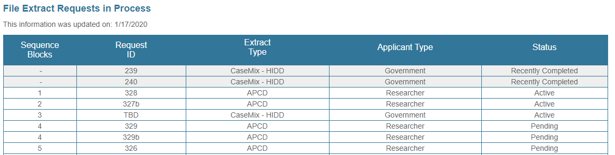
AVAILABLE NOW: Website Release Updates
  Updates on the production of APCD and Case Mix databases and status of individual data requests are now posted to CHIA’s website!
    Aim #1 is to provide weekly or bi-weekly status update on CHIA data products as they are in development.
    Aim #2 is to provide applicants with information about expected fulfillment status for individual data requests.
    Request IDs will be communicated to Data Requestors via email.
  Have you found the new format helpful?

Slide 6
MA APCD Release 8.0
  Available Winter 2020
  **Please hold off on submitting Release 8.0 requests for now**
  Will encompasses data from January 2014 – December 2018 with six months of claim runout (includes paid claims through 6/30/19)
  Will be linkable to Release 7.0 via a crosswalk upon request
  Additional information on highlights and enhancements will be presented in future APCD User Workgroups.

Slide 7
Data Application
  The application to request CHIA data is undergoing updating and User Input is being requested for this process.
  CHIA wants to enhance the application to make it simpler and easier for Users to complete.
  Please provide your suggestions to Don Kirkwood, Donald.Kirkwood@massmail.state.ma.us

Slide 8
USER questions

Slide 9
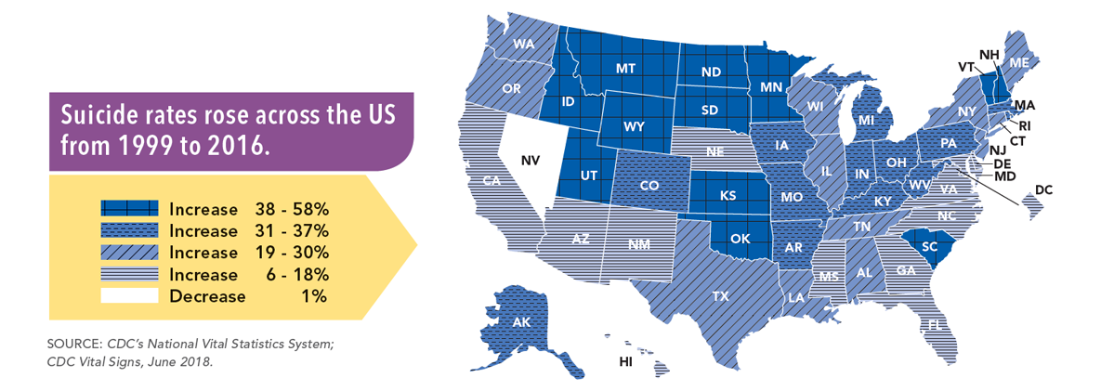
SUICIDE
Question: We are aware that nationwide suicides are on the rise and would like to
apply for the most recent case mix data after ICD-10-CM implementation to better
understand patterns in care seeking for suicide ideation and suicide attempts in Massachusetts. The ICD-10-CM codes related to suicide appear to be extensive. Do you have any information on the extent to which these codes are used in the case mix inpatient, emergency department and observation stay data?
Answer: The CDC’s National Vital Statistics System indicates that the nationwide 25.4% increase in suicide deaths from 1999 to 2016 was paralleled by a 35.3% increase in suicide deaths in Massachusetts for the same time period. See Figure 1 below. Due to the increased complexity and level of detail in how events involving nonfatal suicide attempts and intentional self-harm are coded, on February 26, 2018, the CDC published guidance for surveillance researchers in a National Health Statistics Report entitled, “Issues in Developing a Surveillance Case Definition for Nonfatal Suicide Attempt and Intentional Self-harm Using International Classification of Diseases, Tenth Revision, Clinical Modification (ICD-10-CM) Coded Data” available online at https://www.cdc.gov/nchs/data/nhsr/nhsr108.pdf
Figure 1. Centers for Disease Control and Prevention’s National Vital Statistics System Suicide Rates from 1999 to 2016 by State
US (National) suicide rate increased 25.4%
Massachusetts suicide rate increased 35.3%
Answer continued

Slide 10
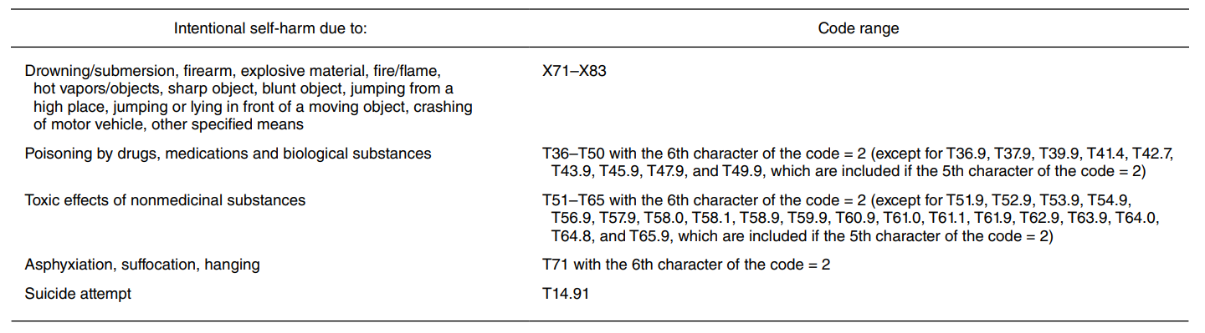
SUICIDE
Answer (continued): ICD-9-CM has approximately 47 external cause of injury codes to describe
suicide attempts and self-inflicted injuries. While ICD-9-CM identified suicide attempts and
Intentional self-harm exclusively by external cause codes, ICD-10-CM has close to 356 external cause codes and diagnosis codes to identify suicide attempts and intentional self-harm. The CDC’s National Center for Health Statistics Report on ICD-10-CM coding for suicide surveillance provides a table covering five different coding ranges with details on how the fifth and sixth digit for specific codes are used to capture intentional self-harm. See Table 1 below.
The above table does not include the ICD-10-CM diagnosis codes for identifying suicide ideations or when the patient has both homicidal and suicidal ideations which are as follows:
Diagnosis Code Full Description
R4585 Homicidal and suicidal ideations
R45851 Suicidal ideations
Table 1. ICD-10-CM codes for identifying suicide attempts and intentional self-harm
Table Source: Hedegaard H, Schoenbaum M, Claassen C, Crosby A, Holland K, Proescholdbell S. Issues in Developing a Surveillance Case Definition for Nonfatal Suicide Attempt and Intentional Self-harm Using International Classification of Diseases, Tenth Revision, Clinical Modification (ICD-10-CM) Coded Data. National health statistics reports. 2018 Feb(108):1-9.
Table 2. ICD-10-CM codes for identifying suicidal ideations
Answer continued

Slide 11
SUICIDE
IDEATION
Answer (continued): While there are a vast number of new ICD-10-CM external cause and diagnosis
codes for suicide attempts and intentional self-harm, they are not yet widely used in FY2018 case
mix data. However, it is noteworthy that in FY2018, the new codes for suicide ideation are heavily
used for 35,754 ED visits, 4,413 observation stays and 21,615 inpatient discharges, see Figure 1
below. Moreover, the monthly pattern of fluctuations in case mix suicide ideation episodes of care mirror monthly increases and decreases in the CDC’s suicide death statistics for Massachusetts for time period, see Figure 2 below.
Centers for Disease Control and Prevention, National Center for Health Statistics. Underlying Cause of Death 1999-2018 on CDC WONDER Online Database, released in 2020. Data are from the Multiple Cause of Death Files, 1999-2018, as compiled from data provided by the 57 vital statistics jurisdictions through the Vital Statistics Cooperative Program. Accessed at http://wonder.cdc.gov/ucd-icd10.html

Slide 12


Question: ZIP codes in the case mix data are critical to our analysis of specific
market catchment areas and for linking to the U.S. Census 5-digit ZIP code
tabulation areas (ZCTAs) to access area measures of poverty status, language
spoken at home, school enrollment status, household and family income status. During a
previous user support webinar, you demonstrated how the case mix UHIN could be used for
obtaining missing race data if the race is reported for the same person in another hospital’s data or at the same hospital during another admission. Can the same method be used to obtain missing ZIP code?
Unknown
ZIP Codes
Answer: The Department of Housing and Urban Development (HUD) in the Federal Register (Vol. 69, No. 146 / Friday, July 30, 2004) describes how when encountering missing address information, one can look to the most recent residential known address. A person’s address does change over time, therefore only ZIP code information in the timeframe of the missing data could potentially be relevant. For example, HUD in their direction on Homeless Management Information Systems recommends:
      If the homeless patient does not have a ZIP Code or City, use the ZIP Code or City of their last known permanent residence.
Therefore, answer to your question is no. The exact same method used for race cannot be used for ZIP codes. A person’s reported self-reported race usually does not change over time enabling one to look across multiple years of case mix by UHIN to search for instances where the race data is reported. If one were looking for reported ZIP code which is subject to change over time, based on HUD’s guidance, you would only want to use the most recent known ZIP Code in the timeframe of when the patient’s ZIP Code data is missing.

Slide 13

Question: Beginning in the FY2016 data, we have noticed a
decrease in expired patient status code ’20’ patients and an increase in code ’41’ patients. Is this a legitimate code in hospital
discharge data?
Hospice Deaths
Answer: Yes, patient status code ’41’ is a legitimate code in the inpatient hospital discharge data which emerged in the data at the beginning of FY2016 (see Figure 1 below). Patient status ’41’ is defined by CMS as “expired in a medical facility such as hospital, SNF, ICF, or freestanding hospice (Hospice claims only).” To date, nine hospitals* are using code ‘41’ in their inpatient hospital discharge data. Since the first quarter of FY2016, there has been an increase in the use of code ‘41’ (see Figure 2 below).
* Note: Nine hospitals: Norwood Hospital (OrgID 41), Carney Hospital (OrgID 42), Good Samaritan Medical Center Brockton Campus (OrgID 62), Holy Family Hospital (OrgID 75), Morton Hospital (OrgID 99), Saint Anne's Hospital (OrgID 114), St. Elizabeth's Medical Center (OrgID 126), Holy Family Hospital at Merrimack Valley (OrgID 11466)

Slide 14
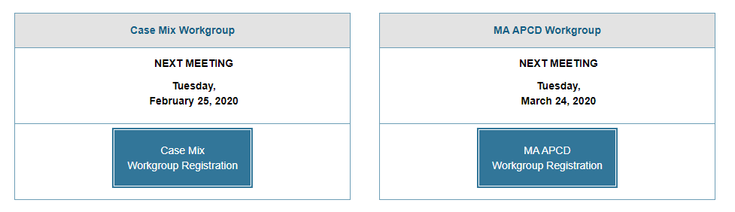
Where can I find old User Workgroup Presentations?
The next APCD User Group will meet Tuesday, March 24. The next Case Mix User Group will be April 28th.
http://www.chiamass.gov/ma-apcd-and-case-mix-user-workgroup-information/

Slide 15
Questions?
Questions related to MA APCD:
apcd.data@state.ma.us
Questions related to Case Mix:
casemix.data@state.ma.us
REMINDER: Please include your IRBNet ID#, if you currently have a project using CHIA data.

Slide 16
Call for Topics and Presenters
If there is a TOPIC that you would like to see discussed at an MA APCD or Case Mix workgroup in 2020, contact Donald Kirkwood [Donald.kirkwood@massmail.state.ma.us]
If you are interested in PRESENTING at an MA APCD or Case Mix workgroup in 2019, contact Amy Wyeth [amy.wyeth@state.ma.us]
You can present remotely, or in-person at CHIA.

