Slide 1
MA Center for Health Information & Analysis
Case Mix User Workgroup
January 24, 2017

Slide 2
Agenda
Announcements
  Update on the status of Case Mix FY15 delivery
Overview of Admin Bulletin 16-14 (Updated Case Mix Fee Schedule)
Overview of New/Revised Application Forms
User Questions
Q&A

Slide 3
Case Mix FY15 Release Update
  *CURRENT* RELEASE TIMEFRAMES FOR EACH FILE:
  Inpatient (HIDD)
  COMPLETE
  Emergency Department (ED)
    COMPLETE
  Outpatient Observation (OOD)
    EXPECTED TO BE COMPLETED IN FEBRUARY

Slide 4
Administrative Bulletin 16-14
Update to the Case Mix Fee Schedule (effective 2/1/2017)
Key Changes:
    Definitions have been simplified
    All fees for Case Mix Data are for one extract and each extract will consist of one year of data
    Researchers are required to demonstrate that the funding source for their research does not cover the cost of the data to be eligible for a full or partial fee waiver.
    Resellers have been clearly defined and may only qualify for a partial fee waiver if they are nonprofits and can demonstrate their project, report or product is in beta stage and not generating any income.
Link: http://www.chiamass.gov/assets/docs/g/chia-ab/16-14.pdf

Slide 5
Revised Data Release Process
Applicants can now request FUTURE YEARS OF DATA
Initial project requires Data Privacy Committee and Data Release Committee review
Additional years (up to 5 years) or release versions of data will be released upon availability and the Recipient’s completion of a Certificate of Continued Need (Exhibit B of the revised DUA)
No additional review required for these additional years of data
Normal data fees still apply

Slide 6
Revised Data Release Process
Applicants will now be able to request authorization to use the data they have received for one project for SUBSEQUENT PROJECTS
Must complete new application for subsequent project – will require Data Privacy Committee and Data Release Committee review
If approved, will not require a new extract – can begin using data already in possession immediately (upon execution/amendment of DUA)
Normal data fees still apply

Slide 7
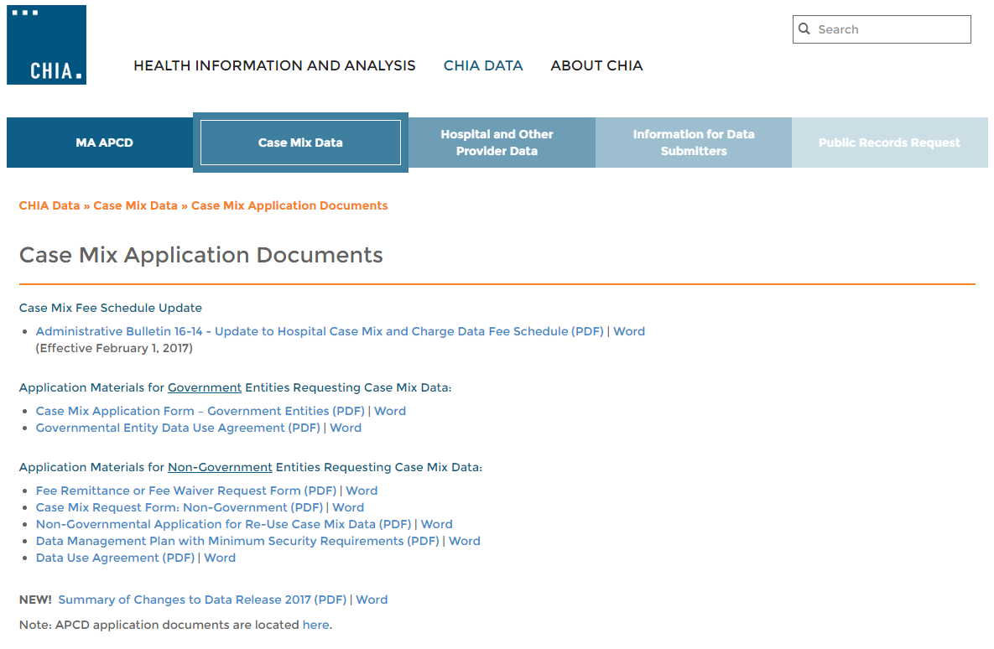
Revised Non-Gov’t Application Forms
Posted here: http://www.chiamass.gov/case-mix-application-documents/

Slide 8
Revised Non-Gov’t Application Forms
Revised Data Use Agreement: http://www.chiamass.gov/assets/Uploads/data-apps/Non-Government-Data-Use-Agreement.pdf
Revised Case Mix Request Form: http://www.chiamass.gov/assets/Uploads/data-apps/Non-Government-Case-Mix-Application.docx
NEW Application for Re-Use of Case Mix Data: http://www.chiamass.gov/assets/Uploads/data-apps/Non-Government-Re-Use-Case-Mix-Application.docx

Slide 9
Revised Data Use Agreement
All newly signed Data Use Agreements will cover all CHIA Data disclosed to the Recipient Organization under all approved projects.
What does this mean?
  New applicants will sign a Data Use Agreement with CHIA for their current Project. Any future Projects once approved will be added to that Data Use Agreement by reference.
  Old applicants will sign a new Data Use Agreement before receiving any additional CHIA data, whether for a previously approved or a new project. Any previous Data Use Agreement(s) would be superseded by the new agreement, and those agreements will be incorporated into the new DUA by reference.
  Data Management Plans will no longer be an exhibit to the DUA, but rather be an attachment to the Application.

Slide 10
QUESTIONS?

Slide 11
QUESTIONS SUBMITTED BY USERS

Slide 12


Question: I need to analyze patients discharged from inpatient care who later have repeat ED Visits and wanted to know the content, quality and completeness of the ED Encrypted Social Security Number (SSN)?
Answer: CHIA ED filing specifications instruct hospitals to submit a valid SSN or ‘000000001’ if unknown. CHIA encrypts all SSN data. When the encrypted SSN field will contain a dash (-) if the field is blank eight dashes followed by number if the SSN is invalid, (--------2, --------3, --------4, --------5, --------6, --------7), and 000000001 if the SSN is unknown. From FY2011 to FY2015 the percent of valid encrypted SSNs has been approximately 80%.
FY2011 to FY2015 ED Visit Volume
FY2011 to FY2015 Percent Valid SSN
When SSN is Unknown
From FY2011 to FY2015 Encrypted SSN Completeness
Fiscal Year | ED Visit Volume | Percent Valid SSN | Total Unknown/Blank/Invalid
2011 | 2,498,986 | 81.60% | 459,600
2012 | 2,538,783 | 81.00% | 481,285
2013 | 2,521,870 | 80.20% | 498,889
2014 | 2,471,195 | 81.80% | 450,517
2015 | 2,473,954 | 81.70% | 451,929
000000001

Slide 13
Question: What is Contained in the ED Site Summary?
FIELD | DESCRIPTION
Number of ED Treatment Beds at Site | Number of ED Beds on last day of the reporting period. Number of permanent ED treatment bays or beds, as approved by the Department of Public Health. Do not count temporary use of gurneys, stretchers, etc., nor beds in ED-based observation units.
Number of ED-based Observation Beds at Site | Number of Observation Beds on last day of the reporting period. Number of permanent beds or treatment bays in ED-based observation unit, if any.
Total Number of ED-based Beds at Site | Combined total number of ED beds and ED-based observation beds. Total number of ED beds and ED-based observation beds, combined.
ED Visits – Admitted to Inpatient at Site | Total number of registered ED Visits occurring during the reporting period that resulted in inpatient admission (whether preceded by observation stay or not).
ED Visits –Admitted to Outpatient Observation at Site | Total number of registered ED Visits occurring during the reporting period that resulted in admission to outpatient observation, but not inpatient admission.
ED Visits - All Other Outpatient ED Visits at Site | Total number of registered ED Visits occurring during the reporting period that had a disposition other than admission to outpatient observation and/or inpatient care.
ED Visits – Total Registered at Site | Total number of all registered ED Visits occurring during the reporting period, regardless of disposition.
Number of Outpatient ED Visits | Must be present. Must be Numeric format. Must be the correct number as defined
Total Charges | Must be present. Must be unformatted currency format.

Slide 14
Questions?
Questions related to APCD : (apcd.data@state.ma.us)
Questions related to Case Mix: (casemix.data@state.ma.us)
REMINDER: Please include your IRBNet ID#, if you currently have a project using CHIA data

Slide 15
Call for Topics and Presenters
If there is a TOPIC that you would like to see discussed at an MA APCD or Case Mix workgroup, contact Adam Tapply [adam.tapply@state.ma.us]
If you are interested in PRESENTING at an MA APCD or Case Mix workgroup, contact Adam Tapply [adam.tapply@state.ma.us]
  You can present remotely from your own office, or in-person at CHIA.

