Slide 1
MA Center for Health Information & Analysis
Case Mix User Workgroup
July 25, 2017

Slide 2
Agenda
Announcements
  Update on the status of Case Mix FY16
New CHIA report: Emergency Department Visits after Inpatient Discharge
User Questions
Q&A

Slide 3
Case Mix FY16 Release Calendar
  *CURRENT* RELEASE TIMEFRAMES FOR EACH FILE:
  Inpatient (HIDD)
  READY NOW
  Emergency Department (ED)
    AUGUST
  Outpatient Observation (OOD)
    SEPTEMBER

Slide 4
Case Mix Application Process
Recap of Changes for 2017:
Now charge per year of data requested
Can now request future years of data
  Future years require no DRC review, absent major changes to the project or data being requested
Can request to use data for one project for a subsequent project
Comprehensive DUAs for each organization (will cover all projects instead of multiple DUAs for each specific project)

Slide 5
Revised Data Release Process
Applicants can now request FUTURE YEARS OF DATA
Initial project requires Data Privacy Committee and Data Release Committee review
Additional years (up to 5 years) or release versions of data will be released upon availability and the Recipient’s completion of a Certificate of Continued Need (Exhibit B of the revised DUA)
No additional review required for these additional years of data
Normal data fees still apply

Slide 6
Application Reminders
Applicants should not use “de-identified” in their application in referring to the data received from CHIA. CHIA datasets are not de-identified as the term is defined by HIPAA.
Also, make sure your IRB approval is valid for the period you intend to use the data.
Please remember your application documents must be signed by the appropriate people when you submit them on IRBNet.

Slide 7
More Reminders
If you’re requesting user support, please do not send us any data
  Aggregate, de-identified data is fine, but sending us any other data may not be allowed. As a general rule, users should not send record or claim-line data to the User Support Team
  Considered a breach of our Data Use Agreement
  Run the risk of not being allowed to request data from CHIA in the future

Slide 8
QUESTIONS?

Slide 9
New Papers and Reports Using CHIA Data
CHIA Data Users asked to be alerted to when new papers and reports are available using CHIA Case Mix Data or All Payer Claims Data. The following new papers and reports are available:
All Payer Claims Data
Barnett ML, Song Z, Rose S, Bitton A, Chernew ME, Landon BE. Insurance Transitions and Changes in Physician and Emergency Department Utilization: An Observational Study. Journal of General Internal Medicine. 2017 May 18:1-0. https://link.springer.com/article/10.1007/s11606-017-4072-4
Figueroa JF, Frakt AB, Lyon ZM, Zhou X, Jha AK. Characteristics and spending patterns of high cost, non-elderly adults in Massachusetts. InHealthcare 2017 July 1. Elsevier. http://www.sciencedirect.com/science/article/pii/S2213076417300350
McCoy TH, Castro VM, Cagan A, Roberson AM, Perlis RH. Validation of a risk stratification tool for fall-related injury in a state-wide cohort. BMJ open. 2017 Feb 1;7(2):e012189. http://bmjopen.bmj.com/content/bmjopen/7/2/e012189.full.pdf
Case Mix Data
França UL, McManus ML. Availability of Definitive Hospital Care for Children. JAMA pediatrics. 2017 July 10:e171096 Supplement. http://jamanetwork.com/journals/jamapediatrics/article-abstract/2634361
Center for Health Information and Analysis, Emergency Department Visits After Inpatient Discharge in Massachusetts State Fiscal Year 2015, July 2014. http://www.chiamass.gov/emergency-department-visits-after-inpatient-discharge

Slide 10
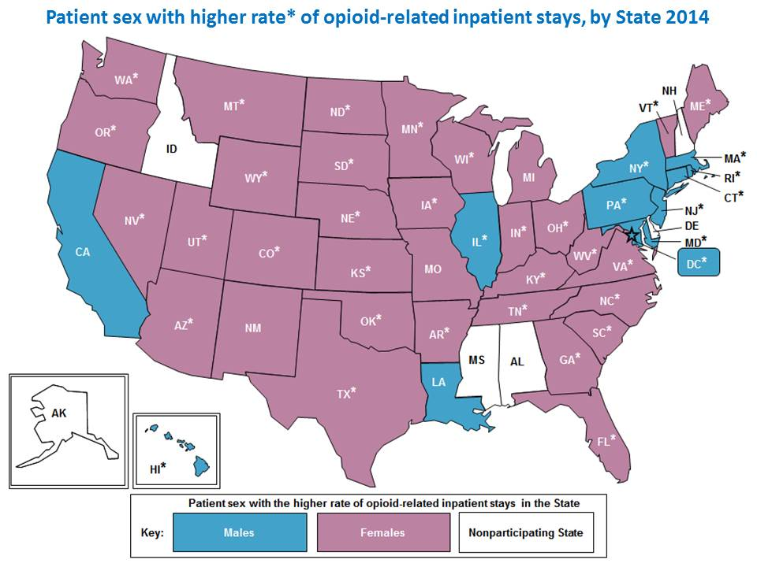
New Papers and Reports Using CHIA Data (continued)
Case Mix Data (Multi-State Comparison using AHRQ HCUP Data)
Weiss AJ (IBM Watson Health), Bailey MK (IBM Watson Health), O'Malley L (IBM Watson Health), Barrett ML (M.L. Barrett, Inc.), Elixhauser A (AHRQ), Steiner CA (Institute for Health Research, Kaiser Permanente). Patient Characteristics of Opioid-Related Inpatient Stays and Emergency Department Visits Nationally and by State, 2014. HCUP Statistical Brief #224. June 2017. Agency for Healthcare Research and Quality, Rockville, MD. www.hcup-us.ahrq.gov/reports/statbriefs/sb224-Patient-Characteristics-Opioid-Hospital-Stays-ED-Visits-by-State.pdf
Massachusetts Highlights from AHRQ HCUP Report
In most States in 2014, females had a higher rate of opioid-related inpatient stays than males but males had a higher rate of opioid-related ED visits than females. However, in Massachusetts males had both a higher rate of opioid-related inpatient stays and ED visits.
Across all patient sex and age groups in 2014: Opioid-related inpatient stays were lowest in Iowa, Nebraska, Texas, and Wyoming and highest in Massachusetts.
Note: Asterisks denote States where the difference between the higher and lower of the male and female rates was at least 10 percent. Opioid-related inpatient rates are per 100,000 population. State-level inpatient rates by sex are provided in Appendix A of report.

Slide 11
QUESTIONS SUBMITTED BY USERS

Slide 12

Question: Are there differences in the completeness of UHIN data by race, age, and facility?
Answer: Yes, when looking at the UHIN field for adults or the mother’s UHIN for infants, 72% of hospitals have less than 10% incomplete UHINs (see table below). The four hospitals with greater than 50% incomplete UHINs have a higher proportion of pediatric population, such as Children’s Hospital (mean age 8 years old), and a higher proportion of senior population, such as New England Baptist (mean age 67 years old).

Slide 13
Question: Are there differences in the completeness of UHIN data by race, age, and facility? (continued)
Answer: In looking at the completeness of UHIN by Race 1 in the FY2015 Inpatient Discharge, patients with Unknown Race 1 had the highest percentage of UHIN errors and American Indians/Alaskan Natives had the highest percentage of missing UHINs.
Race 1 | UHIN Error | Missing UHIN | Invalid UHIN
R1 (American Indian/Alaska Native) | 7.78% | 25.18% | 0.09%
R2 (Asian) | 22.18% | 15.35% | 0.02%
R3 (Black) | 12.91% | 7.62% | 0.03%
R4 (Native Hawaiian or Other Pacific Islander | 23.65% | 19.76% | 0.00%
R5 (White) | 8.43% | 5.14% | 0.05%
R9 (Other Race) | 15.45% | 17.09% | 0.04%
Unknown | 36.44% | 20.77% | 0.02%

Slide 14
Question: Are there differences in the completeness of UHIN data by race, age, and facility? (continued)
Answer: In the Hospital Inpatient Discharge data from FY2014 to FY2015, there has been small 1.67% increase in Valid UHINs attributable to a decrease in UHIN errors and invalid UHINs but paralleled by an increase in missing UHINs.
Comparison of Completeness of FY2014 and FY2015 Inpatient Discharge UHINs

Slide 15
Question: Why would a patient with a length of stay of 1-day be admitted instead of seen in Observation Stay?
Answer: While the CHIA Case Mix data contains data collected from acute care hospitals on inpatient hospital discharges, emergency department visits, and observation stays, 105 CMR 130.000 Massachusetts Hospital Licensure Regulations which falls under the regulatory authority of the Massachusetts Department of Public Health provides specific guidance and standards for the utilization of different hospital care settings.
See: http://www.mass.gov/eohhs/docs/dph/regs/105cmr130.pdf

Slide 16
Questions?
Questions related to APCD : (apcd.data@state.ma.us)
Questions related to Case Mix: (casemix.data@state.ma.us)
REMINDER: Please include your IRBNet ID#, if you currently have a project using CHIA data

Slide 17
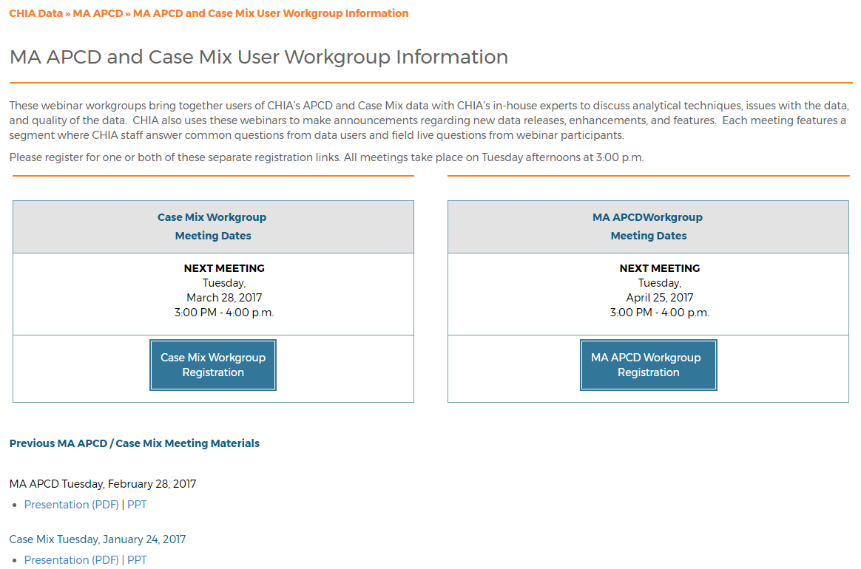
Where can I find old User Workgroup presentations?
http://www.chiamass.gov/ma-apcd-and-case-mix-user-workgroup-information/

Slide 18
Call for Topics and Presenters
If there is a TOPIC that you would like to see discussed at an MA APCD or Case Mix workgroup, contact Adam Tapply [adam.tapply@state.ma.us]
If you are interested in PRESENTING at an MA APCD or Case Mix workgroup, contact Adam Tapply [adam.tapply@state.ma.us]
  You can present remotely from your own office, or in-person at CHIA.

