Slide 1
Case Mix user workgroup
Adam Tapply (Manager of Accounts)
Scott Curley (Manager of Privacy & Compliance)
Sylvia Hobbs (Manager of User Support)
June 25, 2019
CENTER FOR HEALTH INFORMATION AND ANALYSIS

Slide 2
Agenda
Announcements:
  Timeline for FY18 Case Mix Release
  APCD Release 7.0
Application Reminders
Compliance Reminders
Q&A

Slide 3
Case Mix FY18 Release
*CURRENT* RELEASE TIMEFRAMES FOR EACH FILE:
  Inpatient (HIDD)
  End of June
  Emergency Department (ED)
  August
  Outpatient Observation (OOD)
  September

Slide 4
Case Mix FY18 Release
REPEAT APPLICANTS:
  For those applicants with previously approved projects who indicated they would like to receive data annually, we are currently accepting Certificates of Continued Need and Compliance (Exhibit B of your DUA)
  After receiving this, we will send you an invoice for the FY18 data and release data to you once payment is received and the data is ready.
  If you are making any changes to your project, you must go through the amendment process first.

Slide 5
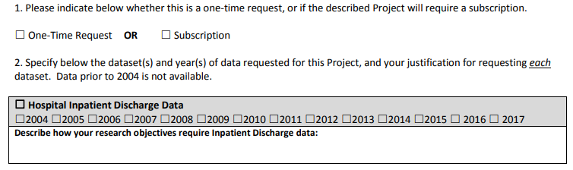
Case Mix FY18 Release
NEW APPLICANTS / NEW PROJECTS:
  We will continue to accept new applications on a rolling basis.
  If you are requesting FY18 data, just click the box for “Subscription” on p. 3 of the application form:

Slide 6
MA APCD Release 7.0
  Available NOW
  Encompasses data from January 2013 – December 2017 with six months of claim runout (includes paid claims through 6/30/18)
  Release Documentation and Data Specifications have been posted to the website: http://www.chiamass.gov/ma-apcd/
  Apply now by listing 2017 (and any other years you want from Release 7.0) in the “Years Requested” section of the current application form
  Available here: http://www.chiamass.gov/application-documents
  Additional Release 7.0 details and highlights can be found in the January 2018 APCD User Workgroup presentation available here: http://www.chiamass.gov/ma-apcd-and-case-mix-user-workgroup-information/

Slide 7
Application reminders

Slide 8
Top Application Reminders
  Answer EVERY question on the Application form and Data Management Plan.
  Remember to submit your Research Methodology or IRB Protocol (not just the IRB approval letter) (per Section IV in the Application form).
  Make sure your IRB approval is up-to-date. If it’s expiring soon, let us know of your plans to make sure it’s renewed.
  Submit Data Management Plans for any organization that will be storing CHIA data (including contractors).
  Provide as much information on proposed linkages as possible (per Section IX), including data elements that will be involved.
  Make sure your Application and Data Management Plan have the required signatures before submitting on IRBNet.
  If requesting a financial hardship waiver, make sure you submit supporting documentation.

Slide 9
COMPLIANCE reminders

Slide 10
Top Compliance Reminders
  You are only allowed to use CHIA data for the approved purposes described in your application.
  All individuals, whether they are employees, contractors or agents of your organization, who will have access or use the data, must sign a Confidentiality Agreement prior to accessing the data.
  You must maintain an up-to-date access log of individuals who use or access the data.
  You are not allowed to move, transmit, or disclose your data except as authorized by your DUA and approved data management plan.
  Absent express written authorization from CHIA, you shall not attempt to link records included in the Data to any other information.
  Adhere to CHIA cell suppression policies when you publish research.
  Respond to CHIA data audits in a timely manner.

Slide 11
Compliance Reminders
  Additional information on CHIA’s data compliance efforts and recent DUA audits can be found in the last Case Mix workgroup presentation from April 2019:
  http://www.chiamass.gov/assets/Uploads/Case-Mix-User-Workgroup-April-2019.pdf

Slide 12
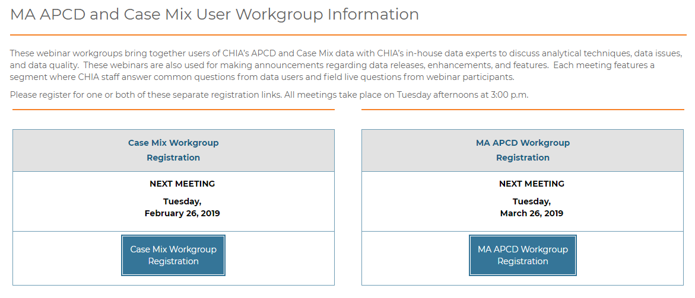
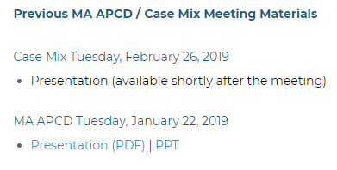
Where can I find old User Workgroup Presentations?
http://www.chiamass.gov/ma-apcd-and-case-mix-user-workgroup-information/

Slide 13
Questions?
Questions related to MA APCD:
apcd.data@state.ma.us
Questions related to Case Mix:
casemix.data@state.ma.us
REMINDER: Please include your IRBNet ID#, if you currently have a project using CHIA data.

Slide 14
Call for Topics and Presenters
If there is a TOPIC that you would like to see discussed at an MA APCD or Case Mix workgroup in 2019, contact Adam Tapply [adam.tapply@state.ma.us]
If you are interested in PRESENTING at an MA APCD or Case Mix workgroup in 2019, contact Adam Tapply [adam.tapply@state.ma.us]
You can present remotely, or in-person at CHIA.

