Slide 1
MA Center for Health Information & Analysis
Case Mix User Workgroup
March 22, 2016

Slide 2
Agenda
Announcements:
  Slides from Previous Workgroups Now Posted
  Case Mix Limited Data Sets
Presentation: CHIA Work on Readmissions
Q&A
User Poll – Preferred Case Mix Formats

Slide 3
Reminder
2016 User Workgroup Changes
Case Mix and APCD User Groups separated
  Every other month
  More presentations from CHIA’s users and external users
Content from presentations will be categorized by topic and posted to the CHIA website
  Easier to find information

Slide 4
User Group Slides Posted Soon
[http://www.chiamass.gov/ma-apcd-and-case-mix-user-workgroup-information/]
Based on feedback, grouped by topic and not date of meeting
Three categories:
  Application Questions (“When do fees need to be paid?”)
  Questions from Users – one PDF containing multiple questions (mostly short questions/answers with 1 or 2 slides each)
    These two sections will be tagged with keywords. The list of keywords will be on the website and those keywords will be footnoted to each slide so people can Ctrl-F in the PDF
  Tutorials – PDFs for each tutorial – hyperlink on the website will say what each tutorial is (Example: “How to Count Patients Admitted from the Emergency Dept. in the HDD file”)

Slide 5
Case Mix Limited Dataset (LDS)
Goal: Protect patient privacy
  Case Mix predates HIPAA
Starting with FY2015 available in June 2016
  Applies to non-government users only; government users may request additional elements
  Revised application forms will be available in early May
Changes are not retroactive to prior years of data
DUAs and Data Management Plans are still required
No changes in fees

Slide 6
CHIA Methodology
Determined what must be excluded, including HIPAA-defined direct identifiers
Investigated elements that potentially should be excluded due to patient privacy concerns (example: free text fields)
Exclude certain quasi-identifiers, which make individuals unique in the population and thus could possibly be used for indirect re-identification
Ended up with a “Core” LDS available to all applicants and offer “buy-up” options for date granularity, geographic granularity, and physician ID#

Slide 7
Case Mix LDS Options
Applicants must justify their need for specific “buy-ups”: Date granularity, 3- or 5-digit Zip Code, Geographic granularity, and Physician ID#

Slide 8
HCUP Age Groupings
Calculated based on DOB and Discharge Date
0 – 4
5 – 9
10 – 14
15 – 19
20 – 24
25 – 29
30 – 34
35 – 39
40 – 44
45 – 49
50 – 54
55 – 59
60 – 64
65 – 69
70 – 74
75 – 79
80 – 84
85 – 89
90+

Slide 9
More Information in May
We will be presenting more information on Case Mix LDS rollout at the May Case Mix User Workgroup, including:
Application Preview
Documentation Preview
Information for long-time/repeat requestors – how best to transition to the new format – no more “Levels”

Slide 10
NAHDO: Call for Abstracts
For the 31st Annual Meeting in October: NAHDO is soliciting abstracts that demonstrate best practices in health care data management & dissemination protocols; data analysis & applications; new technologies to drive system transformation.
Submissions accepted through Friday April 22nd.
For more information view the call for abstracts: http://nahdo.us2.list-manage1.com/track/click?u=53d6a039fa2e0e4a0cd40c228&id=a39e1f024f&e=80567850b7
CHIA is a member of NAHDO and would welcome the opportunity to co-present with our users.

Slide 11
Application Reminders
We need CVs of the PI(s) and at least the Lead Programmer/Analysts
Please make sure you are authorized to sign the Data Use Agreement on behalf of your organization.
  If you’re not sure if you’re an authorized signatory, there’s a good chance you aren’t.
  The organization housing the data is the entity being bound in the DUA, not the researcher.
  Many institutions (especially universities) have a Research Coordinator that is an authorized signatory and can sign agreements binding the organization.

Slide 12
QUESTIONS?

Slide 13
Using the Case Mix Hospital Inpatient Discharge Database to Report on All-Payer Readmissions in Massachusetts
Nick Huntington and Zi Zhang
Case Mix User Workgroup
March 22, 2016

Slide 14
Today
Readmissions background
Measure
Using Case Mix HIDD data
Findings
Background
Measure
Using HIDD
Findings

Slide 15
All-Payer Readmissions Background
2008
CMS started reporting disease-specific measures for Medicare FFS
2010
CMS developed HWR measure for Medicare FFS
CMS started penalizing hospitals (HRRP);
SQAC recommended HWR measure for MA
2012
CHIA adapted HWR measure
for use w/ HIDD, all-payer population
2014
CHIA 1st annual readmission report
2016
CHIA 2nd annual readmission report
Background
Measure
Using HIDD
Findings

Slide 16
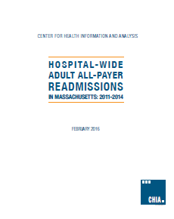
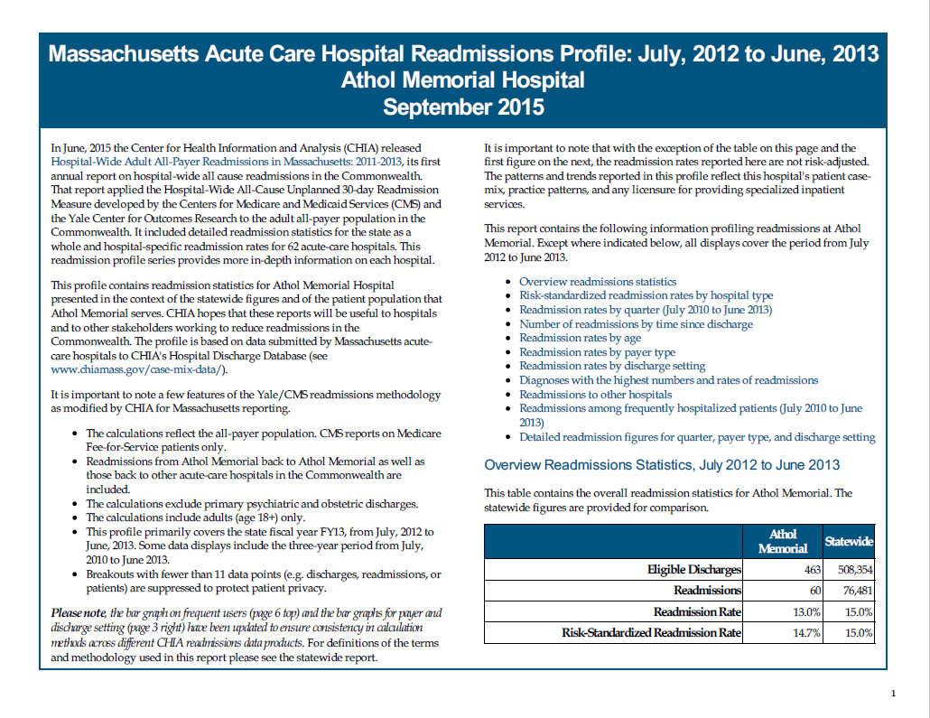
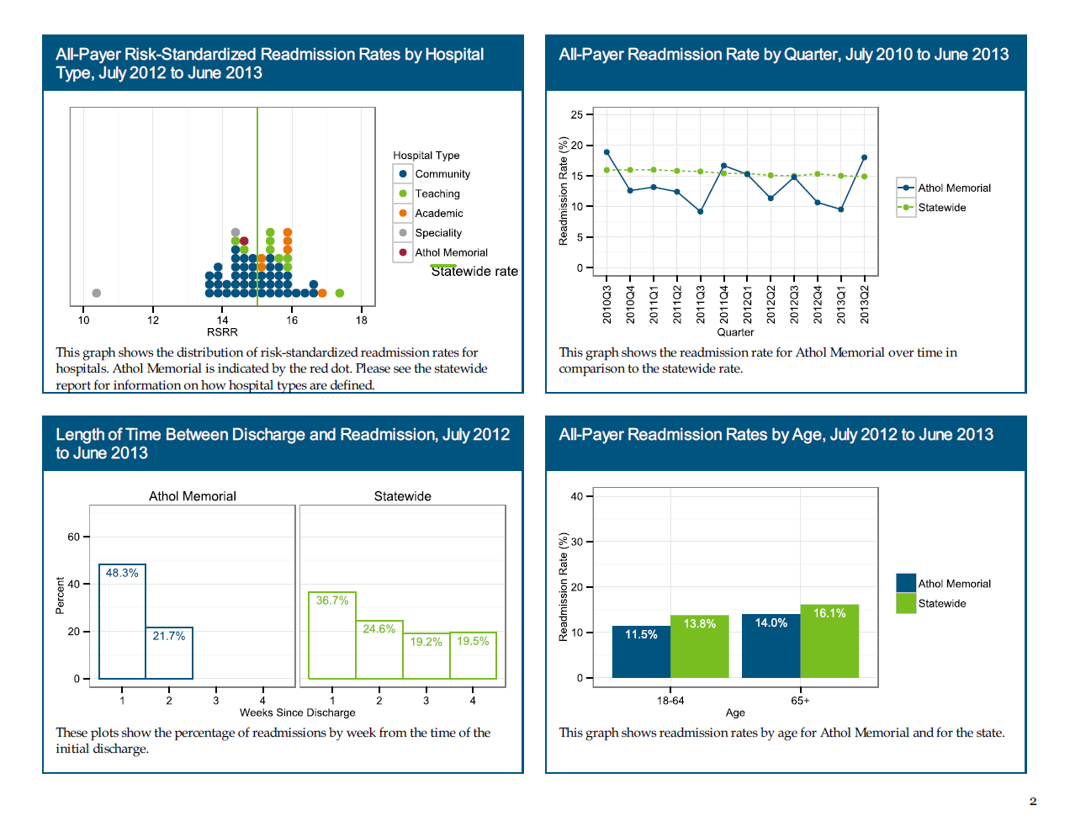
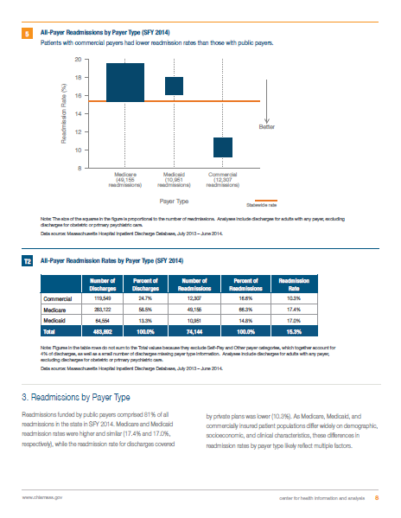
CHIA Readmissions Products
Annual Statewide Reports
Hospital Readmissions Profiles
Background
Measure
Using HIDD
Findings

Slide 17
Yale/CMS Readmissions Measure
Measure’s official title: “Hospital-Wide All-Cause Unplanned Readmissions Measure”
  Hospital-wide
  All-cause
  30-day
  Unplanned
  Adult (18+)
Two types of readmission rates:
  Observed (“raw”) readmission rates
  Risk-standardized readmission rates (RSRRs)
Background
Measure
Using HIDD
Findings

Slide 18
CHIA’s Adaptations to the Measure
Original Yale/CMS Measure | CHIA’s Adapted Version
Medicare FFS population, 65+ | All-payer population, 18+
Based on Medicare claims & enrollment data | Based on Case Mix HIDD data
Background
Measure
Using HIDD
Findings

Slide 19
Calculating Observed (“raw”) Readmission Rates
Step 3
Divide one by the other and multiply by 100
Step 2
Count re-admissions
Number of
Readmissions
Observed Readmission
Rate
=
X 100
Number of Eligible (“Index”)
Admissions
Step 1
Count “index”
admissions
Background
Measure
Using HIDD
Findings

Slide 20
Calculating Risk-Standardized Readmission Rates (RSRRs)
RSRRs calculated at the hospital level
Derived from statistical model
Control for 3 background factors:
  Age
  Comorbidities
  Discharge condition
Compares two quantities for each hospital:
  “Predicted” # of readmissions, given 3 background factors plus hospital
  “Expected” # of readmissions, given 3 background factors without hospital
Background
Measure
Using HIDD
Findings

Slide 21
Adapting Data Processing to the HIDD Data
Original CMS Processing
CHIA Processing
Rename/recode to match CMS files
Collapse interim claims
Collapse overlapping stays
Collapse overlapping stays
Determine eligibility/enrollment
Determine diagnosis history
Determine diagnosis history
Create index, diagnosis, and follow-up files
Create index, diagnosis, and follow-up files
Background
Measure
Using HIDD
Findings

Slide 22
Forming Analytic Cohort with
HIDD Data (SFY14)
Adult (18+) Discharges
677,379
Missing/Invalid UHIN (45,897 – 6.8%)
Record Cleaning/Collapsing (1,305 - 0.2%)
Pediatric Hospitals* (1,806 - 0.3%)
Cancer Hospitals (1,027 - 0.2%)
Transfers** (11,524 - 1.7%)
Deaths** (13,238 - 2.0%)
Base Index Cohort
603,469 – 89.1%
Note: Exclusions not mutually exclusive
* Children’s and Shriners
** Applied after first four exclusions
Background
Measure
Using HIDD
Findings

Slide 23
Forming Analytic Cohort with
HIDD Data (SFY14)
Base Index Cohort
603,469
Obstetric Admissions (64,308 - 10.7%)
Psychiatric Admissions (31,759 - 5.3%)
Cancer Treatment (12,162 - 2.0%)
Against Medical Advice (9,513 - 1.6%)
Rehabilitation Admissions (2,281 - 0.4%)
Analytic Cohort
483,892 - 80.2%
Note: Exclusions not mutually exclusive
Background
Measure
Using HIDD
Findings

Slide 24
Potential for Hospital Feedback
Hospital Question: E.g. Do calculations include:
Patients in swing beds?
Patients in both medical and behavioral health units?
Patients admitted for hospice care?
Feedback/Discussion with Hospital:
Clarify coding
Hospitals work w/ Liaisons
CHIA Data Analysis:
Evaluate scope of issue
Examine impact on rates
Background
Measure
Using HIDD
Findings

Slide 25
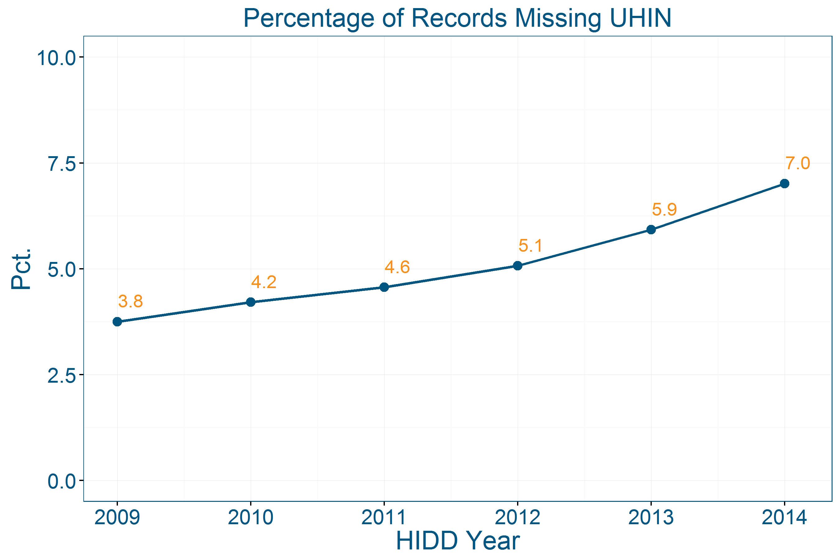
Potential Data Issue: Missing UHIN
Background
Measure
Using HIDD
Findings

Slide 26
Trend in All-Payer Readmission Rate
Background
Measure
Using HIDD
Findings

Slide 27
All-Payer Readmissions by Payer Type
Size of squares is proportional to number of readmissions
Background
Measure
Using HIDD
Findings

Slide 28
Readmissions by Discharge Setting
Size of squares is proportional to number of readmissions
Background
Measure
Using HIDD
Findings

Slide 29
Top Readmissions Diagnoses
Top 10 Diagnoses
(32%)
All Readmissions
All
Remaining Diagnoses
(68%)
Background
Measure
Using HIDD
Findings

Slide 30
Frequent Users
Background
Measure
Using HIDD
Findings

Slide 31
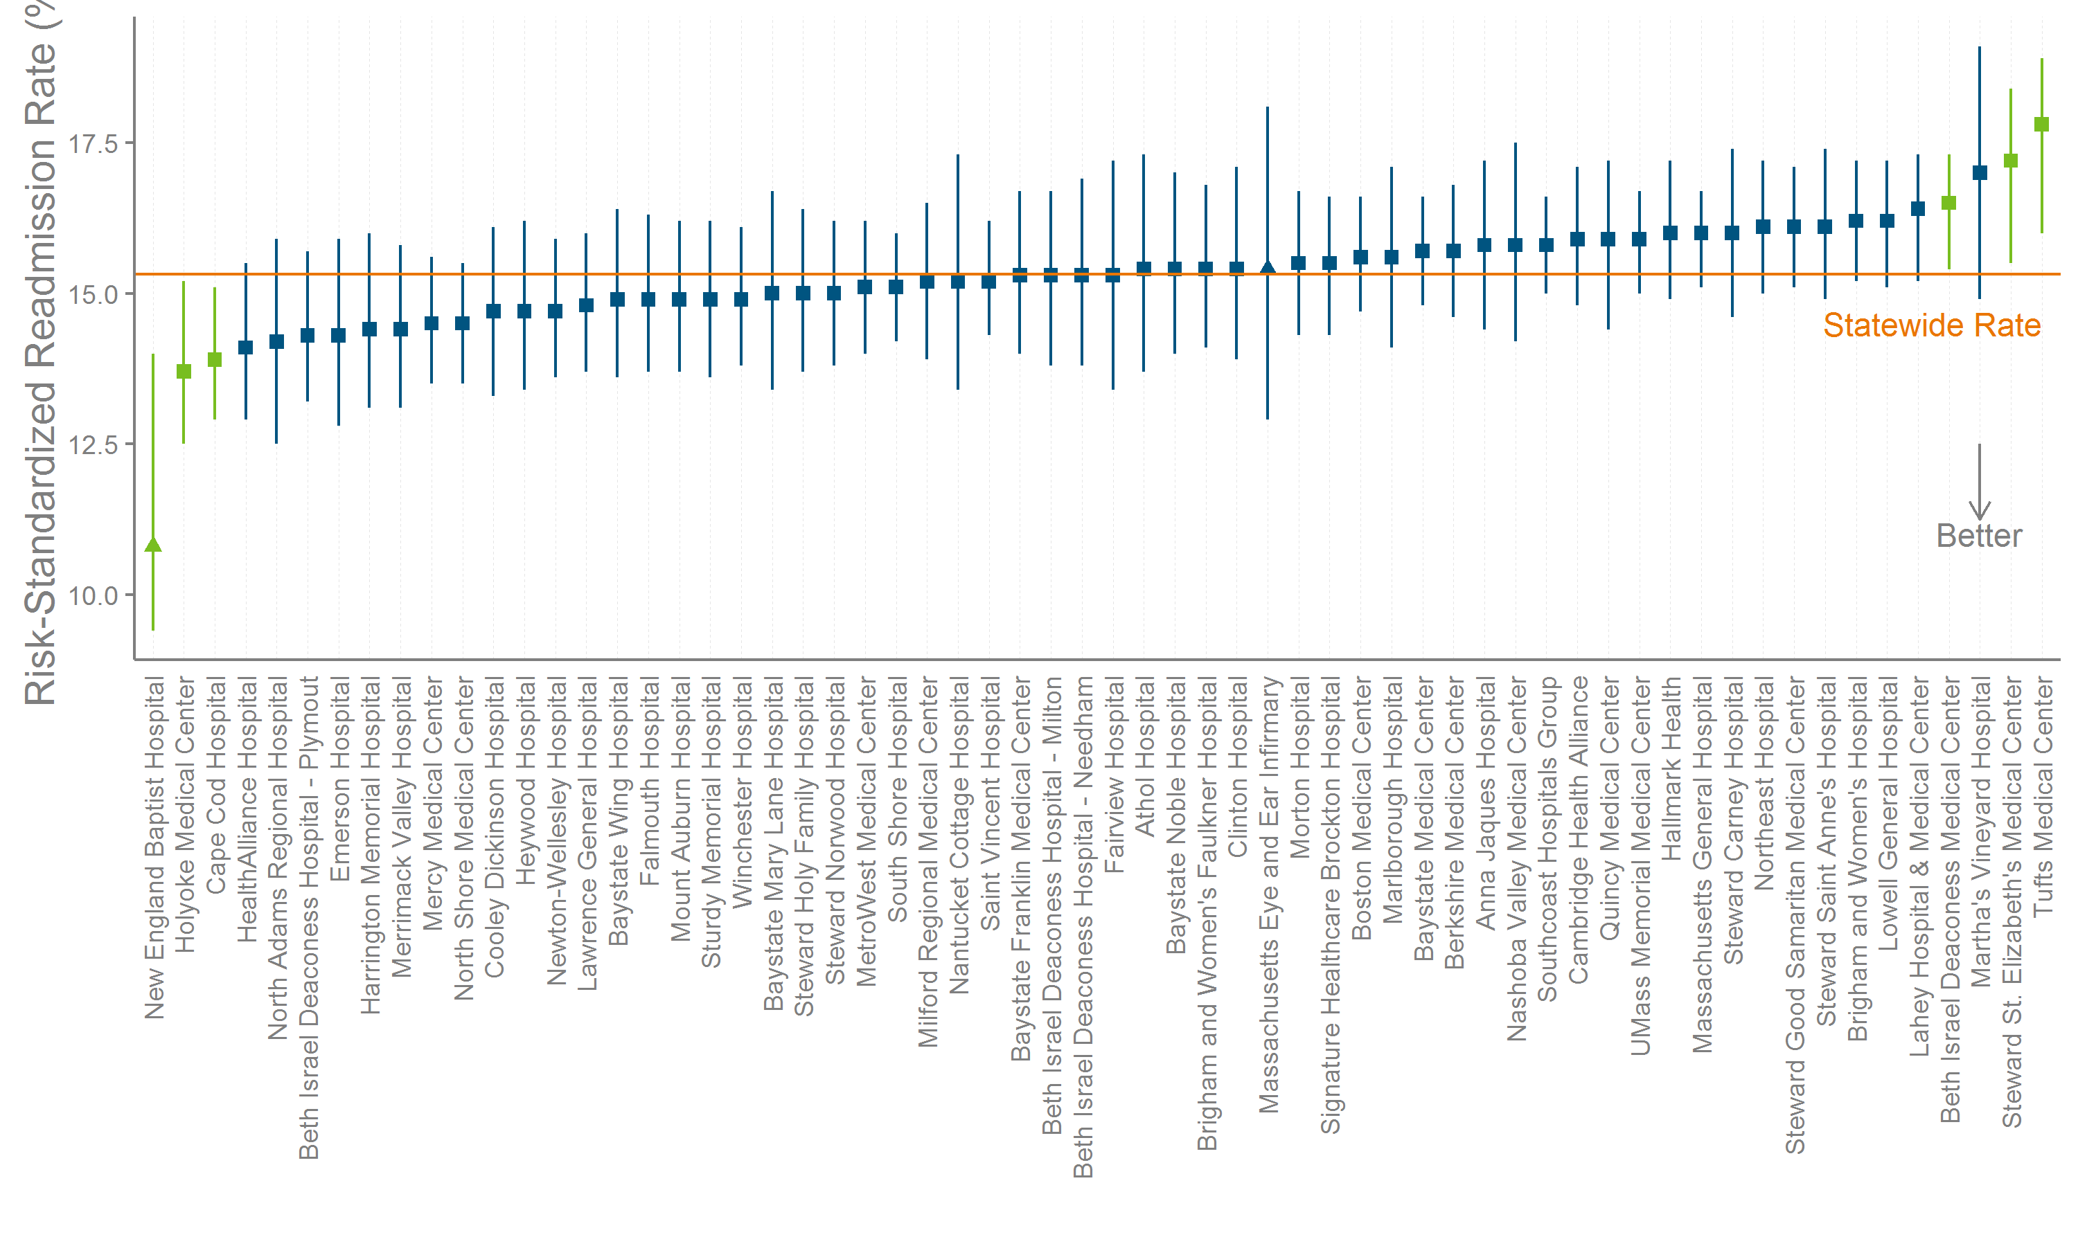
Risk-Standardized Rates (RSRRs) by Hospital
Background
Measure
Using HIDD
Findings
Notes:
Green lines indicate hospitals with risk-standardized rates significantly different from the statewide rate.
Triangles indicate specialty hospitals (New England Baptist and Mass Eye and Ear).

Slide 32
Questions?
Contact:
Nick Huntington & Zi Zhang
Center for Health Information and Analysis
nick.huntington@state.ma.us
zi.zhang@state.ma.us

Slide 33
Questions?
Questions related to APCD : (apcd.data@state.ma.us)
Questions related to Case Mix: (casemix.data@state.ma.us)
REMINDER: Please include your IRBNet ID#, if you currently have a project using CHIA data

Slide 34
Call for Topics and Presenters
If there is a TOPIC that you would like to see discussed at an MA APCD or Case Mix workgroup, contact Adam Tapply [adam.tapply@state.ma.us]
If you are interested in PRESENTING at an MA APCD or Case Mix workgroup, contact Adam Tapply [adam.tapply@state.ma.us]
  You can present remotely from your own office, or in-person at CHIA.

Slide 35
User Poll
In what format would you prefer to receive Case Mix files?
Access files?
SAS files?
XML files?
Delimited text files?
No preference
GoToWebinar Poll should pop up shortly

