Slide 1
MA Center for Health Information & Analysis Case Mix User Workgroup
May 23, 2017

Slide 2
Agenda
Announcements
Update on the status of Case Mix FY15/FY16
User Questions
Q&A

Slide 3
Case Mix FY15 Release Update
*CURRENT* RELEASE TIMEFRAMES FOR EACH FILE:
Inpatient (HIDD)
COMPLETE
Emergency Department (ED)
COMPLETE
Outpatient Observation (OOD)
COMPLETE

Slide 4
Case Mix FY16 Release Calendar
*CURRENT* RELEASE TIMEFRAMES FOR EACH FILE:
Inpatient (HIDD)
JUNE
Emergency Department (ED)
AUGUST
Outpatient Observation (OOD)
SEPTEMBER

Slide 5
Case Mix Application Process
Recap of Changes for 2017:
Now charge per year of data requested
Can now request future years of data
Future years require no DRC review, absent major changes to the project or data being requested
Can request to use data for one project for a subsequent project
Comprehensive DUAs for each organization (will cover all projects instead of multiple DUAs for each specific project)

Slide 6
Revised Data Release Process
Applicants can now request FUTURE YEARS OF DATA
Initial project requires Data Privacy Committee and Data Release Committee review
Additional years (up to 5 years) or release versions of data will be released upon availability and the Recipient’s completion of a Certificate of Continued Need (Exhibit B of the revised DUA)
No additional review required for these additional years of data
Normal data fees still apply

Slide 7
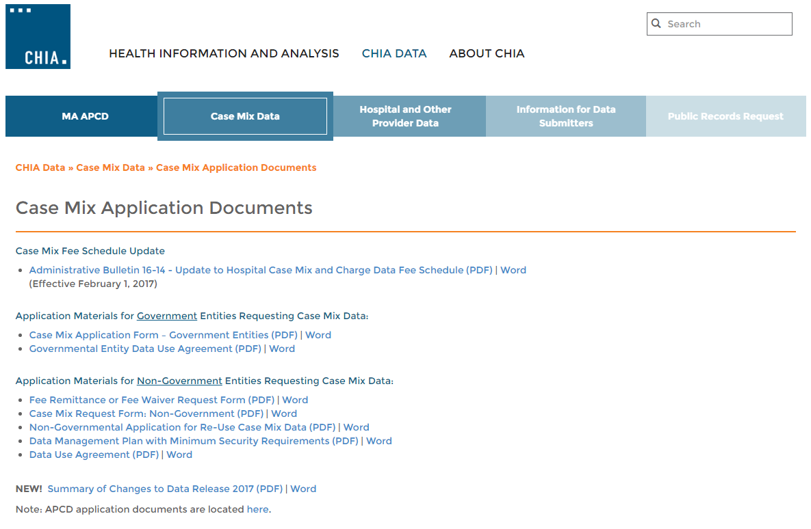
Revised Non-Gov’t Application Forms
Posted here: http://www.chiamass.gov/case-mix-application-documents/

Slide 8
Application Reminders
Applicants should not use “de-identified” in their application in referring to the data received from CHIA. CHIA datasets are not de-identified as the term is defined by HIPAA.
Also, make sure your IRB approval is valid for the period you intend to use the data.
Please remember your application documents must be signed by the appropriate people when you submit them on IRBNet.

Slide 9
QUESTIONS?

Slide 10
QUESTIONS SUBMITTED BY USERS

Slide 11
Question: What is the difference between the Primary and Secondary Payer Type and Payer Source fields in the Case Mix data and where do I find the look-up values?
Answer: This is one of most common questions CHIA receives from first time users of the case mix data. Payer Types are 22 categories used to classify the delivery coverage
Table 1. Case Mix Payer Type Codes and Definitions
plan for health care payers in Massachusetts (see Table 1).
In the case mix data, the Primary Payer Type and Secondary Payer Type must be compatible with Primary Payer Source and Secondary Payer Source.
If Medicaid is one of two payers, Medicaid will be coded as the
secondary Payer Type and secondary Payer Source unless Free Care is the
secondary type and source of payment.
Code | Payer Type Definition
1 | Self Pay
2 | Worker's Compensation
3 | Medicare
F | Medicare Managed Care
4 | Medicaid
B | Medicaid Managed Care
5 | Other Government Payment
6 | Blue Cross
C | Blue Cross Managed Care
7 | Commercial Insurance
D | Commercial Managed Care
8 | HMO
9 | Free Care
0 | Other Non-Managed Care Plans
E | PPO and Other Managed Care Plans Not Elsewhere Classified
H | Health Safety Net
J | Point-of-Service Plan
K | Exclusive Provider Organization
T | Auto Insurance
N | None (Valid only for Secondary Payer)
Q | Commonwealth Care/ConnectorCare Plans
Z | Dental Plans

Slide 12
Answer (continued): The Payer Source is name of the health plan or
program through which the patient (health plan policy holder)
reimburses the health care provider. A look-up table of Payer Source
codes and associated health plan names is available on CHIA’s website at:
http://www.chiamass.gov/assets/docs/p/case-mix/Payer-Source-Codes-2007-2017.xlsx
This online table includes 347 codes and names for health plans used in case mix data from 2007 through present. If Medicaid is one of two payers, Medicaid is coded as the secondary source of payment unless Free Care is the source of payment. There are also certain supplemental “fill-the-gap” plans that cover parts of medical expenses and are valid only as secondary source of payment (See Table 2).
Table 2. Supplemental Plans Valid Only as Secondary Source of Payment
Payer Source Code | Payer Source Name | Payer Type Code | Payer Type Definition
127 | Medicare HMO -Health New England Medicare Wrap | F | Medicare Managed Care
128 | Medicare HMO -HMO Blue for Seniors | F | Medicare Managed Care
129 | Medicare HMO-Kaiser Medicare Plus Plan | F | Medicare Managed Care
131 | Medicare HMO-Pilgrim Enhance 65 | F | Medicare Managed Care
133 | Medicare HMO -Tufts Medicare Supplement (TMS) | F | Medicare Managed Care
136 | BCBS Medex | 6 | Blue Cross
137 | AARP/Medigap Supplement | 7 | Commercial Insurance
138 | Banker’s Life and Casualty Insurance | 7 | Commercial Insurance
139 | Bankers Multiple Line | 7 | Commercial Insurance
140 | Combined Insurance Company of America | 7 | Commercial Insurance
141 | Other Medigap (not listed elsewhere) | 7 | Commercial Insurance
200 | Hartford Life Insurance co. | 7 | Commercial Insurance
201 | Mutual of Omaha | 7 | Commercial Insurance
202 | New York Life Insurance Company | 7 | Commercial Insurance
210 | Medicare HMO-Pilgrim Preferred 65 | F | Medicare Managed Care
211 | Neighborhood Health Plan Senior Health Plus | F | Medicare Managed Care
212 | Medicare HMO - Healthsource CMHC Central Care Supplement | F | Medicare Managed Care

Slide 13
Question: What new Diagnosis-Related Group (DRG) versions will be available with FY2016 Inpatient Hospital Discharge Data?
Answer: In addition to APR-DRG Version 20.0, APR-DRG Version 26.1, APR-DRG Version 30.0, new DRGs included will be APR-DRG Version 34.0 and Version 33.0 annual update to the CMS-DRG (see Table 1 below).
Table 1. DRG Versions Available in FY2009 through FY2016 Inpatient Hospital Discharge Data
HDD Fiscal Year | APR-DRG Version 20 | APR-DRG Version 26.1 | APR-DRG Version 30 | APR-DRG Version 34 | CMS-DRG Version 26 | CMS-DRG Version 27 | CMS-DRG Version 28 | CMS-DRG Version 29 | CMS-DRG Version 30 | CMS-DRG Version 31 | CMS-DRG Version 32 | CMS-DRG Version 33
2016 | X | X | X | X |  |  |  |  |  |  |  | X
2015 | X | X | X |  |  |  |  |  |  |  | X
2014 | X | X | X |  |  |  |  |  |  | X
2013 | X | X | X |  |  |  |  |  | X
2012 | X | X | X |  |  |  |  | X
2011 | X | X | X |  |  |  | X
2010 | X | X | X |  |  | X
2009 | X | X | X |  | X
APR-DRG Version 34.0 contains all of the classifications available in previous APR-DRG versions with 7 new classification DRG classifications (see Table 2 below).
Table 2. Seven New DRG Classification Codes added to 3M’s update to APR-DRG 34
DRG | DRG Code Description
181 | Lower extremity arterial procedures
182 | Other peripheral vascular procedures
322 | Shoulder and elbow joint replacement
469 | Acute Kidney Injury
470 | Chronic Kidney Disease
695 | Chemotherapy for acute leukemia
696 | Other Chemotherapy

Slide 14
Question: Does CHIA still create DRG’s using 15 Diagnosis Codes?
Answer: In the FY2016 Inpatient Hospital Discharge Data, CHIA used all diagnosis codes in the discharge record to calculate the DRG in alignment with the lifting of the limit in the case mix filing specifications on the number of diagnosis codes submitted CHIA to accommodate ICD-10-CM/PCS.
CHIA IT ran several tests and found that the lifting of the limit demonstrated improved accuracy in the severity of illness and risk of mortality noted for patients with a discharge status code of 20 (expired). Also, in comparing 15 diagnosis to unlimited diagnosis, some unspecific DRGs, such as other nervous system and related disorders, were reassigned to more clinically specific DRGs, such as multiple sclerosis and other demyelinating diseases.

Slide 15
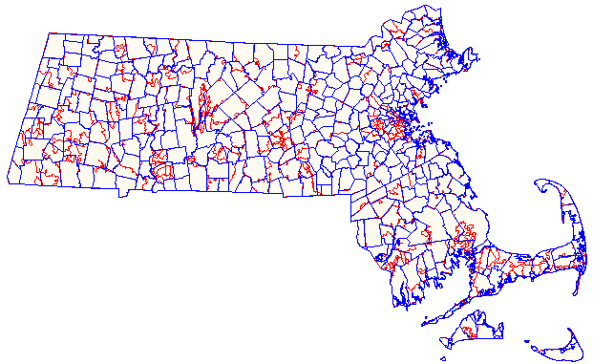
Question: What is the Difference between 3-Digit and 5-Digit Population Counts?
Answer: Many researchers request 5-Digit ZIP for the purposes of linking with the Census ZIP Code Tabulation areas. The Census Bureau records 550 ZIP Code Tabulation Areas (ZCTA) for Massachusetts. The population for the smallest ZCTA requires cell suppression. The largest ZCTA is 02301 (Brockton) which has a ZCTA population of 61,025. Both the ZCTA 3-Digit and the MassGIS quarterly update from US Postal Service for Massachusetts 3-Digit ZIP Code contain 18 grouping with the largest population (1,283,942) in 021 and the smallest population (28,215) in 022 (see Table 1 below) .
Table 1. MA 3-Digit ZIP Code Populations
Always Keep in Mind that Zip Codes Cut Across Multiple Political Boundaries
ZIP CODE | 3-Digit Population
010 | 469,375
011 | 168,835
012 | 130,689
013 | 83,111
014 | 211,812
015 | 373,719
016 | 188,402
017 | 379,027
018 | 713,126
019 | 476,314
020 | 400,371
021 | 1,283,942
022 | 28,215
023 | 441,063
024 | 408,771
025 | 116,621
026 | 147,883
027 | 526,336
Municipalities
Zip Codes
ZIP Codes generally do not show any respect for state, municipal, county, or census statistical area boundaries. They are administrative units for mail carrier routes that intertwine across political geographic boundaries like spaghetti, and are subject to continuous alteration or elimination.

Slide 16
Questions?
Questions related to APCD : (apcd.data@state.ma.us)
Questions related to Case Mix: (casemix.data@state.ma.us)
REMINDER: Please include your IRBNet ID#, if you currently have a project using CHIA data

Slide 17
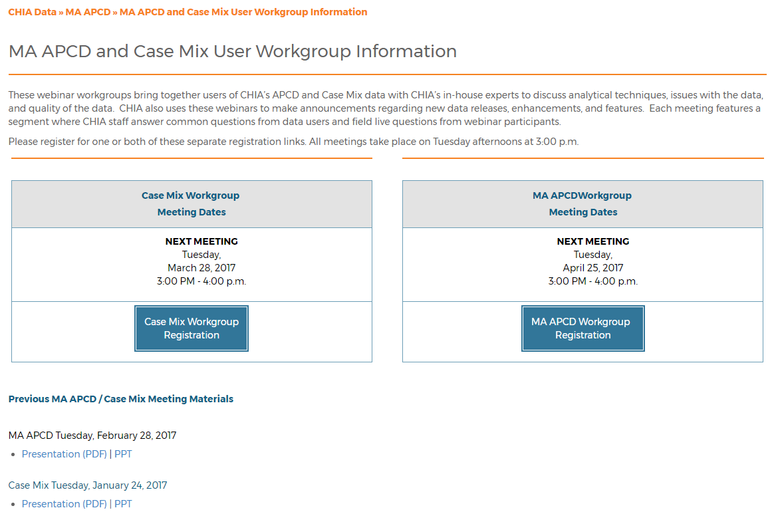
Where can I find old User Workgroup presentations?
http://www.chiamass.gov/ma-apcd-and-case-mix-user-workgroup-information/

Slide 18
Call for Topics and Presenters
If there is a TOPIC that you would like to see discussed at an MA APCD or Case Mix workgroup, contact Adam Tapply [adam.tapply@state.ma.us]
If you are interested in PRESENTING at an MA APCD or Case Mix workgroup, contact Adam Tapply [adam.tapply@state.ma.us]
You can present remotely from your own office, or in-person at CHIA.

