Slide 1
MA Center for Health Information & Analysis Case Mix User Workgroup
October 23, 2018

Slide 2
Agenda
Announcements
Updates on FY17 Case Mix Data Release
Updates to Prior Releases (FY2015-2017)
Additional Info on Summarized Data Reports
User Questions:
Race Count by Encrypted UHIN
Injury Codes for Bite Wounds
Website Updates
Q&A

Slide 3
Case Mix FY17 Release Calendar
*CURRENT* RELEASE TIMEFRAMES FOR EACH FILE:
Inpatient (HIDD)
JUNE [Fixed and Completed]
Emergency Department (ED)
MID NOVEMBER
Outpatient Observation (OOD)
LATE NOVEMBER

Slide 4
Updates to Prior Releases
FY2015 - One hospital has resubmitted data due to approximately 3400 missing birth discharges.
READY THIS WEEK
FY2016 – Two hospitals resubmitted data to include approximately 700 missing behavioral health inpatient discharges.
FIXED
FY2017 – (A) One hospital had a data conversion issue, where Zip Code was reported as ‘00000’ for approximately 5400 discharges. The data was resubmitted; (B) An anomaly was discovered in the Payer Source Code and Payer Type Code data where values were erroneously removed from the released data. This is being corrected.
IN PROCESS OF FIXING REMAINING FILES

Slide 5
Case Mix FY17 Data Release
REPEAT APPLICANTS
For those applicants with previously approved projects who indicated they would like to receive data annually, we began accepting Certificates of Continued Need and Compliance (Exhibit B of your DUA) starting on May 1st.
After receiving this, we will send you an invoice for the FY17 data and release data to you once payment is received and the data is ready
If you are making any changes to your project, you must go through the amendment process first

Slide 6
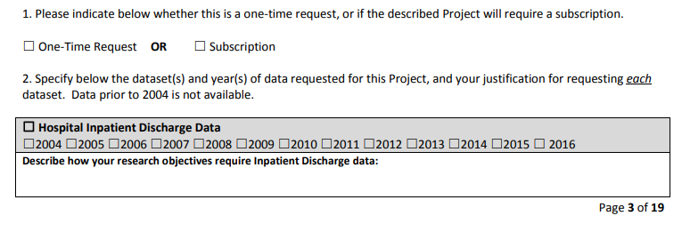
Case Mix FY17 Data Release
NEW APPLICANTS / NEW PROJECTS
We will continue to accept new applications on a rolling basis.
If you are requesting FY17 data, just click the box for “Subscription” on p. 3 of the application form:

Slide 7
QUESTIONS?

Slide 8
Summarized Data Reports
CHIA has updated our Data Release Regulations to allow for Summarized Data Reports
Will contain only aggregate data (data summaries) and De-identified Data, sourced from MA APCD and Case Mix data
Examples of Summarized Data Reports include: counts; totals; rates per thousand; index values; and other standardized metrics.
Will be subject to CHIA’s cell suppression policy (no cell less than 11 will be displayed)
Request form can be found on the MA APCD Application Documents page: http://www.chiamass.gov/application-documents

Slide 9
Summarized Data Reports
In determining whether to compile such a report, CHIA will consider the public interest served, the availability of its resources, the complexity of the request, and privacy concerns (i.e. that there is no more than a minimal risk to individual privacy in the public release of the report)
Submit the request via the new form – please provide as much information as you can, including mock-ups of what you expect the reports to look like
Data Use Agreement and Data Management Plan not required
The Executive Director (or his/her designee) will approve or deny such requests. Such approval/denial is final and not subject to further review or appeal.
A support/production fee of $140/hour will be charged

Slide 10
What goes into creating a report?
Summarized Data Reports take, on average, 10 hours of CHIA resource time to complete.
Steps include:
Initial review to determine feasibility and spot potential issues
Additional review and revisions with applicant to determine final specifications
Final review and Approval to proceed with the report request
Create documentation, including code, on steps to complete request
Independent code review and QA of results
Create documentation for the recipient
Produce final cut of data / report results

Slide 11
Most Common Issues When Applying for Summarized Report Data from CHIA
Data requested on application does not match data columns in report template
Data requested from Case Mix or MA APCD do not exist (remember to check online documentation)
Data requested from Case Mix only exists in MA APCD
Data requested from MA APCD only exists in Case Mix
Codes (ICD-9-CM, ICD-10-CM, HCPCS, CPT, NDC, etc.) are not provided to determine the specifications for report
Applicants requesting geographic aggregation stratify by a high number of covariates requiring extensive cell suppression
Data is requested by non-government researcher that is only available to government researchers
Applicant is not available for technical teleconference for application and report revisions
Applicant is available for technical teleconference, but forgets to make revisions afterwards

Slide 12
Question: I am calculating discharge rates by Race1 using two years of inpatient hospital discharge data. I noticed several instances where a patient’s unique encrypted UHIN was associated with a different Race1. Do patients switch the race they report frequently in the inpatient hospital discharge data?
RACE
Answer: No, the race does not frequently switch for patients who are admitted for inpatient care. As a test, we evaluated the reporting of Race1 data over a 10 year period (from FY2008 through FY2017) for 6.85 million inpatient discharge records with a valid encrypted UHIN. The 6.85 million hospitalizations represented 2,523,202 distinct UHINs with only 4.4% (i.e. 111,187 patients over a 10 year period) switching race on readmission. Of the 111,187 patients who switched race, 65,098 switched between “UNKNOWN” and a known race. Please note, the switching between races did not always constitute a single switch to a different race, but 8.5% switched more than once. In Figure 1 below, you will see that while the largest proportion of patients (91.5%) switched race once, 7.9% switched race twice and 0.6% switch race 3 times or more.
Figure 1. The Frequency of Race Switching for the 4% of
Patients who Switched Race of a 10-year Period
Imputing Race for Unknowns
Some researchers conducting longitudinal research requiring race calculations, when finding instances where an encrypted UHIN has race UNKNOWN/blank, determine if the UNKNOWN/blank race encrypted UHIN has ever switched from or to a known race. If there has been switching and the known race has a higher frequency (reported 10 times) than the UNKNOWN/blank race (reported 1 time) then they will impute race to the UNKNOWN from the known race.

Slide 13
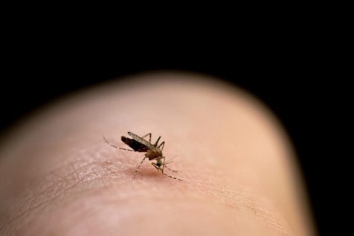
Question: I am in the process of applying for NIH grant to use the Case Mix data to conduct pediatric injury surveillance. ICD-10-CM expanded the number of cause diagnosis codes related to injury wounds from bites and I want to be able to provide information in my grant narrative on whether hospitals are using the full range of bite related codes.
Answer: Yes, the hospitals appear to be using the full range of the ICD-10-CM bite codes. We looked at the outpatient emergency department data (ED) for FY2016 to determine the extent to which bite codes were being used and for one year alone, 444 different ICD-10-CM bite codes were for used for over 30,000 bite related ED visits. The codes include bite related W-Codes (See Table 1 below) and extensive use of S-Codes.
Table 1. FY2016 Outpatient ED Visit Top ICD-10-CM W-Codes related to Bites
ICD-10-CM Code | Full Description | Rank
W57XXXA | Bitten or stung by nonvenomous insect and other nonvenomous arthropods, initial encounter | 1
W540XXA | Bitten by dog, initial encounter | 2
W5501XA | Bitten by cat, initial encounter | 3
W540XXD | Bitten by dog, subsequent encounter | 4
W5501XD | Bitten by cat, subsequent encounter | 5
W5581XA | Bitten by other mammals, initial encounter | 6
W5321XA | Bitten by squirrel, initial encounter | 7
W5381XA | Bitten by other rodent, initial encounter | 8
W57XXXD | Bitten or stung by nonvenomous insect and other nonvenomous arthropods, subsequent encounter | 9
W5311XA | Bitten by rat, initial encounter | 10
W5301XA | Bitten by mouse, initial encounter | 11
W5551XA | Bitten by raccoon, initial encounter | 12
W5511XA | Bitten by horse, initial encounter | 13
W5541XA | Bitten by pig, initial encounter | 14
W6101XA | Bitten by parrot, initial encounter | 15
W5651XA | Bitten by other fish, initial encounter | 16
W6191XA | Bitten by other birds, initial encounter | 17
W503XXD | Accidental bite by another person, subsequent encounter | 18
W5541XD | Bitten by pig, subsequent encounter | 19
W5581XD | Bitten by other mammals, subsequent encounter | 20
W5531XA | Bitten by other hoof stock, initial encounter | 21
W5911XA | Bitten by nonvenomous snake, initial encounter | 22
W540XXS | Bitten by dog, sequela | 23
W5501XS | Bitten by cat, sequela | 24
W5551XD | Bitten by raccoon, subsequent encounter | 25
W5681XA | Bitten by other nonvenomous marine animals, initial encounter | 26
W5901XA | Bitten by nonvenomous lizards, initial encounter | 27
W5301XD | Bitten by mouse, subsequent encounter | 28
W6151XA | Bitten by goose, initial encounter | 29

Slide 14
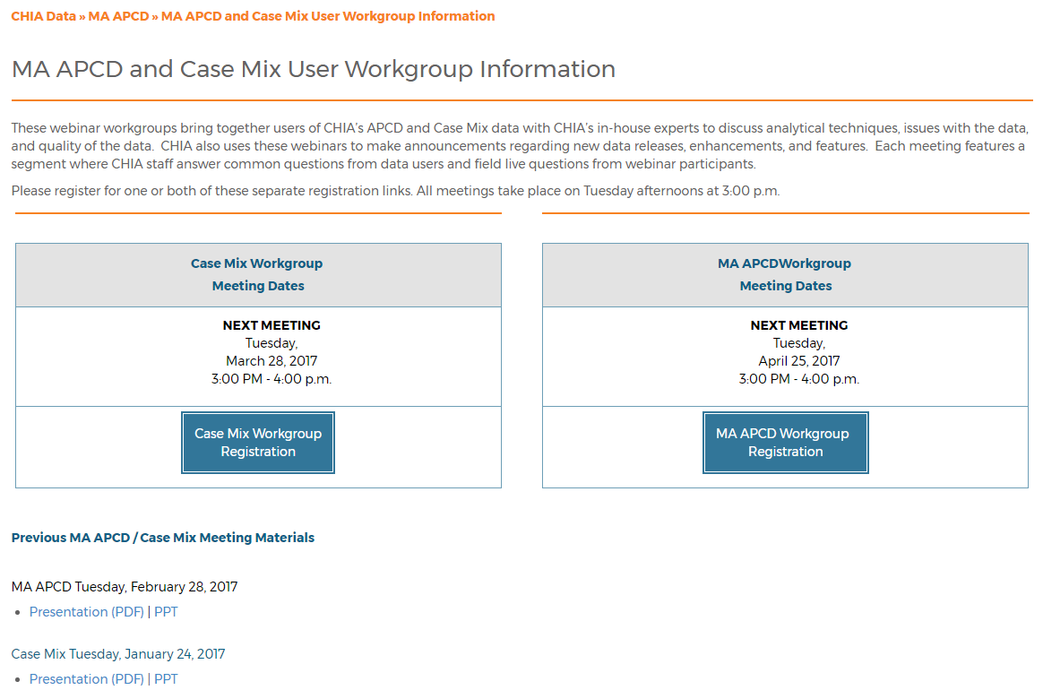
Where can I find old User Workgroup presentations?
http://www.chiamass.gov/ma-apcd-and-case-mix-user-workgroup-information/

Slide 15
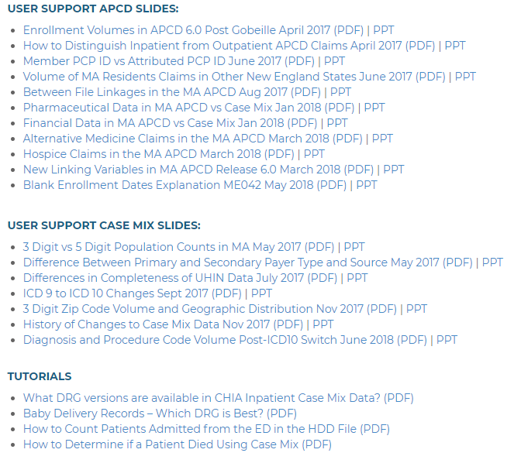
NEW! Updates to the User Workgroup Webpage
User Support slides and tutorials are now available to view and download separately from the presentations.
We will continue to update this page as new presentations happen from month to month.
Link: http://www.chiamass.gov/ma-apcd-and-case-mix-user-workgroup-information/

Slide 16
Updated Case Mix White Paper
Our white paper containing an updated overview of the Case Mix data base was posted last June.
Available on the Case Mix website or via this link: http://www.chiamass.gov/assets/Uploads/casemix/Case-Mix-Whitepaper.pdf

Slide 17
Questions?
Questions related to APCD : (apcd.data@state.ma.us)
Questions related to Case Mix: (casemix.data@state.ma.us)
REMINDER: Please include your IRBNet ID#, if you currently have a project using CHIA data

Slide 18
Call for Topics and Presenters
If there is a TOPIC that you would like to see discussed at an MA APCD or Case Mix workgroup, contact Adam Tapply [adam.tapply@state.ma.us]
If you are interested in PRESENTING at an MA APCD or Case Mix workgroup, contact Adam Tapply [adam.tapply@state.ma.us]
You can present remotely from your own office, or in-person at CHIA.

