Slide 1
MA Center for Health Information & Analysis
Case Mix User Workgroup
September 26, 2017

Slide 2
Agenda
Announcements
  Update on the status of Case Mix FY16 fulfillment
  Expected timeframes for FY17
User Poll: Which groupers do you use?
User Questions
Q&A

Slide 3
Case Mix FY16 Release Calendar
  *CURRENT* RELEASE TIMEFRAMES FOR EACH FILE:
  Inpatient (HIDD)
  READY NOW
  Emergency Department (ED)
    READY NOW
  Outpatient Observation (OOD)
    END OF SEPTEMBER – FIRST WEEK OF OCT

Slide 4
Case Mix FY17 Release Calendar
  *CURRENT* RELEASE TIMEFRAMES FOR EACH FILE:
  Inpatient (HIDD)
  JUNE
  Emergency Department (ED)
    AUGUST
  Outpatient Observation (OOD)
    SEPTEMBER

Slide 5
Case Mix Application Process
Recap of Changes for 2017:
Now charge per year of data requested
Can now request future years of data
  Future years require no DRC review, absent major changes to the project or data being requested
Can request to use data for one project for a subsequent project
Comprehensive DUAs for each organization (will cover all projects instead of multiple DUAs for each specific project)
Not expecting any major changes in 2018

Slide 6
MA APCD Release 6.0
Target release timeframe is Late Fall 2017
More information on the Release will be announced at the APCD User Workgroup as we get closer to release
Make sure you’re signed up for CHIA’s email list to receive important announcements:
Sign Up Here

Slide 7
Application Reminders
Please remember to send in your $300 application fee. We won’t review an application until the application fee has been received.
[doesn’t apply to Government applicants]
Financial Hardship Fee Waiver Requests – We expect applicants to have made an attempt to find some kind of institutional or grant funding. 100% fee waiver requests are extremely unlikely to be granted.

Slide 8
User Poll
Which DRGs (groupers) do you use?
We currently provide:
APR – 20.0, 26.1, 30.0, 34.0
CMS – 34.0
[Click all that apply in the poll pop-up]

Slide 9
QUESTIONS?

Slide 10
Question: In FY2016, why are close to 38% of the Hospital Inpatient Discharges missing procedure codes? How is it possible to have dollar amount charges without procedures codes?
Answer: Over the past 10 years, there has not been notable variation the number of discharges without procedure codes (see Table 1 below). The 10-year percent mean for missing procedure codes is 37.4% (see Table 2 below). You will not see procedure code for certain patients hospitalized for only psychiatric services, physical therapy, occupational therapy, respiratory services, testing (EKG/ECG, CAT Scan, respiratory services, IV Therapy, diagnostic radiology), and various pharmaceutical services. Instead you will find the services associated with their charges in the revenue codes. The years where you do see slight increases in the percent of missing procedures is influenced by the age of the case mix. For example, the CMS.GOV site reports that the Medicare Inpatient public use file is missing 47% of procedure codes.
Procedure Codes & Revenue Codes
Mean

Slide 11

Question: We are using the All-Payer Claims Data (APCD) and noticed an increase in asthma cases seen the in APCD Emergency Department data in September 2014 and decreases during the summer months and wanted to know whether this pattern is also seen in the Case Mix data Outpatient Emergency Department data?
Answer: Yes, you will see that same pattern mirrored in the outpatient emergency department case mix data (see table below). September increases have been associated intensity of ragweed season and increased testing of students returning to school.

Slide 12
Question: ICD-9-CM External Cause of Injury Codes (E-Codes) are no longer used. What ICD-10-CM codes have replaced them?
Answer: Previously, if a patient had an ICD-9-CM Injury code (800- 904.9 or 910-995.89 EXCEPT 995.60-995.69) an E-Code would be used to describe the cause, intent and activity associated with the injury or poisoning. In ICD-10-CM, the S-Codes and T-Codes are used for coding injuries and poisonings and V-Codes, W-Codes, X-Codes and Y-Codes are used for cause.
ICD-10-CM Injury and Poisoning Codes
ICD-10-CM Cause of Injury Codes
S00-S09 Injuries to the head
S10-S19 Injuries to the neck
S20-S29 Injuries to the thorax
S30-S39 Injuries to the abdomen, lower back, lumbar spine, pelvis and external genitals
S40-S49 Injuries to the shoulder and upper arm
S50-S59 Injuries to the elbow and forearm
S60-S69 Injuries to the wrist, hand and fingers
S70-S79 Injuries to the hip and thigh
S80-S89 Injuries to the knee and lower leg
S90-S99 Injuries to the ankle and foot
T07-T07 Injuries involving multiple body regions
T14-T14 Injury of unspecified body region
T15-T19 Effects of foreign body entering through natural orifice
T20-T25 Burns and corrosions of external body surface, specified by site
T26-T28 Burns and corrosions confined to eye and internal organs
T30-T32 Burns and corrosions of multiple and unspecified body regions
T33-T34 Frostbite
T36-T50 Poisoning by, adverse effect of and underdosing of drugs, medicaments and biological substances
T51-T65 Toxic effects of substances chiefly nonmedicinal as to source
T66-T78 Other and unspecified effects of external causes
T79-T79 Certain early complications of trauma
T80-T88 Complications of surgical and medical care, not elsewhere classified
V00-V09 Pedestrian injured in transport accident
V10-V19 Pedal cycle rider injured in transport accident
V20-V29 Motorcycle rider injured in transport accident
V30-V39 Occupant of three-wheeled motor vehicle injured in transport accident
V40-V49 Car occupant injured in transport accident
V50-V59 Occupant of pick-up truck or van injured in transport accident
V60-V69 Occupant of heavy transport vehicle injured in transport accident
V70-V79 Bus occupant injured in transport accident
V80-V89 Other land transport accidents
V90-V94 Water transport accidents
V95-V97 Air and space transport accidents
V98-V99 Other and unspecified transport accidents
W00-W19 Slipping, tripping, stumbling and falls
W20-W49 Exposure to inanimate mechanical forces
W50-W64 Exposure to animate mechanical forces
W65-W74 Accidental non-transport drowning and submersion
W85-W99 Exposure to electric current, radiation and extreme ambient air temperature and pressure
X00-X08 Exposure to smoke, fire and flames
X10-X19 Contact with heat and hot substances
X30-X39 Exposure to forces of nature
X50-X50 Overexertion and strenuous or repetitive movements
X52-X58 Accidental exposure to other specified factors
X71-X83 Intentional self-harm
X92-Y09 Assault
Y21-Y33 Event of undetermined intent
Y35-Y38 Legal intervention, operations of war, military operations, and terrorism
Y62-Y69 Misadventures to patients during surgical and medical care
Y70-Y82 Medical devices associated with adverse incidents in diagnostic and therapeutic use
Y83-Y84 Surgical and other medical procedures as the cause of abnormal reaction of the patient, or of later complication, without mention of misadventure at the time of the procedure
Y90-Y99 Supplementary factors related to causes of morbidity classified elsewhere

Slide 13

Comparison of ICD-9-CM to ICD-10-CM Increase in Diagnosis Codes by ICD-10-CM Major Diagnosis Chapters
59% of ICD-10-CM codes are in the Injury/ poisoning chapter
New Major Diagnosis Categories

Slide 14
Link to the CMS ICD-9 to ICD-10 equivalency documentation.
https://www.cms.gov/Medicare/Coding/ICD10/2015-ICD-10-CM-and-GEMs.html

Slide 15
Questions?
Questions related to APCD : (apcd.data@state.ma.us)
Questions related to Case Mix: (casemix.data@state.ma.us)
REMINDER: Please include your IRBNet ID#, if you currently have a project using CHIA data

Slide 16
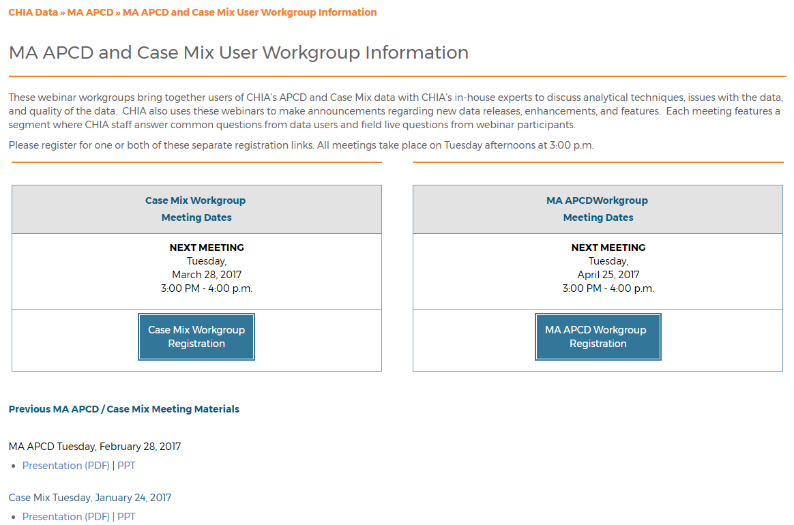
Where can I find old User Workgroup presentations?
http://www.chiamass.gov/ma-apcd-and-case-mix-user-workgroup-information/

Slide 17
Call for Topics and Presenters
If there is a TOPIC that you would like to see discussed at an MA APCD or Case Mix workgroup, contact Adam Tapply [adam.tapply@state.ma.us]
If you are interested in PRESENTING at an MA APCD or Case Mix workgroup, contact Adam Tapply [adam.tapply@state.ma.us]
  You can present remotely from your own office, or in-person at CHIA.

