Slide 1
CHIA user workgroup
Don Kirkwood (Manager of Data Release and Procurement)
Sylvia Hobbs (Manager of User Support)
Scott Curley (Manager Privacy & Compliance)
November 22, 2022
CENTER FOR HEALTH INFORMATION AND ANALYSIS

Slide 2
Agenda
Announcements:
  APCD Release CY 2020 Updates
  FY20 Case Mix Release Projections
Website Updates
User Support Questions
  Poll Attendees on any use of older DRG Versions in Case Mix
  Total Charges in Case Mix compared to MA APCD
  Do Not Resuscitate (DNR) flag and ICD-10-CM DNR
  Hispanic Indicator
Q&A

Slide 3
MA APCD CY 2020 (Release 10.0)
  Available for request
  Applicants with approved projects that require updated APCD data (CY 2020 Data) should submit to CHIA a completed Exhibit B (Certificate of Continued Need and Compliance) of the Data Use Agreement. After submitting a completed Exhibit B you will receive an invoice (if applicable) for the requested data. Upon payment of the invoice the order for the data will be placed.
  CY 2020 Data includes data on services from January 2016 – December 2020 with six months of claim runout.

Slide 4

Case Mix FY21 Release
*CURRENT* RELEASE TIMEFRAMES FOR EACH FILE:
  Inpatient (HIDD)
  Available for request
  Emergency Department (ED)
  Available for request
  Outpatient Observation (OOD)
  Available for request
  Applicants with approved projects that require newly available year(s) of Case Mix Data (e.g., FY 19) should submit to CHIA a completed Exhibit B (Certificate of Continued Need and Compliance) of the Data Use Agreement. After submitting a completed Exhibit B you will receive an invoice (if applicable) for the requested data. Upon payment of the invoice the order for the data will be placed.

Slide 5
Website Release Updates
  Updates on the production of APCD and Case Mix databases and status of data requests are now posted to CHIA’s website!
    Aim #1 is to provide weekly or bi-weekly status update on CHIA data products as they are in development.
    Aim #2 is to provide applicants with information about expected fulfillment status for individual data requests.
    Request IDs will be communicated to Data Requestors via email.
  Please visit http://www.chiamass.gov/status-of-data-requests/ to see the current status of releases.

Slide 6
USER questions

Slide 7

Question: Case mix data has a designated flag field for do not resuscitate (DNR). However, there is also an ICD-10-CM diagnosis code (Z66) for DNR. Should I assume that the diagnosis code ‘Z66’ has been reported if DNR is reported in the flag field? Is one coding option used more than the other and do DNR patients have a higher death rate than other patients?
DNR
Answer: The case mix filing specifications define DNR status as:
    “A status indicating that the patient had a physician order not to resuscitate or the patient had a status of receiving palliative care only. Do not resuscitate status means not to revive from potential or apparent death or that a patient was being treated with comfort measures only.”
The coding options for the DNR status are:
Please note that the DNR status field includes the option for “comfort measures only.” The Joint Commission National Quality Measures explains "comfort measures only refers to medical treatment of a dying person where the natural dying process is permitted to occur while assuring maximum comfort. It includes attention to the psychological and spiritual needs of the patient and support for both the dying patient and the patient's family. It is not equivalent to a physician order to withhold emergency resuscitative measures such as Do Not Resuscitate.“
The ICD-10-CM diagnosis code ‘Z66’ refers to DNR status code ‘1’ DNR order written. While there is not a separate diagnosis code to distinguish comfort measures only, there is a diagnosis code ‘Z515’ for palliative care. While like comfort care, palliative care has a focus on quality of life, unlike comfort care, palliative care can be accompanied by curative or therapeutic care with the goal of curing or delaying disease progression.
DNR Code | Do Not Resuscitate Status Definition
1 | DNR order written
2 | Comfort measures only
3 | No DNR order or comfort measures orders

Slide 8
Answer (continued): The highest frequency DNR Status code in the case mix hospital inpatient discharge data (HIDD) from FY2018 through FY2021 was, as anticipated, Code 3 for patients who had no DNR order or comfort measure orders. Such patients accounted for on average 57% of records over the four-year period. See table below. The second highest frequency was for records where the DNR status field was left blank, accounting for on average 38% of the records. Status Code 1 for DNR Order Written accounted for on average 3.6% of the records, followed by status 2 for Comfort Measures only, accounting for on average less than 1% of the records. Eighty-five percent of patients with a DNR status code 1 (DNR Order Written) also had the ICD-10-CM diagnosis code ‘Z66’ for DNR. Nevertheless, the high percentage of blanks points to potential under coding of DNR status in the status code field.
DNR
FY2018 through FY2021 HIDD DNR Status Code Field Frequency

Slide 9
Answer (continued): When comparing the frequency of ICD-10-CM diagnosis code for DNR (‘Z66’) from FY2018 through FY2021, the volume of patients with the DNR diagnosis code was more than 100% higher than those with DNR status code 1. See figures 1a through 2b below. The magnitude of difference between patients with the diagnosis code ‘Z66’ compared to those with the DNR status code 1 has been increased, with 71,465 patients with diagnosis codes versus 36,465 with DNR status code 1 for the same period in FY2018, compared to 72,578 patients with diagnosis codes versus 24,159 with DNR status code 1 in FY2021. This indicates that the DNR status code field alone should not be relied on for determining DNR status without checking the diagnosis codes for ICD-10-CM diagnosis code ‘Z66’ and that blanks in the DNR status code field should not be interpreted as no DNR without check the diagnosis codes.
DNR
FY2018 through FY2021 HIDD DNR Diagnosis Code ‘Z66’ Compared to DNR Status Field Code

Slide 10
Answer (continued): When comparing ICD-10-CM diagnosis code for DNR ‘Z66’ by DNR status code frequency for HIDD FY2018 through FY2021, although FY2018 had 42% of records where both a diagnosis code for DNR and the DNR status code aligned, the percent of both fields being aligned decreased to 28% in FY2021. See below. In a future webinar, more information will be obtained from hospitals to determine the reason for the conflict; for example, whether the status code is based being interpreted as DNR status at time of admission and after the admission, a DNR order is requested and recorded in the discharge diagnosis.
DNR
FY2018 through FY2021 HIDD DNR Diagnosis Code ‘Z66’ by Frequency of DNR Status Code

Slide 11
Answer (continued): When comparing discharge status for patients with a DNR status Code 1 for DNR Order Written to ICD-10-CM diagnosis code ‘Z66’ for DNR, both the status code and diagnosis code patients had discharged/transferred to a skilled nursing facility as the highest frequency. However, the volume of patients who expired was significantly less and trending downward for patients who had DNR code 1 compared to diagnosis code which was higher and trending upward. See Tables 1 and 2 below.
DNR
Table 1. FY2018 through FY2021 HIDD DNR Status Order Written Frequency by Patient Discharge Status
Patient Discharge Status | 2018 | 2019 | 2020 | 2021
Discharged/transferred to skilled nursing facility | 36% | 34% | 31% | 28%
Discharged/transferred to home care of organized home health service organization | 26% | 28% | 31% | 33%
Discharged to home/self-care (routine charge) | 12% | 13% | 14% | 15%
Expired (patient did not recover) | 8% | 6% | 6% | 6%
Discharged/transferred to a Hospice home | 5% | 6% | 6% | 7%
Discharged/transferred to an inpatient rehabilitation facility | 3% | 4% | 4% | 4%
Discharged/transferred to a Hospice medical facility | 4% | 3% | 3% | 3%
Discharged/transferred to a long-term care hospital | 2% | 2% | 2% | 1%
Discharged/transferred to other short term general hospital for inpatient care | 2% | 1% | 2% | 2%
Discharged/transferred to intermediate care facility | 1% | 2% | 1% | 1%
All other discharge status codes | 2% | 1% | 1% | 2%
DNR Code Order Written
Death Volume
Table 2. FY2018 through FY2021 HIDD ICD-10-CM DNR DX Code ‘Z66’ Frequency by Patient Discharge Status
Patient Discharge Status | 2018 | 2019 | 2020 | 2021
Discharged/transferred to skilled nursing facility | 35% | 32% | 28% | 25%
Discharged/transferred to home care of organized home health service organization | 22% | 21% | 22% | 24%
Expired (patient did not recover) | 14% | 16% | 19% | 19%
Discharged to home/self-care (routine charge) | 12% | 11% | 11% | 12%
Discharged/transferred to a Hospice home | 5% | 6% | 7% | 7%
Discharged/transferred to a Hospice medical facility. | 4% | 5% | 6% | 6%
Discharged/transferred to an inpatient rehabilitation facility | 3% | 3% | 3% | 3%
Discharged/transferred to other short term general hospital for inpatient care | 1% | 1% | 1% | 2%
Discharged/transferred to a long-term care hospital | 1% | 1% | 1% | 1%
Discharged/transferred to intermediate care facility | 1% | 1% | 1% | 0.3%
All other discharge status codes | 2% | 2% | 2% | 2%
DNR DX Code ‘Z66’
Death Volume

Slide 12
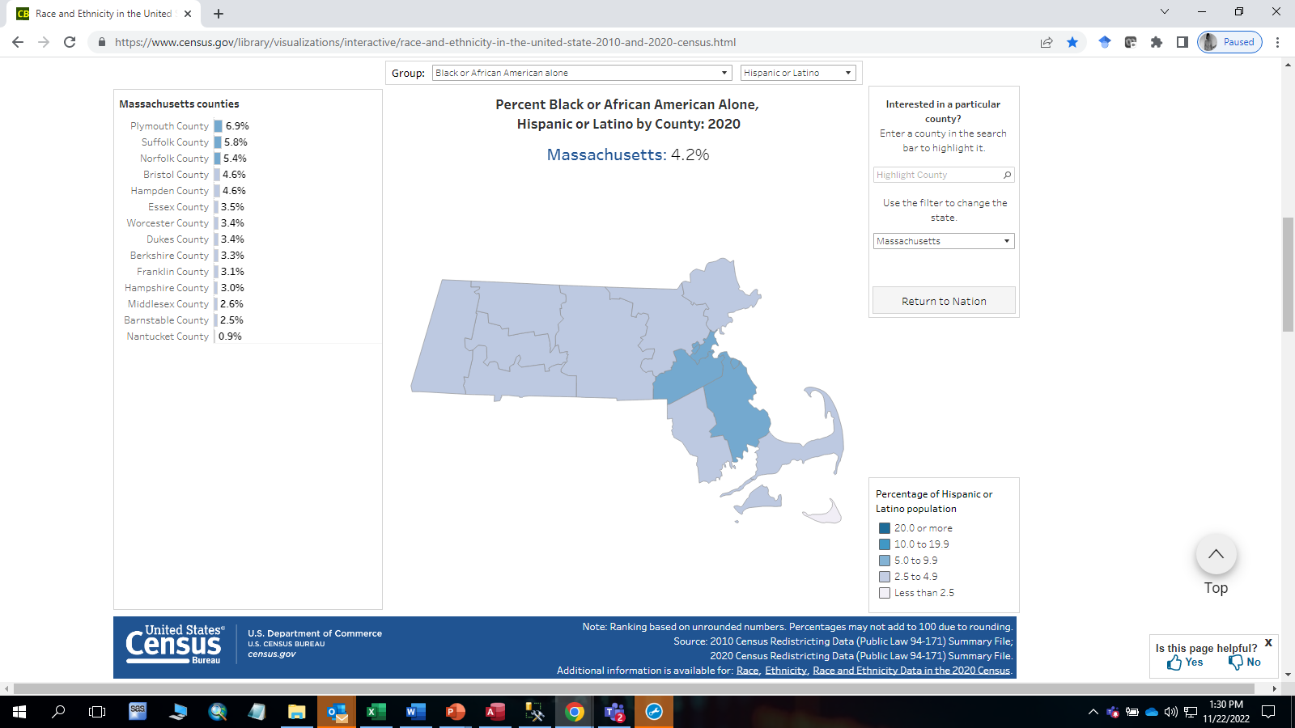
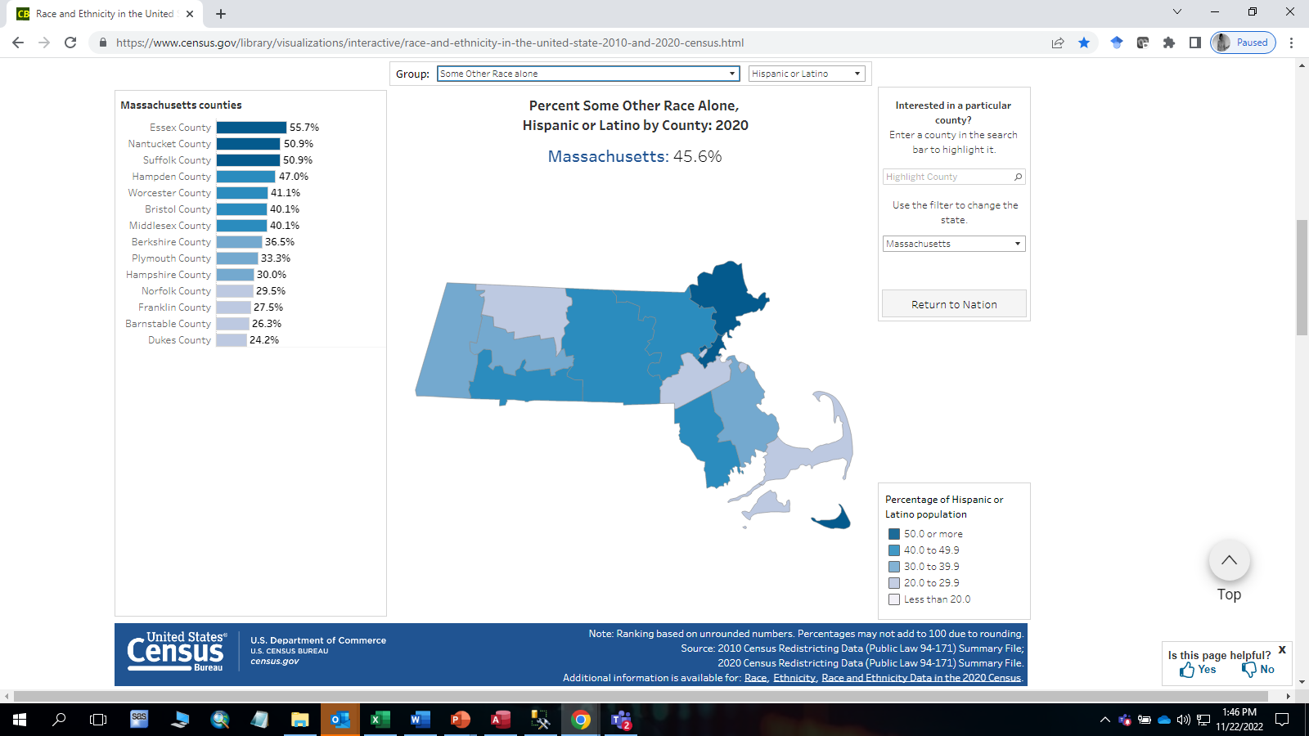
Question: The Hispanic Indicator is not always populated even if the record has an ethnicity recorded as Hispanic. In such instances, I impute a ‘Yes’ to the Hispanic Indicator field. Is there a way of determining whether imputation is accurate?
Hispanic
Indicator
Answer: A ‘yes’ in the Hispanic Indicator field is recorded if the patient is Hispanic/Latino/Spanish. You are correct, there are instances when the field is left blank, but a Hispanic ethnicity is recorded in one of the ethnicity fields. Data users do commonly impute the indicator if a Hispanic ethnicity is recorded in an ethnicity field. The United States Census Bureau 2020 Data Summary Files have been aggregated into an interactive mapping tool which enables checking how close your imputation is to the census population. This tool is available online the following web link: https://www.census.gov/library/visualizations/interactive/race-and-ethnicity-in-the-united-state-2010-and-2020-census.html . As an example, the Census Bureau 2020 data indicates 4.2% of the Massachusetts population in the decennial 2020 census is Black Hispanic, see Figure 1 below. The FY2020 outpatient ED Visit data indicates the 5.9% of the of the Massachusetts population who visited the ED were Black Hispanics. Another example, the Census Bureau 2020 indicates 45.6% of the Massachusetts population is Other race Hispanic and the FY2020 ED visit data indicates 53.3% of ED Visits were Other race Hispanics. These types of comparisons are useful when comparing submitted data and imputations.
Fig 1. Census Bureau 2020 MA Black Hispanic Fig 2. Census Bureau 2020 MA Other Race Hispanic

Slide 13

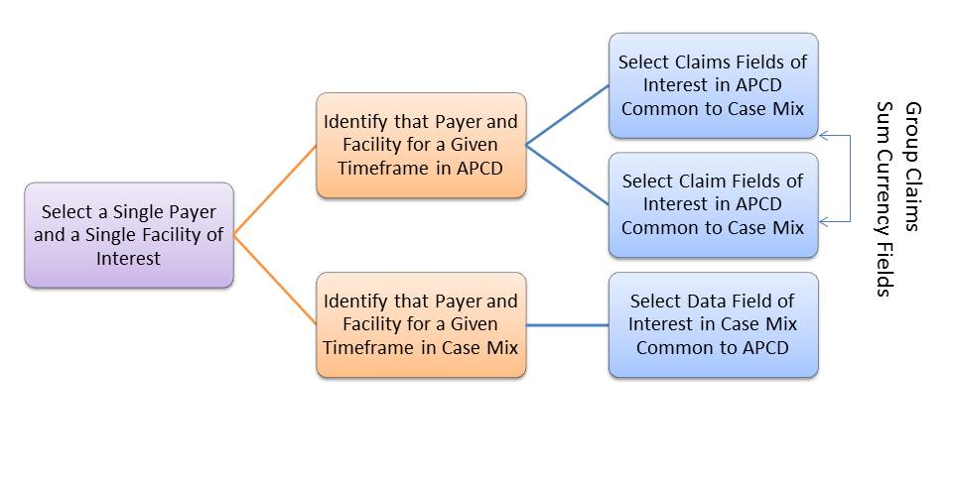
Question: How do the case mix data and MA APCD differ by currency fields?
Answer: The MA APCD medical claims has 25 currency fields. The hospital inpatient discharge data’s currency fields are limited to charge amounts.
Medical Claims Currency fields
Charge Amount
Paid Amount
Prepaid Amount
Copay Amount
Coinsurance Amount
Deductible Amount
Coordination of Benefits/TPL Liability Amount
Other Insurance Paid Amount
Medicare Paid Amount
Allowed amount
Non-Covered Amount
Withhold Amount
Value Amount - 1
Value Amount - 2
Value Amount - 3
Value Amount - 4
Value Amount - 5
Value Amount - 6
Value Amount - 7
Value Amount - 8
Value Amount - 9
Value Amount - 10
Value Amount - 11
Value Amount - 12
Hospital Inpatient Discharge Data Currency Fields
Total Charges Routine
Total Charge Special
Total Charges All
Total Charges Ancillaries
Facility Specific Charges Can be Compared by Payer and Claim Type

Slide 14
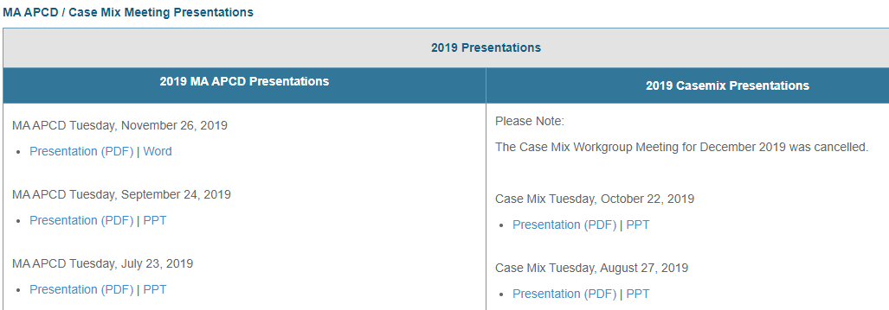
Where can I find past User Workgroup Presentations?
http://www.chiamass.gov/ma-apcd-and-case-mix-user-workgroup-information/

Slide 15
When is the next User Group meeting?
The next MA APCD webinar will meet Tuesday January 24, 2023.
The December 27, 2022 Case Mix webinar is postponed.
The next Case Mix webinar will meet Tuesday February 28, 2023.
The 2023 meeting schedule will be posted to the website soon:
http://www.chiamass.gov/ma-apcd-and-case-mix-user-workgroup-information/

Slide 16
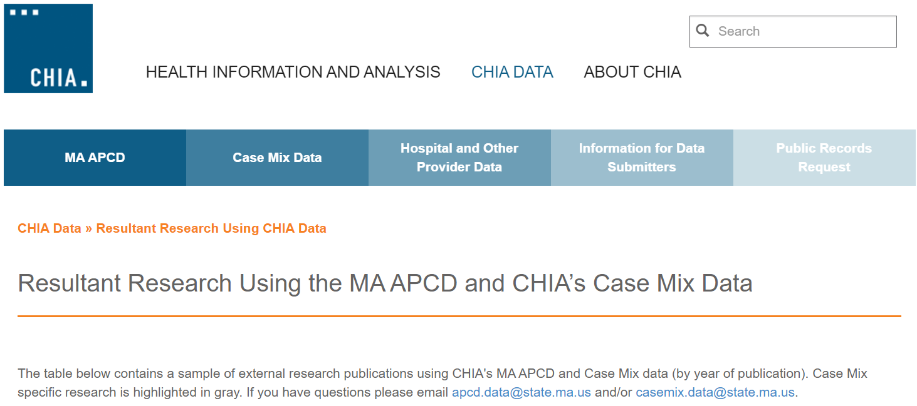
Resultant Research Using CHIA Data
https://www.chiamass.gov/resultant-research-using-chia-data

Slide 17
Questions?
Questions related to MA APCD:
apcd.data@chiamass.gov
Questions related to Case Mix:
casemix.data@chiamass.gov
REMINDER: Please include your IRBNet ID#, if you currently have a project using CHIA data.

