Slide 1
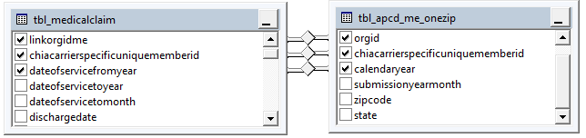
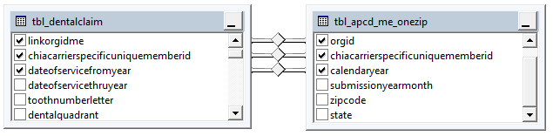
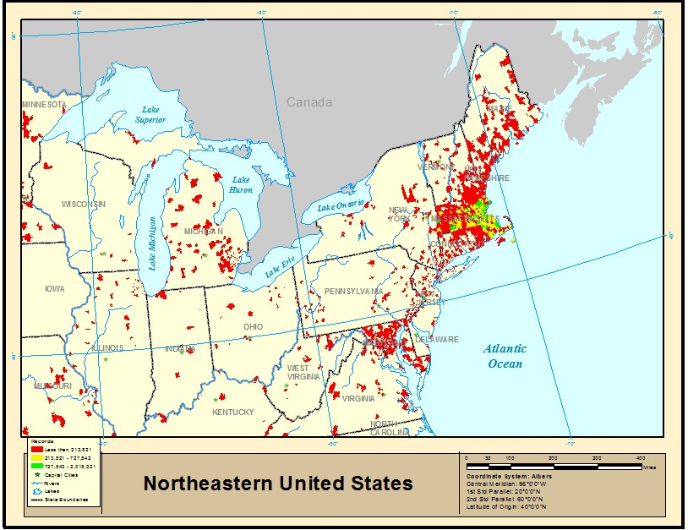
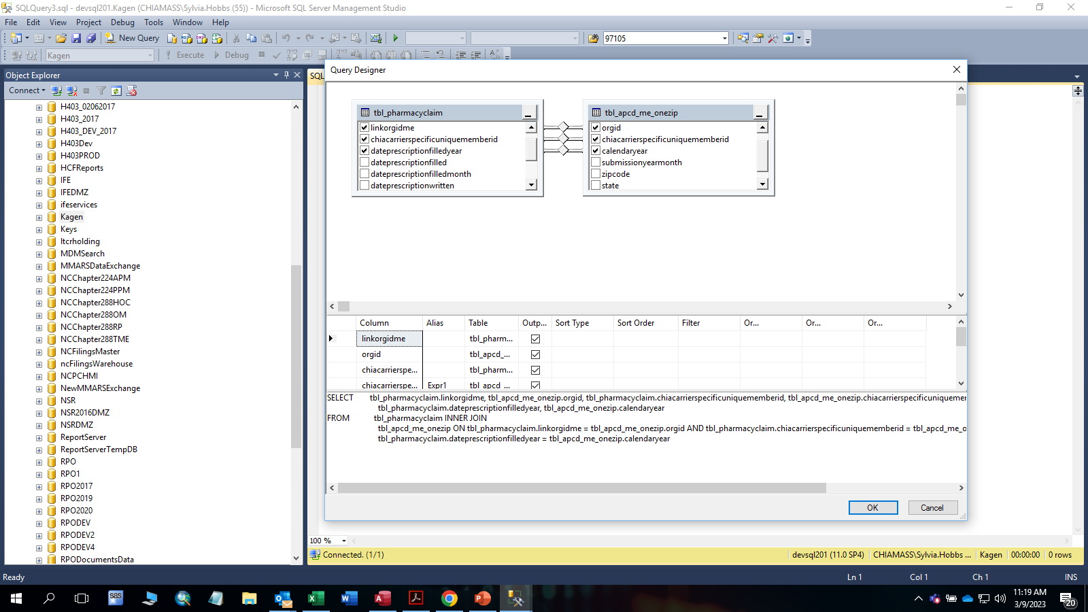
The ME One ZIP table contains six fields: orgid, chiacarrierspecificunqiuememberid, calendaryear, submissionyearmonth, zipcode, and state. The MC table (see Figure 1) links to the membereligibility (ME) one ZIP code per year table by linkorgidme, chiacarrierspecificuniquememberid, and dateofservicefromyear fields, as does the DC table (see Figure 2). The PC table (see Figure 3) links to the ME one ZIP code per year table by linkorgidme, chiacarrierspecificuniquememberid, and dateprescriptionfilledyear fields. State codes outside New England geographic boundaries are represented by a hash character in the state field (see Table 1).
Claims Linkage to ME One ZIP Code per Year Table
Figure 1. Tbl_Medical Claims (MC) Linkage to ME One ZIP Table
Table 1. Member Eligibility One ZIP Table Record Count by Calendar Year and State Code
State | 2015 | 2016 | 2017 | 2018 | 2019 | 2020 | 2021 | 2022
# | 2,331,408 | 1,509,490 | 1,659,687 | 1,334,906 | 882,739 | 947,955 | 1,071,003 | 908,216
CT | 159,209 | 123,782 | 114,912 | 101,049 | 69,720 | 66,507 | 70,319 | 51,801
MA | 30,484,746 | 28,936,691 | 27,842,914 | 27,479,625 | 22,393,139 | 20,134,088 | 19,026,509 | 13,665,367
ME | 75,755 | 48,977 | 55,597 | 48,112 | 31,840 | 28,655 | 30,543 | 20,798
NH | 363,738 | 270,871 | 289,303 | 276,092 | 164,893 | 160,053 | 161,394 | 104,320
NY | 201,328 | 123,279 | 127,297 | 120,326 | 80,691 | 84,725 | 95,496 | 83,421
RI | 170,307 | 131,443 | 128,404 | 150,138 | 76,153 | 75,257 | 77,460 | 56,017
VT | 20,825 | 14,752 | 14,336 | 13,192 | 10,231 | 9,230 | 10,485 | 7,931
Total | 33,807,316 | 31,159,285 | 30,232,450 | 29,523,440 | 23,709,406 | 21,506,470 | 20,543,209 | 14,897,871
tbl_apcd_me_onezip INNER JOIN MC ON tbl_apcd_me_onezip.orgid = MC.linkorgidme AND
tbl_apcd_me_onezip.chiacarrierspecificuniquememberid = MC.chiacarrierspecificuniquememberid
AND tbl_apcd_me_onezip.calendaryear = MC.dateofservicefromyear
Figure 2. Tbl Dental Claims (DC) Linkage to ME One ZIP Table
ZIP codes outside New England are represented by ‘99999’ except when carriers submitted conflicting data with a New England state code and a ZIP code outside the New England state boundaries (see Figure 4).3
Figure 4. Geographic Distribution of ZIP Codes in ME One ZIP Table
tbl_apcd_me_onezip INNER JOIN DC ON tbl_apcd_me_onezip.orgid = DC.linkorgidme AND
tbl_apcd_me_onezip.chiacarrierspecificuniquememberid = DC.chiacarrierspecificuniquememberid
AND tbl_apcd_me_onezip.calendaryear = DC.dateofservicefromyear
Figure 3. Tbl Pharmacy Claims (PC) Linkage to ME One ZIP Table
tbl_apcd_me_onezip INNER JOIN PC ON tbl_apcd_me_onezip.orgid = PC.linkorgidme AND
tbl_apcd_me_onezip.chiacarrierspecificuniquememberid = PC.chiacarrierspecificuniquememberid AND tbl_apcd_me_onezip.calendaryear = PC.dateprescriptionfilledyear

